Slide 1
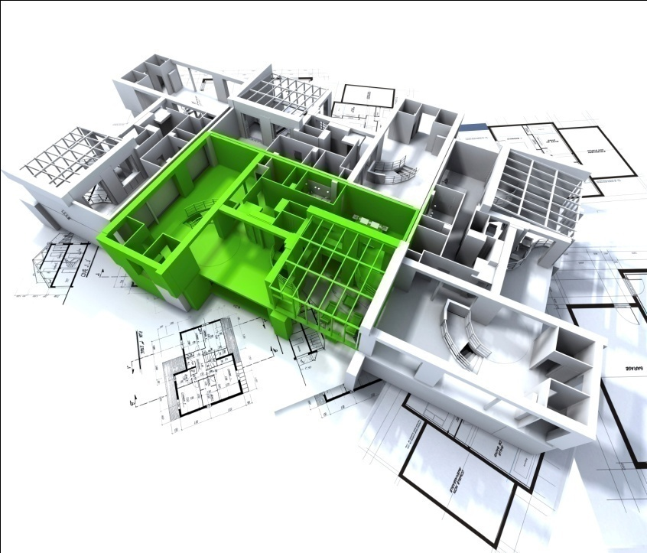

MARUEEB kick off meeting
17-19 February, 2016 Genoa
AE Consulting LLC
Company Overview and Profile
LOADING
Please wait . . .

Slide 2



About Us
AE Consulting is a private, employee-owned, consulting and full service architectural & engineering design company located in Yerevan, Armenia with branch in Tbilisi, Georgia.
Our highly skilled team of professionals provides works at the highest international level.
Our consultants can help you in finding solutions in any stage of construction process.
Our professionals are ready to consult during all construction
process, from selecting design concept to installation works and further.
AE Consulting price policy can compete worldwide, while quality remains at the highest level.

Slide 3
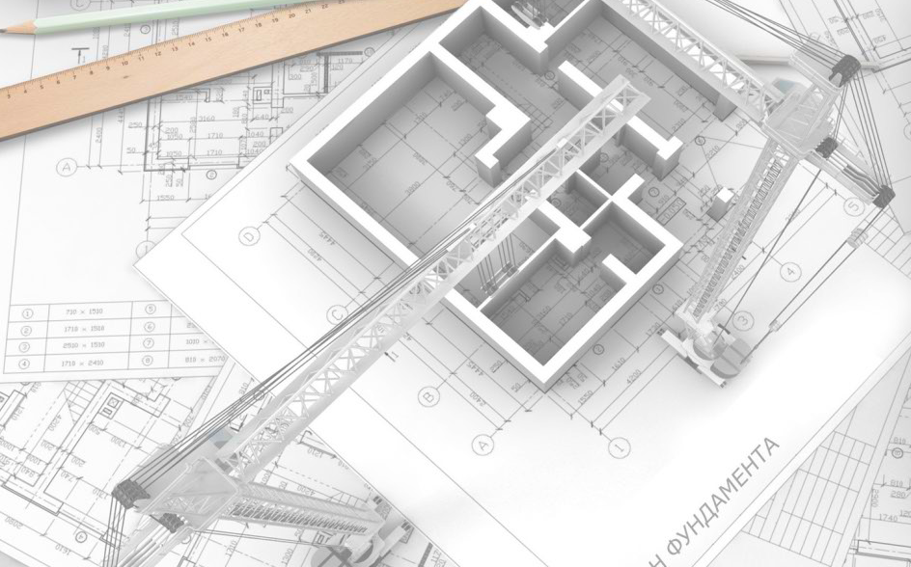
ENGINEERING DESIGN & CONSTRUCTION
CONSULTANCY
ENERGY
POST CONSTRUCTION SERVICES
OUR SERVICES

Slide 4
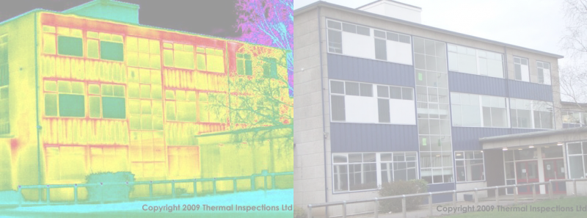
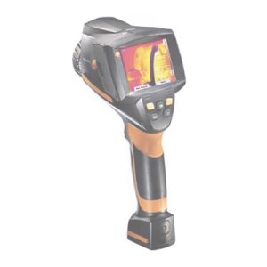
ENERGY
Development of Energy Passports and Certificates
Energy Efficiency Potential Assessment
Energy Audit

Slide 5
Energy Audit of Buildings
Walkthrough Energy Audits
Detailed Energy Audits
Design Based Audits
Measurement Based Audits
Composition of Building Energy Passport
Issuance of Certificate of Building Energy Performance

Slide 6
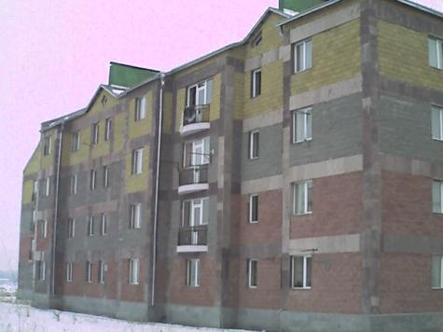
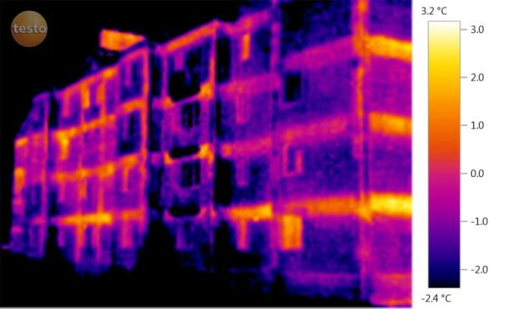
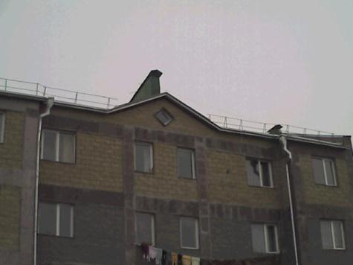
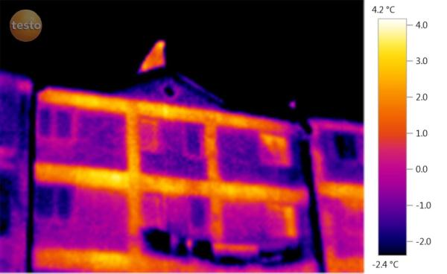
Current Practice

Slide 7
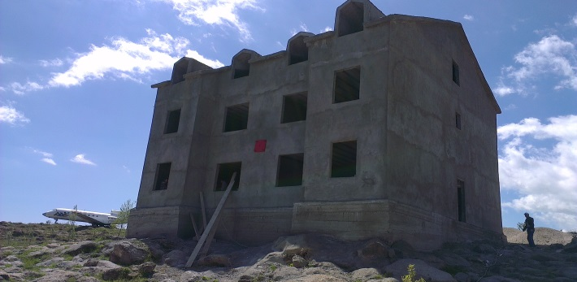
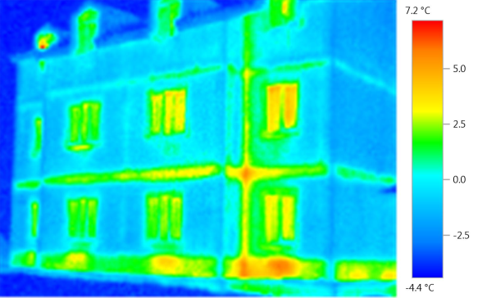
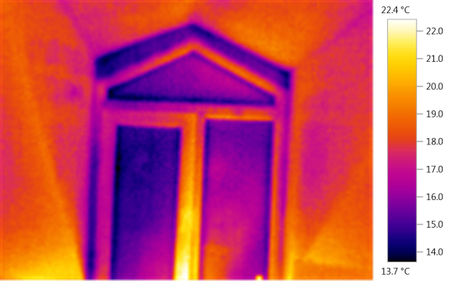
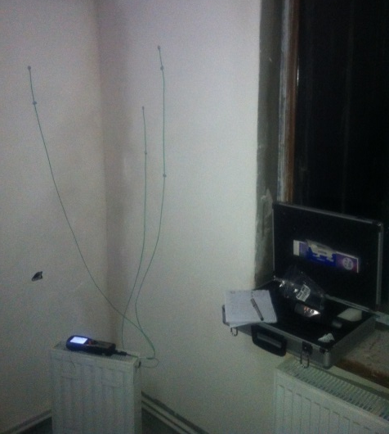
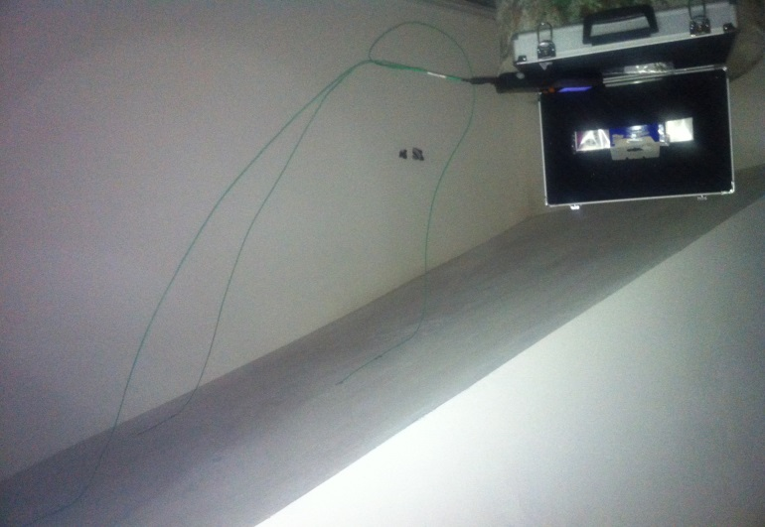
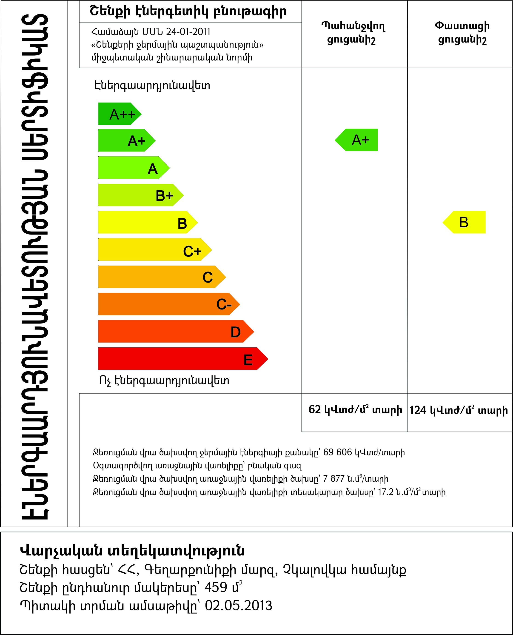
Selected Projects: Experimental building

Slide 8
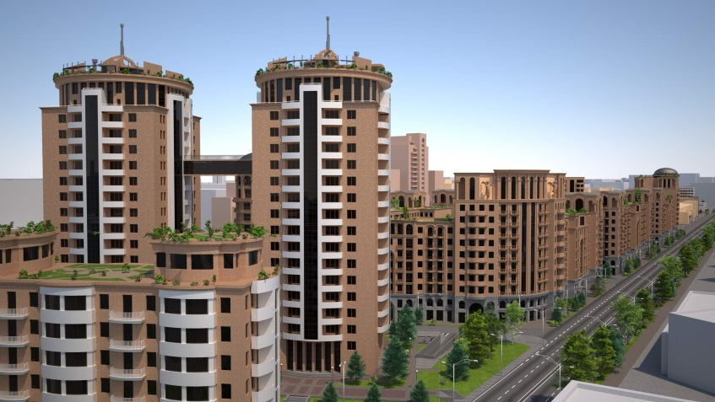
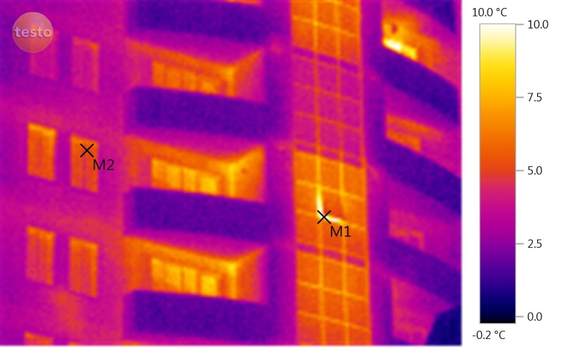
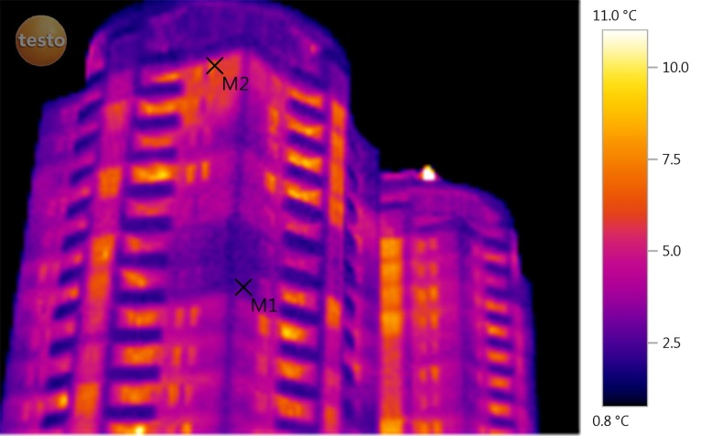
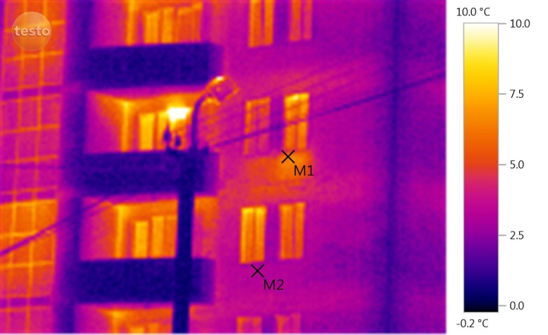
Selected Projects: Residential complex

Slide 9
Design of EE Improvement Measures for Buildings
Data Collection
Baseline Analysis
Design of EE Improvement Measures (according to local and international standards)
Construction Oversight
Post Implementation Consulting

Slide 10
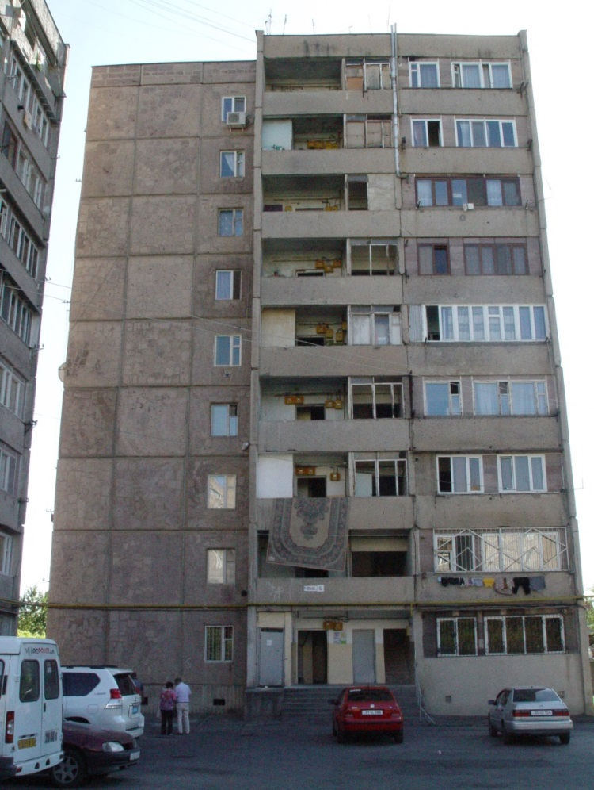
Selected Projects
Design of Demo Building in Avan, Yerevan (UNDP)
As-built drawings
Conceptual design
Working design
Support in materials selection
Thermal envelope calculations
Field supervision

Slide 11
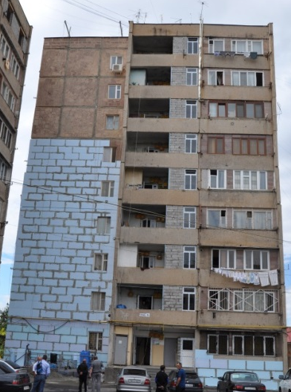
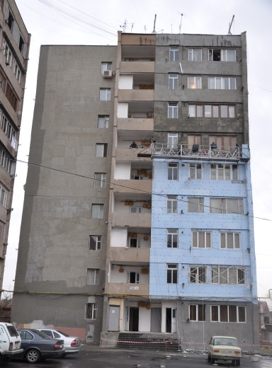
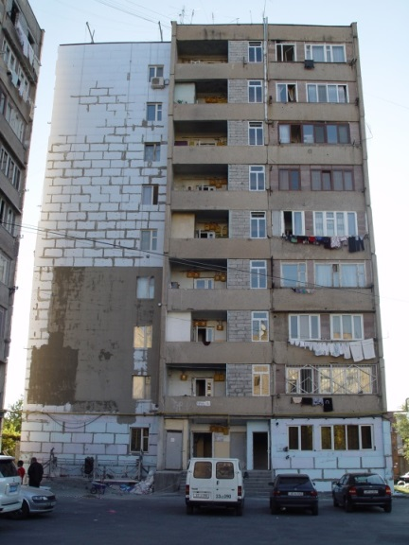
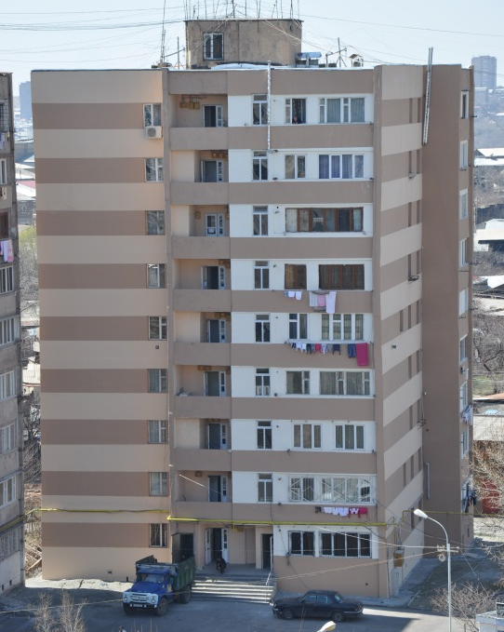
  Construction Phases

Slide 12
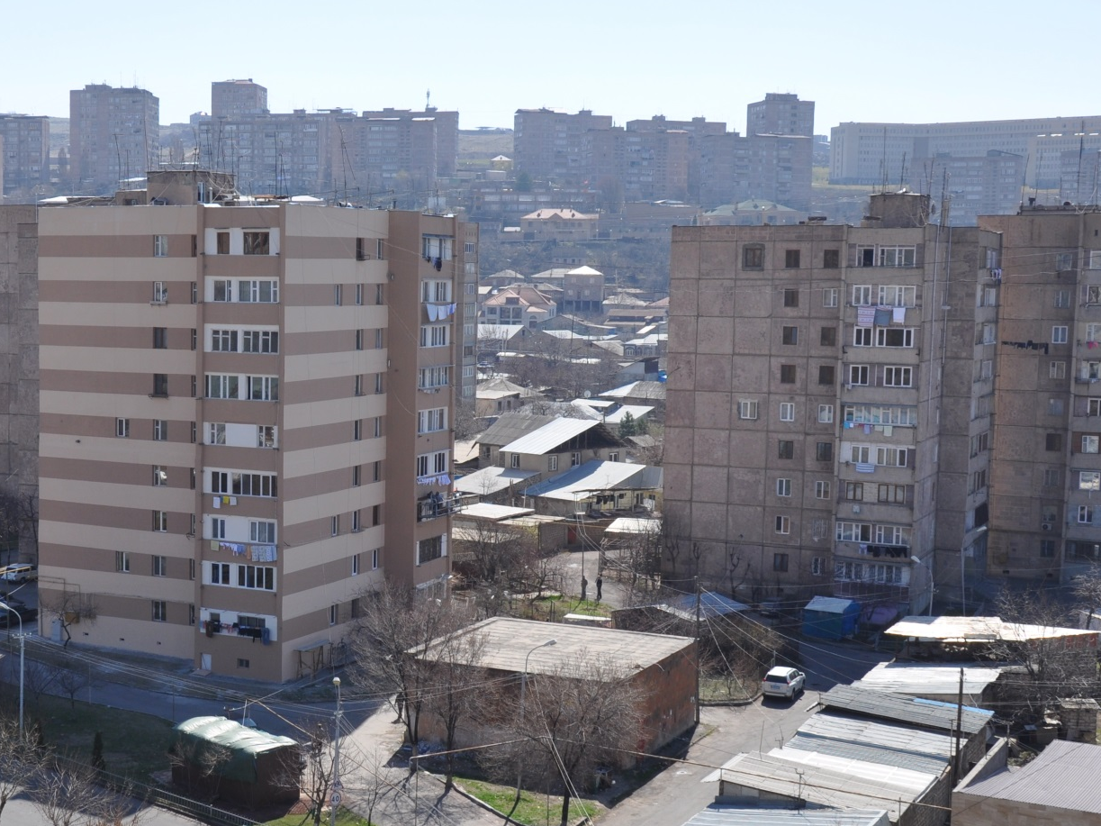
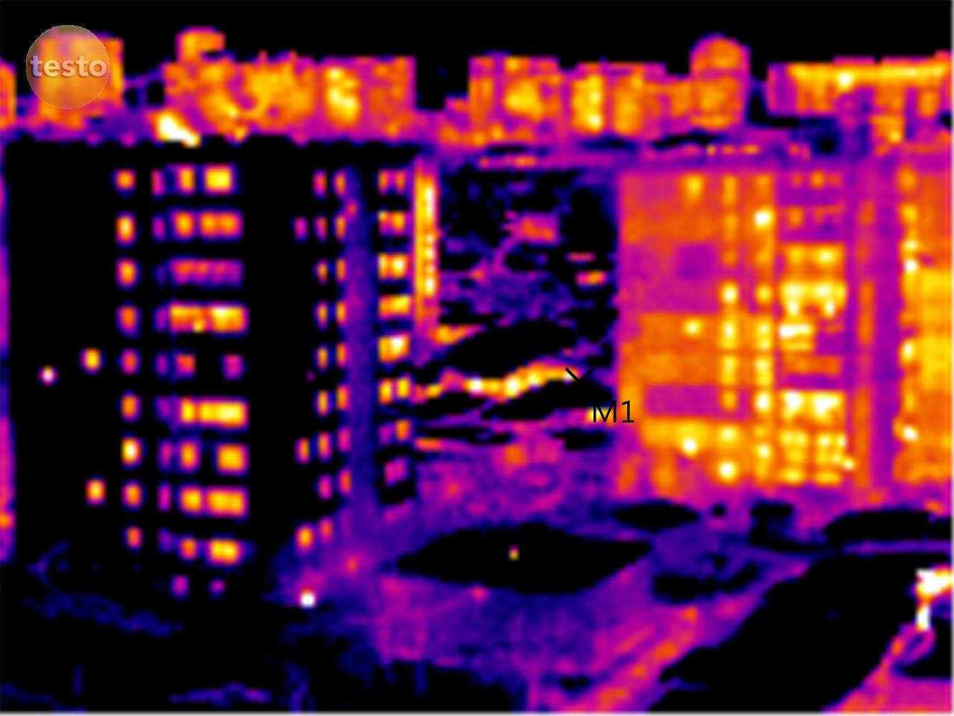
Results
After
74kWh/m2 year
Before
178kWh/m2 year

Slide 13
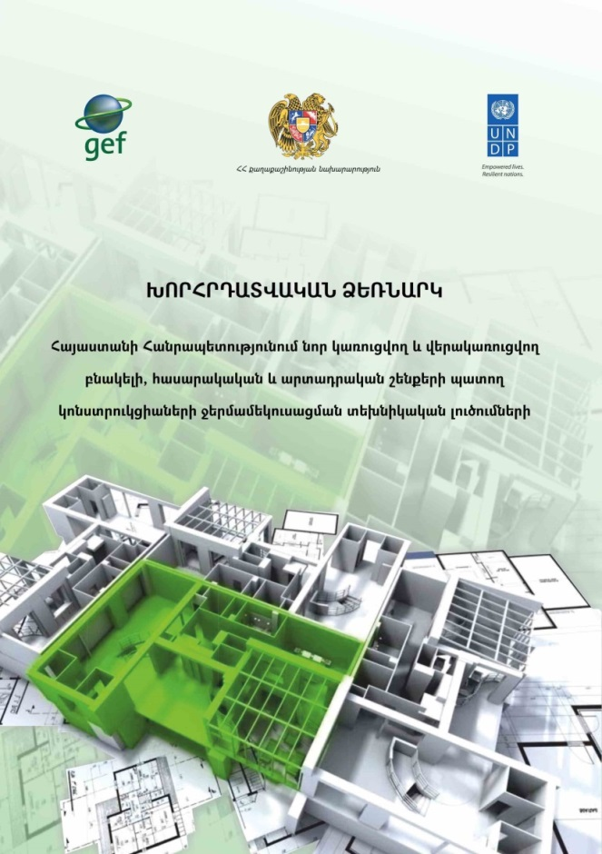
  Scientific Activities
Catalogue of technical solutions for insulation of buildings (UNDP)
Dedicated for the architects and engineers
Adopted by ordinance of the Minister of
Urban Development

Slide 14
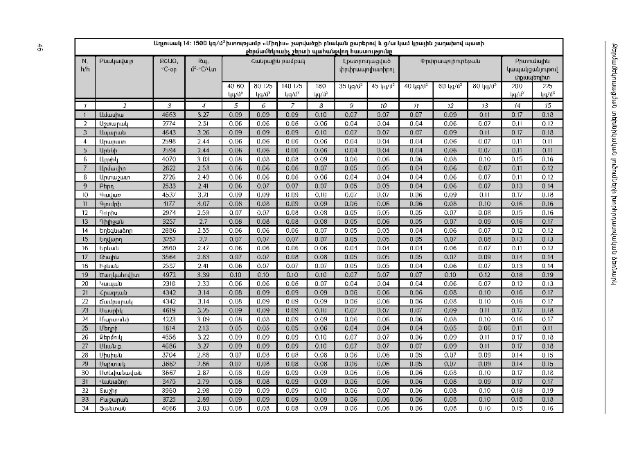
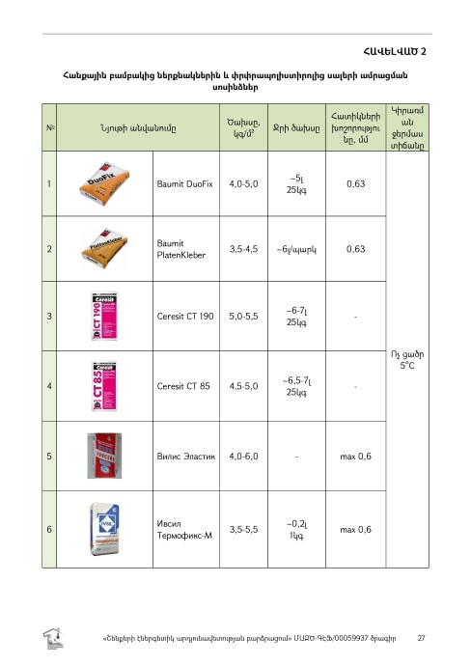
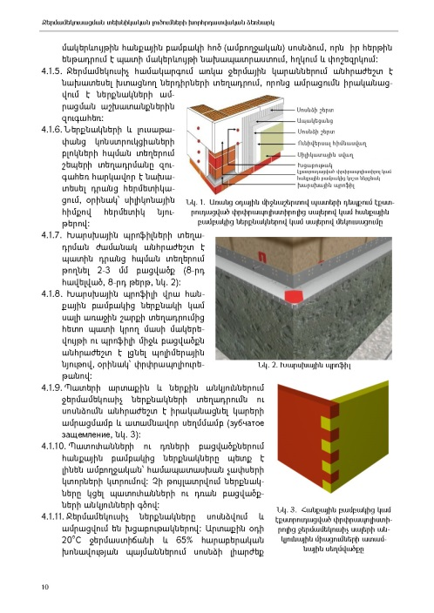
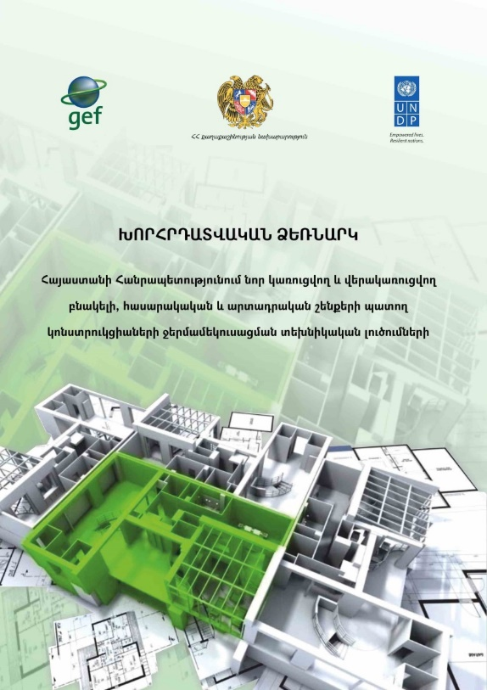
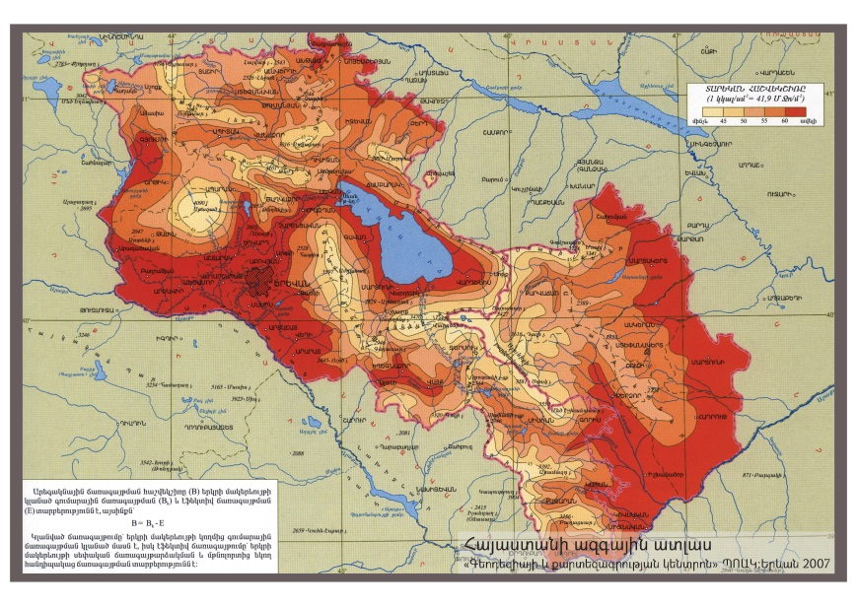
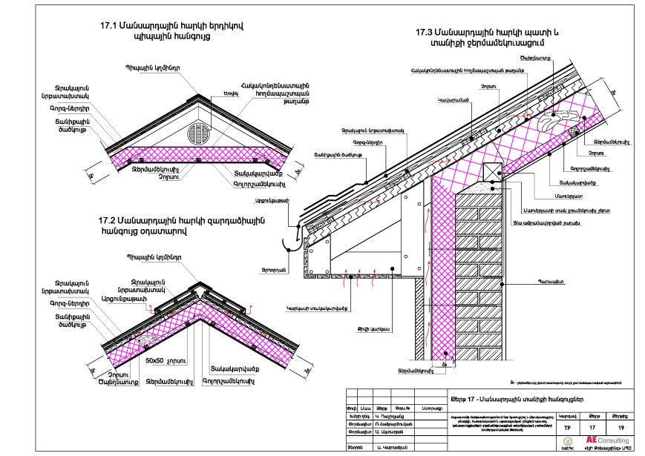

Slide 15

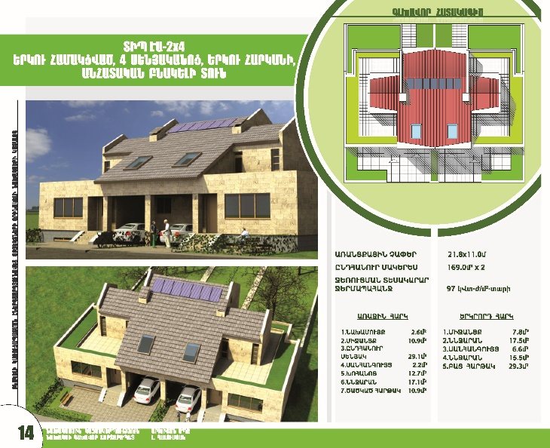
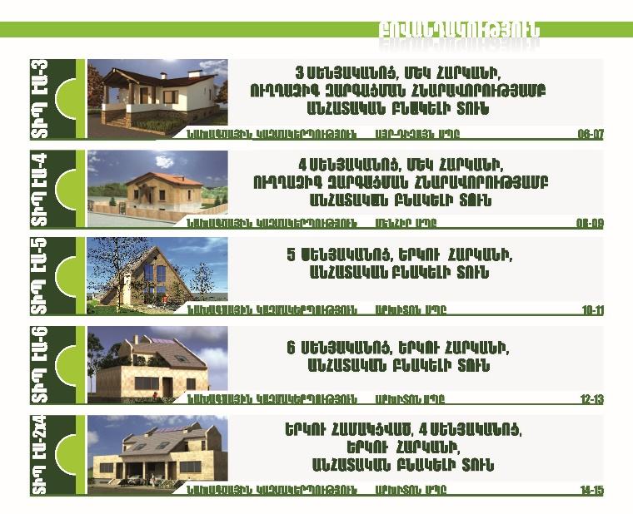
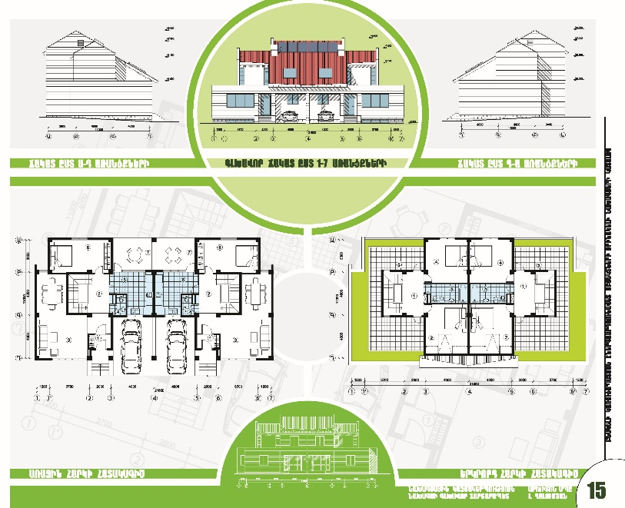
  Catalogue of 5 EE replicable houses designs

Slide 16
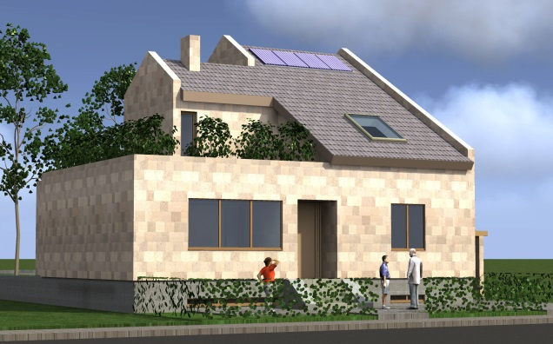
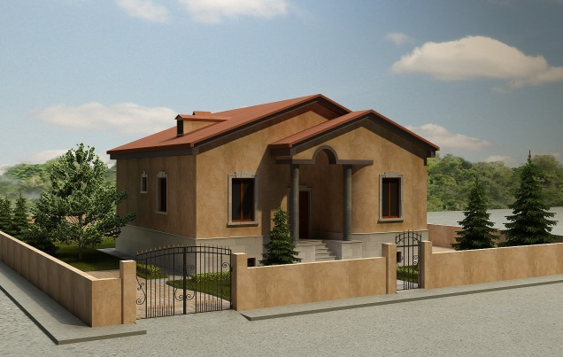
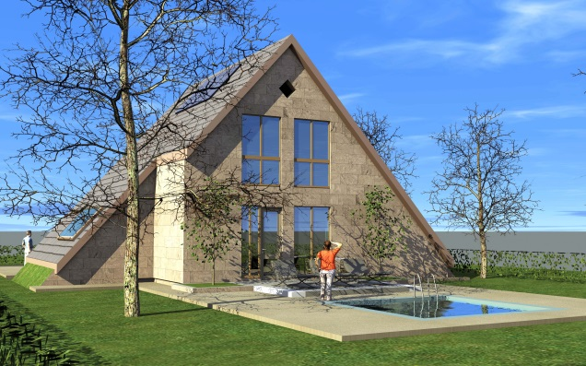
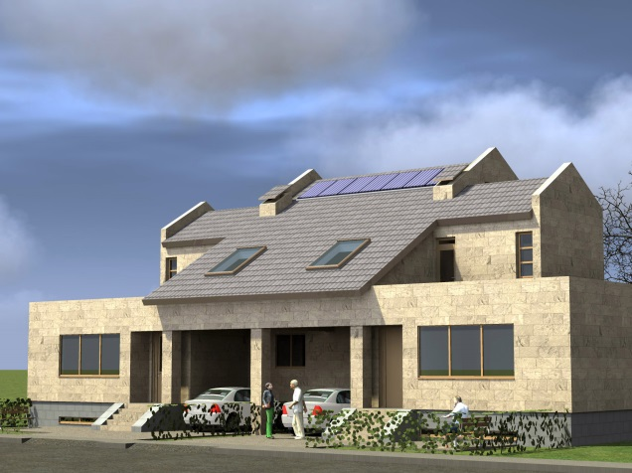
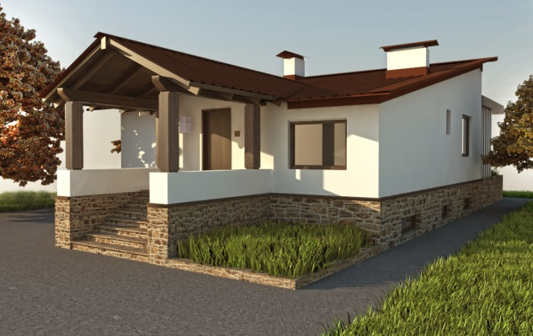

Slide 17
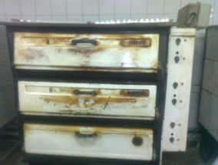
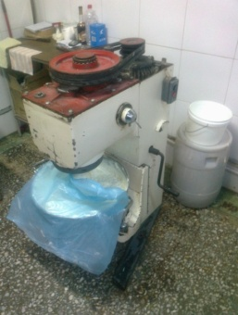
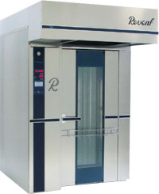
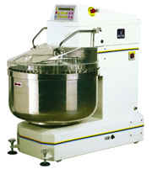
Industrial Energy Audits
Brief description of investment: Replacement of bread, bakery baking old ovens and supplementary with modern Rotating ovens and equipment
Cost of measure 180,000 USD
Primary energy consumption before realization of the project 284,462 [kWh/year]
Primary energy consumption after realization of the project 146,701 [kWh/year]
CO₂ emission before realization of the project 28,462 [kg CO₂/year]
CO₂ emission after realization of the project 14,678 [kg CO₂/year]
Results: Energy savings: 137,761 kWh/year i.e. 48.4 %
CO₂ savings: 13,784 kg CO₂/year i.e. 48.4 %

Slide 18
Industrial Energy Audits
Brief description of investment: Expansion of the production by replacement of the old semiautomatic production lines with new automatic one in Macaroni foods production facility.
Cost of measure 179,786.94 Euro
Primary energy consumption before realization of the project: 3,471,968 [kWh/year]
Primary energy consumption after realization of the project: 1,653,054 [kWh/year]
CO2 emission before realization of the project: 418,493 [kg CO2/year]
CO2 emission after realization of the project: 236,501 [kg CO2/year]
Results: Primary Energy savings: 1,818,914 kWh/year i.e. 52.4 %;
CO2 savings: 181,992 kg CO2/year i.e. 43.5 %

Slide 19


RELOADING
Piazza Grande Business Center, office #100
10 Vazgen Sargsyan street, Yerevan, 0010, Armenia
+374 91 300 595
+374 94 477 000
info@aeconsulting.co
www.aeconsulting.co

