Slide 1


Renewables, Energy Efficiency, and Environmental Science at the American University of Armenia
Erasmus+ MAUREEB Kick-Off Meeting
Genoa, Italy
17-19 November 2016
Alen Amirkhanian, Director, AUA Acopian Center for the Environment
alen@aua.am

Slide 2

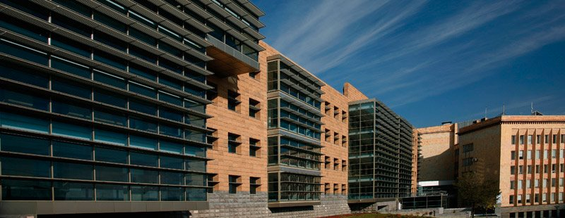

All courses taught in English
The only US-accredited university in the region
Formal affiliation with the University of California system
Currently 1600 students, growing to 2000 over the next year
OVERVIEW

Slide 3
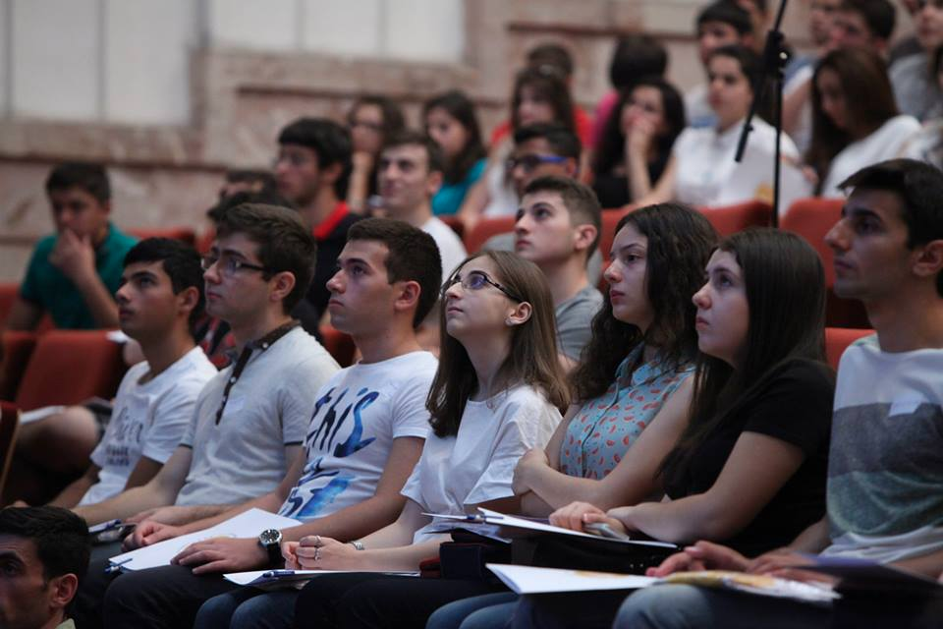
Degree Programs
Research
8 Masters degrees
  Public Health
  Computer & Info Science
  Industrial Eng & Systems Mngmt
  TEFL
  Poli Sci and Intl Affairs
  Law
  MBA
  Economics
3 Bachelors degrees
  Computational Sciences
  Business Administration
  English & Communications
  Certificate programs
9 Centers/Labs
Acopian Center for the Environment
Center for Responsible Mining
[GIS & Remote Sensing Lab]
Entrepreneurship & Product Innovation Center
Engineering Research Center
Center for Public Health Research & Dev.
Center for Applied Linguistics
Turpanjian Center for Policy Analysis
Legal Resources Center
ACADEMIC

Slide 4
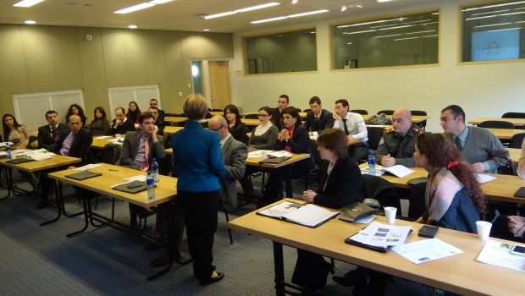
Extension
Non-degree, life-long learning courses open to all; several thousand people a year are served
Rural & Regional Development
Turpanjian Rural Development Program (revolving loan fund and tech assist.)
Library
Eye care clinics
Higher Education and Society
Community Outreach
Digital Library of Ancient Manuscripts
Extracurricular English teaching
Extracurricular Environmental Education

Slide 5


Erasmus+
Key Action 1:
Mobility
NTNU - In 2 years, 8 students and 6 faculty/staff; starts in Spring 2016
8 Applications for 2016 call: France, Greece, Germany, Latvia, Romania, Spain, Turkey
Erasmus+
Key Action 2:
Capacity Building
4 Tempus
1 Erasmus+: MAUREEB
8 Applications for 2016 call: 2 as coordinating partner
Portfolio of EU Programs Expanding
Other EU-Funded Projects
2 projects with Black Sea Cross Border Programme
FP5, FP7
Nothing yet with Horizon 2020 but have it on radar
Corporate & Others: Volkswagen Foundation, Heinrich Boell Stiftung, Konrad Adenaur Stiffung, Samsung Corporation, National Instruments, Mentor Graphics

Slide 6
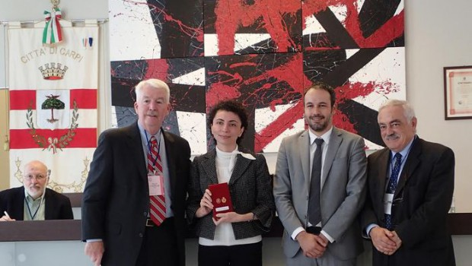
Strengthen innovation & incubation capacity
Enhance student experience and learning
Develop joint/dual degree programs
Enable student/staff mobility
Conduct joint research
What we seek
Notes:
Just a few fact to frame our discussion on energy efficiency
I’ll use the case of Armenia, though a similar story exists in many other countries

Slide 7
What is happening at AUA on renewables, energy efficiency, and environment
  Courses, research and operations
  Pilots and pioneers
  Accumulating and transferring knowledge
  Seeking synergies (ADB)
  Start early (in schools)

Slide 8
AUA Map of Renewables, Energy Efficiency, and Environment
School of Public Health
College of Business & Economics
College of Science & Engineering
College of Humanities & Social Sciences
Entrepreneurship & Product Innovation Center
SPH Environmental Health
CSE 145 GIS and Remote Sensing
CSE 240 Energy Sources
IE 350 Alternative Energy
IE 351 Engineering Green Buildings
IE 352 Decision Making Tools in Energy
IESM Energy Track
Proposed:
Solar systems Engineering (Fall 2016)
Research:
Air-to-air heat exchangers
Roadmap of RE and EE in Armenia
LLM Environmental Law
PSIA Sustainability Policy
Potential has to be explored
ENV 101 Intro to Env Sci
ENV 202 Env Projects
ENV 210 Disasters
ENV 230 Water
ENV 320 GIS and Env Analysis (2 units)
ENV 321 Remote Sensing and Env Analysis (1 unit)
ENV 300 Natural Environment and Humans (1 unit)
ENV 330/BUS 391 Business & Env Sustainability (1 unit)
Proposed:
Mining (undergrad)
Food (undergrad)
Minor in Env Sci (undergrad)
Resource Efficiency, No Waste, Clean Production (Grad)
Research:
Green, Inclusive and Resilient Schools
Off-grid village school
Yerevan Sustainable Energy Action Plan (SEAP)
EU Black Sea Building Energy Efficiency
EU Black Sea Natural Treatment Systems for Wastewater
Green Architecture textbook
Erasmus+ MAUREEB
Acopian Center for the Environment
Non-academic Operations & Facilities
Solar PV and thermal collectors
BMS, fully automated HVAC
State of the art insulation
Center for Responsible Mining
Non-academic Student Activities/Clubs
Student volunteer clubs
Other potentials not yet explored
Mining sector highly energy inefficient; potential great; serious other environmental/social issues

Slide 9
What is happening at AUA on renewables, energy efficiency, and environment
  Courses, research and operations
  Pilots and pioneers
  Accumulating and transferring knowledge
  Seeking synergies (ADB)
  Start early (in schools)

Slide 10
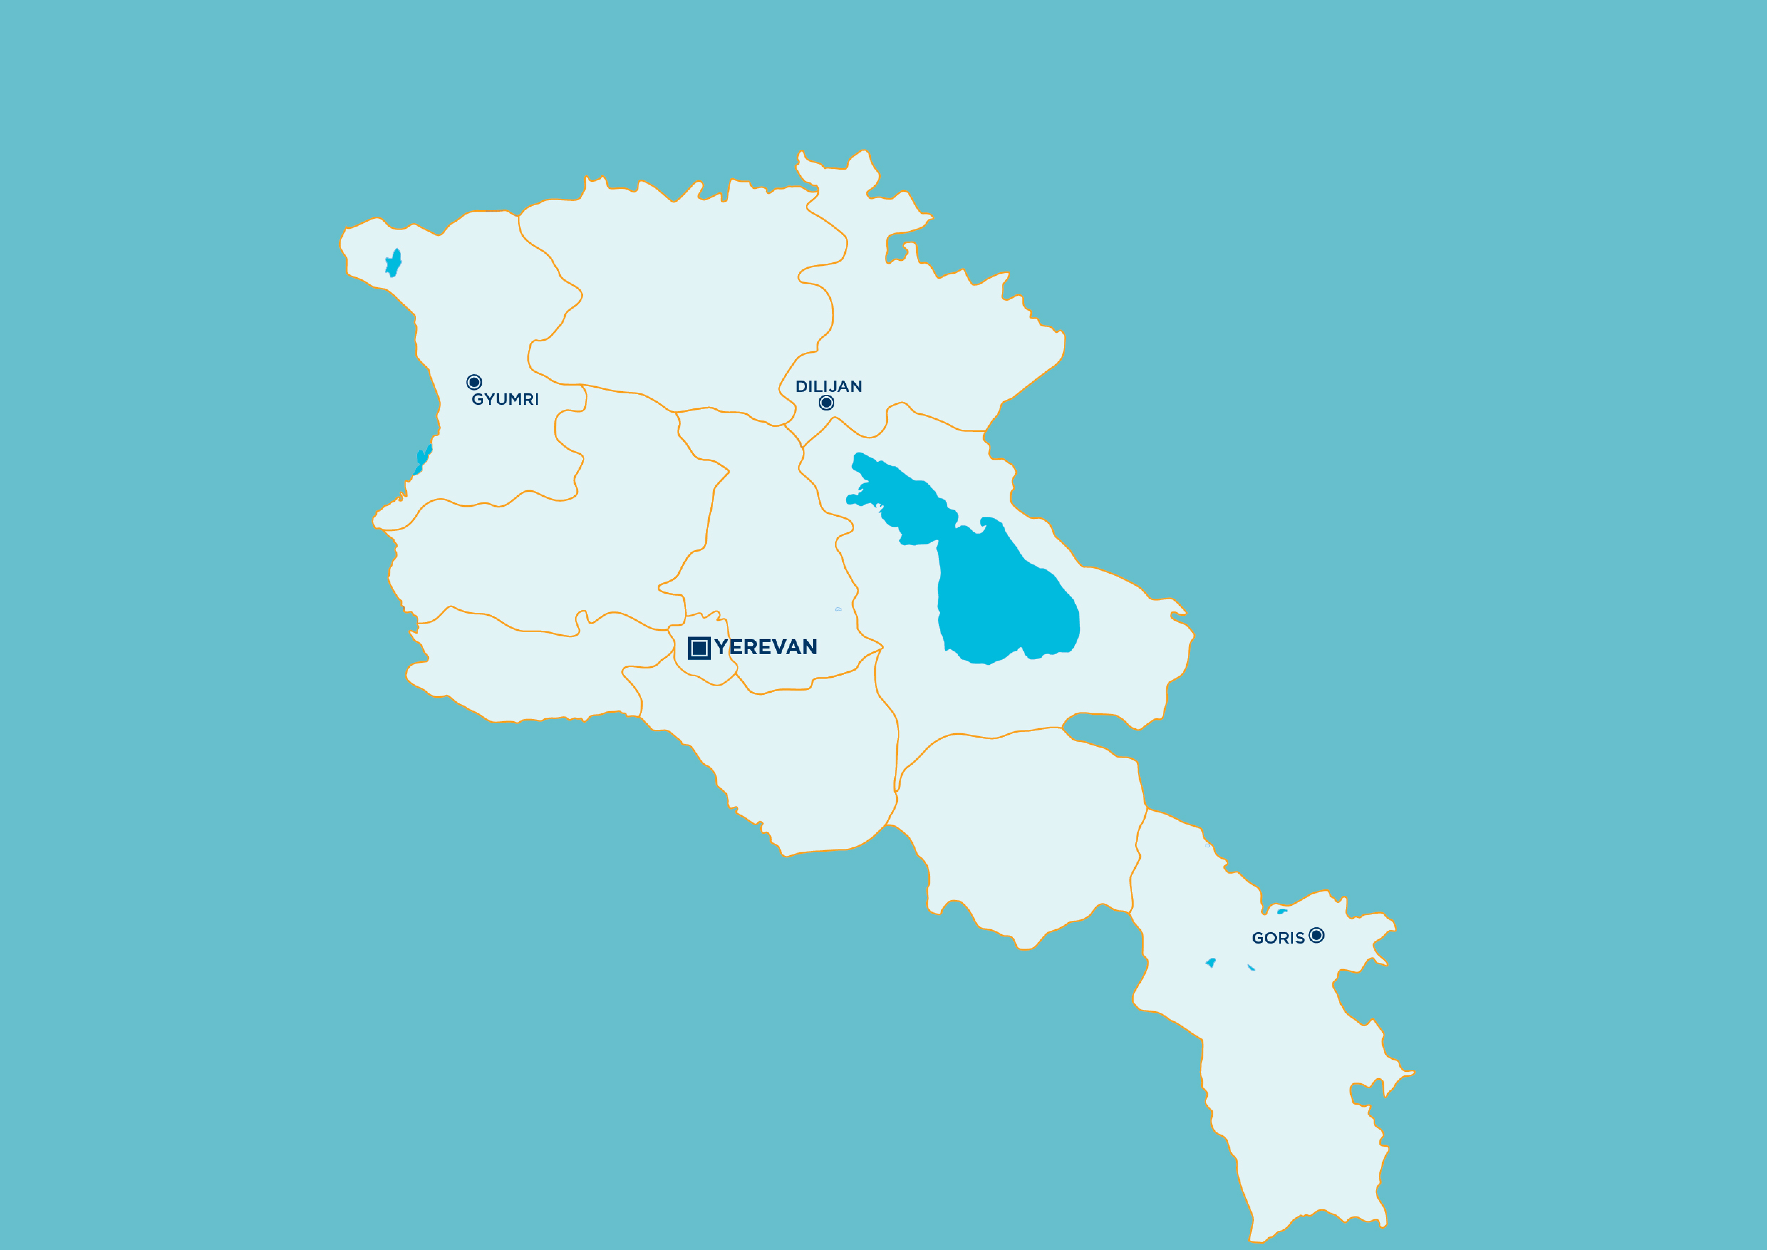



National Study Tour of Green
Buildings and Facilities in
Armenia – May 18-21, 2015
Էկո շենքեր և կառույցներ Հայաստանում. ուսումնական շրջայց
մայիսի 18 – 21, 2015թ.
Այսօր Հայաստանն ունի բավարար հաջողություններ, որից կարելի է դասեր քաղել:
Եկե՛ք բազմացնենք այս հաջողությունների ցանկը:
Armenian Caritas (geothermal heat pumps, solar power, building envelope)
UWC Dilijan School (BREEAM certified)
Avedisian School (LEED certified)
American University of Armenia (building envelope, shading, heat recovery, solar heat and power)
We can learn from our successes to date. Let’s add to the list of successes.
UNDP retrofitted Avan Residential building (60% efficiency gain in heating)
UNDP Avan Cogeneration Plant
Nubarashen Methane Harvesting Plant
Social housing (building envelope)
Laboratory on Energy Efficiency in Buildings (NUACA)
Diana Hotel (solar thermal)
Visit | Այցելեք` ace.aua.am
Քարտեզում ներկայացված չեն բոլոր շենքերն ու կառույցները, որոնք ունեն էկո լուծումներ: Ցուցադրված են միայն այն շենքերն ու կառույցները, ուր ացելել են ուսումնական շրջայցի մասնակիցները:
The map does not represent all buildings and facilities that offer green solutions. It shows only facilities visited during the Study Tour.

Slide 11
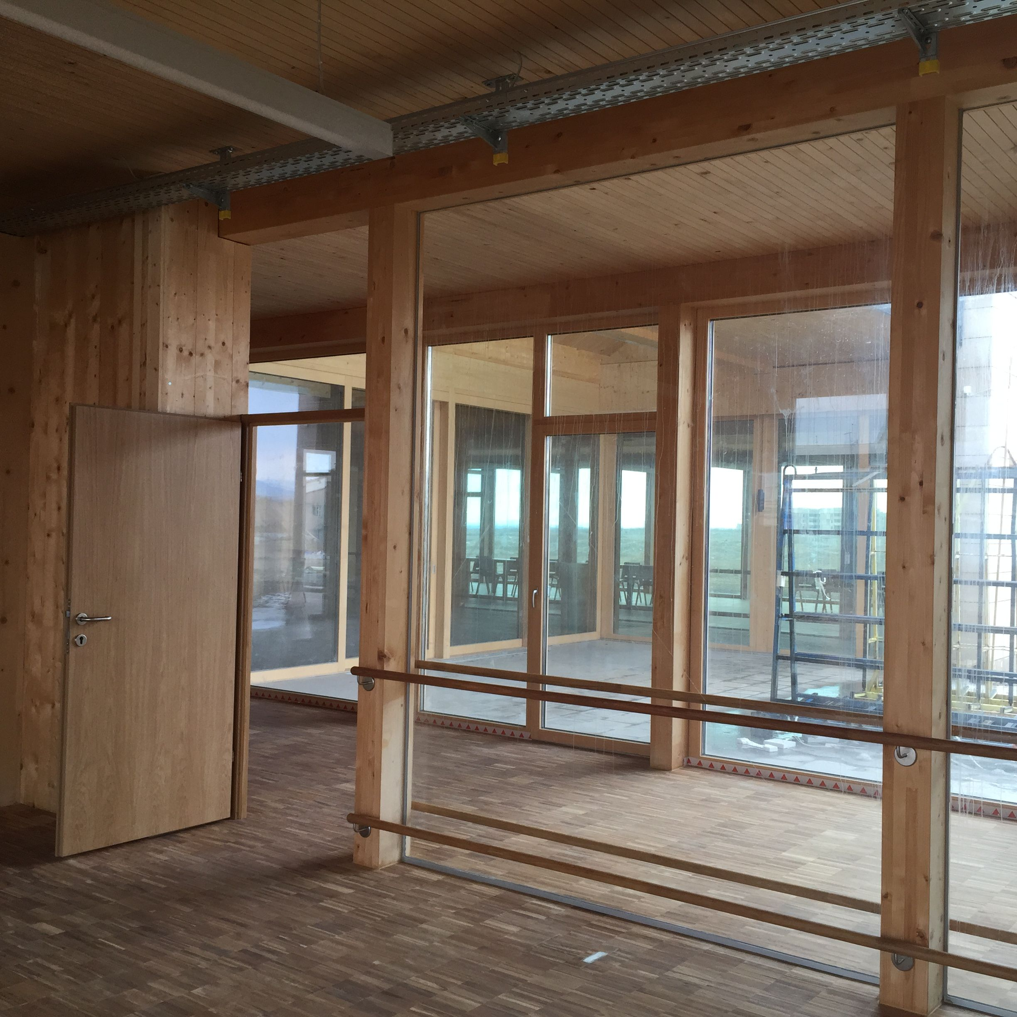
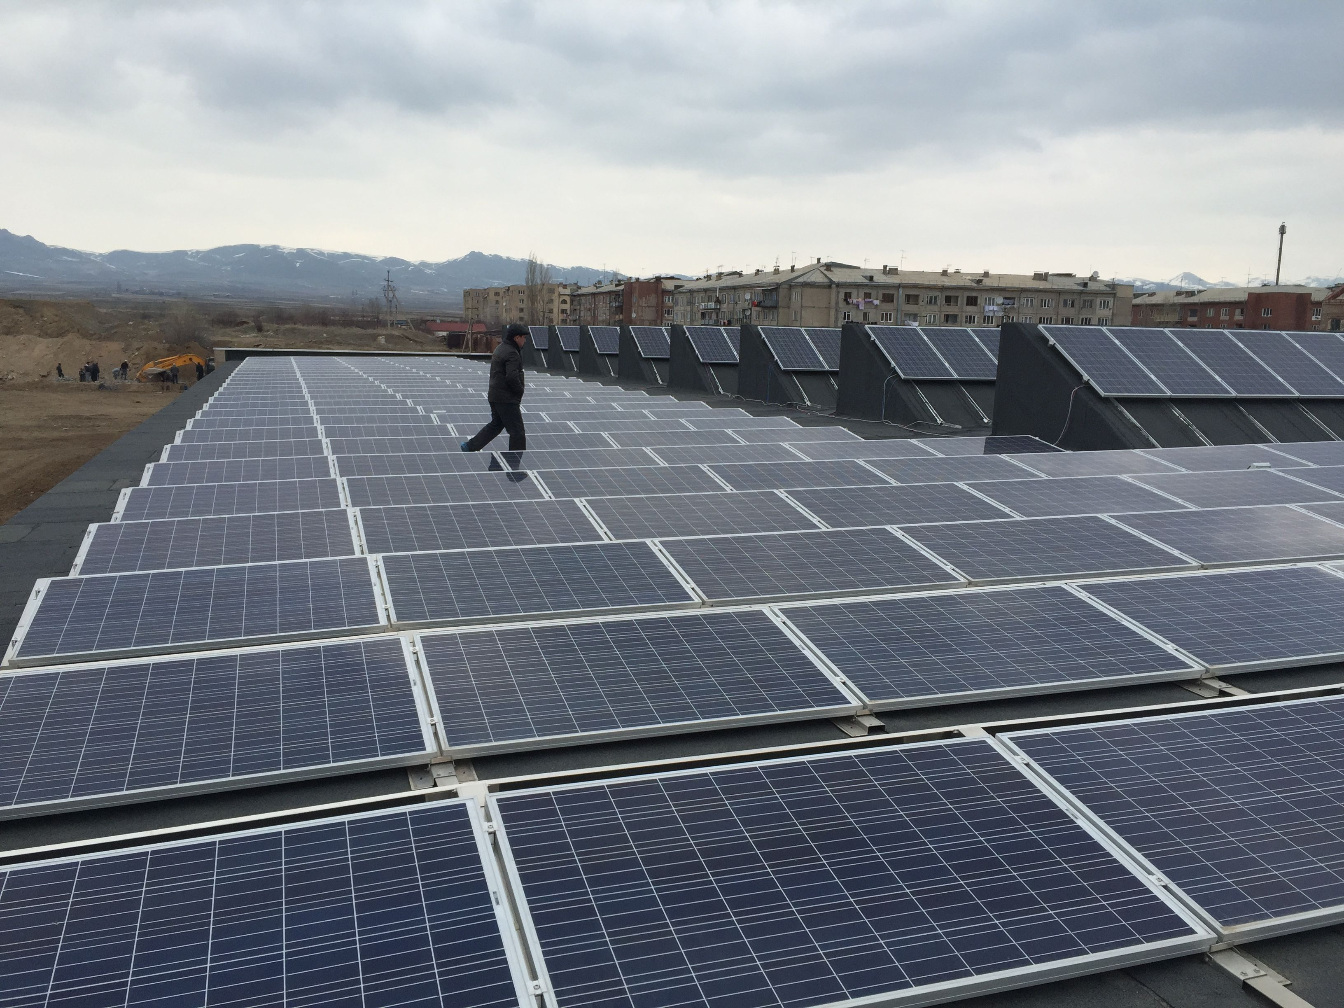
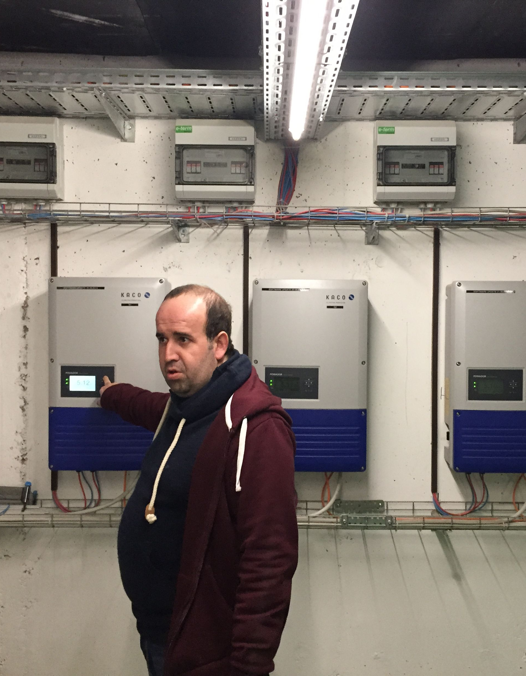
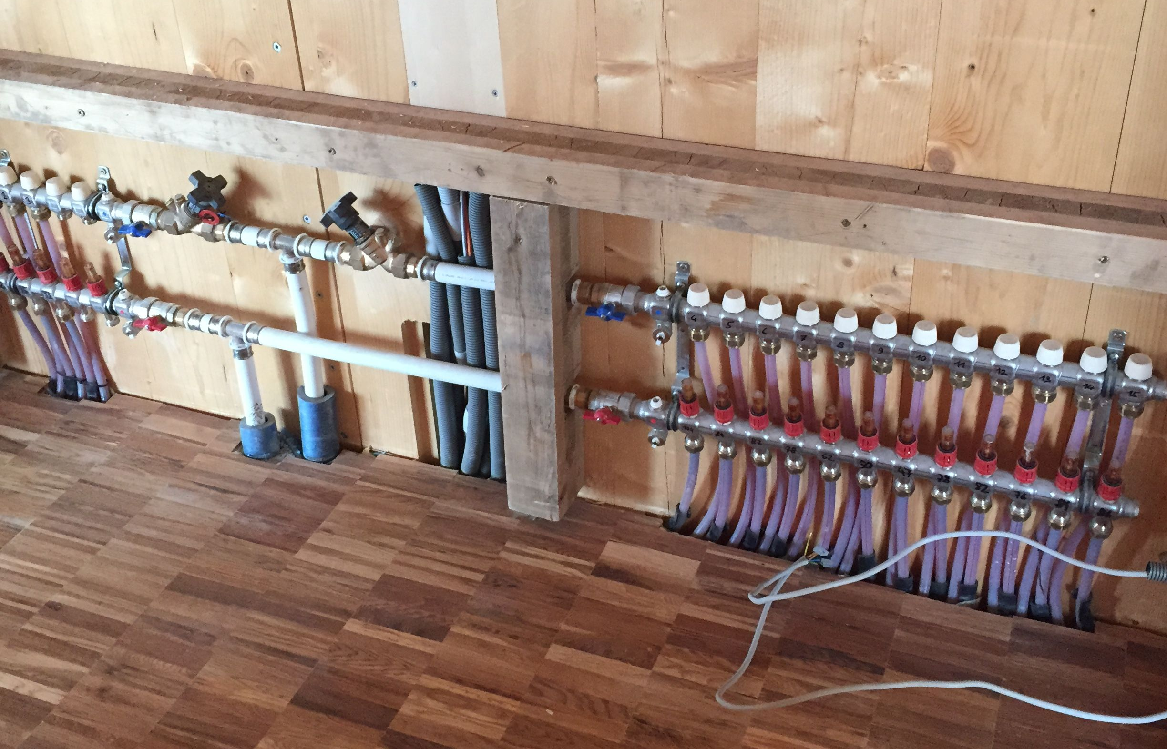
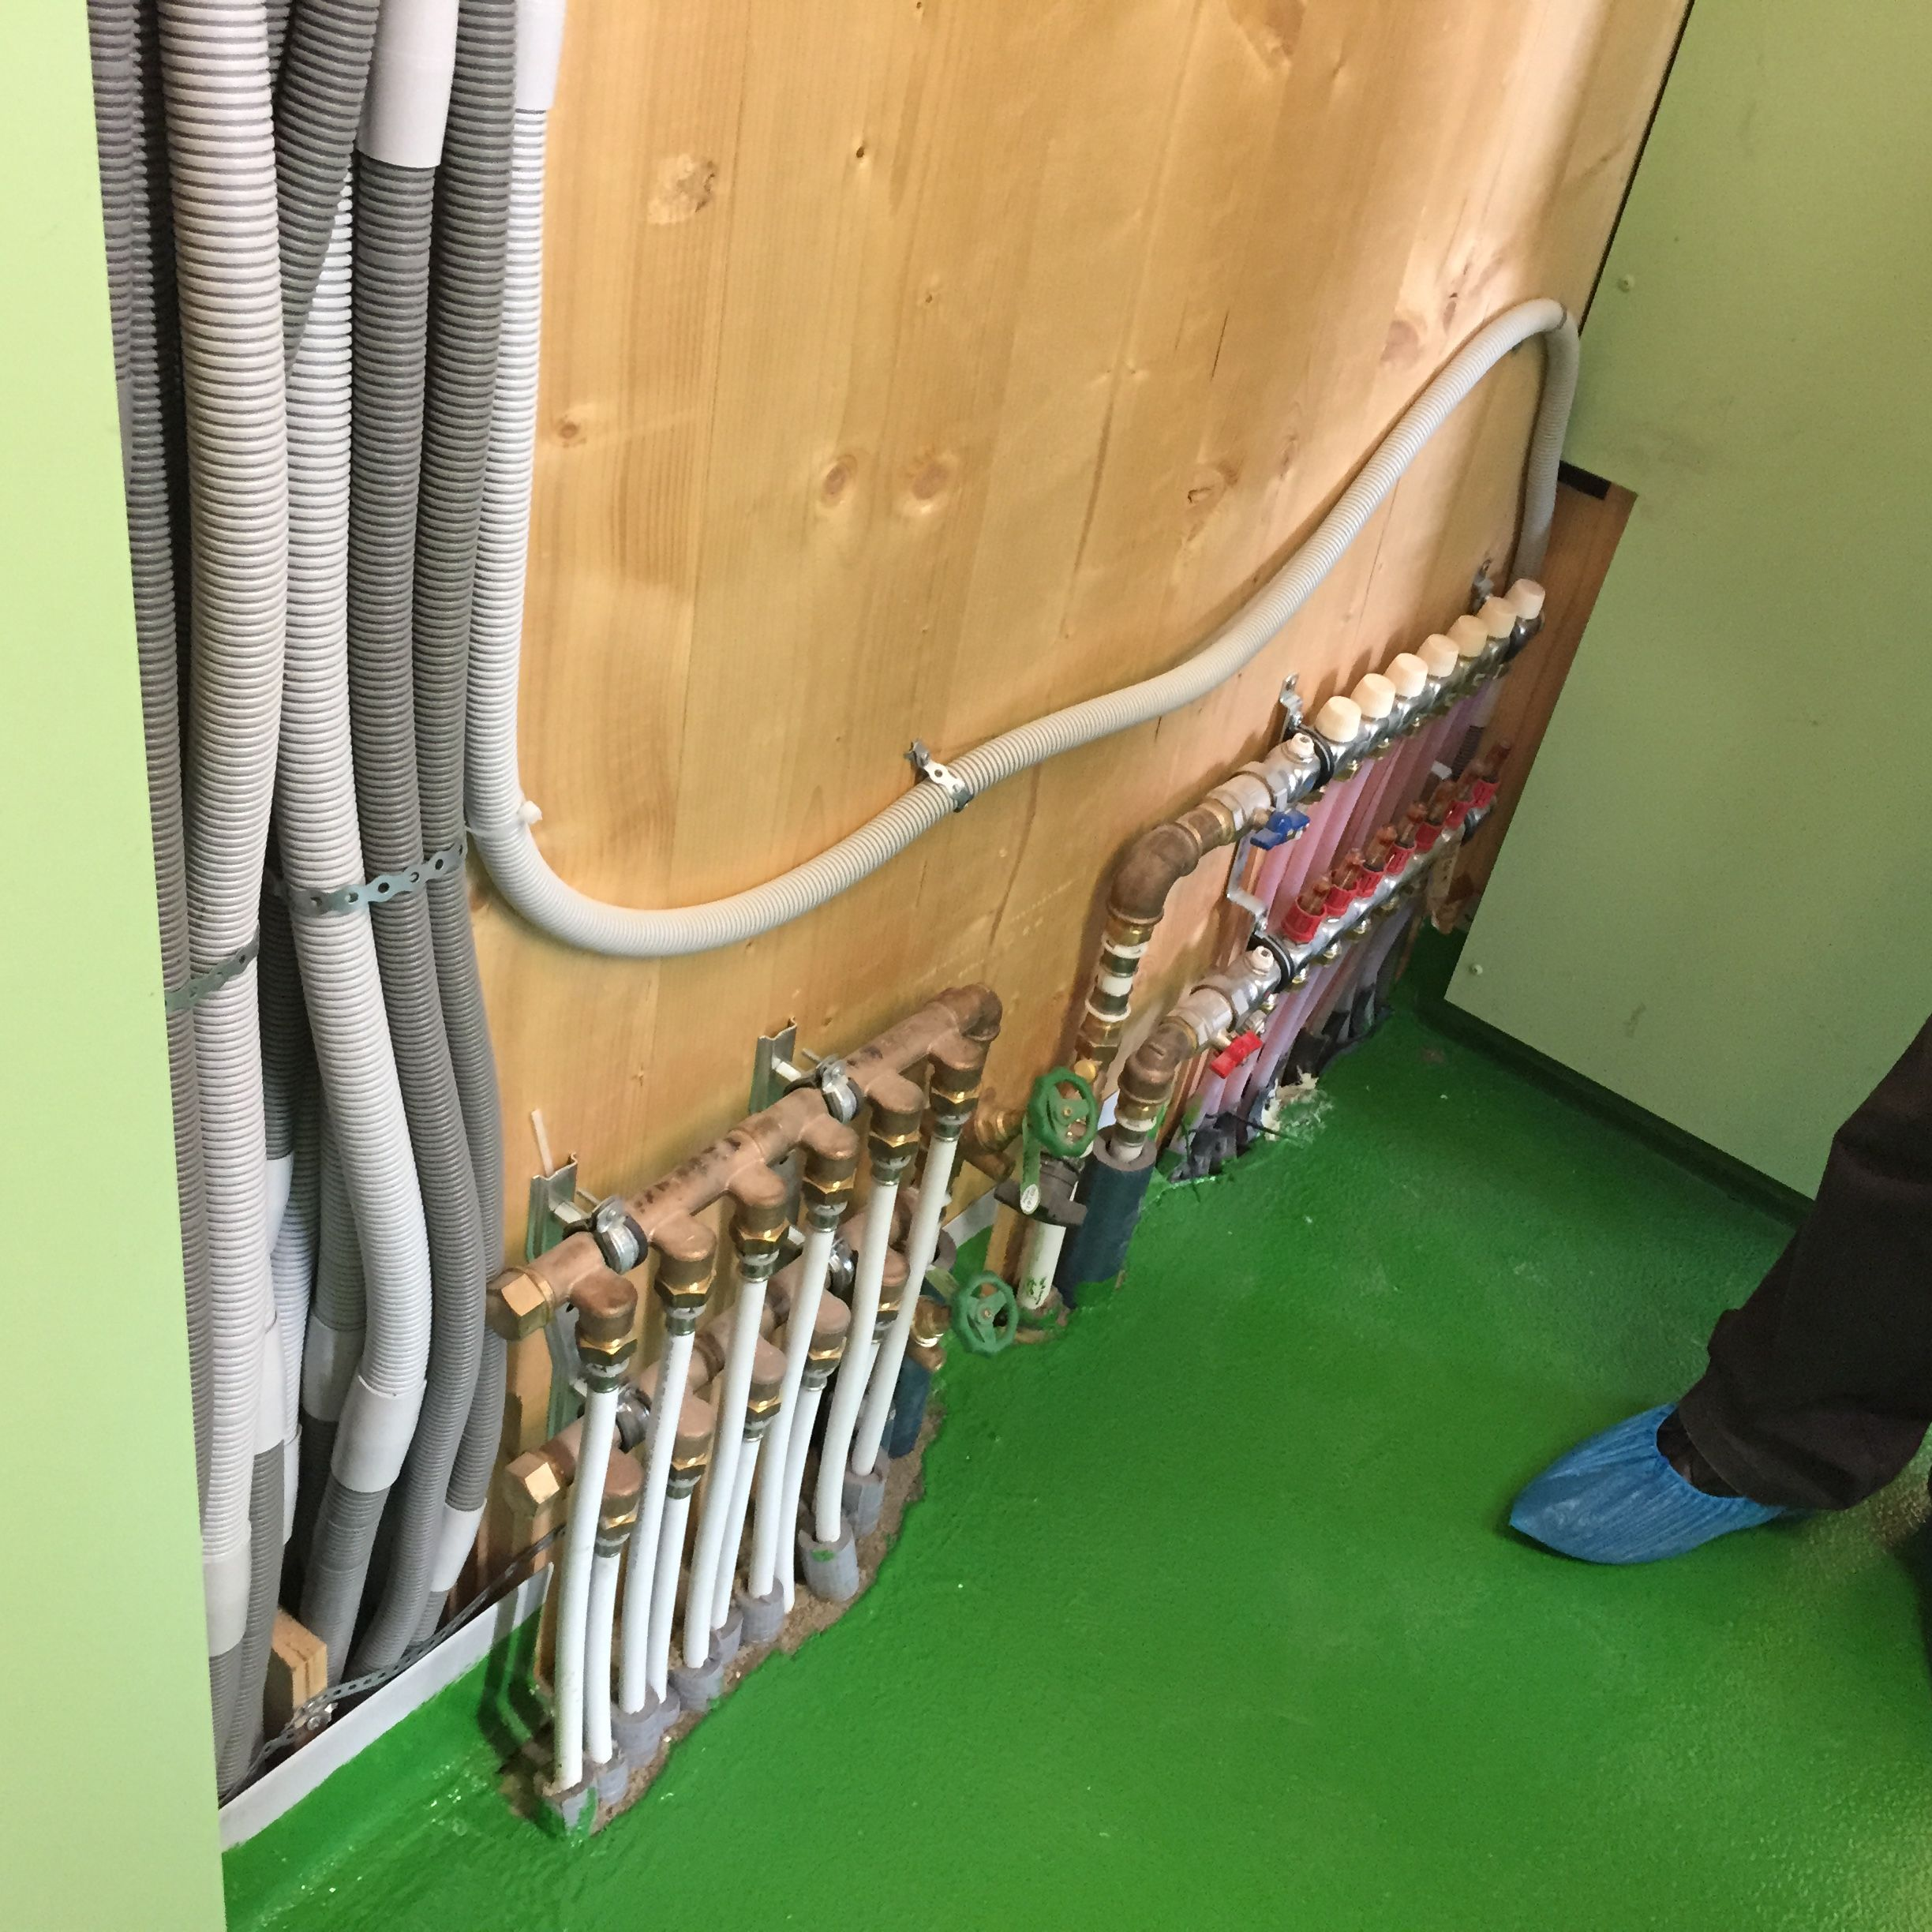
National Study Tour of Green
Buildings and Facilities in
Armenia – May 18-21, 2015
Էկո շենքեր և կառույցներ Հայաստանում. ուսումնական շրջայց
մայիսի 18 – 21, 2015թ.
Հայկական Կարիտաս (գեոթերմալ և արևային էներգիա, շենքի ծածկ)
Armenian Caritas (geothermal heat pumps, solar power, building envelope)
UWC Dilijan School (BREEAM certified)
Հայկական Կարիտասում ուսումնական խումբը դիտարկեց լայանամասշտաբ գեոթերմալ ջեռուցման պոմպերի և արևային էներգիայի կիրառումը:
Avedisian School (LEED certified)
American University of Armenia (building envelope, shading, heat recovery, solar heat and power)
UNDP retrofitted Avan Residential building (60% efficiency gain in heating)
www.caritasarm.am
Social housing (building envelope)
UNDP Avan Cogeneration Plant
Diana Hotel (solar thermal)
Nubarashen Methane Harvesting Plant
Laboratory on Energy Efficiency in Buildings (NUACA)
At the Armenian Caritas, the group observed application of large-scale geothermal heat pumps and solar power.
Քարտեզում ներկայացված չեն բոլոր շենքերն ու կառույցները, որոնք ունեն էկո լուծումներ: Ցուցադրված են միայն այն շենքերն ու կառույցները, ուր ացելել են ուսումնական շրջայցի մասնակիցները:
The map does not represent all buildings and facilities that offer green solutions. It shows only facilities visited during the Study Tour.

Slide 12
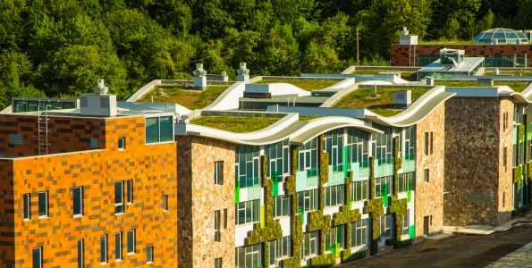
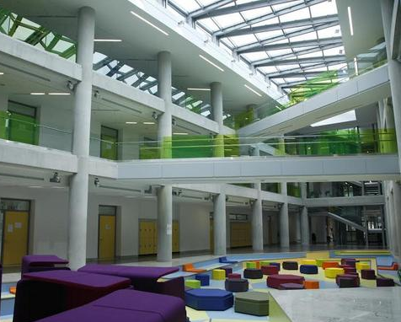
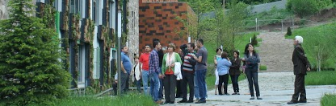
National Study Tour of Green
Buildings and Facilities in
Armenia – May 18-21, 2015
Էկո շենքեր և կառույցներ Հայաստանում. ուսումնական շրջայց
մայիսի 18 – 21, 2015թ.
UWC Դիլիջանի դպրոցում ուսումնական խումբը դիտարկեց դպրոցի նորարար էկո լուծումները և շենքի ժամանակակից ծածկը:
Armenian Caritas (geothermal heat pumps, solar power, building envelope)
UWC Դիլիջանի դպրոց (BREEAM վկայագիր)
UWC Dilijan School (BREEAM certified)
www.uwcdilijan.org
Avedisian School (LEED certified)
American University of Armenia (building envelope, shading, heat recovery, solar heat and power)
UNDP retrofitted Avan Residential building (60% efficiency gain in heating)
Social housing (building envelope)
UNDP Avan Cogeneration Plant
Diana Hotel (solar thermal)
Nubarashen Methane Harvesting Plant
Laboratory on Energy Efficiency in Buildings (NUACA)
In UWC Dilijan School the study tour observed the eco solutions in buildings and modern building envelope.
Քարտեզում ներկայացված չեն բոլոր շենքերն ու կառույցները, որոնք ունեն էկո լուծումներ: Ցուցադրված են միայն այն շենքերն ու կառույցները, ուր ացելել են ուսումնական շրջայցի մասնակիցները:
The map does not represent all buildings and facilities that offer green solutions. It shows only facilities visited during the Study Tour.

Slide 13
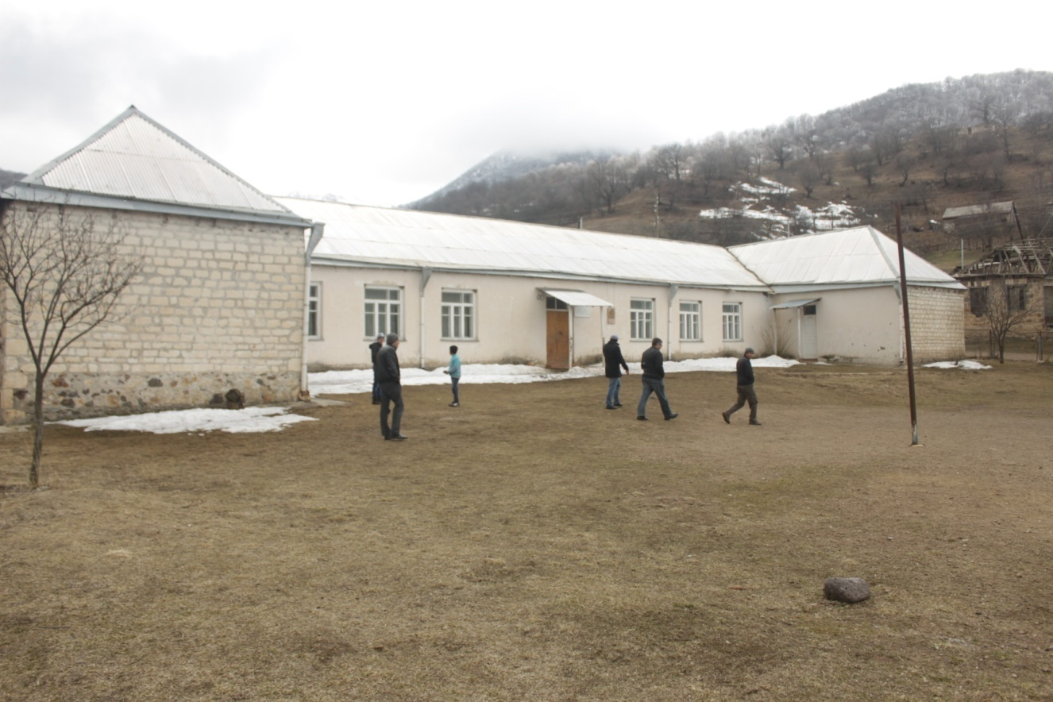


Make Energy Efficient and Independent
Insulation
Geothermal heat pump
Solar thermal
Photovoltaic
Trombe wall
Biomass
MEP Consulting Engineers

Slide 14
MEP Consulting Engineers

Slide 15
am
pm
pm
am
pm
MEP Consulting Engineers

Slide 16
MEP Consulting Engineers

Slide 17
MEP Consulting Engineers

Slide 18
What is happening at AUA on renewables, energy efficiency, and environment
  Courses, research and operations
  Pilots and pioneers
  Accumulating and transferring knowledge
  Seeking synergies (ADB)
  Start early (in schools)

Slide 19



Slide 20
ԿԱՆԱՉ ՃԱՐՏԱՐԱՊԵՏՈՒԹՅՈՒՆ՝
Էներգաարդյունավետություն և վերականգնվող էներգիա
GREEN ARCHITECTURE:
Energy Efficiency and Renewable Energy
Ten (10) modules
Each module:
Key concepts
Learning outcomes
Presentation of key concepts, issues, solutions, and challenges
Additional reading and audio-visual materials
Discussion questions
The ranges of topics covered in the 10 modules are numerous and (we believe) comprehensive

Slide 21
What is happening at AUA on renewables, energy efficiency, and environment
  Courses, research and operations
  Pilots and pioneers
  Accumulating and transferring knowledge
  Seeking synergies (ADB)
  Start early (in schools)

Slide 22



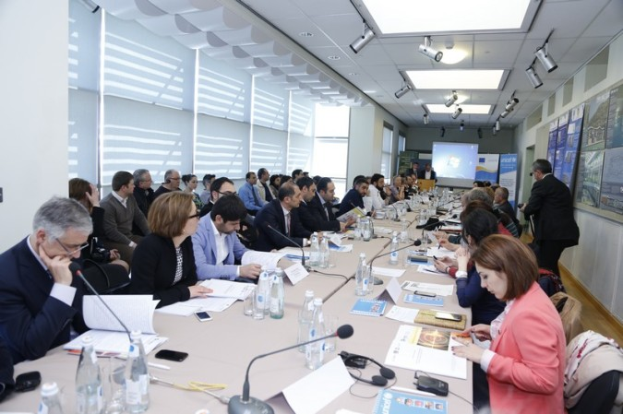
Inclusive and Resilient Schools: Schoolhouses for Armenia’s Children in the 21st Century
“The 21st century school facilities should themselves serve as pedagogical tools, teaching students about using energy and water optimally and generating energy from renewable sources, creating an environment where children learn about life-cycles of materials and health impacts of materials.”
ADB is extending a loan to Armenia to rebuilt seismically safe schools.
We are working to make sure the new schools will also address inclusiveness and resource/energy concerns

Slide 23
What is happening at AUA on renewables, energy efficiency, and environment
  Courses, research and operations
  Pilots and Pioneers
  Accumulating and transferring knowledge
  Seeking Synergies (ADB)
  Start early (in schools)

Slide 24

  Start early (in schools)
Extracurricular educational activities
Edible schoolyards
Curriculum integration
Green Schools – school students conducting energy and water audits of their school houses

Slide 25
THANK YOU
Alen Amirkhanian, Director
AUA Acopian Center for the Environment
American University of Armenia
alen@aua.am
http://ace.aua.am

