Slide 1
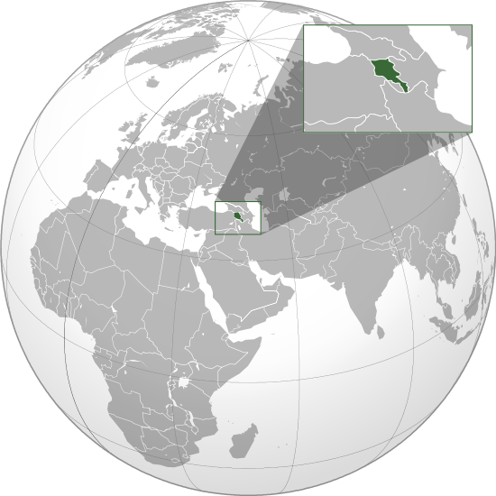
About Armenia
Official Name:
Republic of Armenia - Hayastany Hanrapetoutyun (Hayastan)
Capital City: Yerevan
Official Language: Armenian
Religion:
Christian, Armenian Apostolic Church
Currency Unit:
Armenian Dram
Population:
3,210,000
Territory:
29.74 thousand square kilometers
Ethnic Breakdown:
Armenians - 96%
Minorities: Russians, Yezidis, Kurds, Greeks, Ukrainians, Jews and others
Neighboring Countries:
North: Georgia
West: Turkey East: Azerbaijan
South: Iran

Slide 2
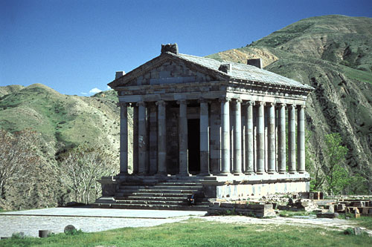
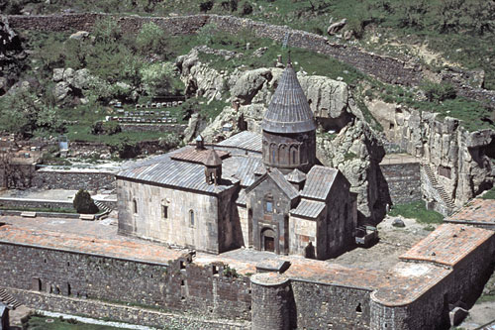
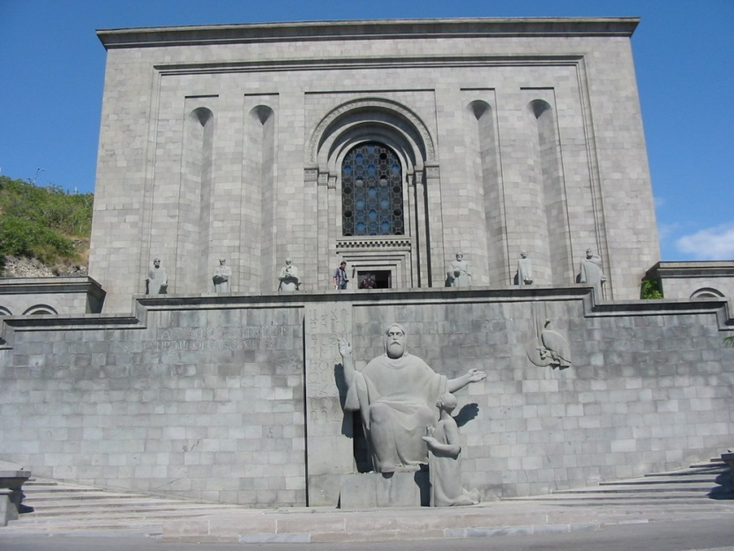
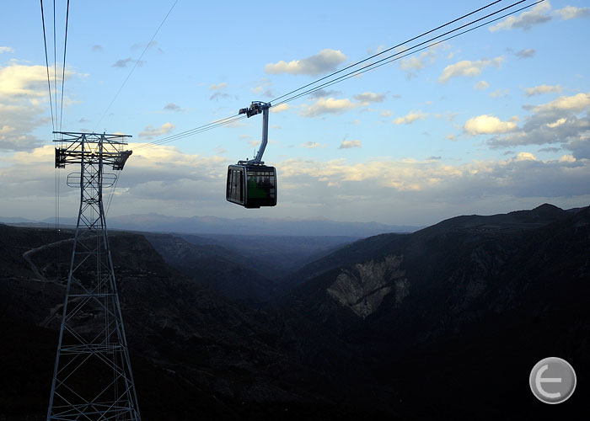
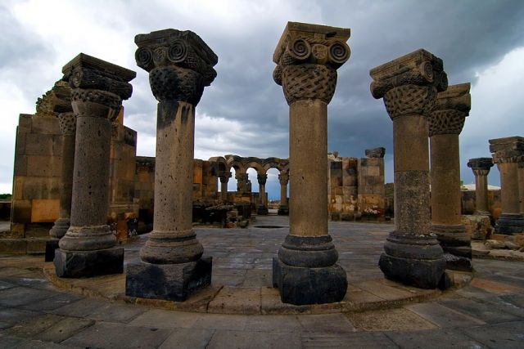
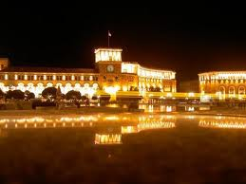
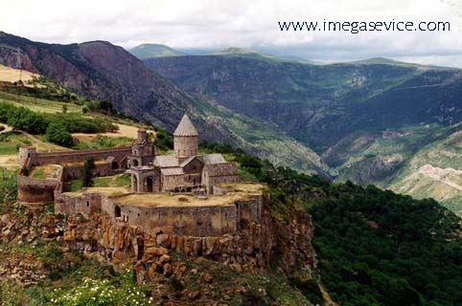
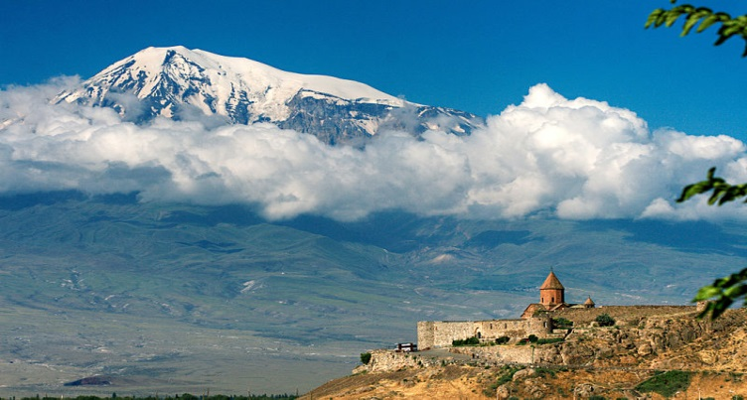
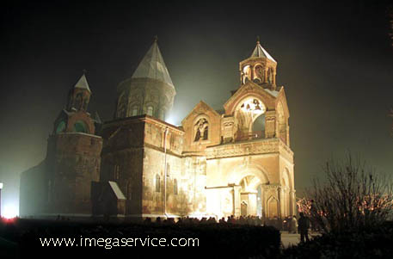
Garni Temple (3rd century BC)
Monastery of Geghard
(listed as a UNESCO World Heritage Site)
Matenadaran (extraordinary collection of over 17,000 handwritten book)
Zvartnots Temple
(1st century BC)
Yerevan Republic Square
Ropeway - Armenia (5.7 km)
Tatev Monastery (9-13th centuries)
Khor Virap, Armenian Apostolic Church
Holy Echmiadzin Cathedral (4th century)

Slide 3






Razmik Barseghyan
 | Engineering Academy of Armenia NGO Vice President
 | National Polytechnic University of Armenia Assoc. prof. Chair of Energetic and Safety Environment Dep. of Energetic
 | INTERNATIONAL ACADEMY OF ENGINEERING NGO Full Member
 | Ecoatom Scientific Industrial LLC Scientific Consultant
 | Research Institute of Ecological Problems of Energetic LLC Vice director

Slide 4
Engineering Academy of Armenia
Engineering Academy of Armenia (EAA) as a public organization has been created in 1992.
It consolidates a number of industrial enterprises, research institutes and higher educational institutions.
The Academy is the constituent member of International Academy of Engineering, in which academies of some CIS countries, as well as those of Greece, Serbia, Slovenia, Czeck Republic are included.
The goal of the EAA is the practical assistance to restoration and development of the industry and all economic potential of the Republic of Armenia. Now the Academy unites over 300 leading scientists and engineers in various technical directions, including over 200 doctors and candidates of sciences, 10 academicians of the National Academy of Sciences of Armenia, representatives of Government, directors, principal investigators and chief engineers of various industrial organizations.

Slide 5
Engineering Academy of Armenia
In the conditions of the limited financial assistance from the state budget, experts of EAA participate in various scientific researches, finding the finance from the international scientific and technical programs (ISTC, FP 7, TEMPUS, TACIS, INTAS, CRDF, ANSEF, etc.),
The members of Academy are engaged also in educational activity in the leading universities in Armenia: National Polytechnic University of Armenia (NPUA), Yerevan State University (YSU), Armenian State University of Economics (ASUE), etc.

Slide 6
Engineering Academy of Armenia realized research works in areas
Economics and Management
Electro technology and Instrumentation
Energetics
Mining-Ore Industry
Architecture, Civil Engineering and Construction
Mechanical Engineering and Metallurgy
Technology of Food and Light Industry
Information Systems, Electronics and Scientific Instrumentation
Chemical, Biological and Nature Protection Technologies

Slide 7
Engineering Academy of Armenia
The main partner of EAA is NPUA
Departments of EAA have active collaboration with chairs and faculties of Polytechnic.
They realize joint scientific projects, conferences and other discussions.

Slide 8
Engineering Academy of Armenia
The main partner of EAA is NPUA
Taking into account the demand of workers market with the professors and scientific workers of Polytechnic, specialists of EAA discuss the perspectives of development of necessary professions, take part in the development and investment of programs of new specialists.

Slide 9
Engineering Academy of Armenia
The main partner of EAA is NPUA
EAA Energy Department has active participation in scientific programs, conferences and other events, that are realized in the field of energy safety and energy saving.
Together with NPUA Energy faculty and organizations concerned, educational programs connected with energy safety, energy saving and alternative energy are developed and discussed.
The employers of the Academy take part both in state and international projects concerning energy saving and energy safety.

Slide 10









EAA has worked at projects
 | U.S. Civilian Research & Development Foundation
 | ANSEF – Armenian National Science & Education Fund
 | State Committee of Science Ministry of Education & Science of Armenia
 | Eurasia Partnership Foundation
 | Enterprise Incubator Foundation & Government of Armenia
 | International Science & Technology Centre (ISTC)
 | Local Projects by EAA, Arev, Ecoatom, Tranzistor Plus, YA, etc.

Slide 11

EAA has worked at projects
 | Z Phase Strengthened Steel for Ultra-supercritical Power Plants / NMP3-SL-2013-309916/
 | The Generation and Spreading of Waves an Troposphere / 15 RF- 034 /
 | Biomass Heating Solutions for Rural Development / ENPI /2015 / 364-029/

Slide 12
THANK YOU
Razmik Barseghyan
Raz_bars@yahoo.com
Tel. +374 91 388 233

