Slide 1

KAUNAS UNIVERSITY OF TECHNOLOGY

Slide 2

II.
FACTS & FIGURES

Slide 3
GENERAL
STRUCTURE
RESEARCH
Since 1922
Public university
Among top 4% of
world universities
(QS Rankings)
9 faculties
10 science institutes
125 national projects
73 international projects
Almost 1000 technology development services
STUDENTS AND PROGRAMMES
ACADEMIC STAFF
1130 academic and research staff
(1:9.6 teaching staff: students ratio)
175 professors
74 % of teaching staff hold
an academic degree
10 856 undergraduate and
postgraduate students
332 PhD students
751 international students
49 interdisciplinary study programmes
62 study programmes delivered
in English (BSc, MSc, PhD)
7 % of international students

Slide 4
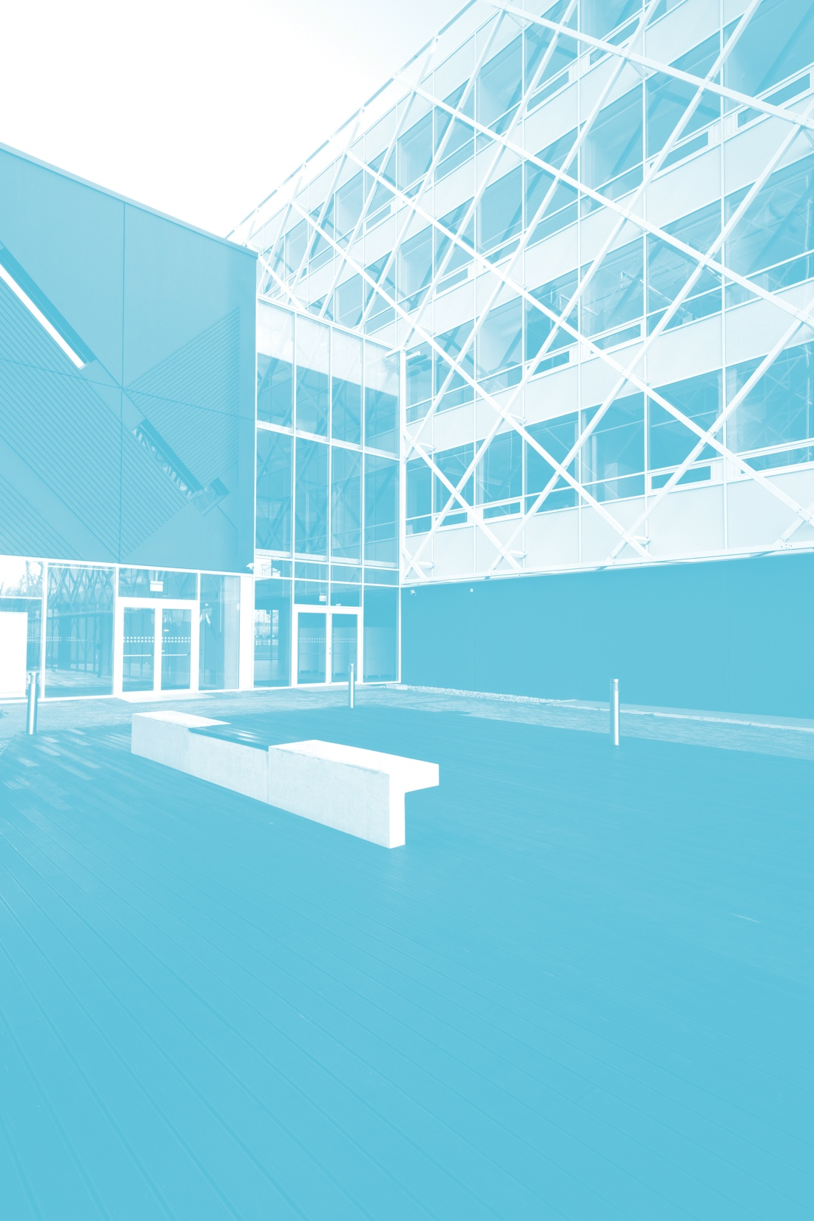
1.1
terdisciplinarity
in
Joint/dual degree programmes
Plenty of possible combinations of
majors and minors
Study programmes incorporating knowledge from
several study and research fields
Research undertaken across disciplines,
institutes and institutions

Slide 5
tegrating sustainability
in
Recent reforms optimise human and financial resources
Sustainable mobility projects inspire university and
city-wide attitude changes
Rapidly expanding e-learning resources for
students and society
New modern facilities for businesses, students, and
society change the city’s physical and mental landscape

Slide 6
The Institute of Environmental Engineering
Cleaner production and financing;
Cleaner products, eco-design;
Environmental management;
Chemicals risk assessment and control;
Preventive waste management;
Sustainable consumption and Production;
Resource & Energy management.
MSc. Programme “Environmental Management and Cleaner Production”
PhD. Programme “Environmental Engineering” (for Sustainable Industries)

Slide 7
Single teaching modules related to Energy efficient buildings at KTU
Master level
Sustainable Management of Regions
Energy Efficient Buildings
PhD level
Sustainable energy systems
Engineering systems for energy efficient buildings

Slide 8
Projects on Energy Efefficiency Buildings
(2013-2015) TREO (Training on Resource Efficiency and Optimization) is a partnership project, which main objective is to transfer and exploit the vocational education and training (VET) European Course on Eco-efficiency.
(2011 – 2014) RENERGY – Regional Strategies for Energy Conscious Communities
(2006–2009) Magnify success: Extension of the European Energy Trophy competition to 18 countries – „Energy Trophy+“. Intelligent Energy Europe Programme. Partners: B.&S.U. Beratungs und Service-Gesellschaft Umwelt GmbH (Germany) 18 selected institutions from 17 EU countries.
Doctoral dissertation: Milutienė, E. (2013). Environmental performance improvement possibilities of a building using renewable materials and energy technological sciences, environmental engineering

Slide 9
Thank You for Your Attention
Prof., Dr. Hab. Jurgis K. Staniškis
The Institute of Environmental Engineering,
K. Donelaičio str. 20, LT-44239 Kaunas, Lithuania
Web page: www.apini.lt
E-mail: jurgis.staniskis@ktu.lt
The Official Contact Person
Prof., Dr. Eglė Katiliūtė
School of Economics and Business,
Kaunas University of Technology
Gedimino str. 50, LT-44239 Kaunas, Lithuania
E-mail: egle.katiliute@ktu.lt

