Slide 1
Master Degree in Innovative Technologies in Energy Efficient Buildings for Russian & Armenian Universities and Stakeholders - MARUEEB
Genoa - February, 2016
Ruben Aghgashyan,
NPUA Vice-rector

Slide 2
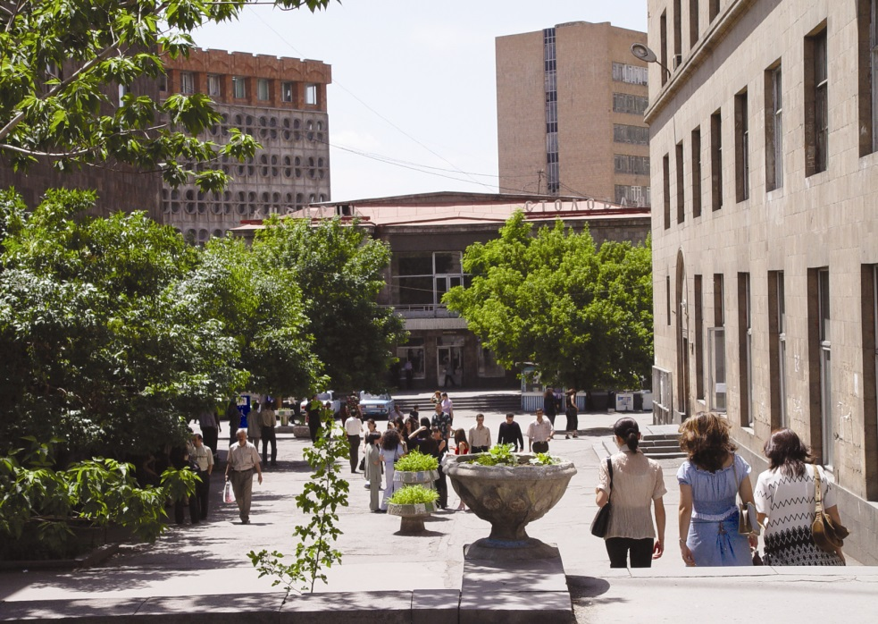
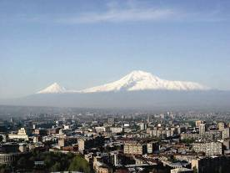
Welcome to National Polytechnic
University of Armenia
Genoa - February, 2016

Slide 3
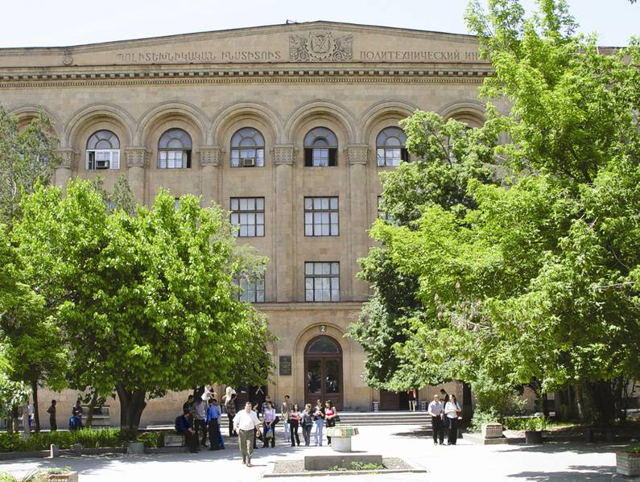
National Polytechnic University of Armenia is the legal successor of Yerevan Polytechnic Institute: one of the leading engineering schools of the former Soviet Union

Slide 4
The University at a glance - 1
The Central Campus of the University is located in Yerevan and
the 3 Branch Campuses - in Gyumri, Vanadzor and Kapan.
The University has affiliated high schools in Yerevan and Regional Campuses, aimed at recruiting future gifted students from schools.
4 study programs of vocational and higher education,
conferring the qualification degrees of junior diploma specialist, bachelor, master and researcher (PhD).
The University also offers extended education courses by means of
its faculties and a network of continuing education structures.
45 Bachelor’s, 36 Master’s and 22 Researcher’s (PhD) majors in
Engineering, Industrial Economics and Management, Applied
Mathematics and Physics.

Slide 5
The University at a glance - 2
At present over 10 thousand students following 4 degree programs, more than100 foreign students studying in English and Armenian language groups.
In addition, over 900 learners at the NPUA central
and regional affiliated high schools.
The academic staff of the University exceeds 800,
most of them with Doctoral Degrees.
With its developed research system and infrastructure the University is nationally recognized as the leading center in technical sciences and technologies.

Slide 6
The University at a glance - 3
The University has one of the leading roles in the reformations
of the higher education system of Armenia:
SEUA was the first HEI in RA that introduced two (in 1993)
and then three (in 1995) levels of higher & post-higher education,
implemented a credit system (in 2004) compatible with ECTS
in harmony with the Bologna Process developments.
During the last decade, the University has developed an extended network of international cooperation including many leading EU universities and research centers, is a member of EUA.

Slide 7
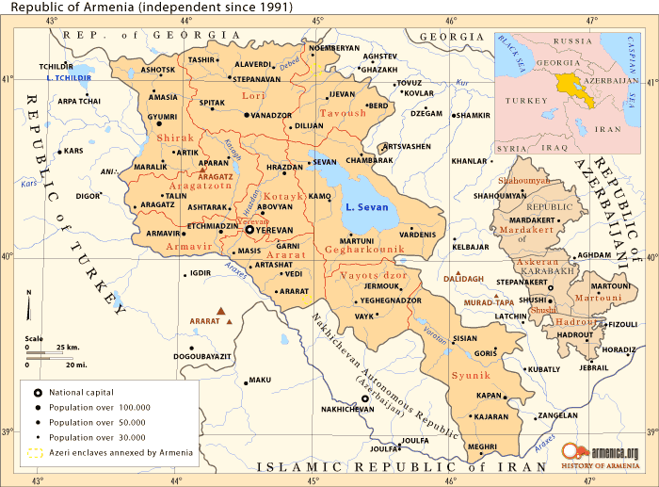
NPUA Regional Branches
Vanadzor Branch
Gyumri Branch
Kapan Branch

Slide 8
International Activity of NPUA
The University is a member of:
European Universities Association,
Black See Universities Network,
Technical Universities Association of RF,
Network University of CIS countries,
was and is involved in:
many European and other international research and educational programs (TACIS, Tempus, Erasmus Mundus, Erasmus+, DAAD, NISCUPP, OSF, INTAS, USAID, NATO Science, FP- 5, 6,7, etc.).
SEUA has successfully implemented 16 TEMPUS projects in the areas of university management, educational reforms, curricular renovation and strategic planning; at present 9 Tempus, 2 Erasmus Mundus, 2 Erasmus Plus KA2 and 3 - KA1 projects are going on.

Slide 9
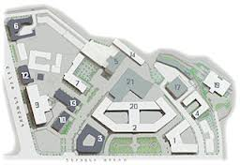
NPUA Institutes and Faculties (Central Campus)
Institute of Energy and Electrical Engineering
Mechanics and Machine Study
Machine Building
Chemical Technologies and Environmental Engineering
Radio Engineering and Communication Systems
Computer Systems and Informatics
Applied Mathematics and Physics
Cybernetics
Mining and Metallurgy
Transportation Systems
Design
Correspondence Education

Slide 10
Institute of Energy and Electrical Engineering (IEEE)
Founded in 2015 on the basis of former Power Engineering and Electrical Engineering Faculties through their reorganization as a new structural university unit with a quite high autonomy.
Has the following 5 Chairs with over 80 faculty members and more than 1000 students studying at all 3 educational levels:
Electrical Power Engineering,
Thermal Power Engineering and Environmental Protection,
Economics and Management of Energy Field,
Electrical Machines and Apparatus,
Electrical Engineering and Electrical Drive.
Among the main educational and research interests are:
Environmental Protection in the field of Energy,
Energy Saving and Energy-efficient Technologies,
Alternative and Renewable Energy resources.

Slide 11
Energy-efficient Technologies and Energy Management Speciality (Degree: Bachelor of Engineering) - Code: 140300
“Energy Saving and Energy-efficient Technologies” Module - 1
Codes | Titles of Courses | Semester, Credits (ECTS) & weekly hours
1.12.2.91 | Basics of Energy Saving | Autumn (3-rd semester) 4 Credits ( 2: 1: 0 )
1.12.2.90 | Methods and Devices of Account, Control and Regulation of Energy Resources | Spring (6-th semester) 5 credits ( 2: 0: 2)
1.12.2.92 1.12.2.93 | Energy-efficient Technologies in Thermal Power Engineering - 1,2 | Spring (6-th semester) 5 credits ( 2: 0: 2) Autumn (7-th semester) 5 credits ( 2: 0: 2)
1.12.2.94 | Energy-efficient Technologies in Thermal Power Engineering - Project Work | Autumn (7-th semester) 1 credit

Slide 12
Energy-efficient Technologies and Energy Management Speciality (Degree: Bachelor of Engineering) - Code: 140300
“Energy Saving and Energy-efficient Technologies” Module - 2
Codes | Titles of Courses | Semester, Credits (ECTS) & weekly hours
1.12.2.95 | Energy-efficient Technologies in Electrical Power Engineering | Autumn (7-th semester) 5 Credits ( 2: 0: 2 )
1.12.2.122 | Energy Management | Autumn (7-th semester) 5 credits ( 2: 0: 2)
1.12.2.123 | Energy Management - Project | Autumn (7-th semester) 1 credit
1.12.2.88 | Legal Regulation of Energy and Energy Saving Fields | Spring (8-th semester) 5 credits ( 5: 2: 0)
1.12.2.124 | Nontraditional Renewable Energy Sources | Spring (8-th semester) 6 credits ( 5: 3: 0)

Slide 13
Energy-efficient Technologies and Energy Management
Master Degree: Module of Professional Core Courses
Codes | Titles of Courses | Semester, Credits (ECTS) & weekly hours
2.12.2.71 | Cogeneration plants | Autumn (1-st semester) 5 Credits ( 3: 1: 0 )
2.12.2.05 | Energy Development Planning and Investment Management | Autumn (3-rd semester) 4 Credits ( 2: 1: 0 )
2.12.2.64 | Actual problems of Energy development | Autumn (3-rd semester) 5 Credits ( 3: 1: 0 )
2.12.2.72 | Energy saving in municipal services | Autumn (3-rd semester) 4 Credits ( 2: 1: 0 )
2.12.2.19 | Basics of Energy Audit | Spring (4-th semester) 3 Credits ( 2: 0: 2 )
2.12.1.21 | Modern Renewable Energy Technologies | Spring (4-th semester) 4 Credits ( 3: 1: 0 )

Slide 14
Energy-efficient Technologies and Energy Management
Master Degree: Module of Related Elective Courses
Elective Course 1
2.12.2.74 | Energy and Resource Saving Technologies in Power Engineering | Spring (2-nd semester) 5 Credits ( 3: 1: 0 )
2.12.2.04 | Energy Saving and Energy Management
2.12.2.16 | Research and Optimisation of Technical Water Supply Systems of Thermal Power Plants
Elective Course 2
2.12.2.65 | Energy Saving in Thermal Power Engineering and Thermal Technologies | Autumn (3-rd semester) 4 Credits ( 2: 1: 0 )
2.12.2.67 | Energy Saving in Electrical Power Supply Systems
2.12.2.27 | Economics of Nature Management and Forecast

Slide 15
Energy-efficient Technologies and Energy Management
Master Degree: Module of Related Elective Courses
Codes | Titles of Courses | Semester, ECTS Credits & weekly hours
Elective Course 3
2.12.2.36 | Basic Environmental Problems in Energy Systems | Spring (4-th semester) 3 Credits ( 2: 1: 0 )
2.12.2.77 | Modern Ecological Technologies in Thermal Power Engineering
2.12.2.78 | Energy and Environmental Impact Assessment
Elective Course 4 ...

Slide 16
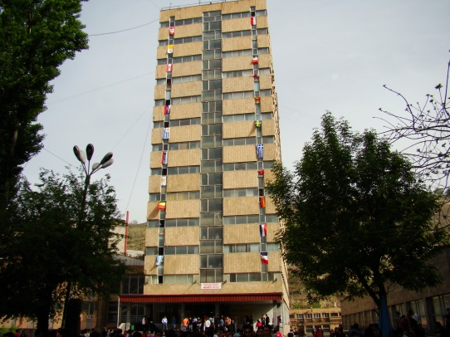
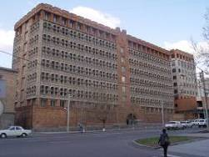
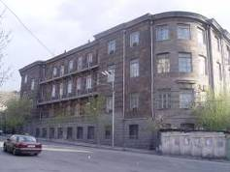
The main strengths of NPUA
NPUA (former Yerevan Polytechnic Institute/SEUA) is the indisputable leader in technical education of RA
During 83 years since its establishment
NPUA has given more than 120,000
graduates
The graduates have formed RA’s
main engineering manpower
scientific technical community
industrial leadership

Slide 17
Thank you

Slide 18
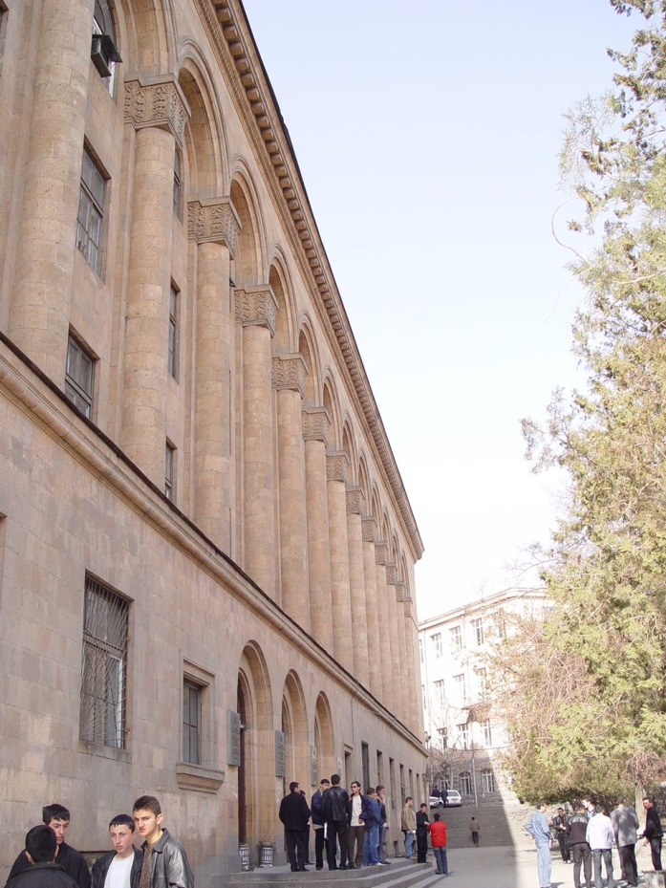
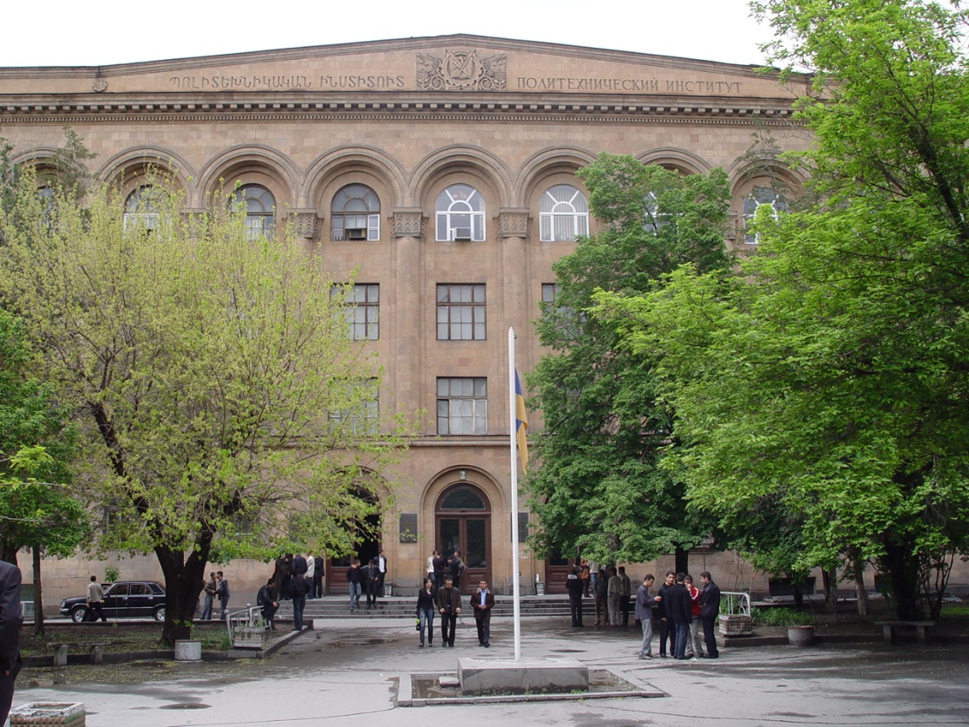
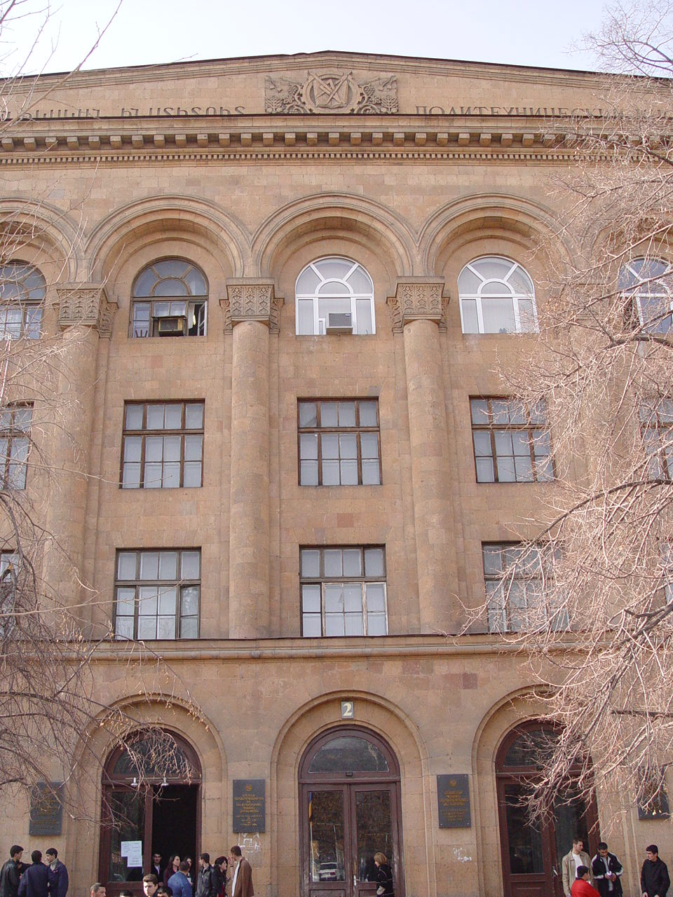
Welcome to a short
video tour of NPUA

Slide 19
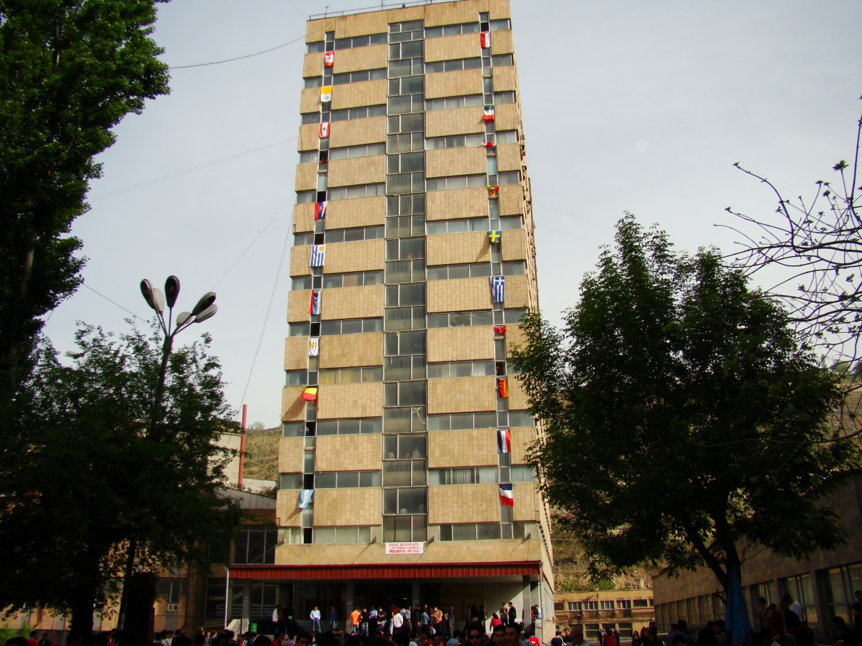
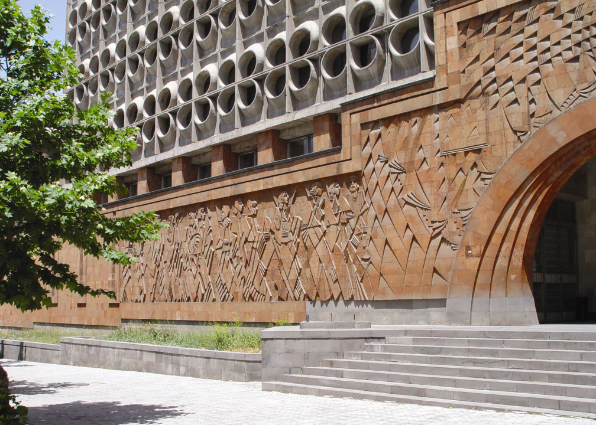
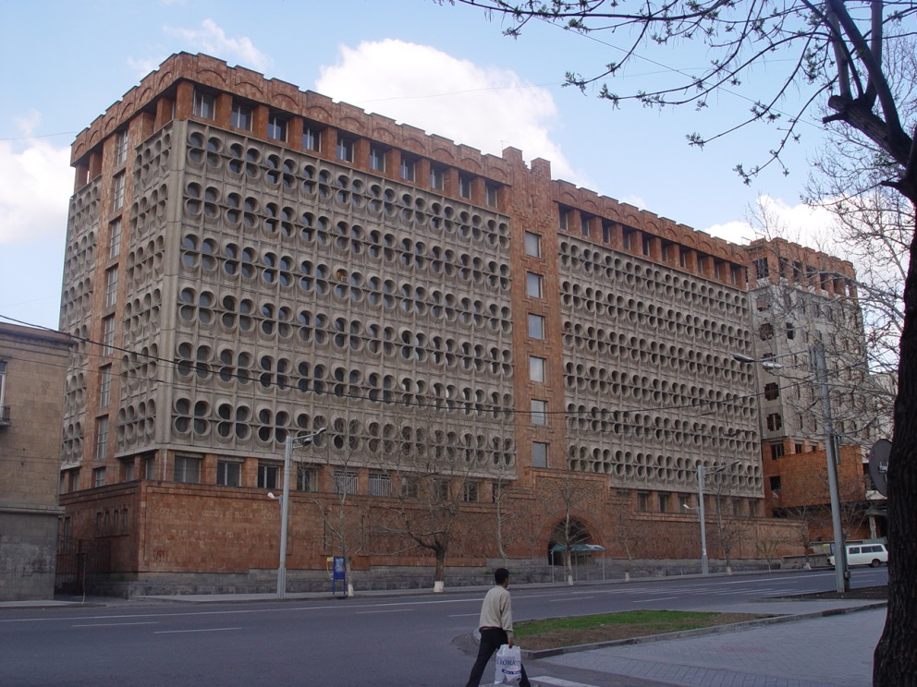

Slide 20
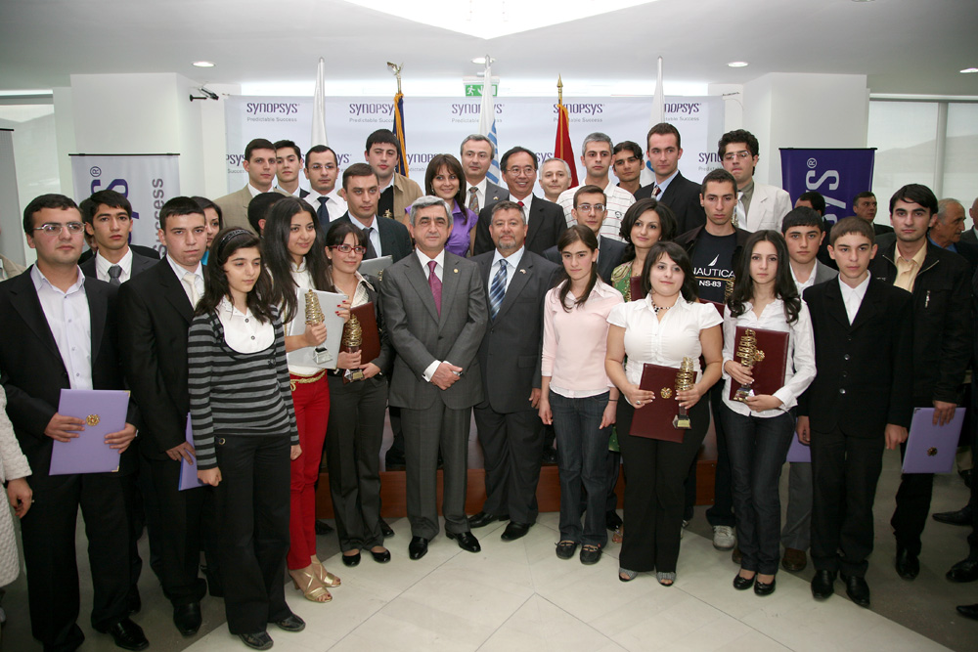

Slide 21
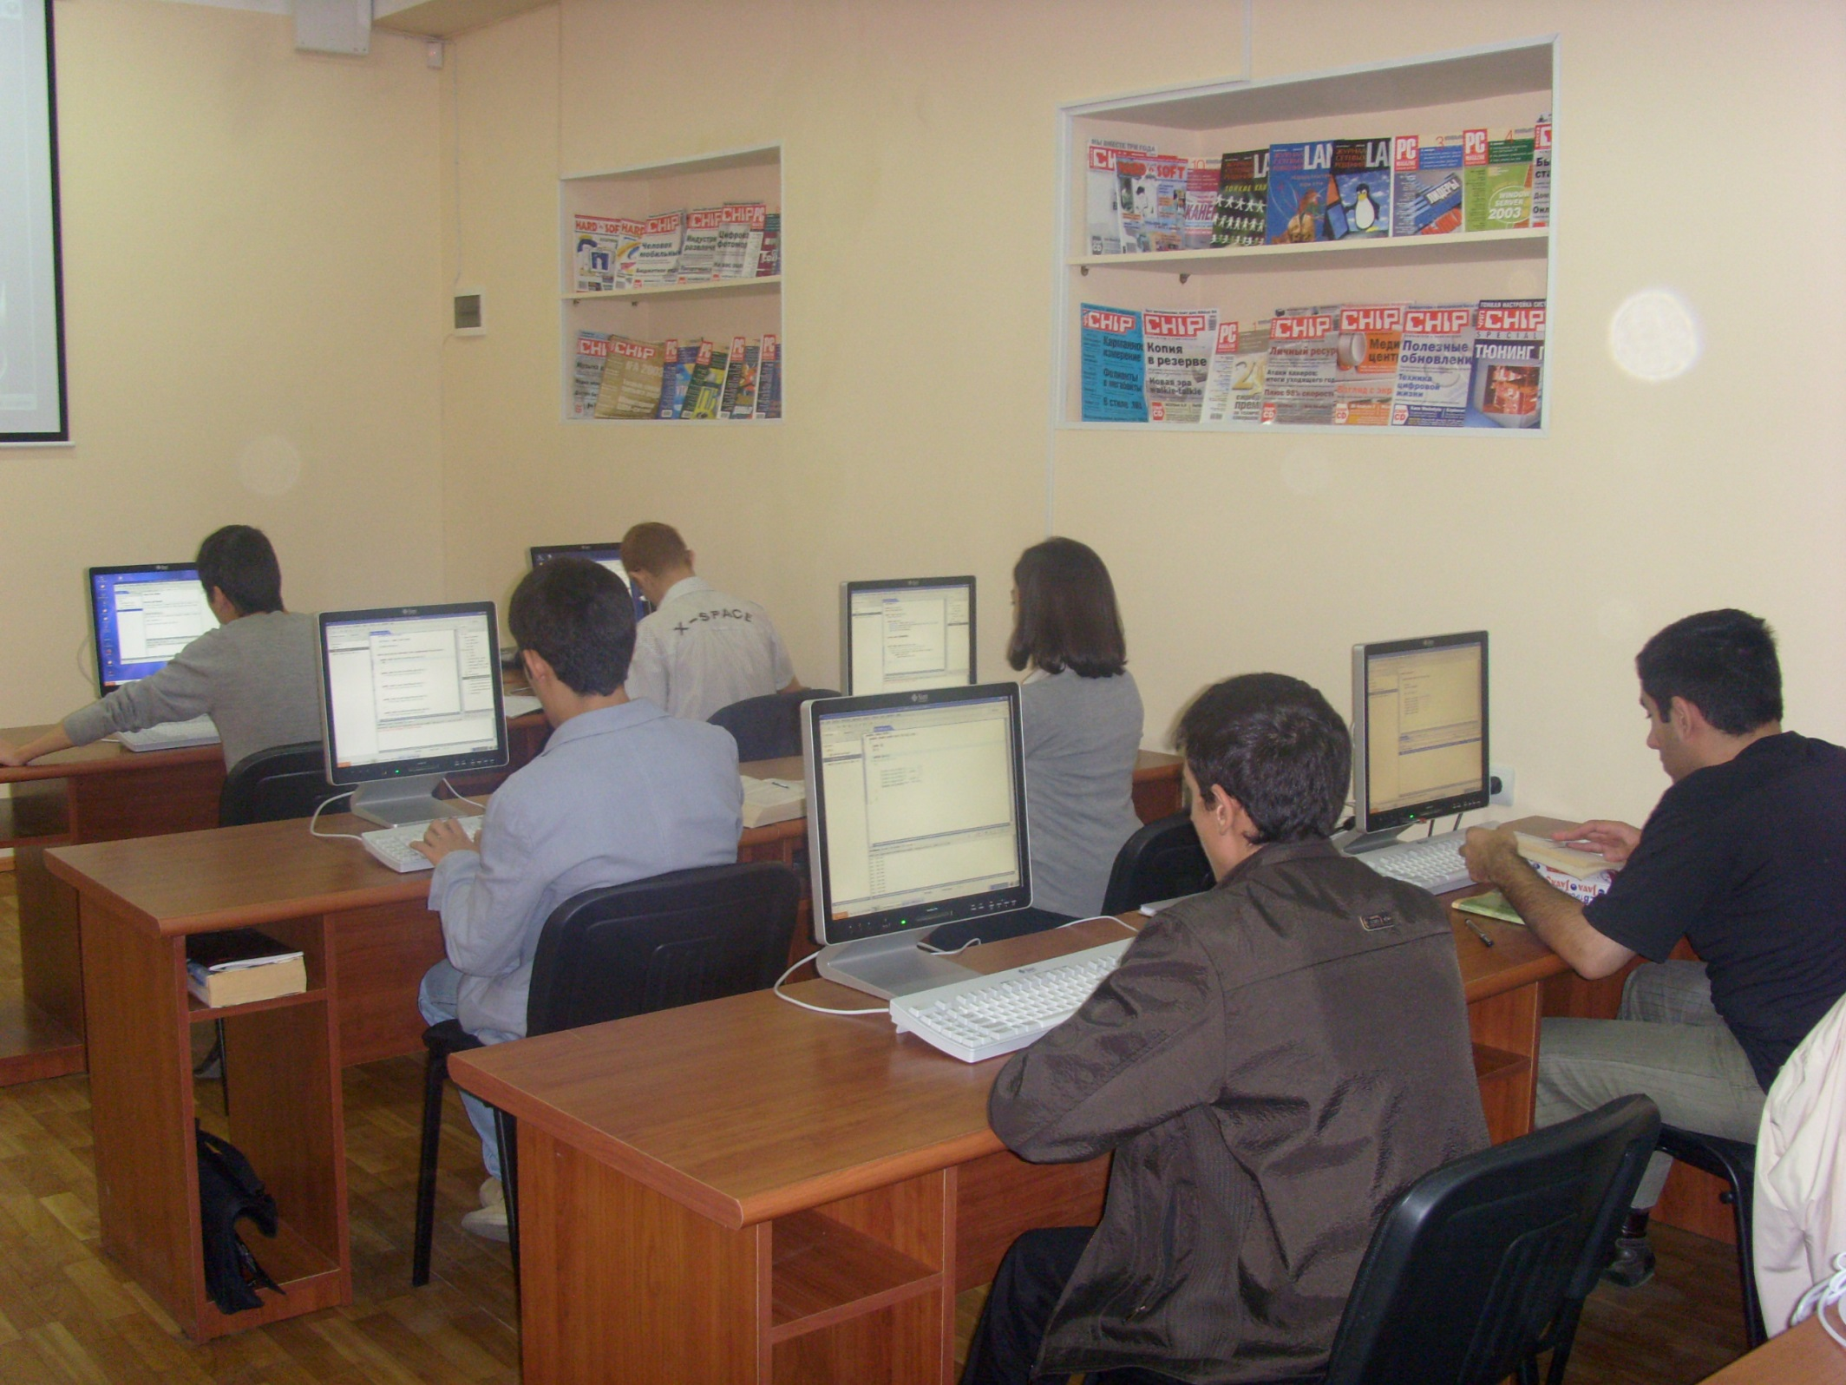

Slide 22
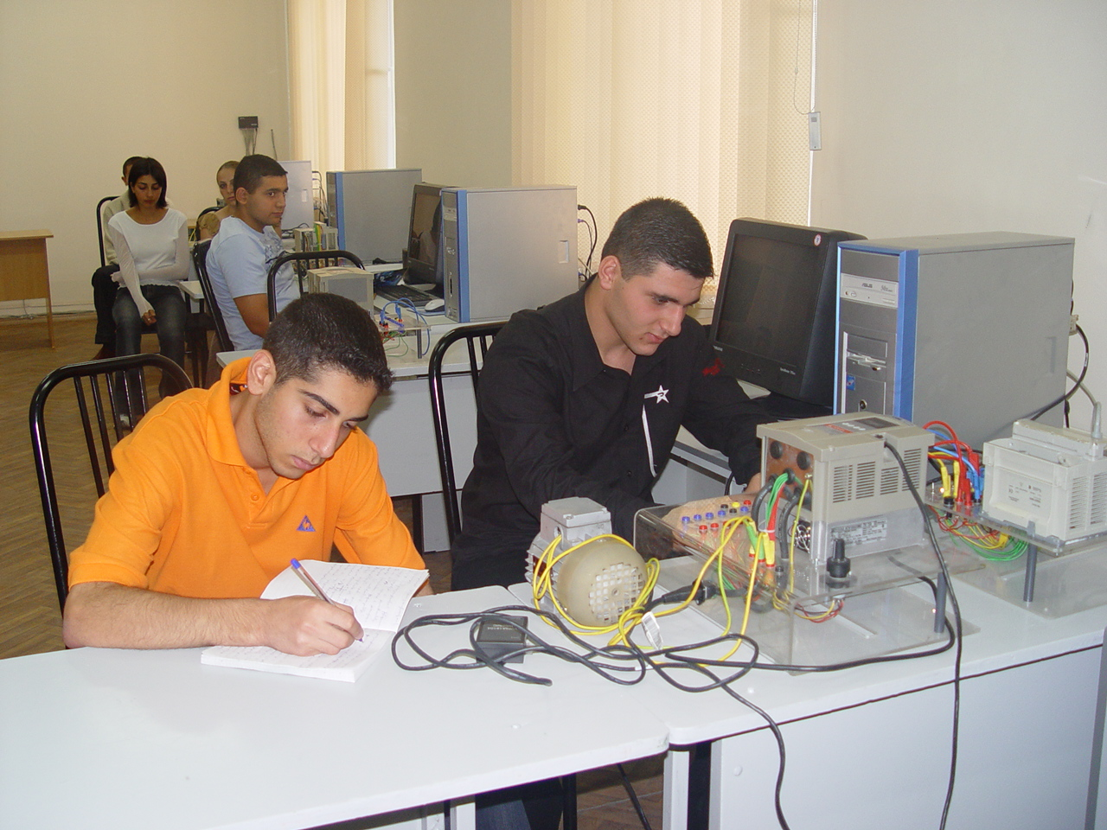

Slide 23
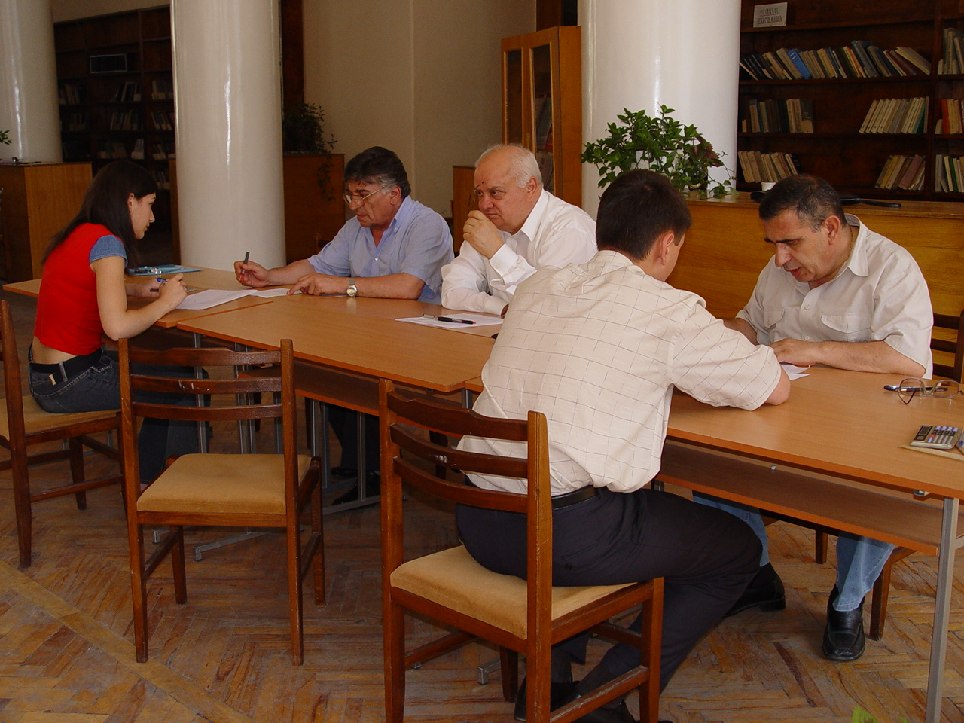

Slide 24
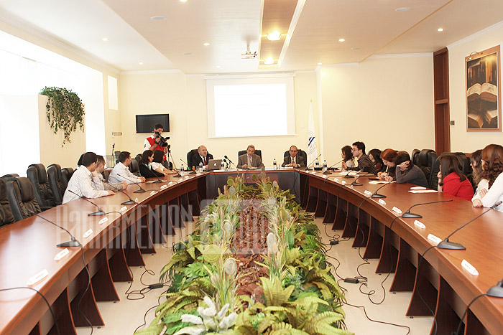

Slide 25
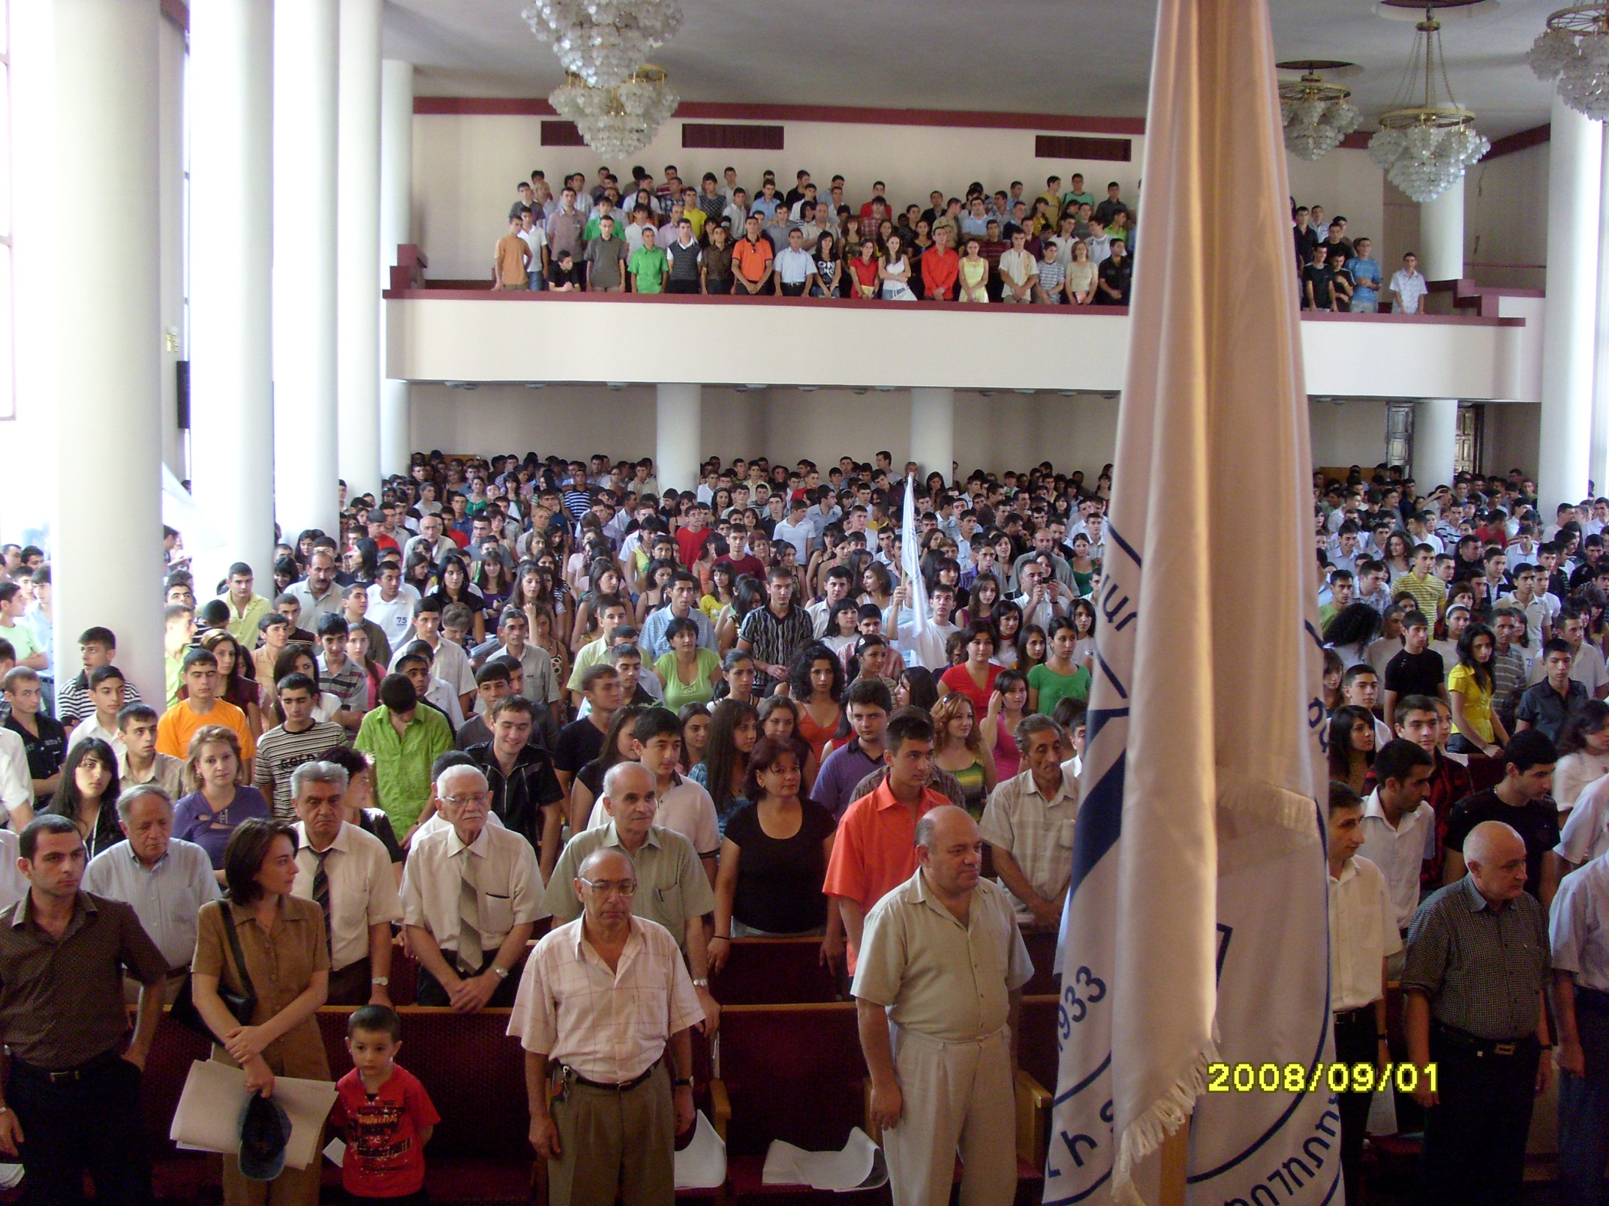

Slide 26
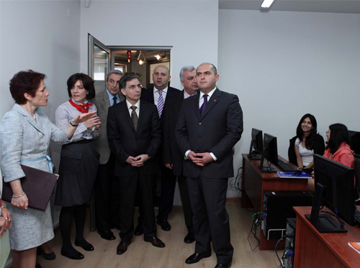

Slide 27
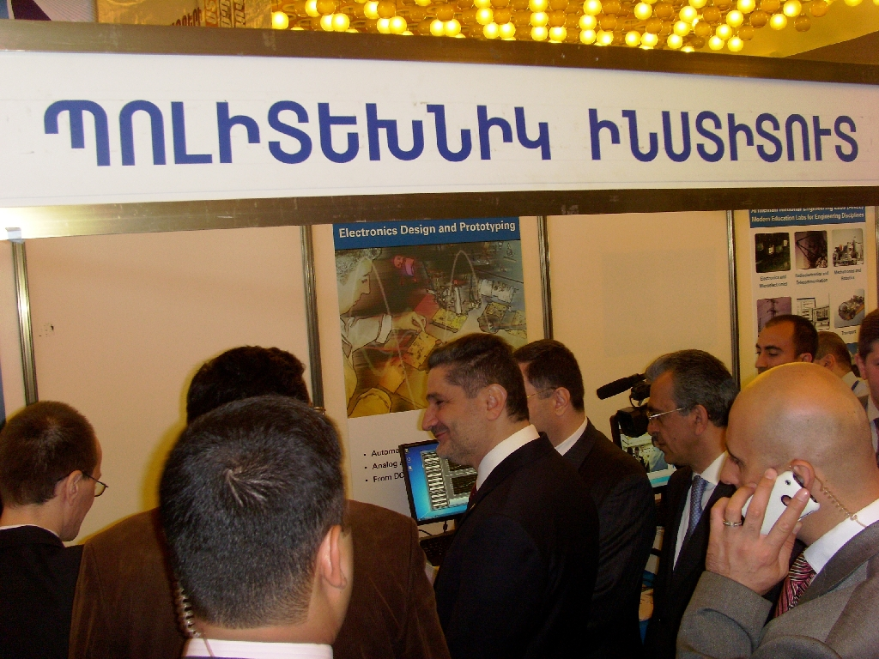

Slide 28
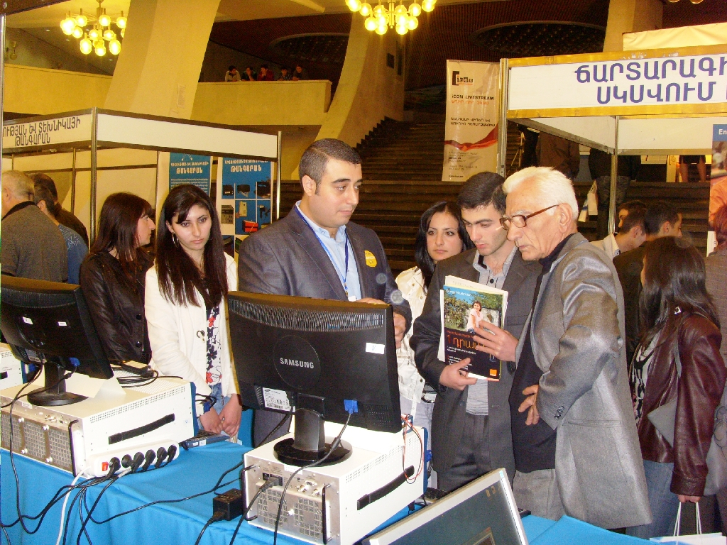

Slide 29
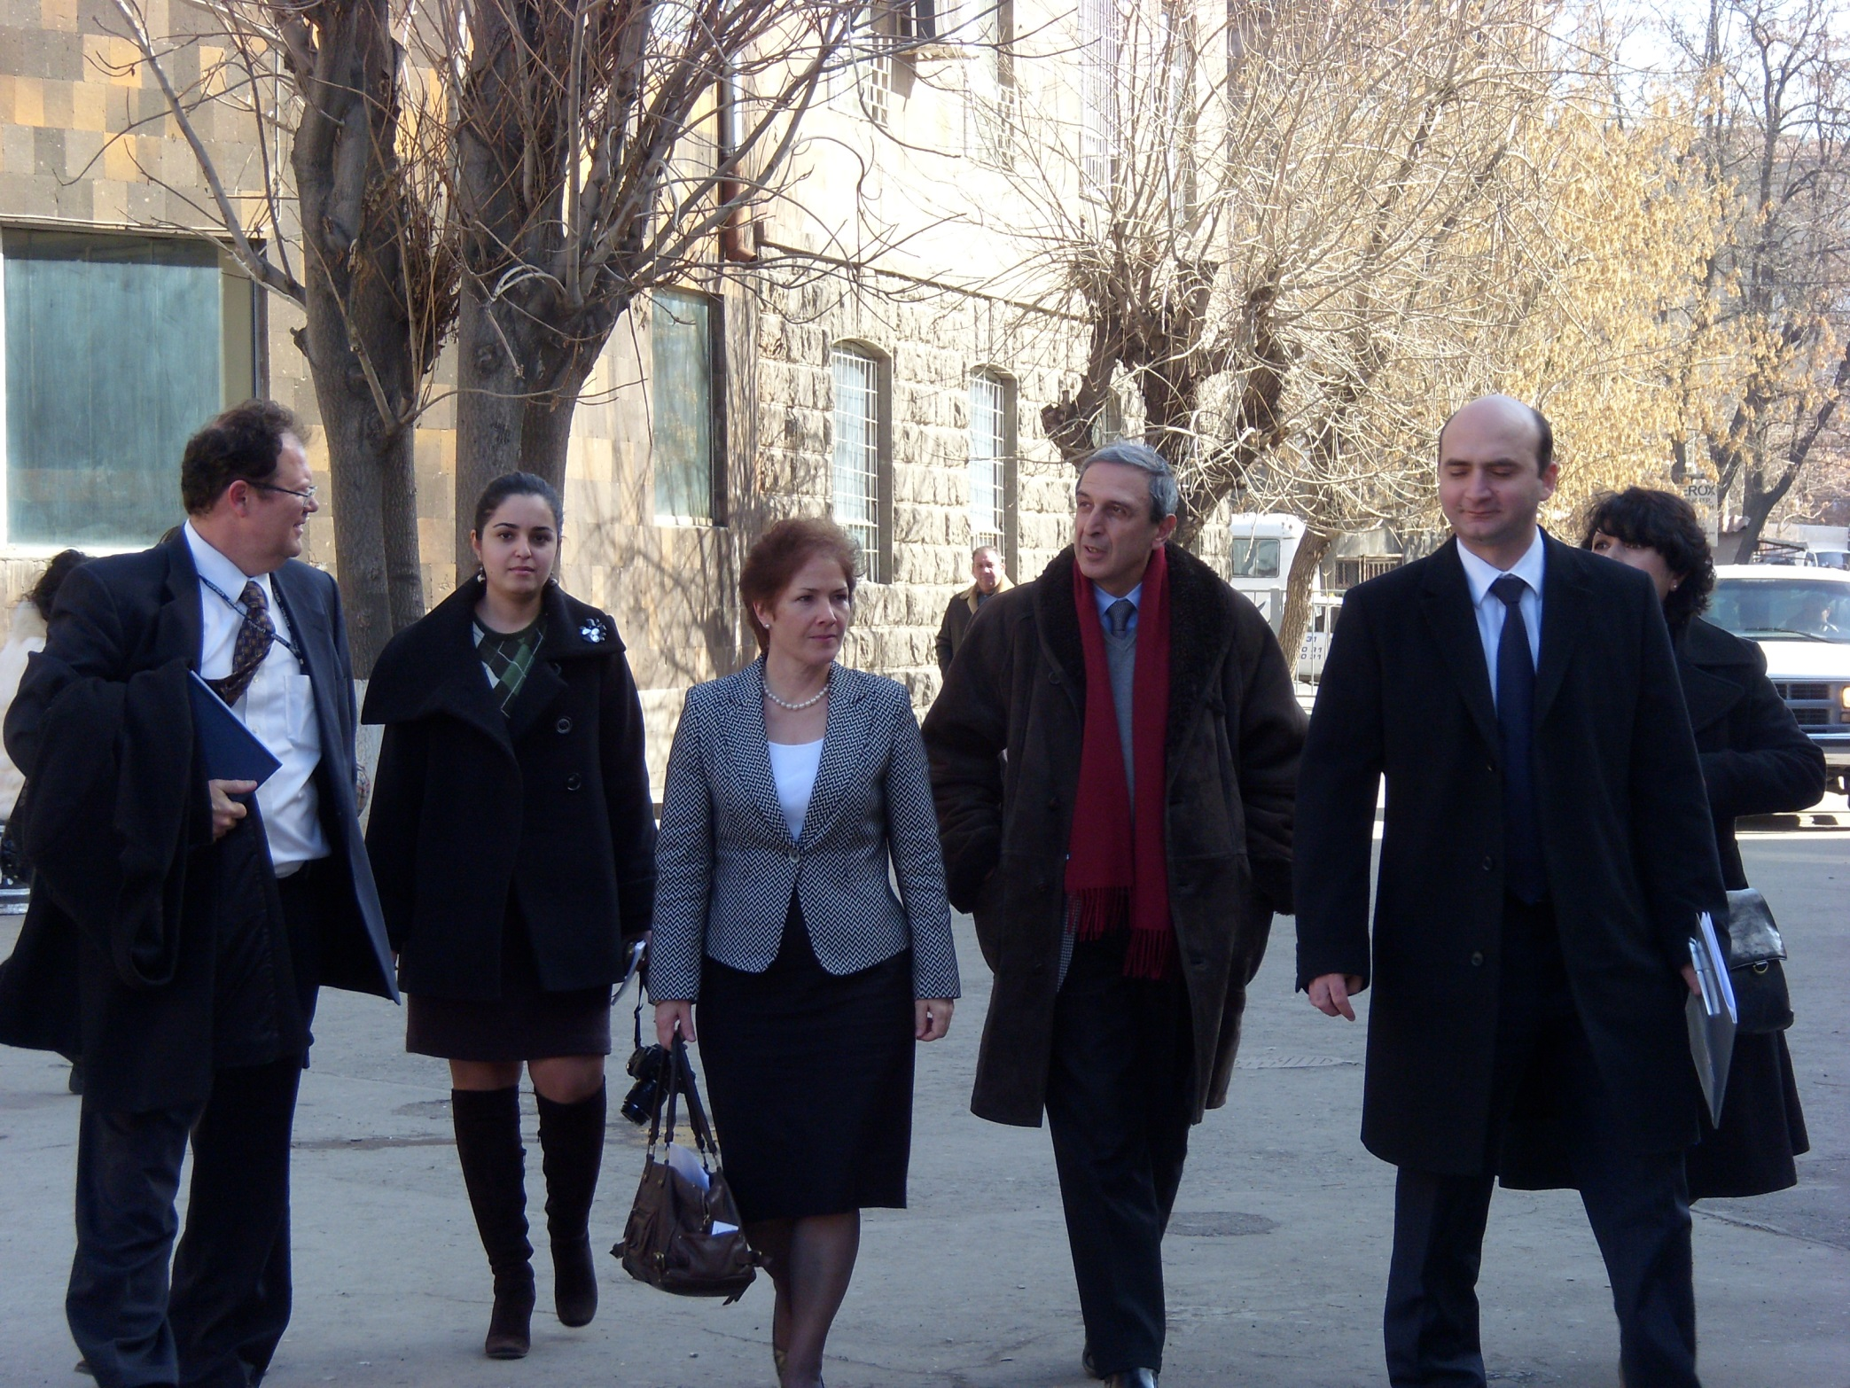

Slide 30
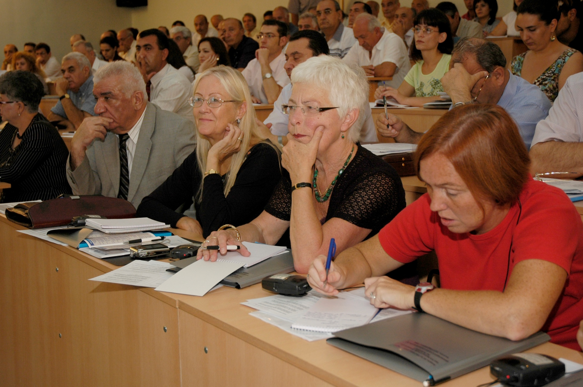

Slide 32
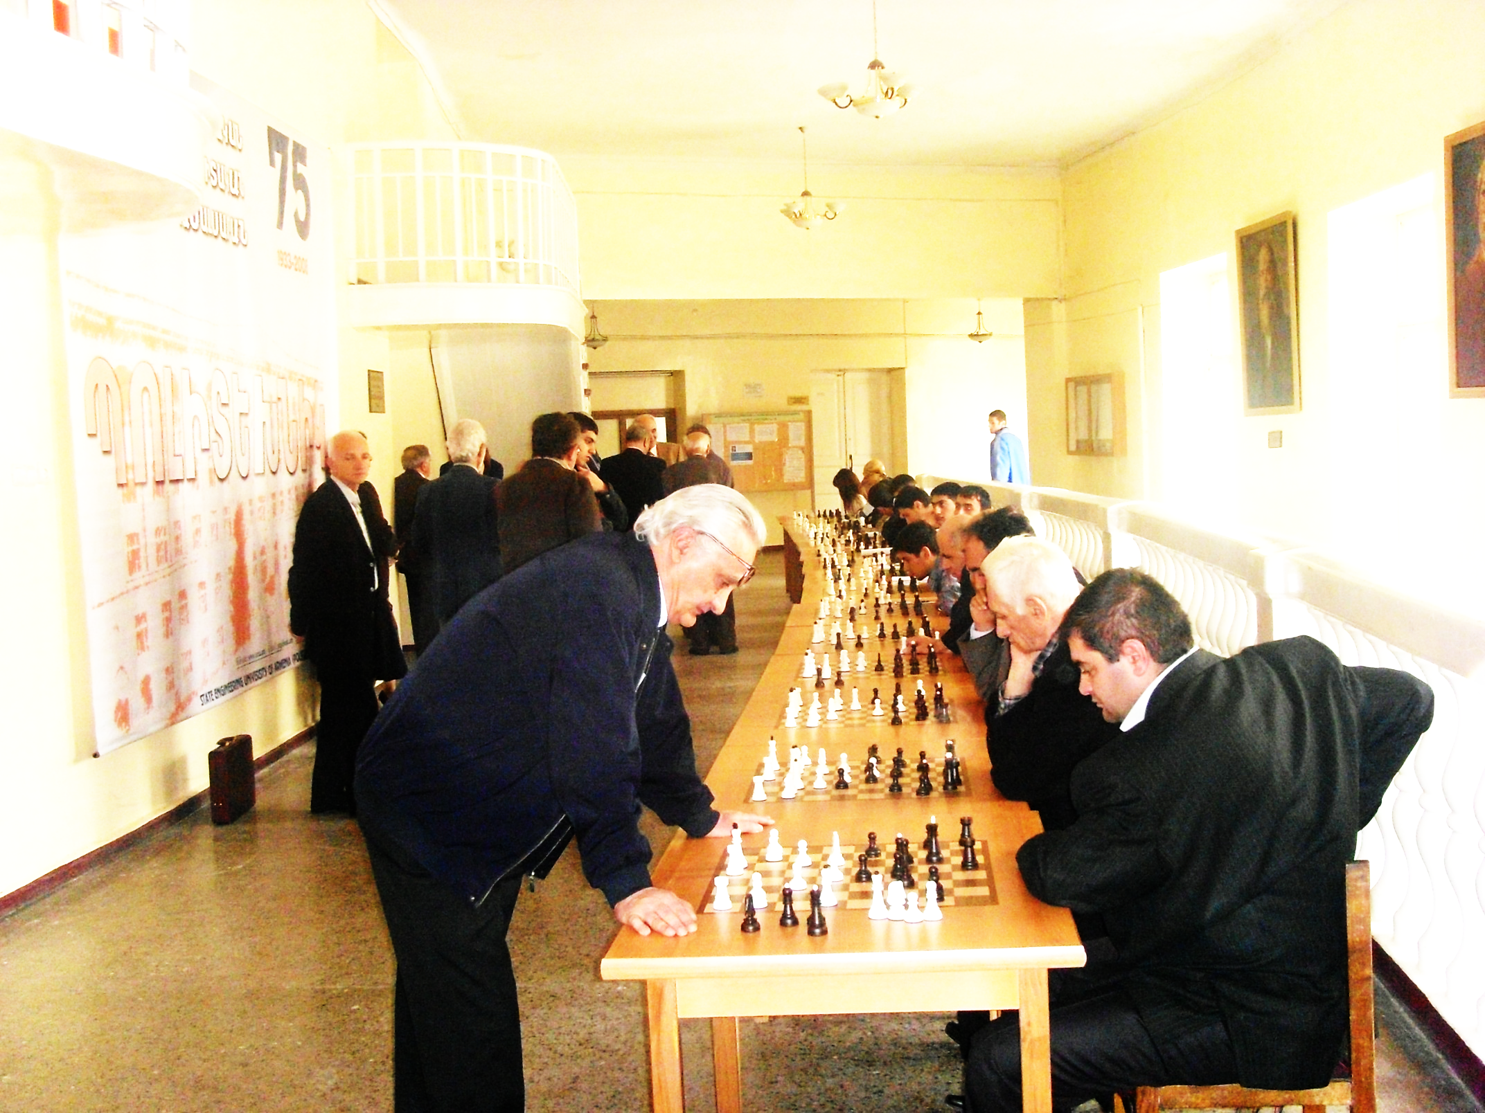

Slide 33
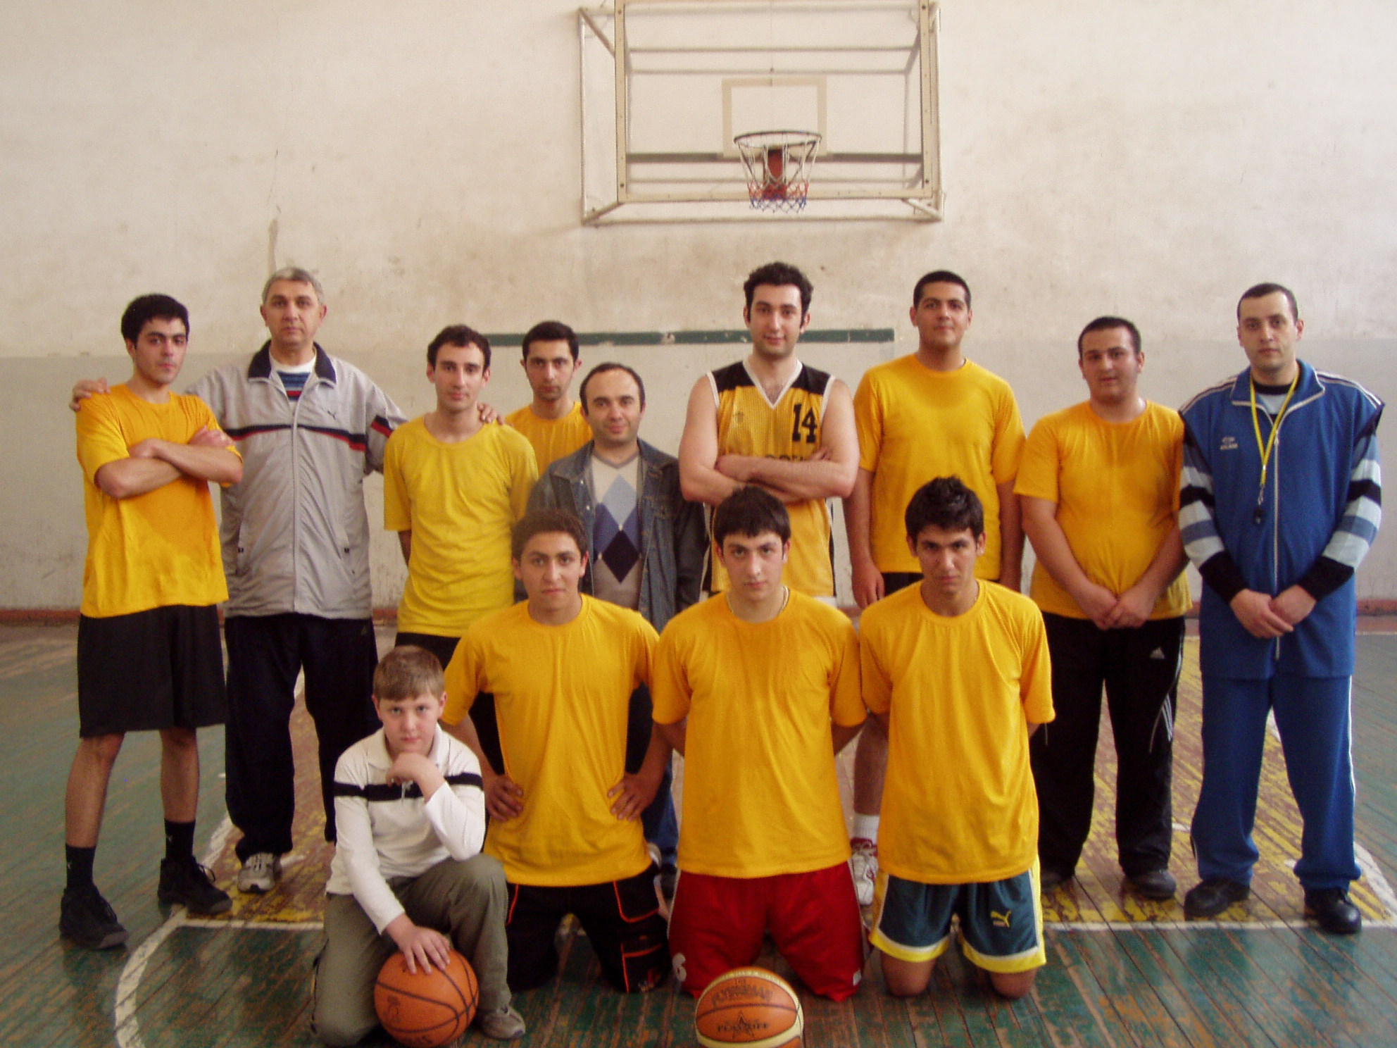

Slide 34
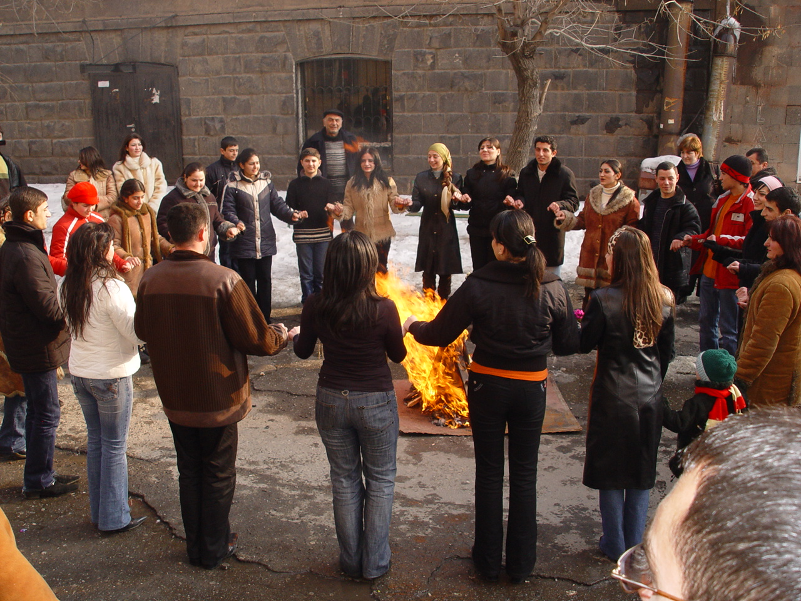

Slide 35
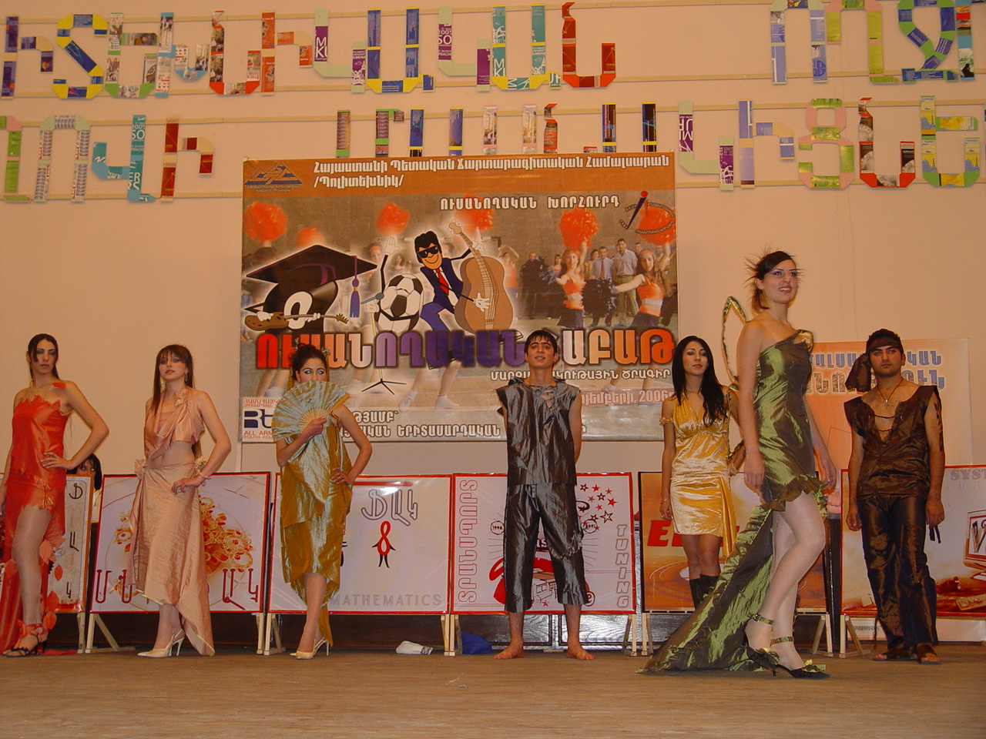

Slide 36
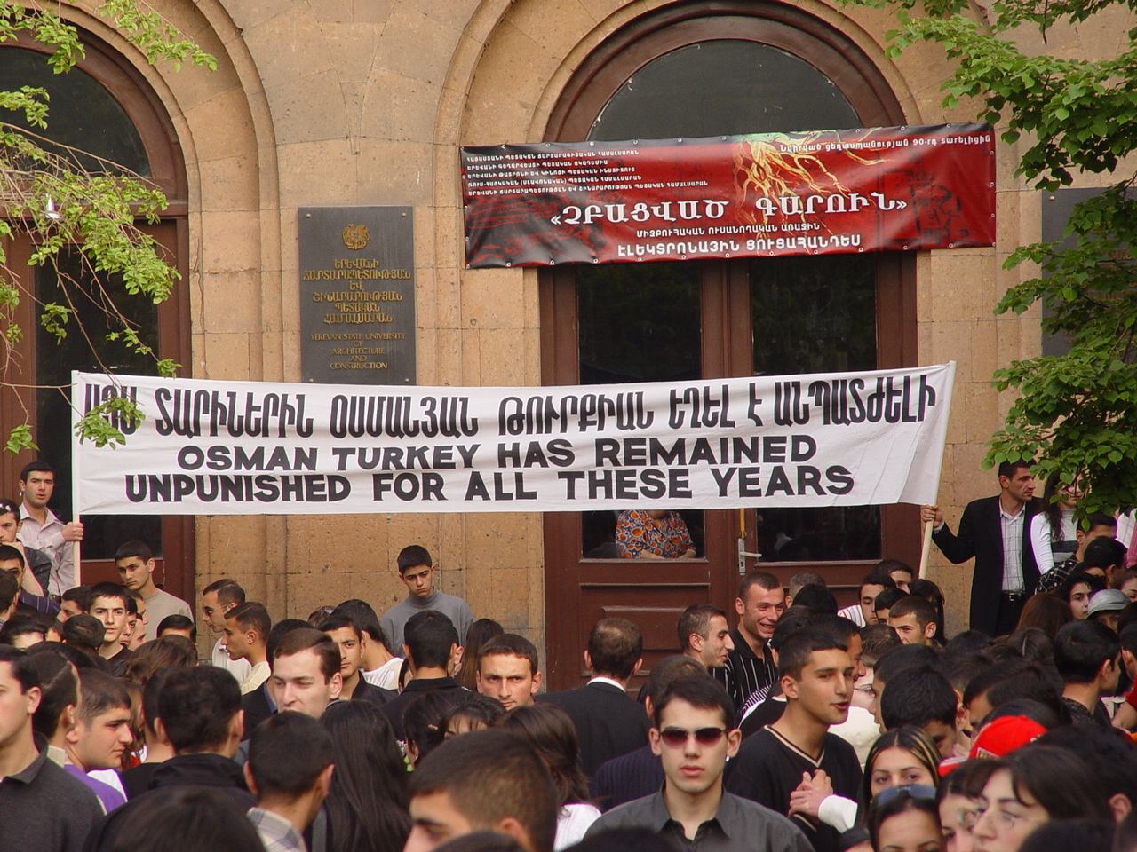
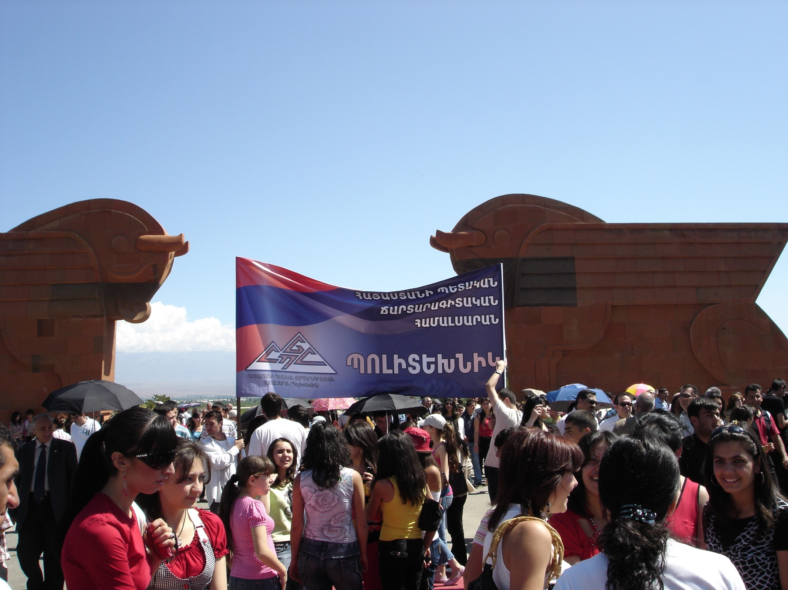

Slide 38
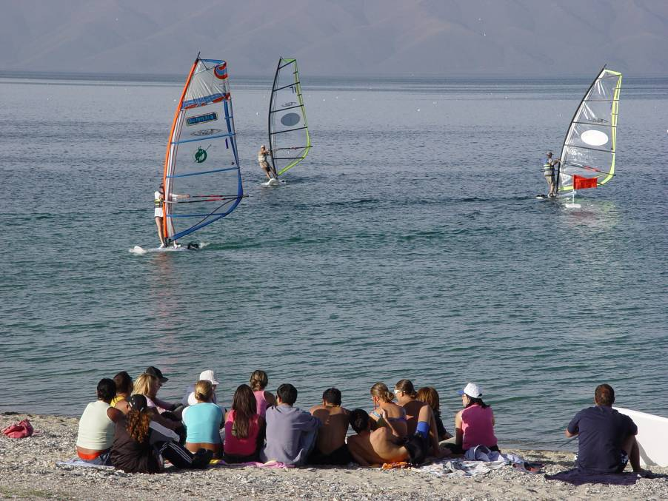

Slide 39
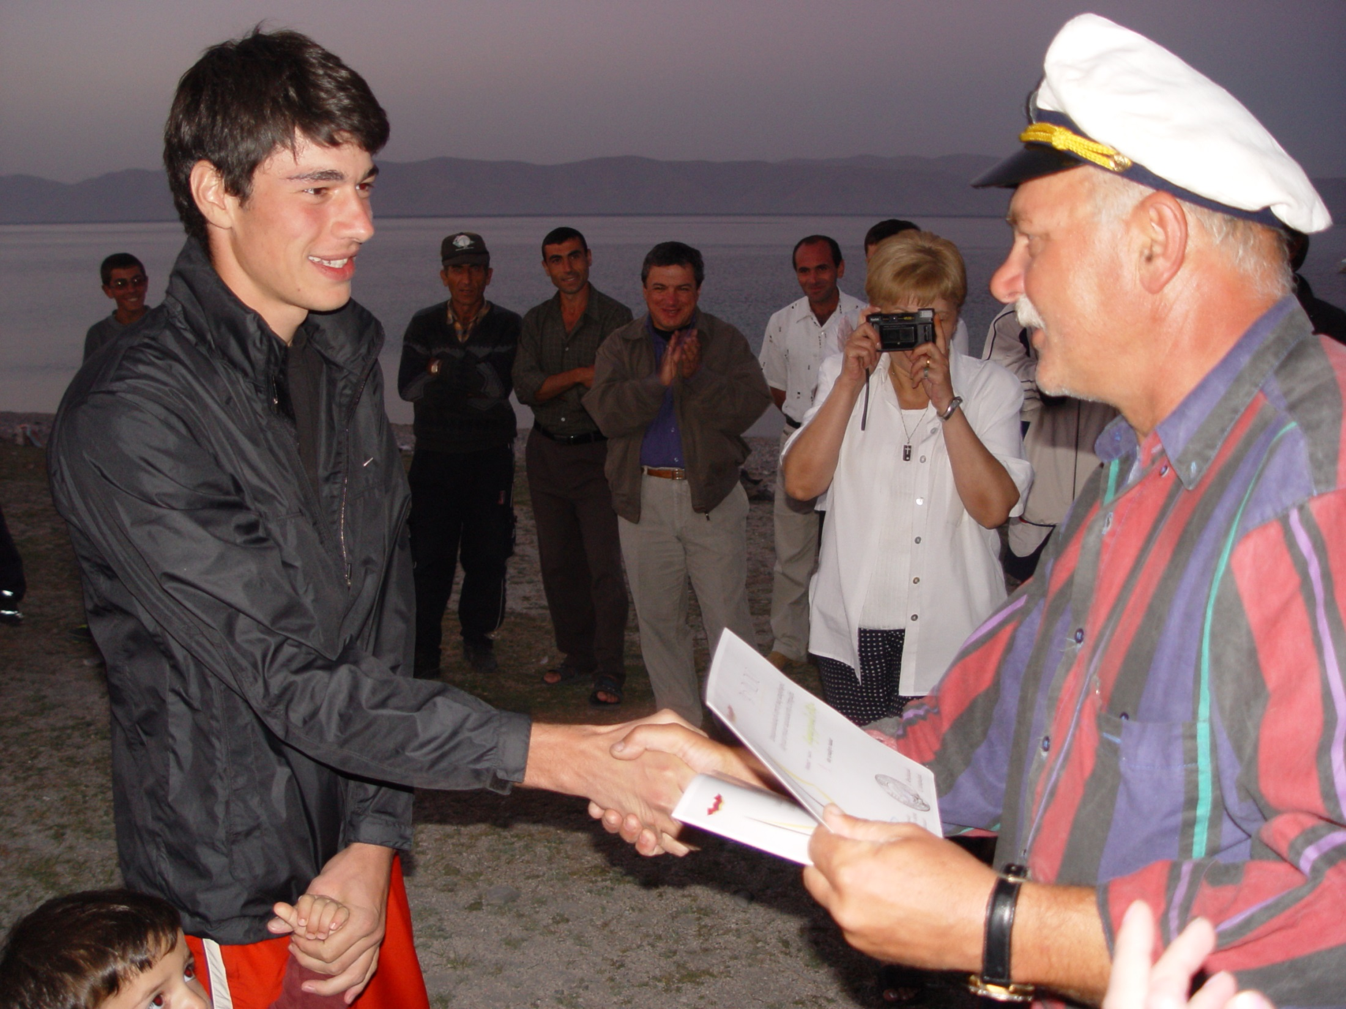

Slide 40
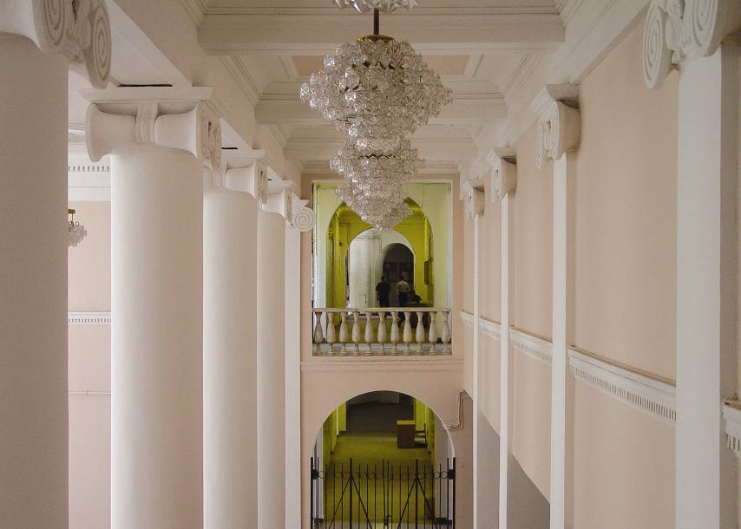
Thank you for visiting National Polytechnic University of Armenia

Slide 41
Thank you

