Slide 1
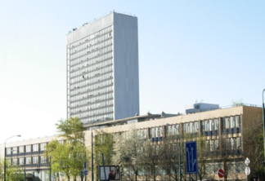
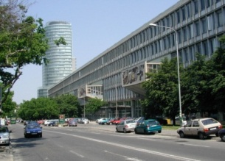
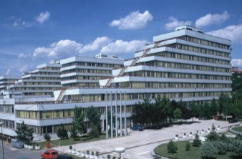
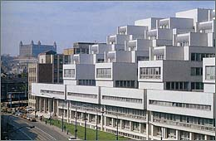
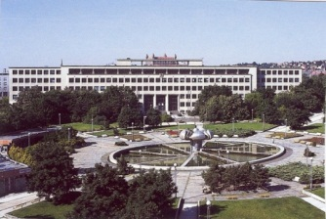
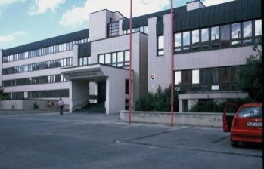
WELCOME...
SLOVAK UNIVERSITY OF TECHNOLOGY
IN BRATISLAVA
Notes:
1

Slide 2
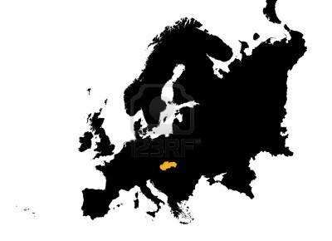
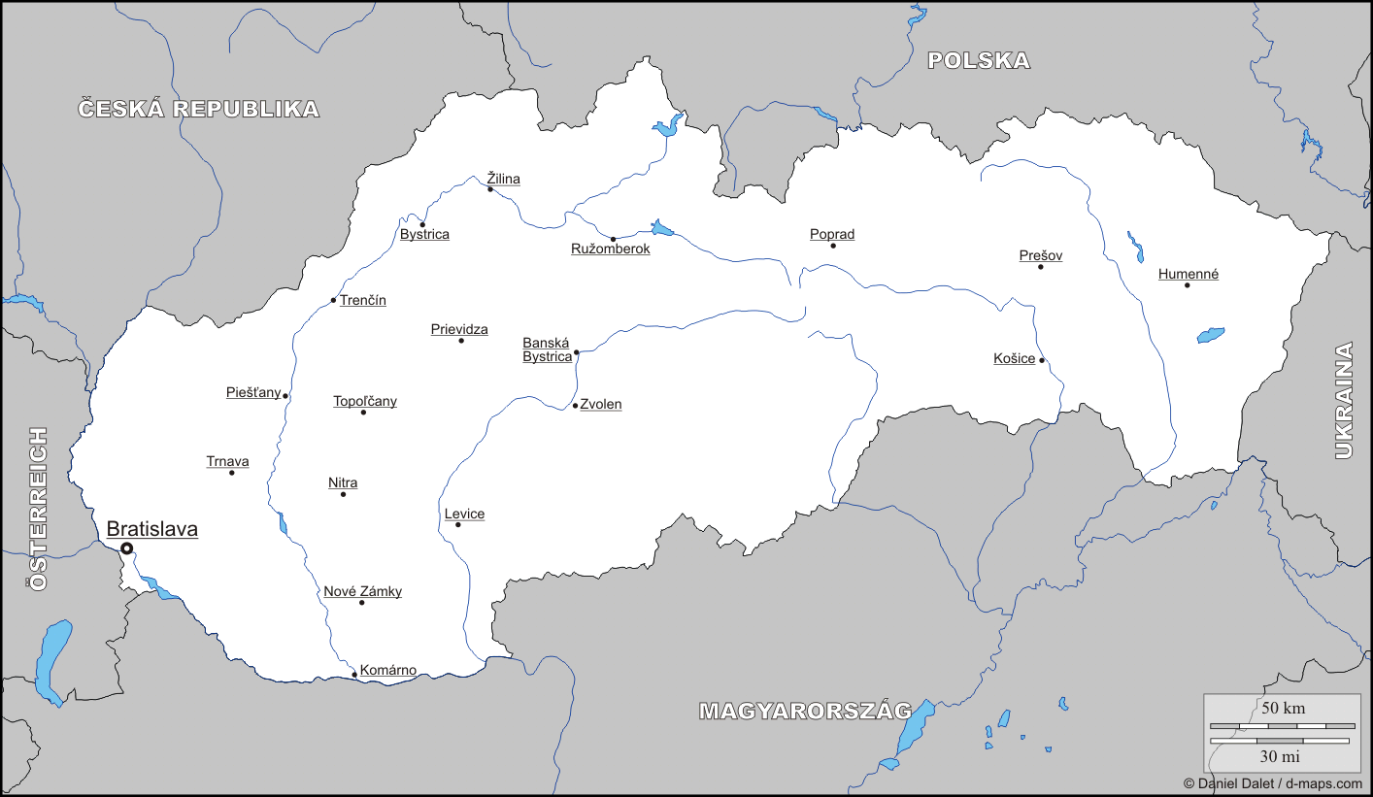
SLOVAKIA

Slide 3
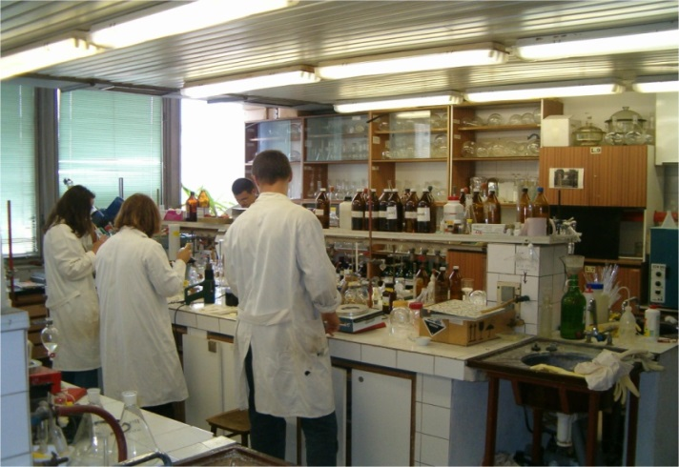
STU nowadays
STU offers:
unity of education and scientific research, engineering and arts
theoretical-practical learning methods (link to Mining academy
in Banská Štiavnica)
direct cooperation with industry & strong international links
STU in numbers:
147 100 graduates
15 400 students
1 412 teaching and research staff
766 state research projects
500 industrial contracts
100 international projects
7 faculties (schools)
1 university institute

Slide 4
Faculties and University Centres
Faculty of Civil Engineering
Faculty of Mechanical Engineering
Faculty of Electrical Engineering and Information Technology
Faculty of Chemical and Food Technology
Faculty of Architecture
Faculty of Materials Science and Technology in Trnava
Faculty of Informatics and Information Technologies
Institute of Management
Lifelong Learning Institute
University Research Park , Know-How Centre, Project Centre
Multimedia Centre, Computing Centre, Publishing House,
Student Houses, Academic Sports Centre
Notes:
4

Slide 5
Current teaching offer
Building services study program
Field of study: SVF 5.1.4 Building Structures
Faculty: Faculty of Civil Engineering
Study Mode & length of study (years): full-time (2)
Language in which the course is taught: slovak
Qualification awarded: inžinier (Ing.)
Level of qualification: 2nd cycle
Key Learning Outcomes:
Acquisition of knowledge in field of theory and creation of technical facilities of the buildings and systems of the environment technology in architectural work, acquisition of knowledge on principles of technical facilities of the buildings, physical effects which take place in production and distribution of the heat, electricity and cool within supplying the building with water and sewage, knowledge on interactions between individual systems and facilities of the technology of building environment following the control systems with varying level of control and transfer of information.
Notes:
5

Slide 6
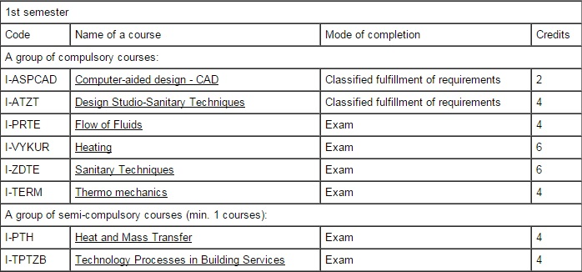
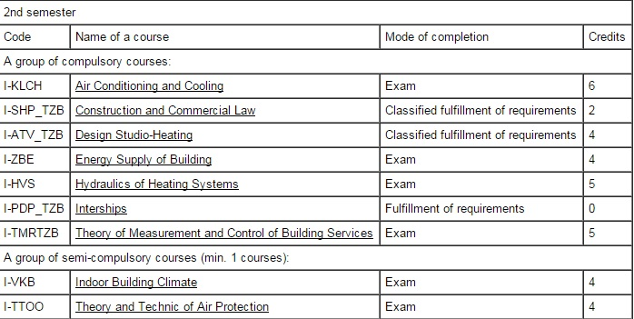
Course structure diagram

Slide 7
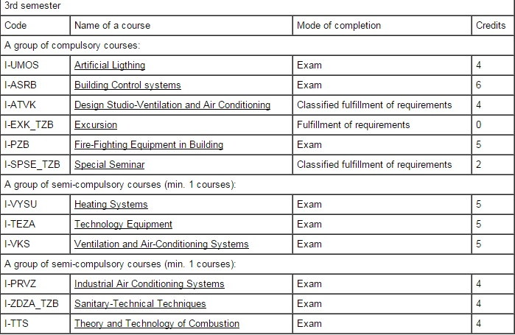
Course structure diagram

Slide 8
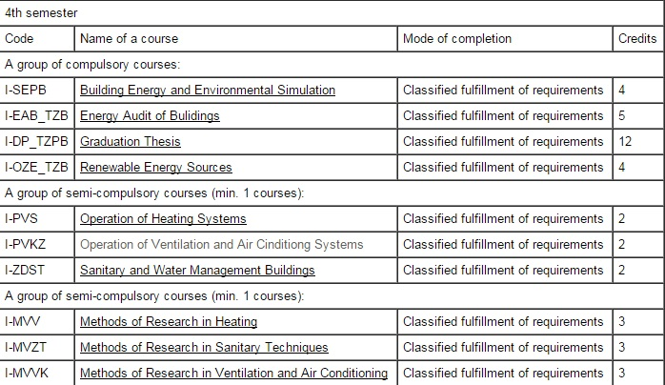
Course structure diagram
Vložte názov prezentácie

Slide 9
Current teaching offer
Theory and environmental technology of buildings study programe
Field of study: SVF 5.1.4 Building Structures
Faculty: Faculty of Civil Engineering
Study Mode & length of study (years): full-time (4), part-time (5)
Language in which the course is taught: slovak, english
Qualification awarded: doktor (PhD.)
Level of qualification: 3rd cycle
Key Learning Outcomes:
Acquisition of knowledge on problematics of theory and creation of technics of the environment in the architectural work and in construction as such, on physical phenomenons, which characterize supply of water, gas, heat and cool. Ability to create and experimentally analyse the inner environment in intelligent buildings.

Slide 10
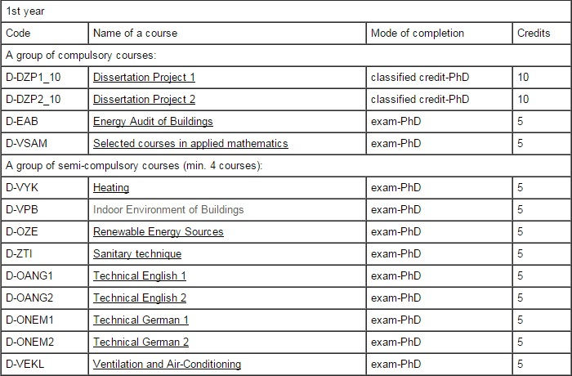
Course structure diagram

Slide 11
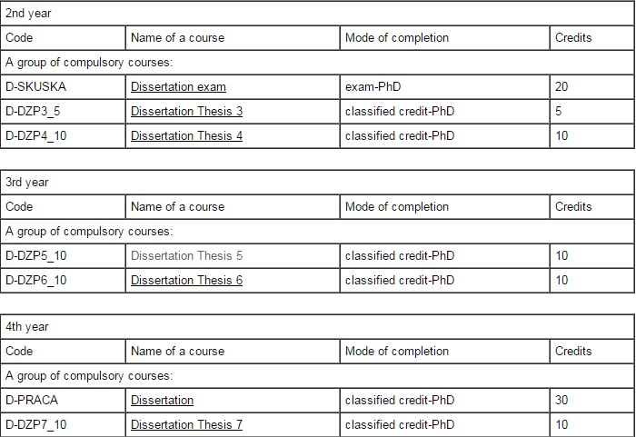
Course structure diagram

Slide 12
Bachelor study programs:
Building Technology and Management
Buildings and Architecture
Hydraulic Engineering and Water Resources Management
Structures for Creation and Protection of the Environment
Civil Engineering
Master study programs:
Environmental Technology of Buildings
Structures for Land Protection
Another relevant courses

Slide 13
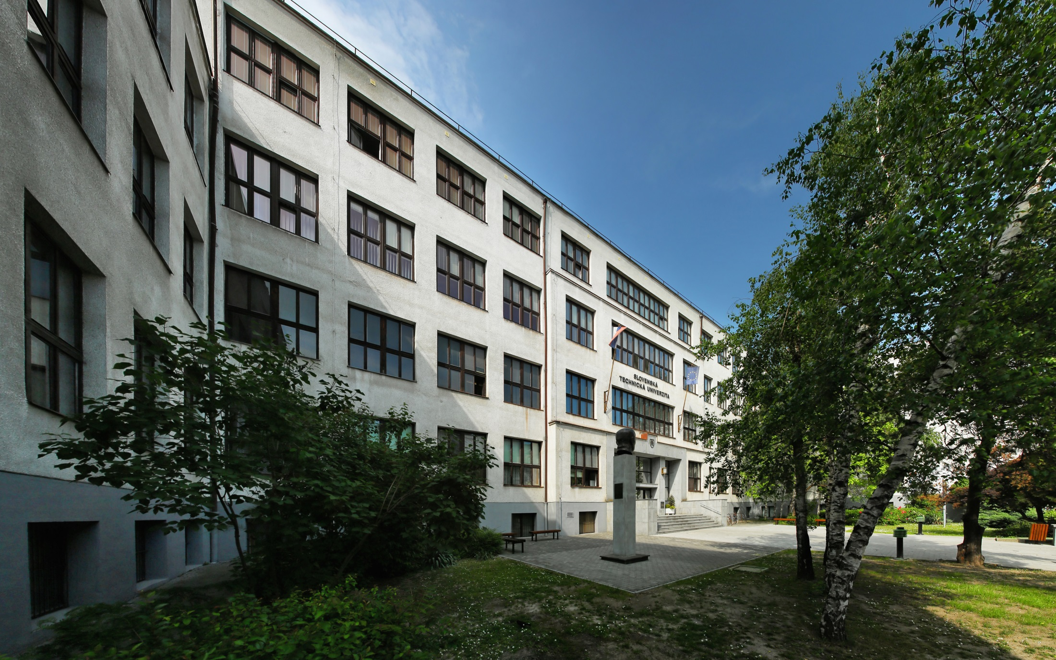
SLOVAK UNIVERSITY OF TECHNOLOGY IN BRATISLAVA
Vazovova 5
812 43 Bratislava 1
Slovak Republic
www.stuba.sk
Notes:
výsledky ARRA, snaha o zahraničných študentov

