Slide 1
SOUTH URAL
STATE UNIVERSITY
(National Research University)

Slide 2
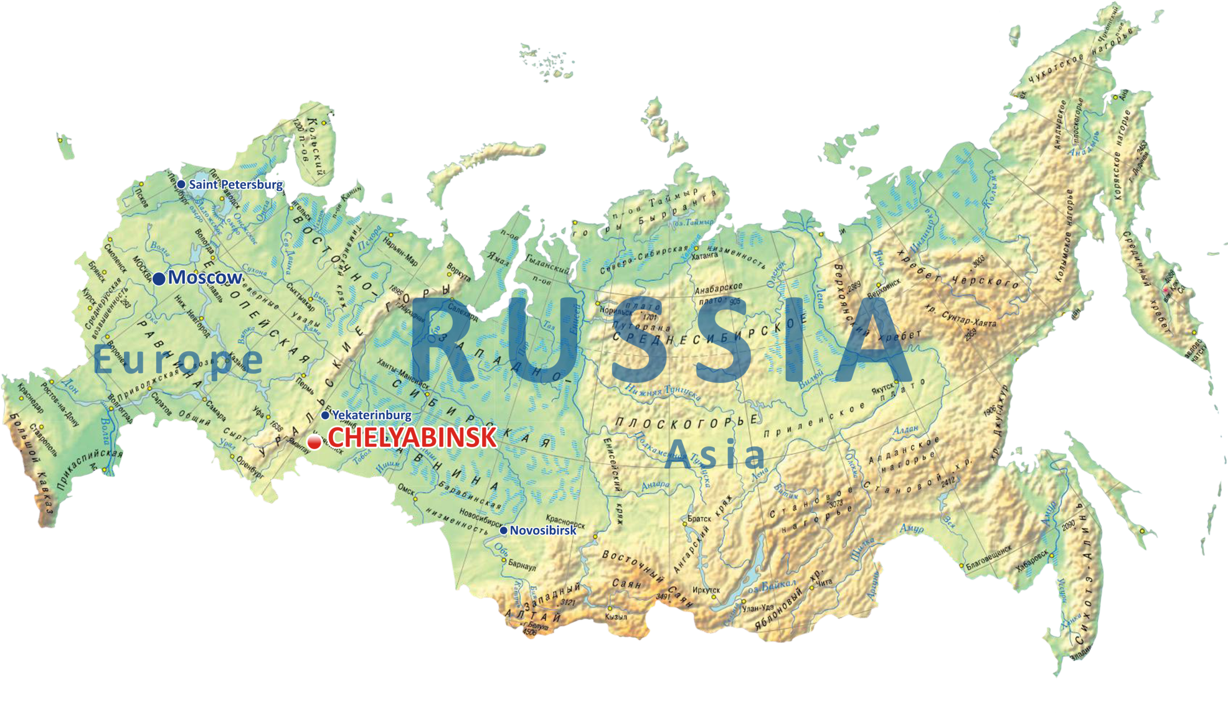
Geographical Position

Slide 3
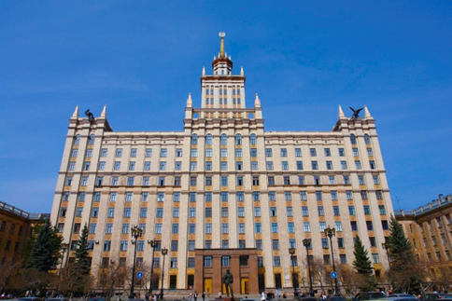
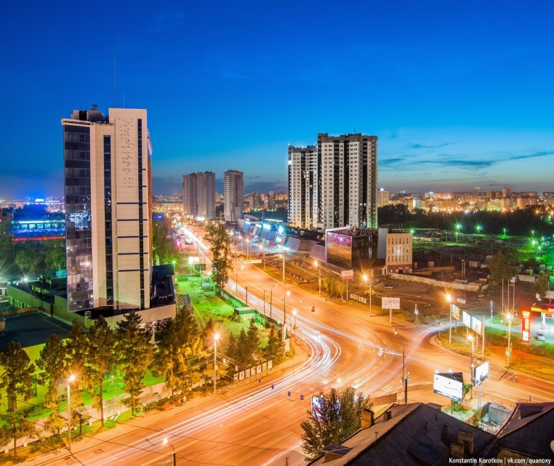
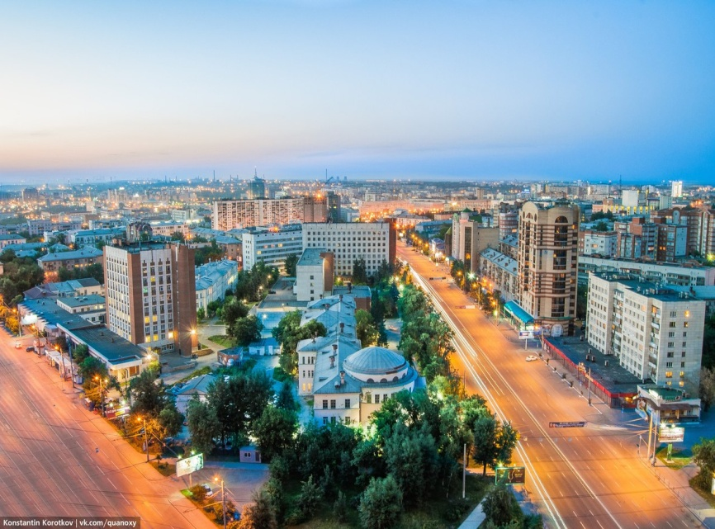
Chelyabinsk
Founded in 1736
Population 1 183 387 inhabitants
Business, scientific and cultural
center of the South Urals
One of the well-designed cities

Slide 4
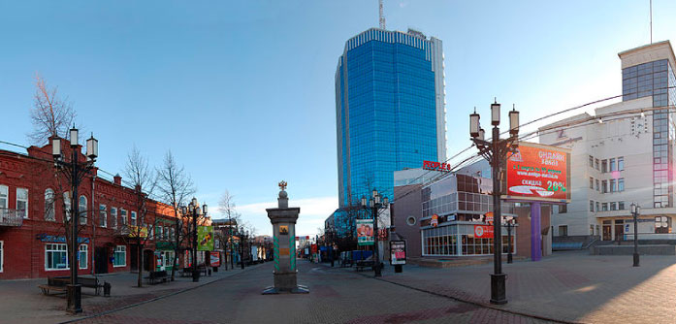
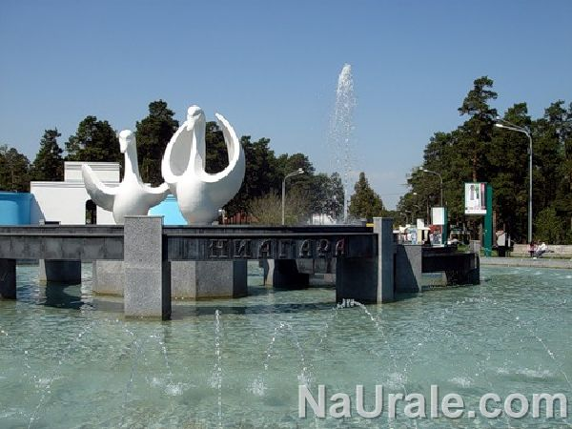
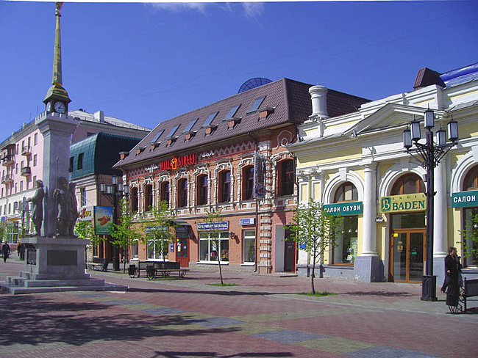
Cultural life in Chelyabinsk

Slide 5
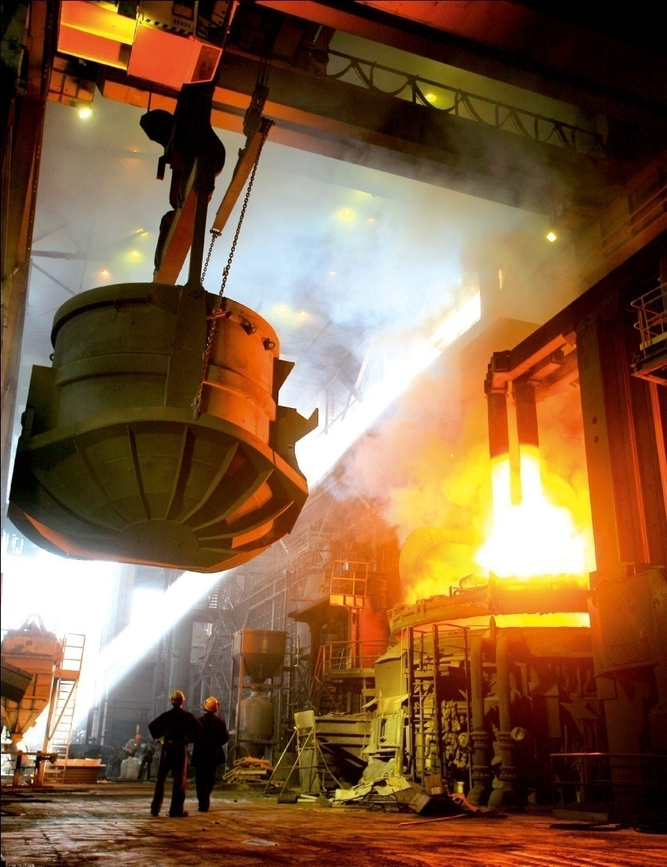
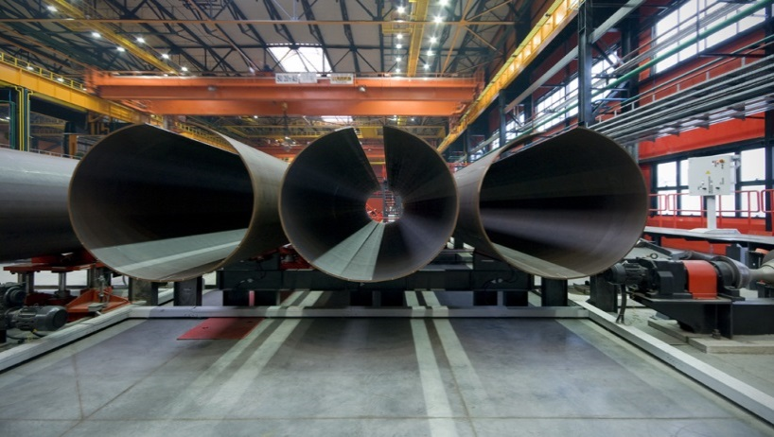
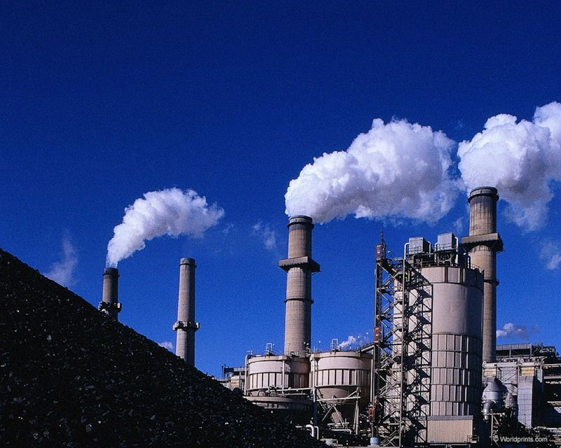
Branch structure of industrial production in Chelyabinsk region
Ferrous metallurgy - 53%
Mechanical engineering and metal processing - 17%
Electric power engineering - 9%
Nonferrous metallurgy - 7%
Constructional materials industry - 3%
Food industry - 5%
Other - 6%

Slide 6
CHELYABINSK REGION ECONOMY
Region power base is represented by a few powerful thermal power plants.
The Mechanical engineering is one of the priority industries of the Chelyabinsk region. Engineering plants produce more than 12% of industrial output.
In Russia the Chelyabinsk Region occupies:
- 4th place in the volume of industrial production,
- 9th place in building.

Slide 7
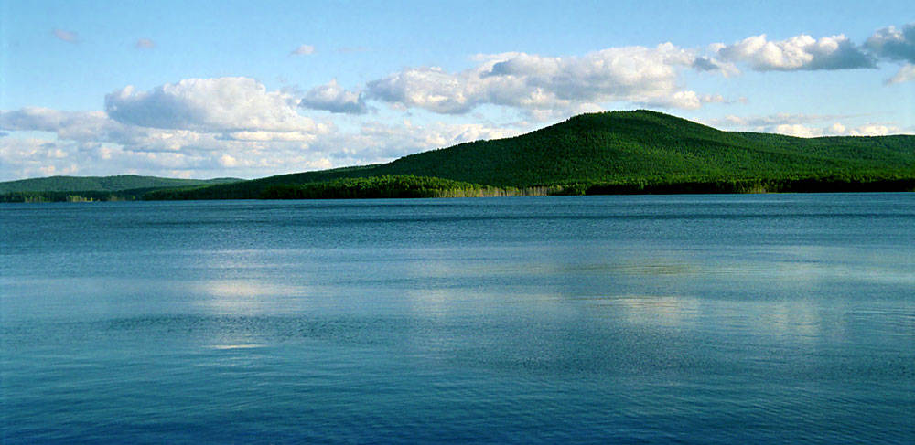
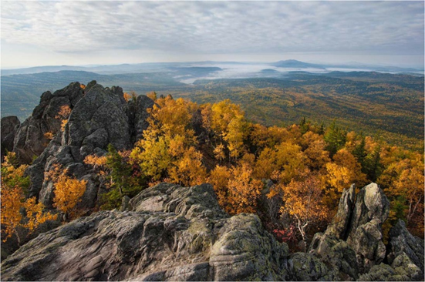
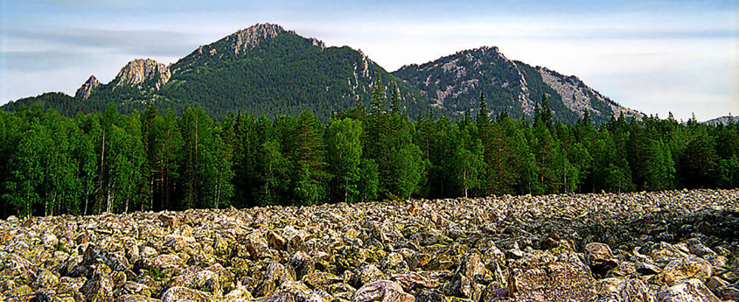
Combination of Nature
&
Science
More than 3 500 lakes in the region
More than 200 hectars of National Parks and Nature reserves

Slide 8
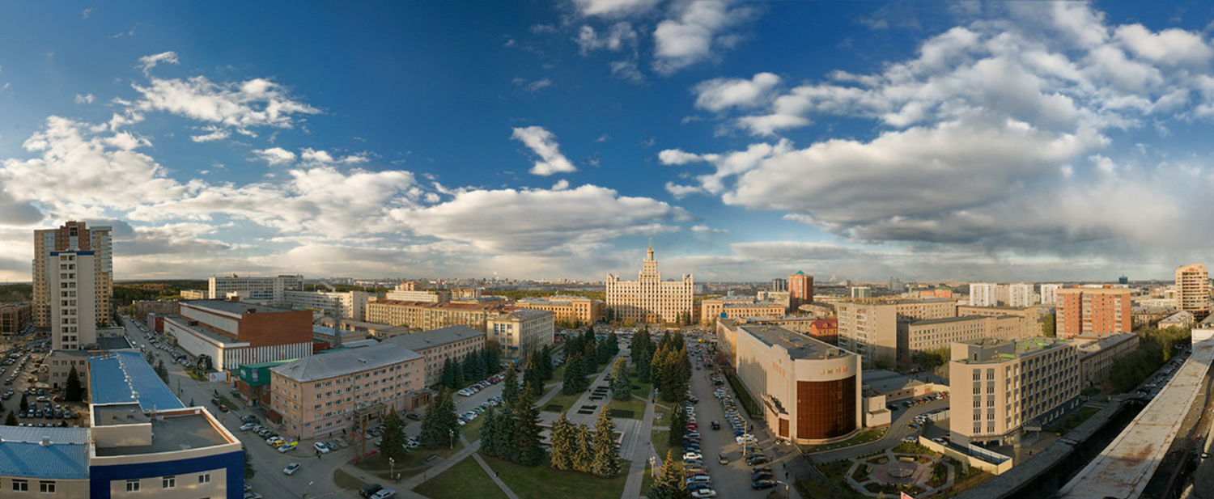
SOUTH URAL STATE UNIVERSITY
NATIONAL RESEARCH UNIVERSITY

Slide 9
General information
Member of national 5-100 and NRU
National Research University ( since 2010)
35 700 enrolled students
2 000 international students from 31 countries
5 000 employees
Over 200 000 alumni

Slide 10
University World ranking
Top-200 Universities in QS- BRICKS
TOP-30 Russian Universities in Webometrics
Interfax – 62
Expert RA– 42
QS BRICS – 151-200
RankPro – 412

Slide 11
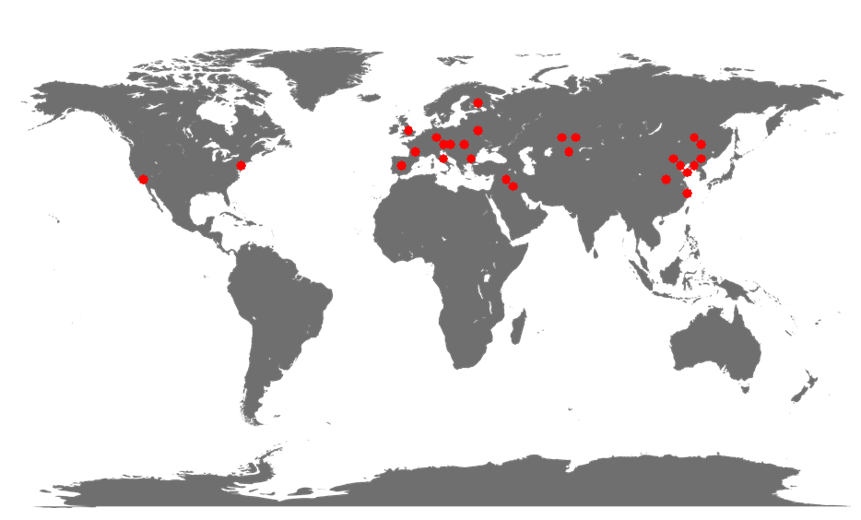
SUSU general international partners

Slide 12
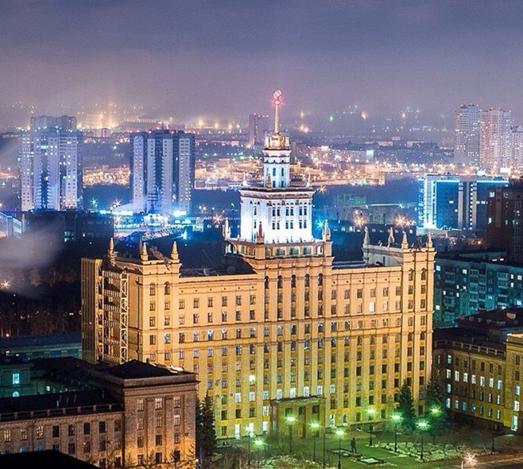
Education at SUSU
32 academic unites
10 branches
200 bachelor and master’s degree programmes,
3 english master’s degree programmes
91 PhD programmes and 13 doctoral degree
programmes

Slide 13
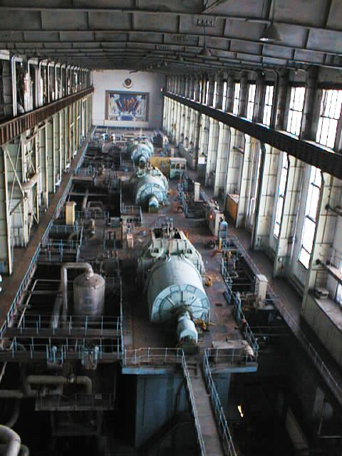
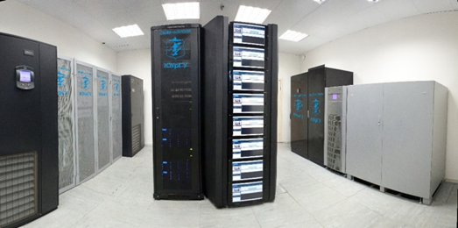
SUSU science and research
9 world-class innovative laboratories
Nanotechnologies,
Supercomputer,
Experimental mechanics,
Tribotech,
Physical Modelling of Thermomechanical Processes,
Plant-Web, opened in cooperation with Emerson Corporation
Research priorities – aerospace engineering, supercomputer simulation, life sciences
Development and introduction of the “Smart university” concept

Slide 14
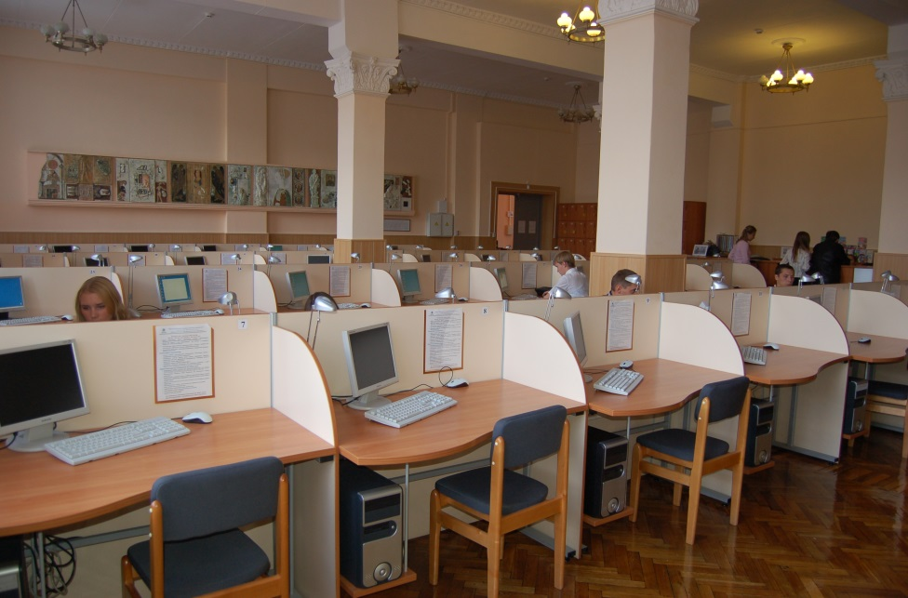
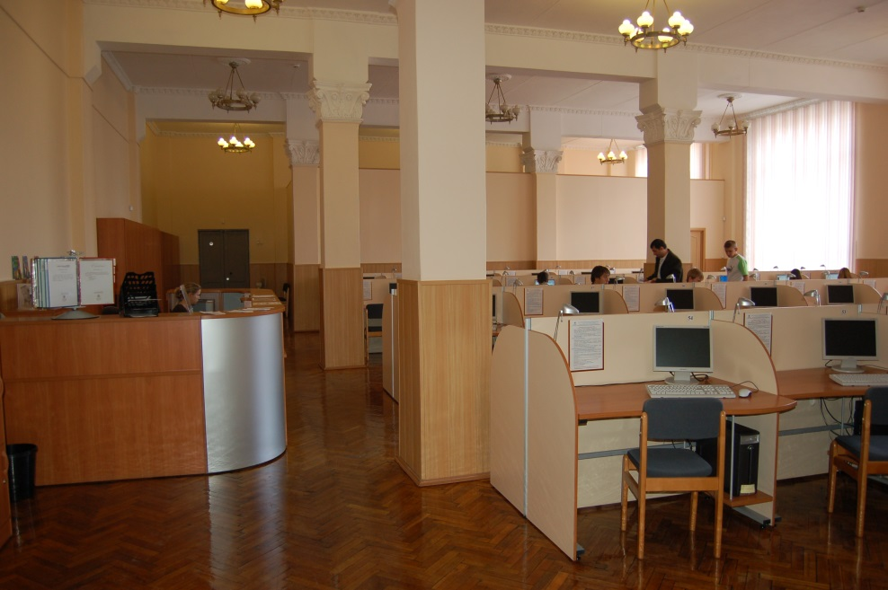
SUSU Library
Quantity of the SUSU Uniform library stock makes of more 2.5 million copies

Slide 15
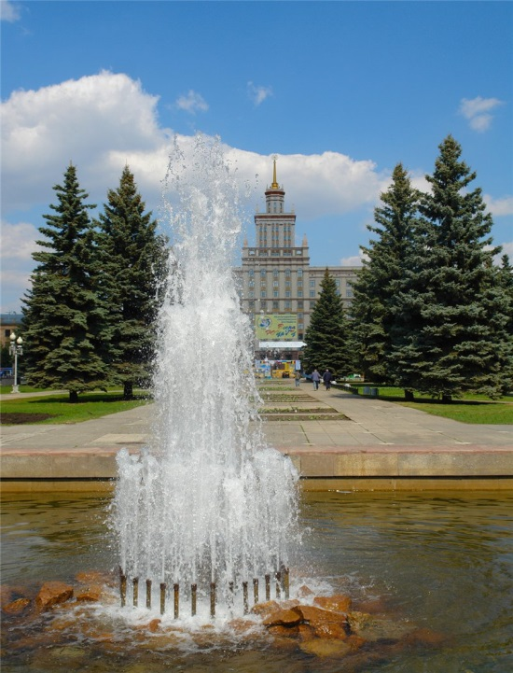
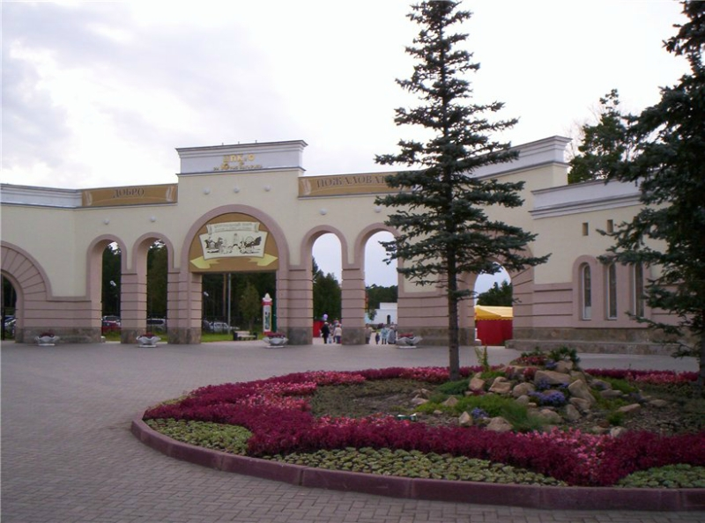
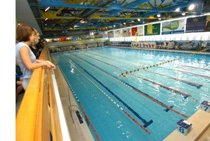
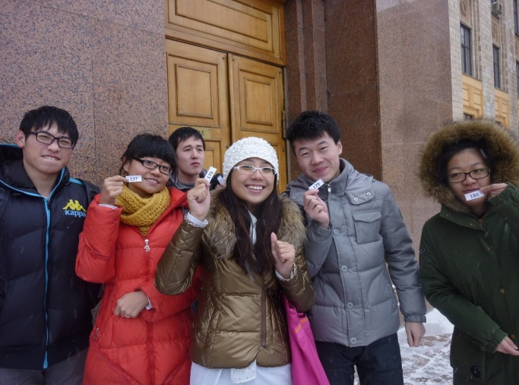
SUSU Campus
Located in the city center
Close to city parks
Plenty of activities and recreation
International student body

Slide 16
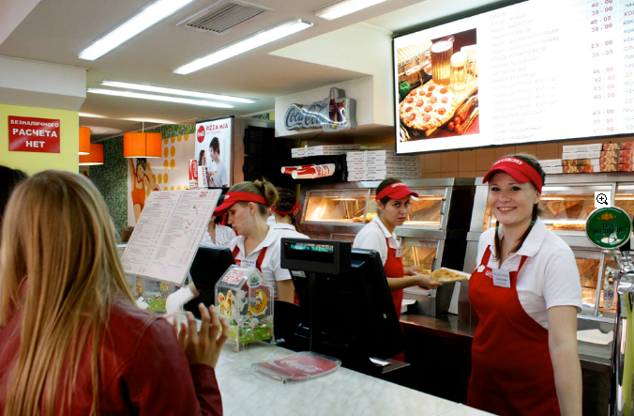
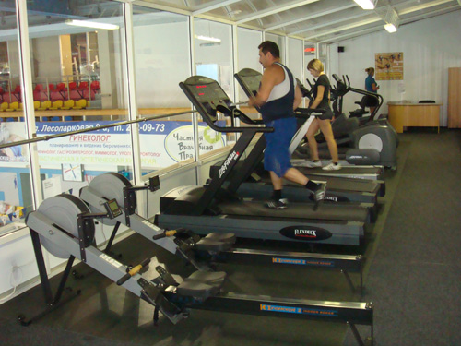
SUSU Campus is one of the best and biggest complex in Russia.
SUSU Campus comprises:
9 Buildings equipped with all the needed facilities,
Medical center
Sport center with Olympic-size swimming pool
A wide range of cafes and restaurants nearby

Slide 17
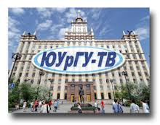
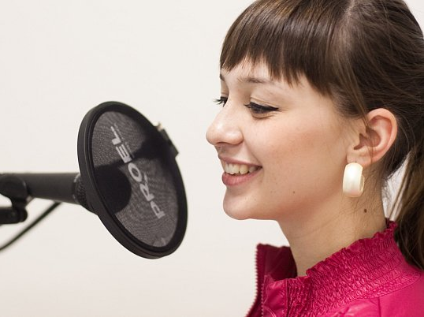
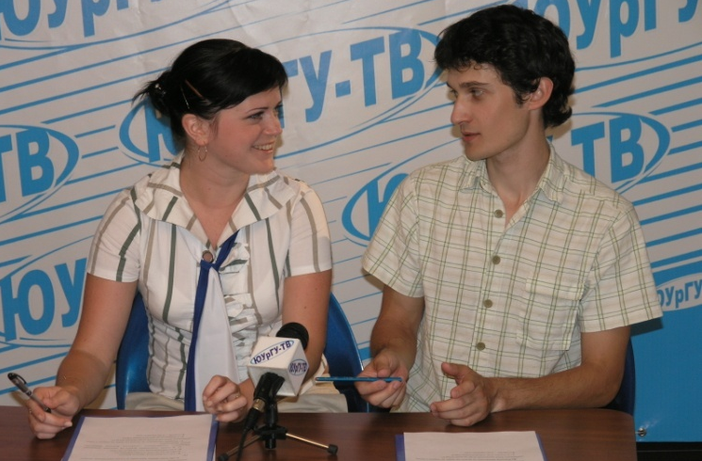
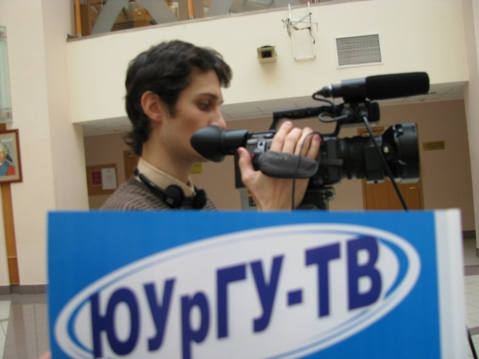
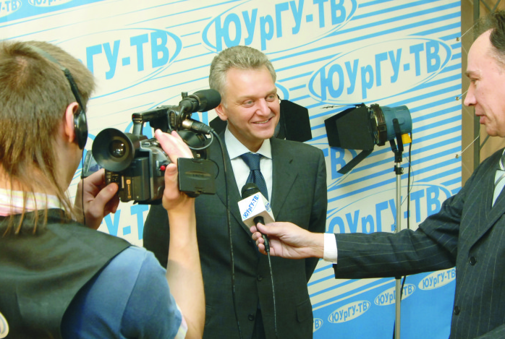
SUSU-TV and Radio
SUSU has a personal broadcasting company - SUSU-TV.
It is the only university broadcasting company in Russia.
tvr.susu.ac.ru

Slide 18
Faculty of
Architecture
and construction
Founded in 1952

Slide 19
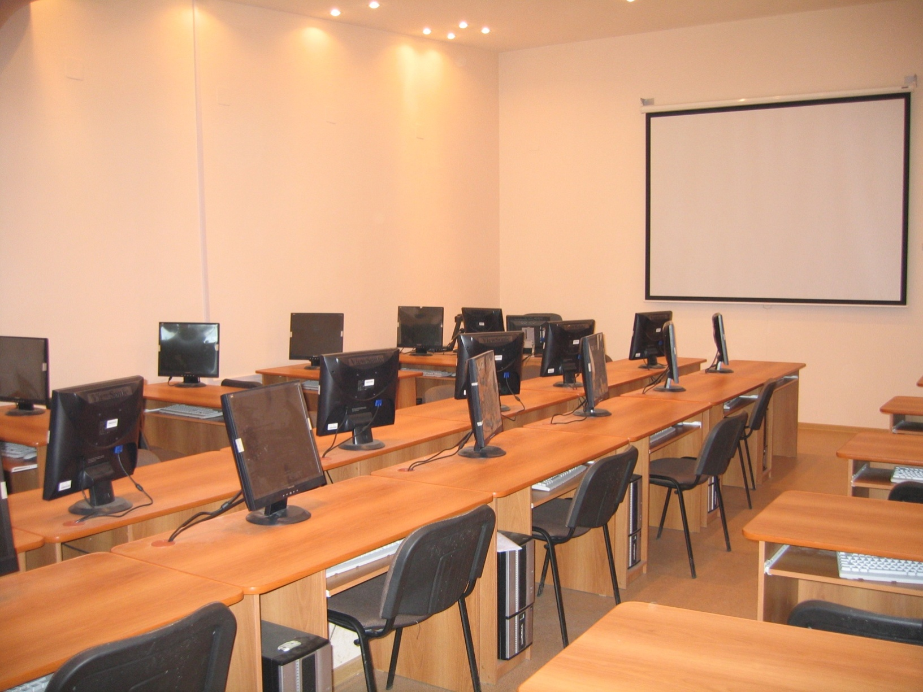
Civil Engineering Faculty
Has 7 Departments:
«Civil Engineering»;
«Construction Mechanics»;
«Construction Management »;
«Urban Planning»;
«Construction Materials»;
«Heat and gas supply and ventilation»;
«Water supply and sewage»;
18 Doctors of Science, Professors and 67 PhD, Associate Professors;
All Departments have the training centers, are well equipped with modern testing facilities from the international manufacturers;
Departments are cooperating with the leading Universities and construction companies in China, Germany, Sweden, Denmark, Finland, Hungary and other countries.

Slide 20
qualifications, majors and specializations
Qualification – bachelor, period of studying – 4 years
(based on high school graduation)
Programme «Construction».
Specializations:
Industrial and Civil Construction;
Computer-aided Design of Buildings and Constructions;
Urban Construction and Municipal Facilities;
Production of Building Materials, Products and Structures;
Water Supply and Water Disposal;
Highways;
Expert Examination and Property Management;
Technical Operation of Objects of Housing and Public Utilities.

Slide 21
2. Programme «Land Arrangement and Urban Planning».
Specialization: «Urban Planning».
3. Programme «Heat and Power Engineering and Thermotechnics».
Specialization: «Heat and Power Engineering and Thermotechnics».
Qualification – specialist,
Period of studying – 6 years
(based on high school graduation)
Programme: «Construction of Unique Buildings and Structures».
Note: Unique Buildings are large span structures, multi-storey buildings, underground and special constructions and buildings.
Specialization: «Construction of multi-storey and large span structure buildings».

Slide 22
qualification – master Degree, period of studying – 2 years
Major «Construction».
Main educational programs:
The theory calculations and CAD of engineer constructions, buildings and structures
Materials and methods of industrial and civil construction
Theory and practice of organizational, technological and economic solutions
Water supply and water disposal
5. Theory and practice of maintenance systems construction for buildings microclimate

Slide 23
Ph.D STUDIES, PERIOD OF STUDYING– 3 years
8 Educational programs:
«Civil Engineering»;
«Construction Mechanics»;
«Construction Management»;
«Construction Materials»;
«Land hydrology, water resources, hydrochemistry»;
«Landing Arrangement, Urban Planning»;
«Mathematic modeling, numerical method and program complexes»;
«Industrial Heat and Power Engineering».

Slide 24
PROGRAMME “GREEN BUILDING”
(ENERGY EFFICIENT BUILDING)
Programme 08.04.01 Construction (Academic master’s degree).
Master’s degree programme Theory and practice of organizational, technological and economic solutions.
Specialization Modern problems of construction science and technology.
Content:
The concept of science, engineering and technology. Engineering heritage in the works of Russian scientists. Organizational structure of business science. System of regulative documents. Research in SUSU at Architecture and construction faculty. Sustainable development of territories. Green building standards. Energy efficiency and conservation. Principles of passive house. Advantages and disadvantages of constructive-technological systems in civil engineering. Safety and security of building complexes.

Slide 25
Specialization 2.02.01 Energy efficiency and conservation in building processes
Content:
Legislation on energy saving energy efficiency improvements
in the Russian Federation and Europe. System of regulative documents in the
sphere of energy efficiency and conservation. Governmental control in the sphere of
energy conservation and energy efficiency improvements. Energy efficiency support in
buildings, constructions and facilities. Energy inspection. Performance contracts.
Energy efficiency measures to improve energy efficiency. Alternative energy sources.
Government control for compliance with the law on Energy Conservation and
Energy Efficiency Improvement.
Specialization Modern technologies of system compositions to insulation of the fronts of buildings
Content:
Legislation and regulative documents in the sphere of energy-saving and improvement of energy efficiency. Technologies of green suspended facades. Floor area, rooftops and doors insulation. Adjustment of innovative insulation: vacuum panels, metallic microarray, aerogel. Principles of green building. Technology of smart building.

Slide 26
Specialization Innovation building in the construction building
Content:
Functional and cost analysis of construction systems. Derivative laws of engineering systems. Contradiction and efficiency improvement of construction systems. Evolution dree derivation. Analysis methodology and perfection of building technologies. Software programme “System analysis and design”. Examples of FCA of residential house, construction 3D printer, detailed project execution plan, principles of green building.
Specialization Green building and sustainable development of territories (planned)
Content:
Standard categories of green building: comfort and quality of outside environment, quality of architecture and facility design, control and ecology of internal environment, quality of sanitary safety and recycling of wastes, water conservation, energy efficiency and energy saving, application of alternative and renewable energy, development exploitation and utilization of facilities, economic efficiency, quality of preparation and project management. Compliance assessment as per GOST Р 54964-2012 standard.

Slide 27
Programme “Heat-power and thermal engineering” (Bachelor’s programme)
Specialization “Heat and gas supply and microclimate of buildings”
Discipline “Energy conservation in heat-power and thermal engineering”.
Within the discipline the following issues are discussed: methods and criteria of assessment of energy recovery efficiency; regulation of energy consumption; energy-efficiency measures during generation, transportation and distribution heat of energy; usage of secondary energy resources; basis of energy audit; prospects of design and construction of “Green buildings” in Russia.

Slide 28
Programme “Heat-power and thermal engineering” (Master's program)
Specialization “Theory and practice of systems construction of ensuring microclimate of buildings”
Disciplines:
1. “Energy audit in the systems of ensuring microclimate of buildings”: objectives, types, methodology and peculiarities of carrying energy inspection of buildings in total and engineering systems in particular, and basic activities on energy resources efficiency
2. “Energy efficiency in the systems of ensuring microclimate of buildings”: In matters of design and construction of “Green buildings” in the process of studying the discipline the following issues are discussed: efficient use of energy and water resources; use of environmentally friendly building materials; waste products, emissions and other environmental impacts reduction; use of building materials of local origin (reduction of environmental damage from transportation of materials); use of renewable energy sources to provide energy needs for heating, hot water and air conditioning (solar energy, wind energy, geothermal energy, low potential energy of soil, water, exhaust air, etc); use of modern engineering equipment and automation systems;

Slide 29
THANK YOU FOR YOUR ATTENTION!
Cooperation proposals at deevav@susu.ru
Cooperation proposals at ulrikhdv@susu.ru
Website http://www.susu.ru/en
Prepared by Architecture and Construction Department
Prepared by International Affairs Division

