Slide 1
“MARUEEB: Master Degree in Innovative Technologies in Energy Efficient Buildings for Russian & Armenian Universities and Stakeholders”
TICASS’s Activity

Slide 2
TICASS Regional innovation hub
TICASS – acronym for Innovative Technologies for Environmental Control and Sustainable Development - is a non-profit Consortium established in March 2010, composed of research authorities and large, medium and small companies.
TICASS performs, promotes and enhances research activities, as well as transferring excellence technologies in the "Energy and Environment" area with regards to Sustainable Development and Quality of Life.
The consortium role is also the coordination of the above mentioned activities at regional, national and international level. Its main goal is to widen knowledge and introduce innovative technologies by the cross-border cooperation, with universities and other public and private bodies.

Slide 3
TICASS Regional Research and
Innovation Hub…..
Ticass is a non-profit Consortium including public research bodies (Departments of the University of Genoa), SME's and large Companies. It is the core of the regional Innovation Hub "Energy and Environment" supported by ERDF in the Liguria Region in Italy. Ticass is finalized to carry out, promote, diffuse, transfer and exploit research and innovative technologies for:
- Support to regional stakeholders and focus on resources - Environmental Control and Management - Sustainable Products and Processes
- Materials
- Horizontal Activities (Blue energy, ICT and processes control, etc.)

Slide 4
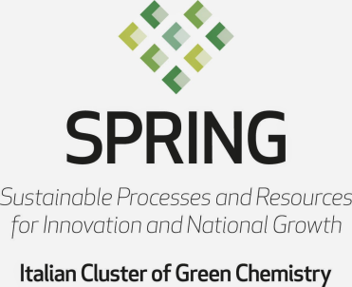
Ticass activities:
Research & Development: European, national and regional research projects;
Training: University master, Life long training, professional courses, Tempus, Erasmus + projects;
Technology transfer: conversion adaptation and exploitation of research’s outcomes to match concrete industrial requirements and to solve technical and production issues
Provision of services for SMEs and Large Companies
Networking: members of two National technological Clusters, European technology platform for water….

Slide 5
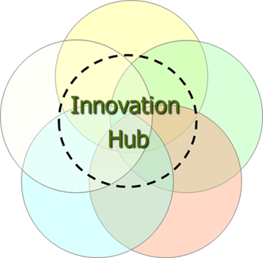
Small Companies
INDUSTRIA AMBIENTE
CRSAAA
Active Cells
ITEC
ANALISI e CONTROLLI
ANTEA
Large Companies
GIS & WEB
SERVIZI ECOLOGICI
EUROCHEM
FRIGOMAR
Archimede Ricerche
Medium Companies
SIIT/PMI
GISIG
IREOS LABORATORI
BOERO
P & T
SIGE
Muvita
CPG Lab
PM Ten
Micamo
Giuseppe SANTORO
SEPG
ARCADIA
ITALIANA COKE
Biotec Sistemi
IREOS
FONDAZ. CIMA
FONDAZ. AMGA
ISTITUTO ITALIANO SALDATURA
AMIU
A&A F.llI PARODI
IPLOM
IRENAcqua Gas
FACI
Circle CAP
University of Genoa;
CNR; INFN; CeRSAA

Slide 6
How do we do, Ticass’s approach:
Market driven approach;
Early involvement of companies and SMEs to collect industrial inputs;
Interdisciplinary approach to supply a complete useful answer to concrete problems;
Open access to competences and skills of the University of Genova and National Research Council;
Development of multidisciplinary and culturally diverse work team specifically targeted for each project;
Support the interaction and relationship development between University and Industry;
Development of organizational tool to foster technology transfer and trust generation.

Slide 7
Experience in the Training field
Post graduate training;
European projects (Netwater, GreenMA, GeoSmartCity…);
Research Grants (coordination of 11 research grants, involving 22 companies, of which 10 SMEs);
Scouting regarding instruments, incentives and concessions supporting work placement.

Slide 8
Post graduate training
Water Treatment;
Environmental monitoring;
Registration, Evaluation, Authorisation and Restriction of Chemicals REACH;
Master in Advanced Welding Engineering MAWE;
Intensive course for Russian junior staff in «Energy saving for Environmental Protection and Control“;
Training in Technologies of Water Resources Management

Slide 9
Implementation of GREENMA: Empowerment of Junior Teaching Staff of Russian Partners
24 junior teaching staff members trained in Genoa, intensive course in Sep/Nov 2013;
About ~250 hours of lectures provided
~30 teachers from University and companies involved in the empowerment
Visit to local industrial plants
Broad range of topics covered (engineering and chemical field, up to the economics and - although briefly - Bologna Process)
Final assessment and thesis discussion included in the empowerment action

Slide 10
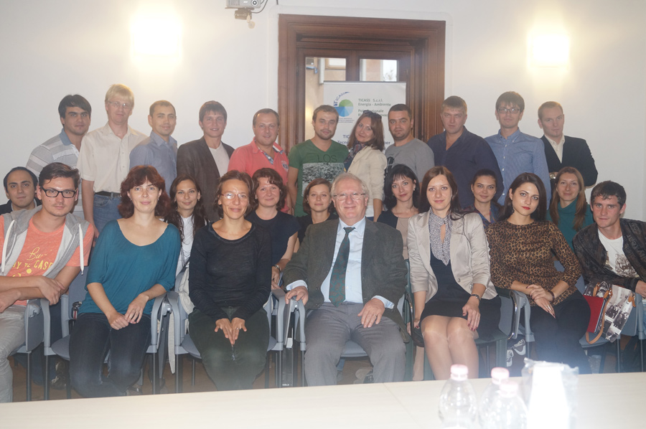
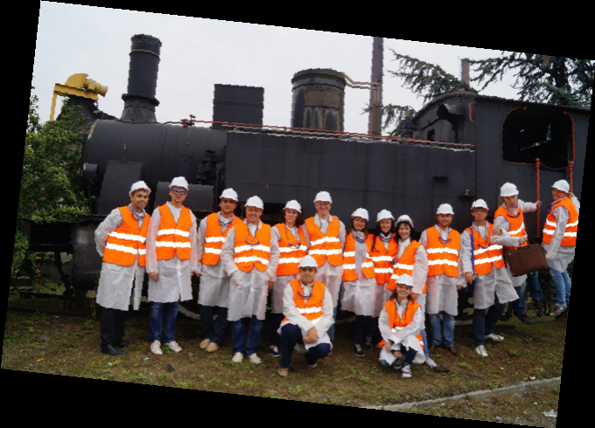
GREENMA
PROJECT
2013/2015

Slide 11
MARUEEB Project – The Ticass Tasks
Joint coordination activities related to the model for professional recognition of degrees & qualification

Slide 12
MARUEEB Project – The Ticass Tasks
Cooperation with UNIGE in the evaluation of the current academic and Lifelong Learning Programme (LLP) offer
Support to the definition and management of training modules of intensive course targeting the ARU junior teaching staff
Participation in some of the above training modules during the delivery of the intensive course to the ARU junior teaching staff

Slide 13
MARUEEB Project - The Ticass Tasks
Elaboration of a model for professional recognition of degrees & qualifications related to the course.
Drafting of the “MARUEEB Model for Environmental Protection and Energy Efficient Buildings”
Distribution of promotional and informative material
Cooperation on activities of the GREENMA and MARUEEB Network

Slide 14
MARUEEB Project - The Ticass Tasks
Networking activities fostering contacts between ARU junior teaching staff and senior teaching staff and between ARU junior teaching staff and the Companies belonging to the Innovation Hub (Ticass) as IRETI Spa, Boero spa, IPLOM spa, and other…

Slide 15
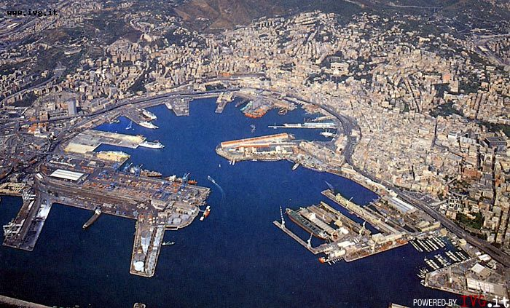
For more information www.ticass.it

