Slide 1

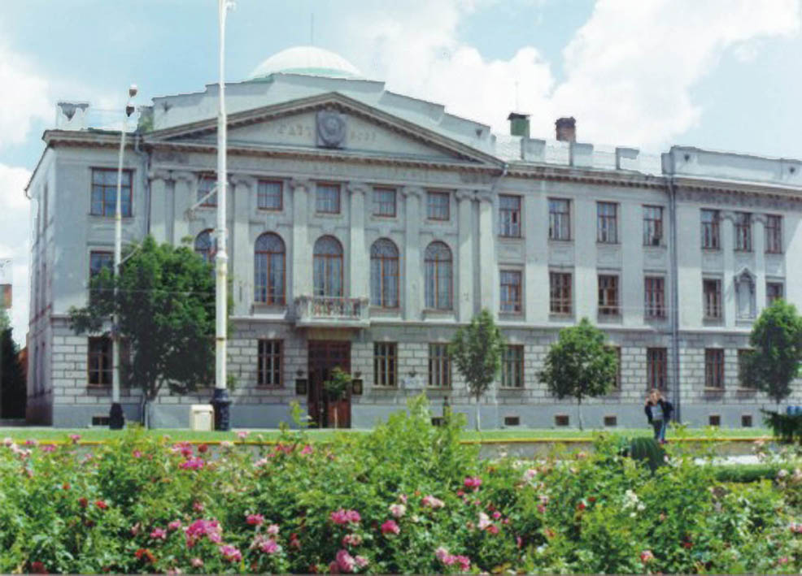
Tambov State Technical University
Since 1958

Slide 2

Background information on TSTU
Total number of students 12 000
Teaching staff 700
Number of institutes 8
Number of departments 49
Number of academic programs 115
Annual number of graduates 1600
Campus area 34 ha

Slide 3
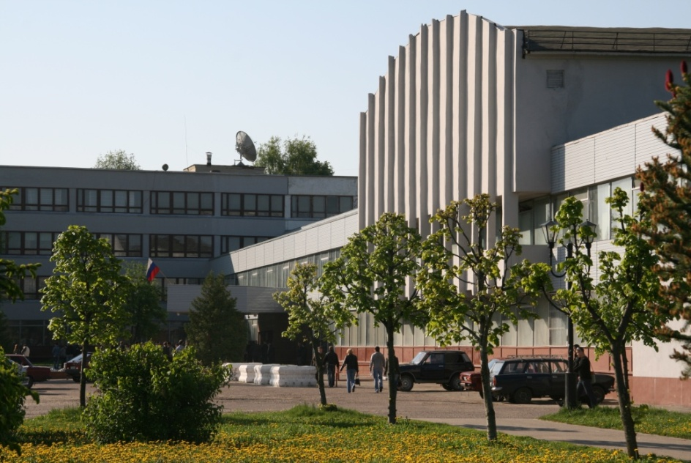
Tambov State Technical University
49 Departments
8 Institutes:
  Technological
  Power Engineering, Tool Engineering and Radio Electronics
  Automation and Information Technologies
  Architecture, Civil Engineering and Transport
  Economics and Quality of Life
  Law
  Study by correspondence
  Additional Professional Education
Qualifications:
Specialist, Bachelor, Master, PhD, Doctor

Slide 4
Tambov State Technical University
TSTU is an active participant of TEMPUS programme having received financing for 12 projects on different topics from European Commission. The most recent are:
“On-line quality assurance of study programmes”
“LLL Training and Master in Innovative Technologies for Energy Saving and Environmental Control for Russian Universities, involving Stakeholders GREENMA”
ON-LINE QUALITY ASSURANCE OF STUDY PROGRAMMES

Slide 5
Tambov State Technical University
Institute of Architecture, Civil Engineering and Transport
Institute is a large university subdivision and has sufficient hardware and staff potential to use for MARUEEB project, 119 teachers are involved in the education process, modern classrooms and laboratories has new equipment. The institute is located in the main campus of TSTU. Institutes’ graduates are famous for their outstanding construction and architectural projects not only in the region but also all over Russia.

Slide 6
Tambov State Technical University
Institute of Architecture, Civil Engineering and Transport (education)
Bachelor Programs - 10
Architecture, Construction, Technology of Transport Processes, Transport Machines and Complexes Maintenance, Agroengineering and others
Graduate Programs – 10
Construction of Unique Buildings and Structures
Construction, Maintenance, Reconstruction and Covering of Highways, Bridges and Tunnels
Construction, Maintenance, Reconstruction and Covering of Highways
Industrial and Civil Engineering,
Urban Construction and Planning
Others
Master Programs - 5
Architecture, Construction, Technology of Transport Processes and others

Slide 7
Tambov State Technical University
Institute of Architecture, Civil Engineering and Transport (education)
In the frames of the above programmes most subjects taught contain the problems of energy saving and environment protection in construction.
The program in TSTU could be named
Design, Construction and Maintenance of Buildings with Passive and Active systems of Energy Saving
2. Design, Construction and Maintenance of Energy Efficient Buildings
«Проектирование, строительство и эксплуатация зданий с пассивными и активными системами энергосбережения»
или
«Проектирование, строительство и эксплуатация аний»

Slide 8
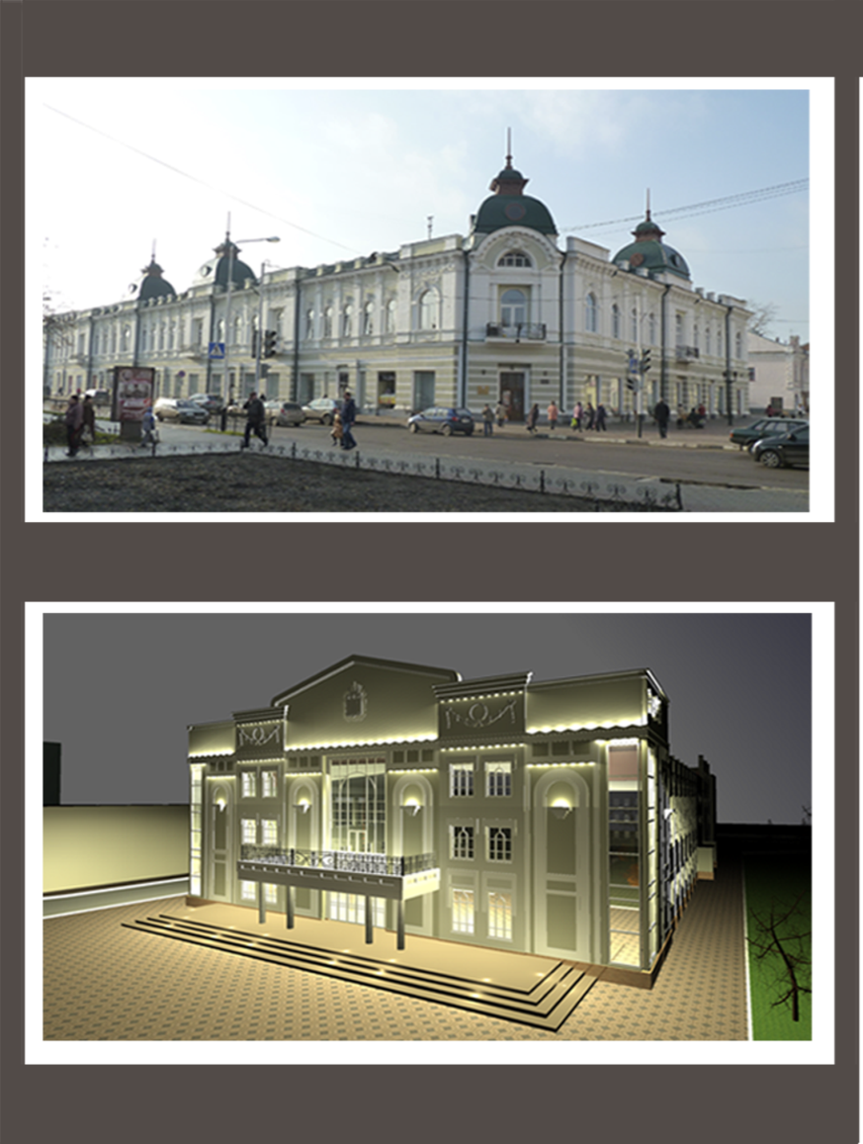
Tambov State Technical University
Institute of Architecture, Civil Engineering
and Transport (research)
The institute conducts research in energy efficiency and energy saving and rational nature management connected with using energy saving systems, development energy efficient building technologies, development energy efficient equipment for fuel production. Development of products with specific construction and heat insulation properties with significant economy of natural resources, power and labour, etc.
Restoration of Merchant M.L. Shorshorov’s House
Restoration of Tambov Regional Concert Hall

Slide 9
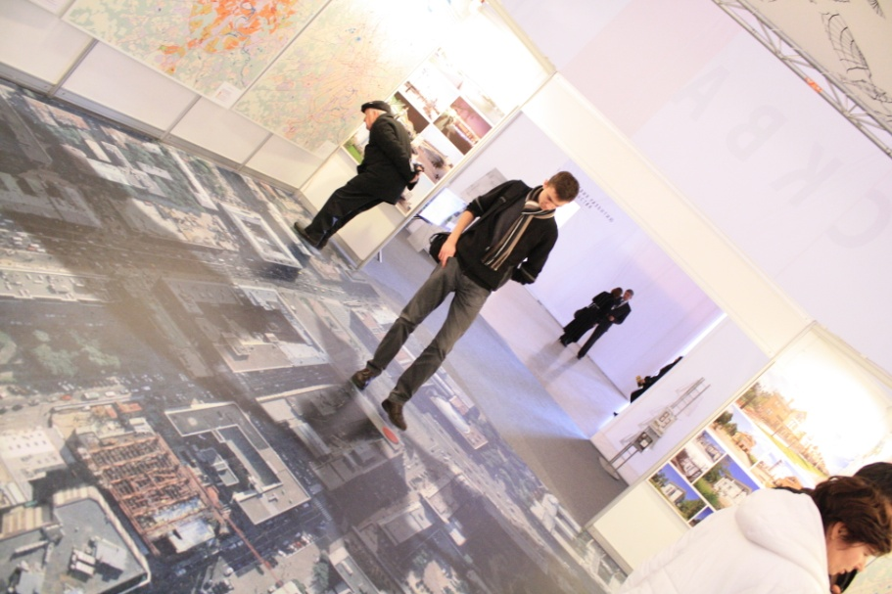
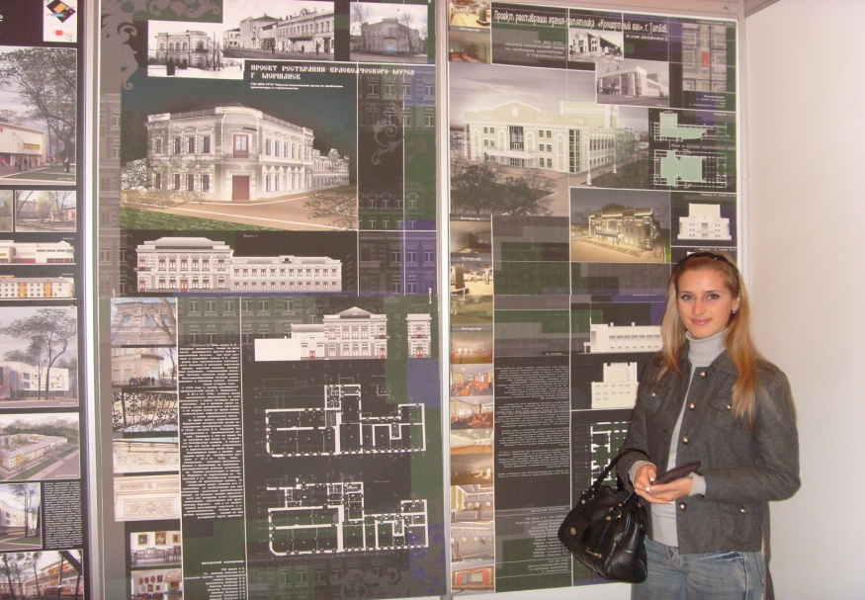
Tambov State Technical University
Institute of Architecture, Civil Engineering and Transport
(International Activities)
Italy: Romualdo Del Bianco Foundation, cooperation in culture and architecture.
Poland: Bialystok Technical University, educational and research cooperation, academic exchange
Netherlands: University of Applied Sciences, Networking project “NEPTUNE” (14 partners from different countries)

Slide 10
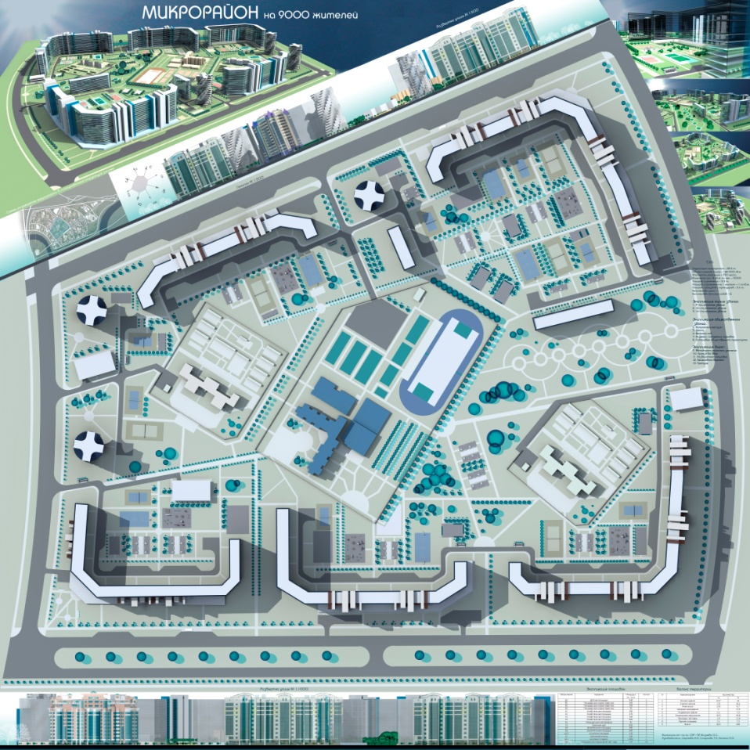
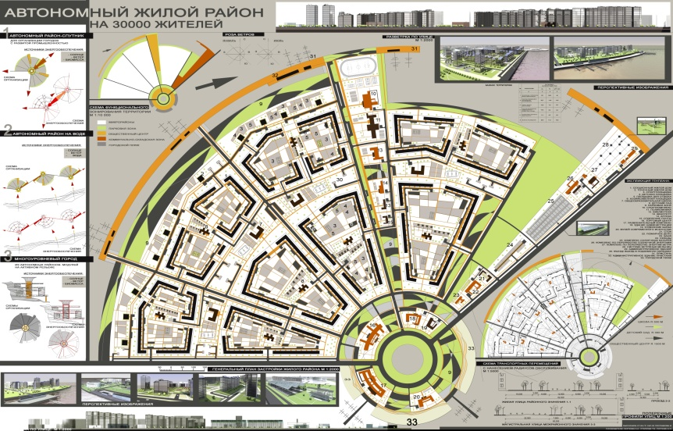
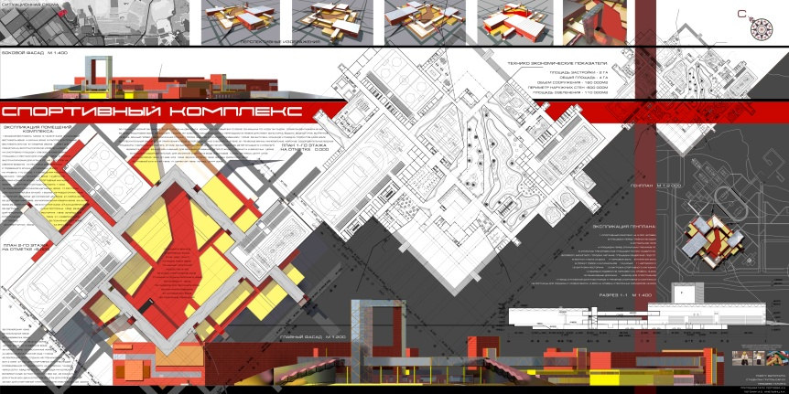
Tambov State Technical University
Institute of Architecture, Civil Engineering and Transport
(Diploma Projects)

Slide 11
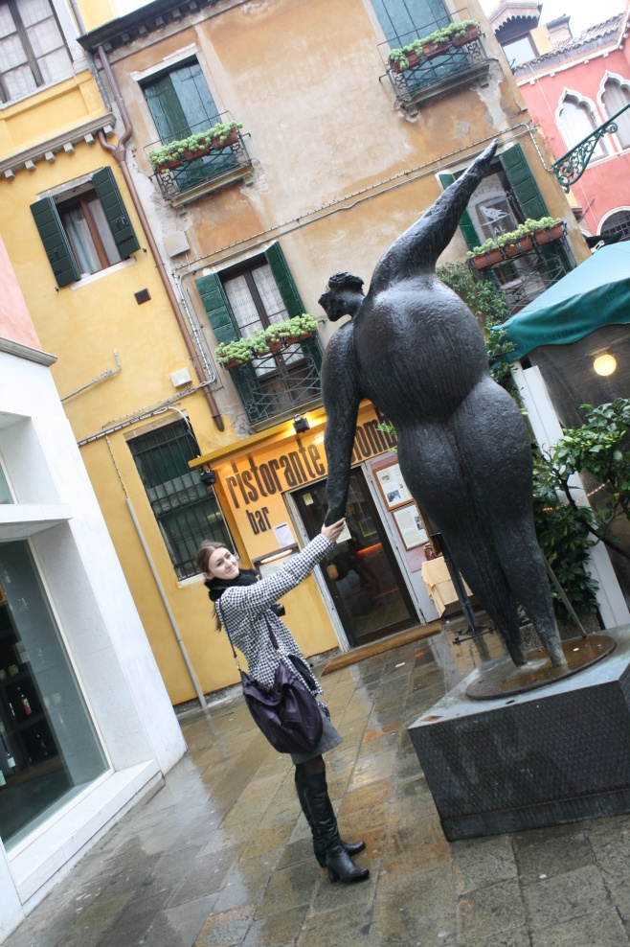
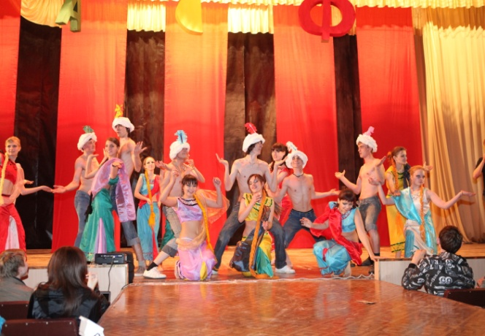
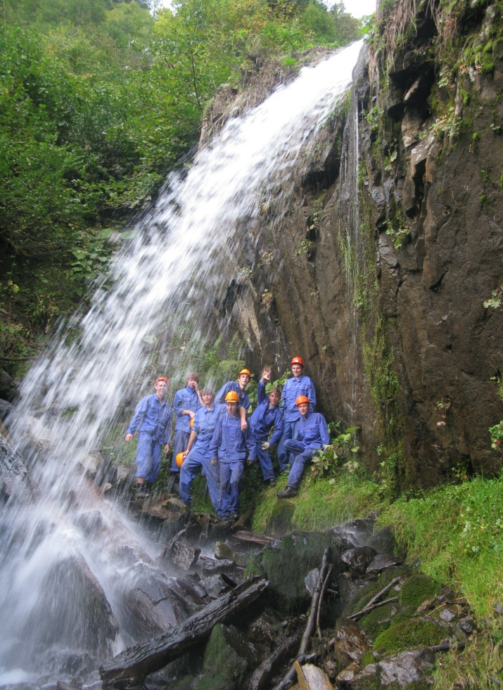
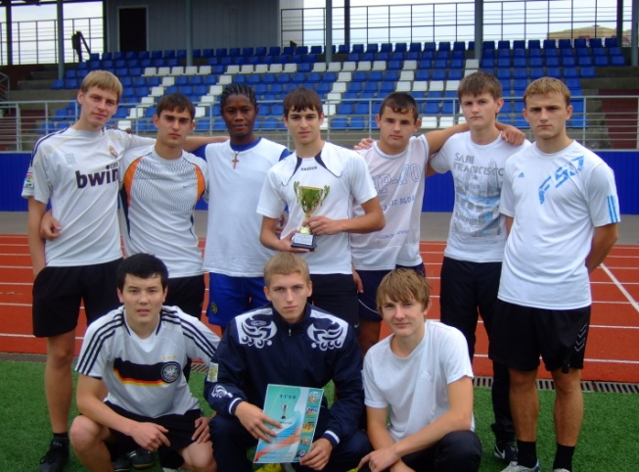
Tambov State Technical University
Institute of Architecture, Civil Engineering and Transport
(Students’ Life)

Slide 12
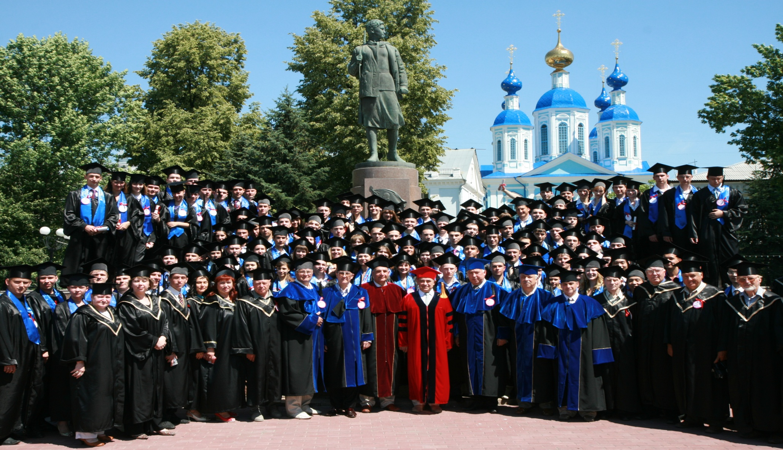
Thank you for your attention.

