Slide 1


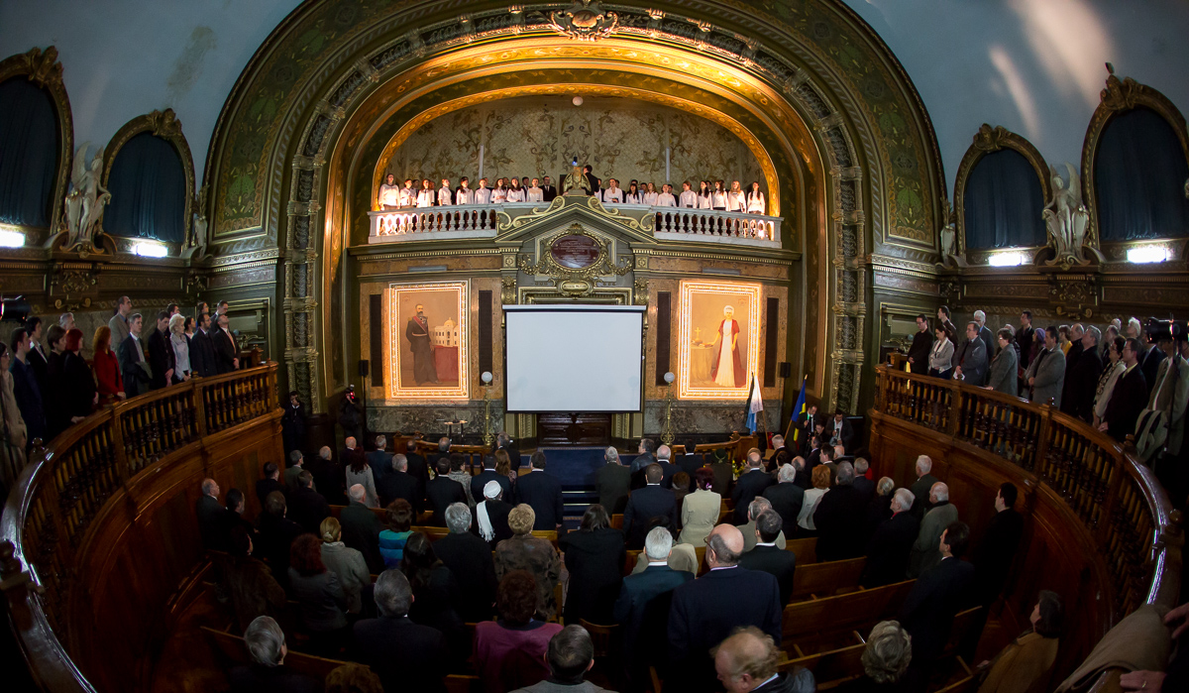
TUIASI
“GHEORGHE ASACHI” TECHNICAL UNIVERSITY OF IASI
Welcome to TUIAȘI!
www.tuiasi.ro/en

Slide 2

THE PEOPLE
STUDENTS AND ACADEMICS
14.000
students
647
have a PhD degree
1544
administrative staff
735
academic staff
97
associate professors

Slide 3
RESEARCH
CENTERS
23
research centers
“Gheorghe Asachi” Technical University of Iasi holds scientific research in very high regard, with its 23 research and excellence centers, 8 research teams and accredited research laboratories.
10
PhD Schools
13
research fields
139
PhD thesis
495
PhD students in 2013
175
PhD supervisors

Slide 4
INTERNATIONAL COOPERATION
NUMBERS
303
Erasmus Agreements
25
countries
73
academic partners

Slide 5












THE FACULTIES
“G.M. Cantacuzino” Faculty of Architecture
Faculty of Automatic Control and Computer Engineering
Faculty of Chemical Engineering and Environmental Protection
Faculty of Civil Engineering and Building Services
Faculty of Textiles, Leather and Industrial Management
Faculty of Machine Manufacturing and Industrial Management
Faculty of Material Science and Engineering
Faculty of Electronics, Telecommunications and Information Technology
Faculty of Mechanical Engineering
Faculty of Hydrotechnical Engineering,
Geodesy and Environmental Engineering
Faculty of Electrical Engineering

Slide 6

THE FACULTIES
STUDY PROGRAMS
BA
MA
PhD
Bachelor studies (46 programs of study, 4 years)
Master studies (19 domains, 81 programs of study,
2 years)
PhD studies (13 programs of study, 3 years)

Slide 7
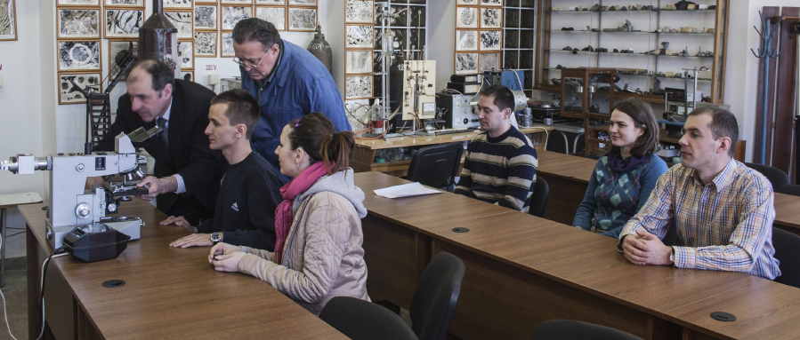
Faculty of Materials Science and Engineering
BA
Economic Engineering in Mechanics
Machines Manufacturing Technology
Machine Tools and Manufacturing Systems
Welding Engineering
Fine Mechanics and Nanotechnologies
Hydraulic and Pneumatic Machines and Systems
MA
Materials Engineering
(2 programs)
Mechanical Engineering
(1 program)
Industrial Engineering
(1 program)

Slide 8
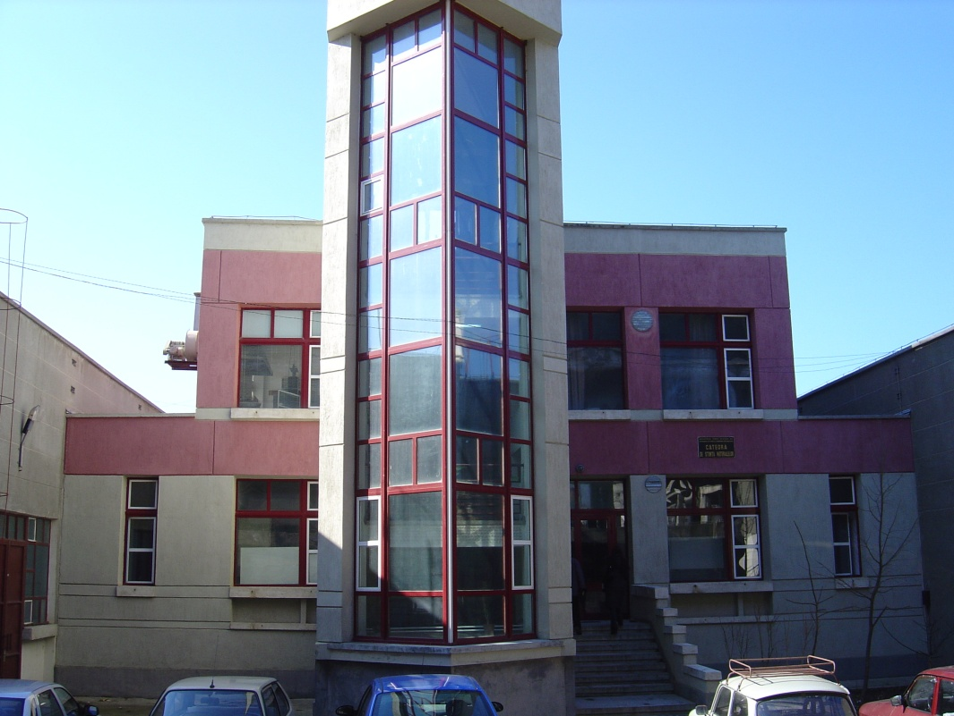
Faculty of Materials Science and Engineering
DEPARTMENTS
Materials Engineering and Industrial Safety
Materials Science
Technologies and Equipment for Materials Processsing
Work Health and Safety
Technological Education

Slide 9
Current teaching offer on the topics related to the
"Energy Efficient Buildings"
Faculty of Materials Science and Engineering
Subject | year /semester/ specialty area | code | number of hours | ECTS
Bachelor studies
Numerical Methods | 2 / 1 / Material engineering | 2SM06DF | 2c + 1L | 4
Energy and mass transfer | 2 / 2 / Material engineering | 2SM9DID | 2c + 2s | 4
Physics metallurgy (I) | 2 / 2 / Material engineering | 2SM11DID | 2c + 2L | 4
Physics metallurgy (II) | 3 / 1 / Material engineering | 3IPM01DID | 2c + 1L | 4
Equipment and heating installations | 3 / 1 / Mechanical engineering | 3IPM05DS | 2c + 1L | 4
Thermal analysis of metallic materials | 3 / 1 / Material engineering | 3SM17DS | 2c+1L | 4
Spectrometry | 3 / 1 / Material engineering | 3SM19DS | 1c+1L | 2
Master studies
Advanced techniques for simulation of thermo-gazo dynamics processes | 1 / 1 / Material engineering | 5TAIPMDI05 | 1c+2L | 6

Slide 10
Faculty of Materials Science and Engineering
HEAT TRANSFER LABORATORY

Slide 11
Faculty of Materials Science and Engineering
HEAT TRANSFER LABORATORY

Slide 12
Faculty of Materials Science and Engineering
HEAT TRANSFER LABORATORY

Slide 13
Faculty of Materials Science and Engineering
HEAT TRANSFER LABORATORY

Slide 14
Faculty of Materials Science and Engineering
HEAT TRANSFER LABORATORY

Slide 15
Faculty of Materials Science and Engineering
HEAT TRANSFER LABORATORY

Slide 16
Faculty of Materials Science and Engineering
HEAT TRANSFER LABORATORY

Slide 17
Faculty of Materials Science and Engineering
HEAT TRANSFER LABORATORY

Slide 18
Faculty of Materials Science and Engineering
SCANNING ELECTRON MICROSCOPY LABORATORY
Scanning electron microscopy (SEM) can be succesfully applied to investigate the composition of the internally mixed soot containing different percentages of CaSO4. For this purpose, the soot filter sample can be analyzed by SE/BSE detectors (VegaTescan LMH II) with an energy selective electron (ESE) detector and an in-lens secondary electron detector. The sample was measured under vacuum (2.53 104 mbar) at an acceleration voltage of 1, 10, 20 and 30 kV and a working distance of 15.5 mm. Using SEM equipment, secondary electrons detector we can evaluate the porous morphology of the soot matrix. In general using SEM we will be able to establish the crystallites, any kind, embedded degree in the soot matrix.
The instrument is also equipped with an energy-dispersive X-ray detector (Bruker model) that can be successfully used for chemical determinations on reduce areas. The elemental images of particles were converted from net X-ray intensities using a PB ZAF quantification method.
This equipment can be used in thin films case and even for light elements like C, N and O from the particles even if are not determined exactly, we can consider the equipment error for our calculations. For different experimental cases the specific analyze modules can be use to determine chemical composition insights like Point (chemical analyze on 90 nm spot for automatic or element list mode), Line (distribution of chemical elements on a selected line) and Mapping (distribution of chemical elements on a specific area).

Slide 19
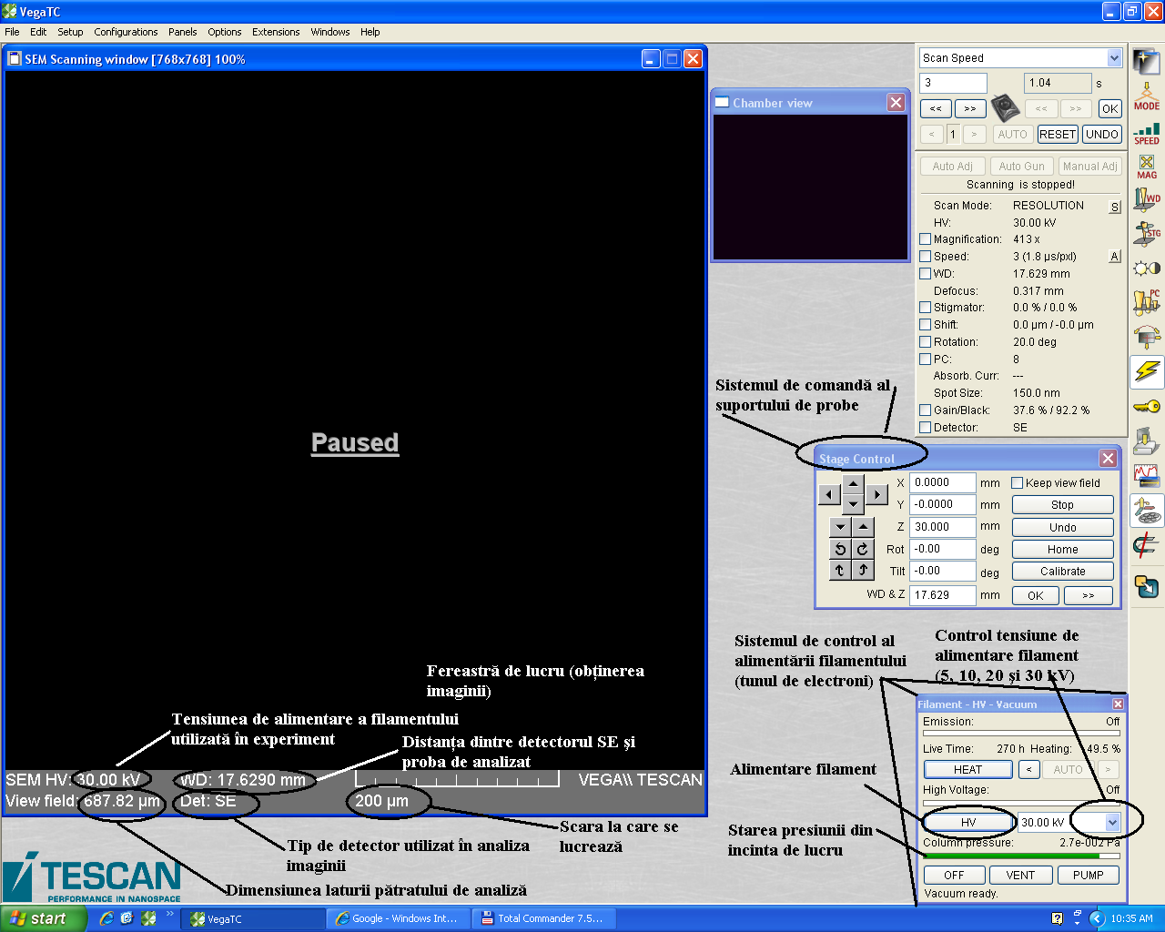
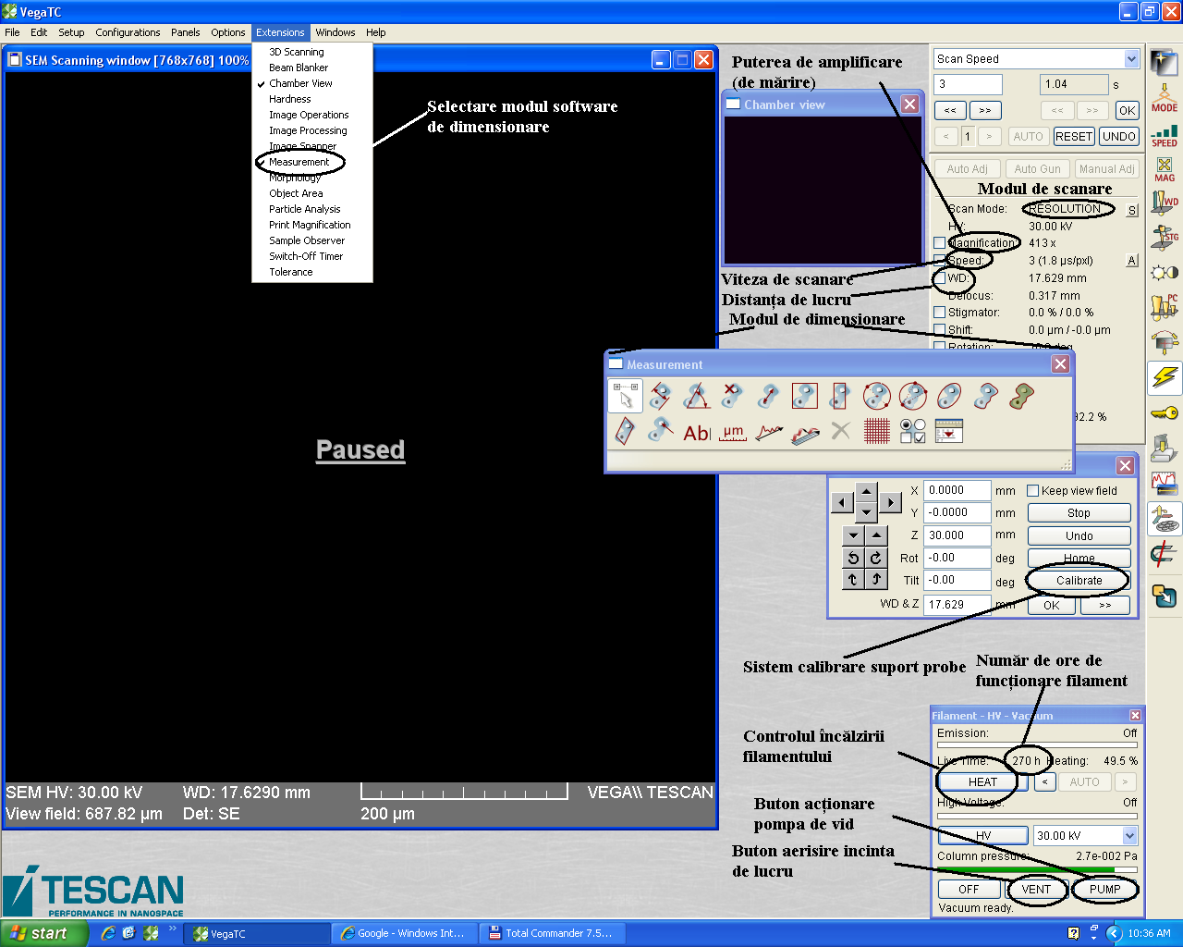
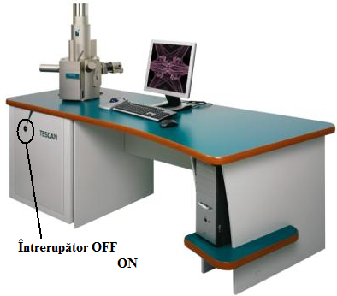
Faculty of Materials Science and Engineering
SCANNING ELECTRON MICROSCOPY LABORATORY

Slide 20
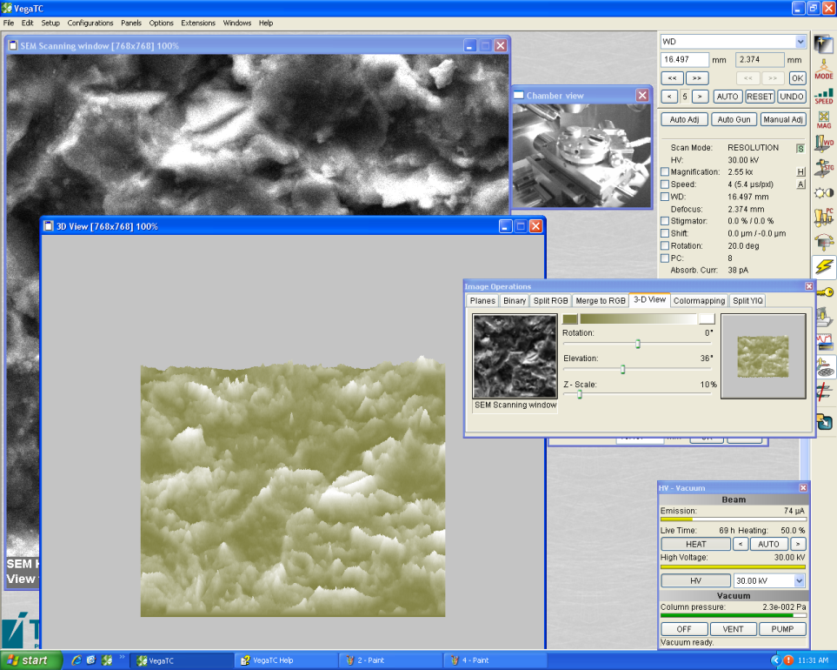
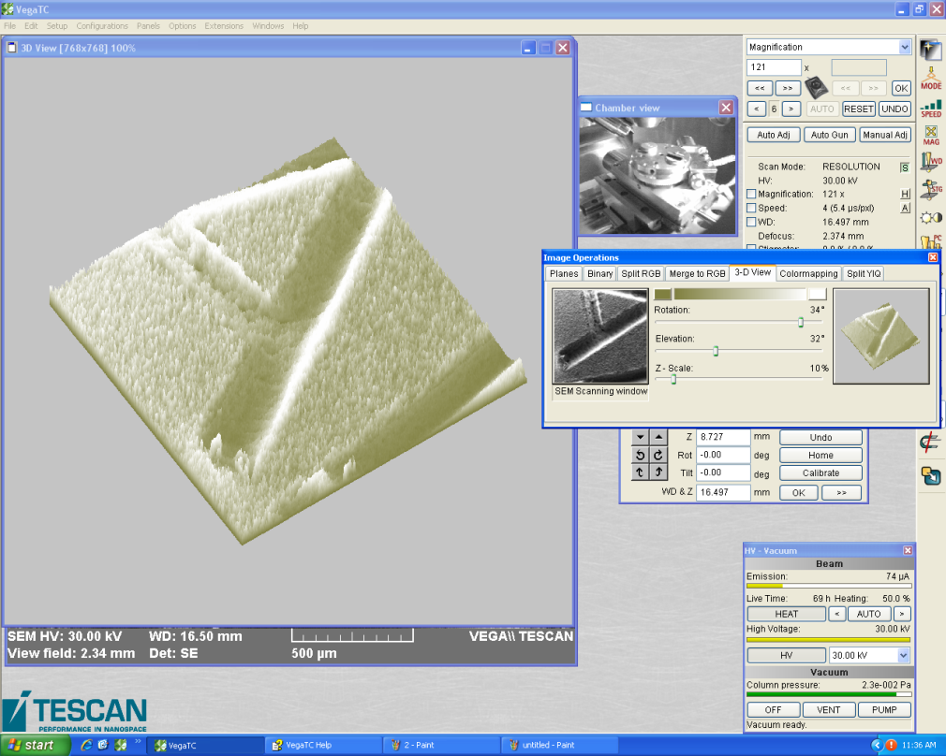
Faculty of Materials Science and Engineering
SCANNING ELECTRON MICROSCOPY LABORATORY
3D PROFILOMETRY OF SURFACES

Slide 21
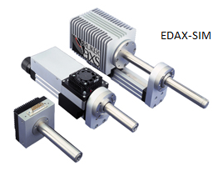
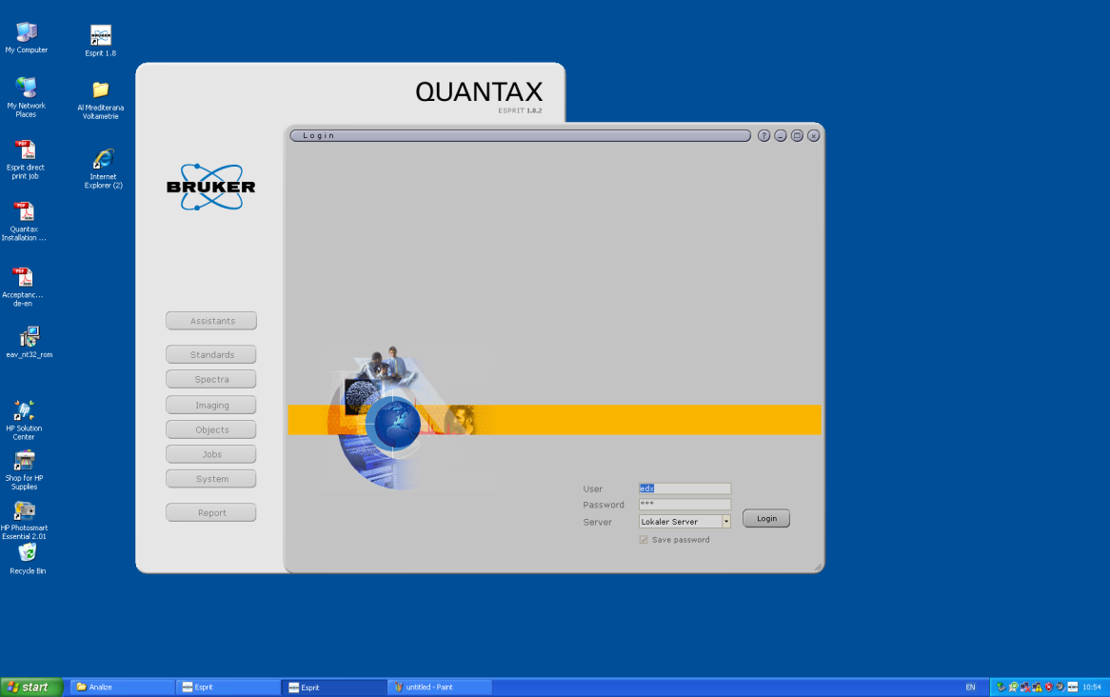
Faculty of Materials Science and Engineering
SCANNING ELECTRON MICROSCOPY LABORATORY

Slide 22
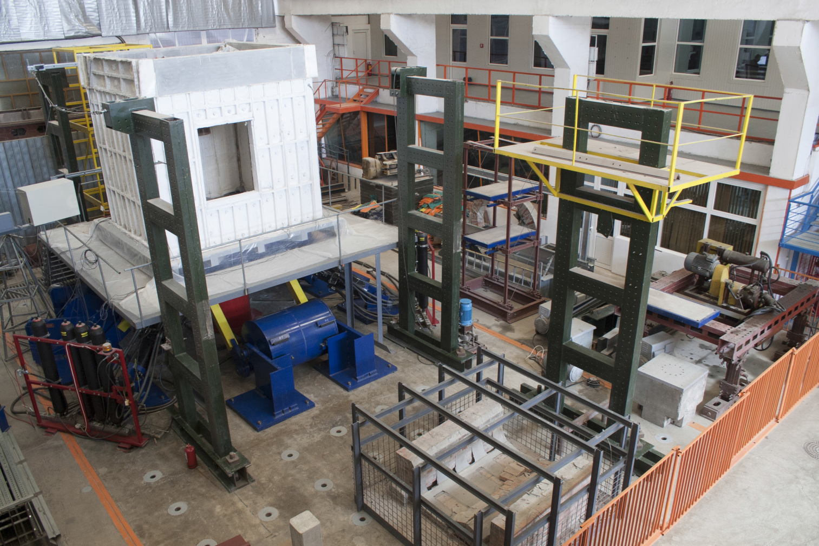
Faculty of Civil Engineering and Building Services
BA
Building Services
Civil Engineering (in English)
Civil, Industrial and Agricultural Construction
Transportation Infrastructure
MA
Civil Engineering (9 programs – 1 in English)
Building Services Engineering (1 program)

Slide 23
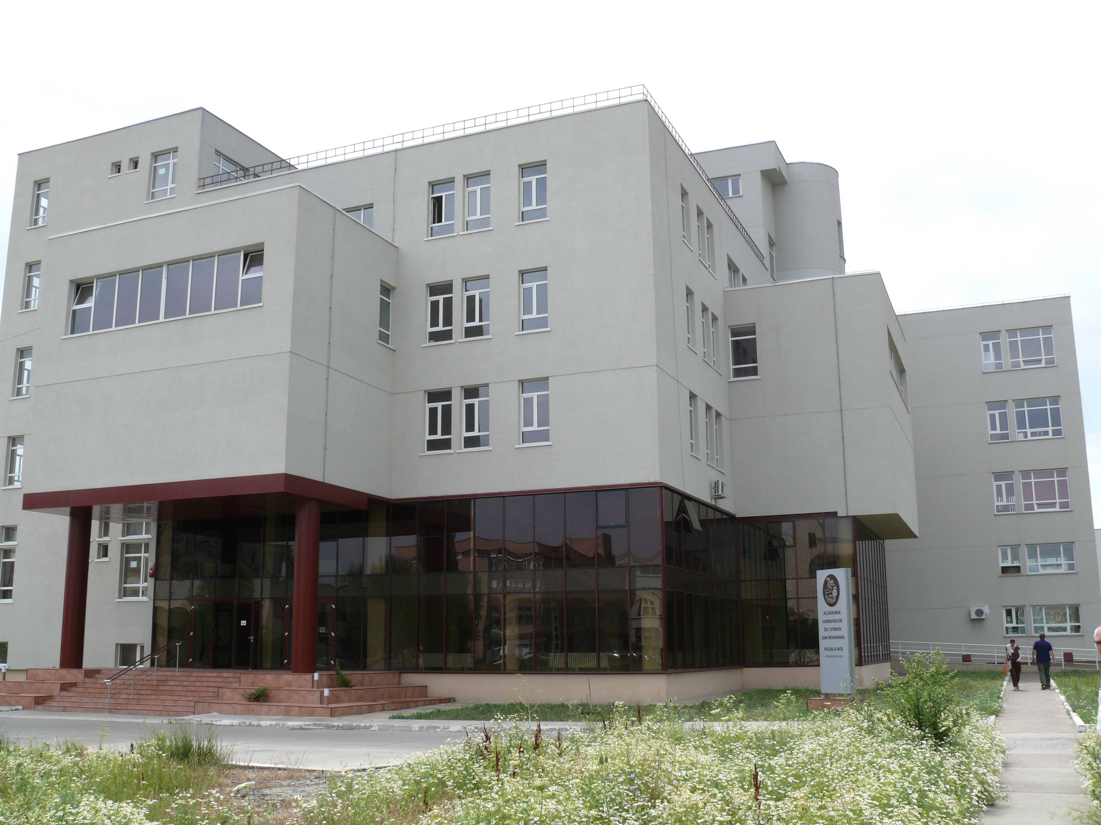
Faculty of Civil Engineering and Building Services

Slide 24
Current teaching offer on the topics related to the
"Energy Efficient Buildings"
Faculty of Civil Engineering and Building Services
Subject | year /semester/ specialty area | code | number of hours | ECTS
Bachelor studies
Environmetal engineering | 3 / 1/ Installations engineering | CI 303 | 2c | 4
Computer assisted design | 3 / 2/ Installations engineering | CI 309 | 2c + 2L | 3
Building Services in Constructions | 4 / 2/ Installations engineering | CE 406 | 1 L | 3
Master studies
Installations and equipment for environmental protection and non-conventional energies | 1 / 1 / Civil engineering | IEPMVEN | 2c + 1L | 4
Conceiving and computer assisted design for functional buildings | 1 / 1 / Civil engineering | CPACSFC | 2p | 3
Energetical strategies | 1 / 2 / Civil engineering | SE | 2c | 2

Slide 25
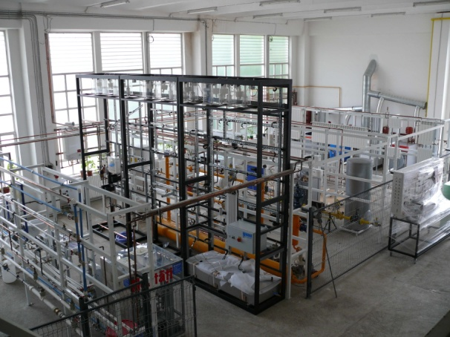
Faculty of Civil Engineering and Building Services
Main Hall

Slide 26
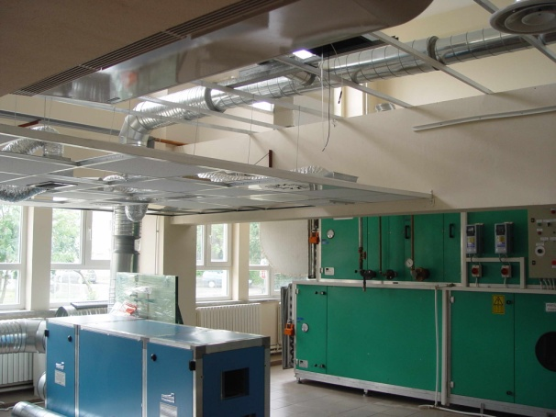
Faculty of Civil Engineering and Building Services
HVAC Laboratory

Slide 27
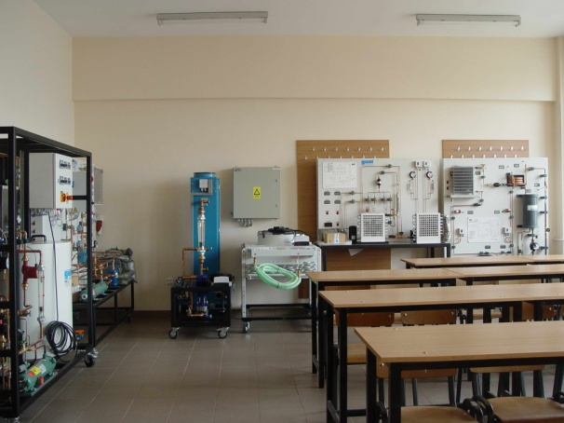
Faculty of Civil Engineering and Building Services
Cooling Laboratory

Slide 28
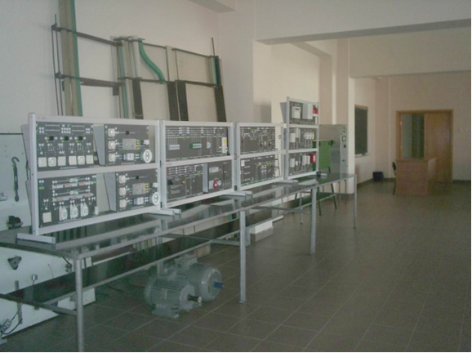
Faculty of Civil Engineering and Building Services
Electricity Laborator

Slide 29
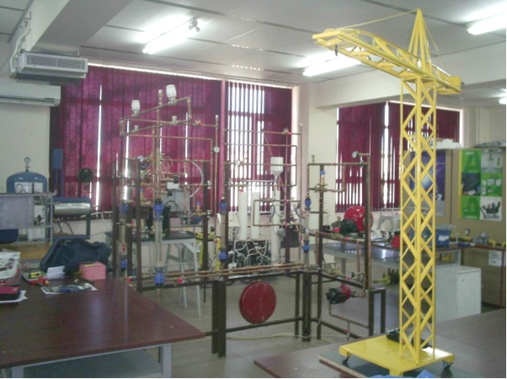
Faculty of Civil Engineering and Building Services
Automated and Measurement Laboratory

Slide 30
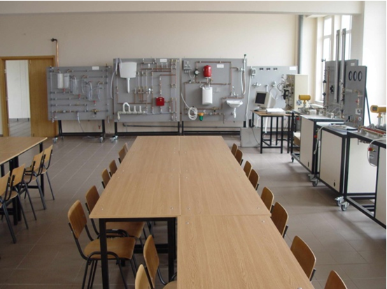
Faculty of Civil Engineering and Building Services
Plumbing and sewerage Laboratory

Slide 31
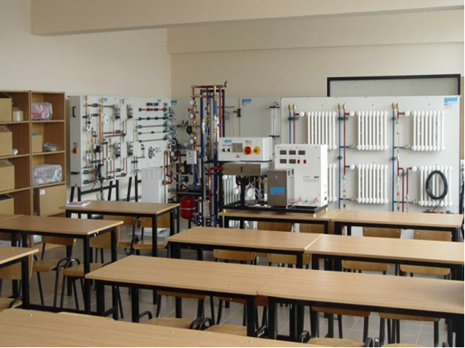
Faculty of Civil Engineering and Building Services
Heating Laboratory

Slide 32
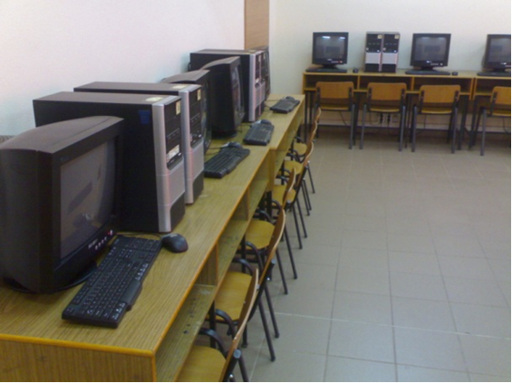
Faculty of Civil Engineering and Building Services
Computing Laboratory

Slide 33
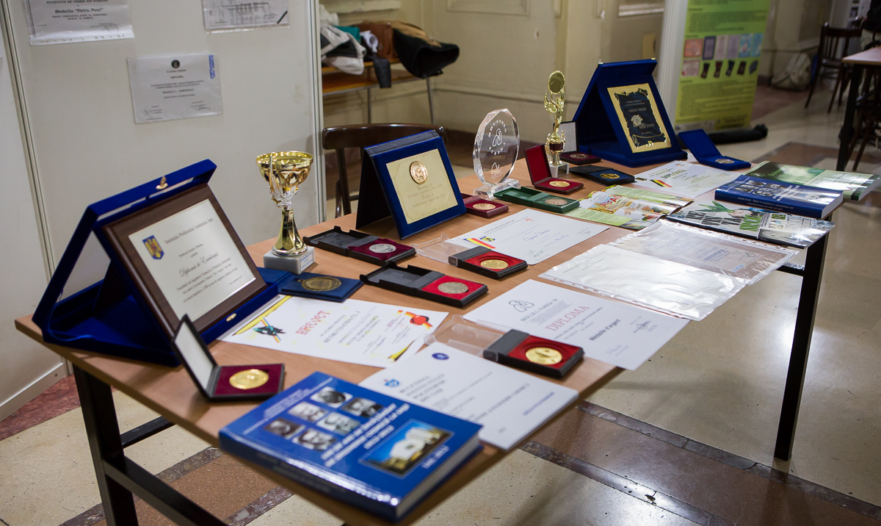
TUIASI
“GHEORGHE ASACHI” TECHNICAL UNIVERSITY OF IASI
Thank you!

