Slide 1


URAL FEDERAL UNIVERSITY:
Building a world-class university in the heart
of Eurasia

Slide 2
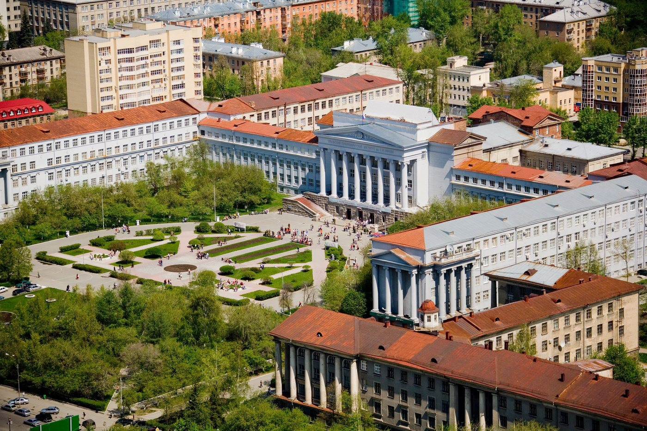
www.urfu.ru
Ural Federal University
named after the first President of Russia
B. N. Yeltsin
18 Institutes
256 Departments
30 000+ students from 80 countries of the world
2 000+ faculty members
350+ Bachelor, Master and PhD programs
According to Scopus indicators, UrFU is among world leaders in 29 research competencies, mainly connected with mathematics, physics and chemistry

Slide 3
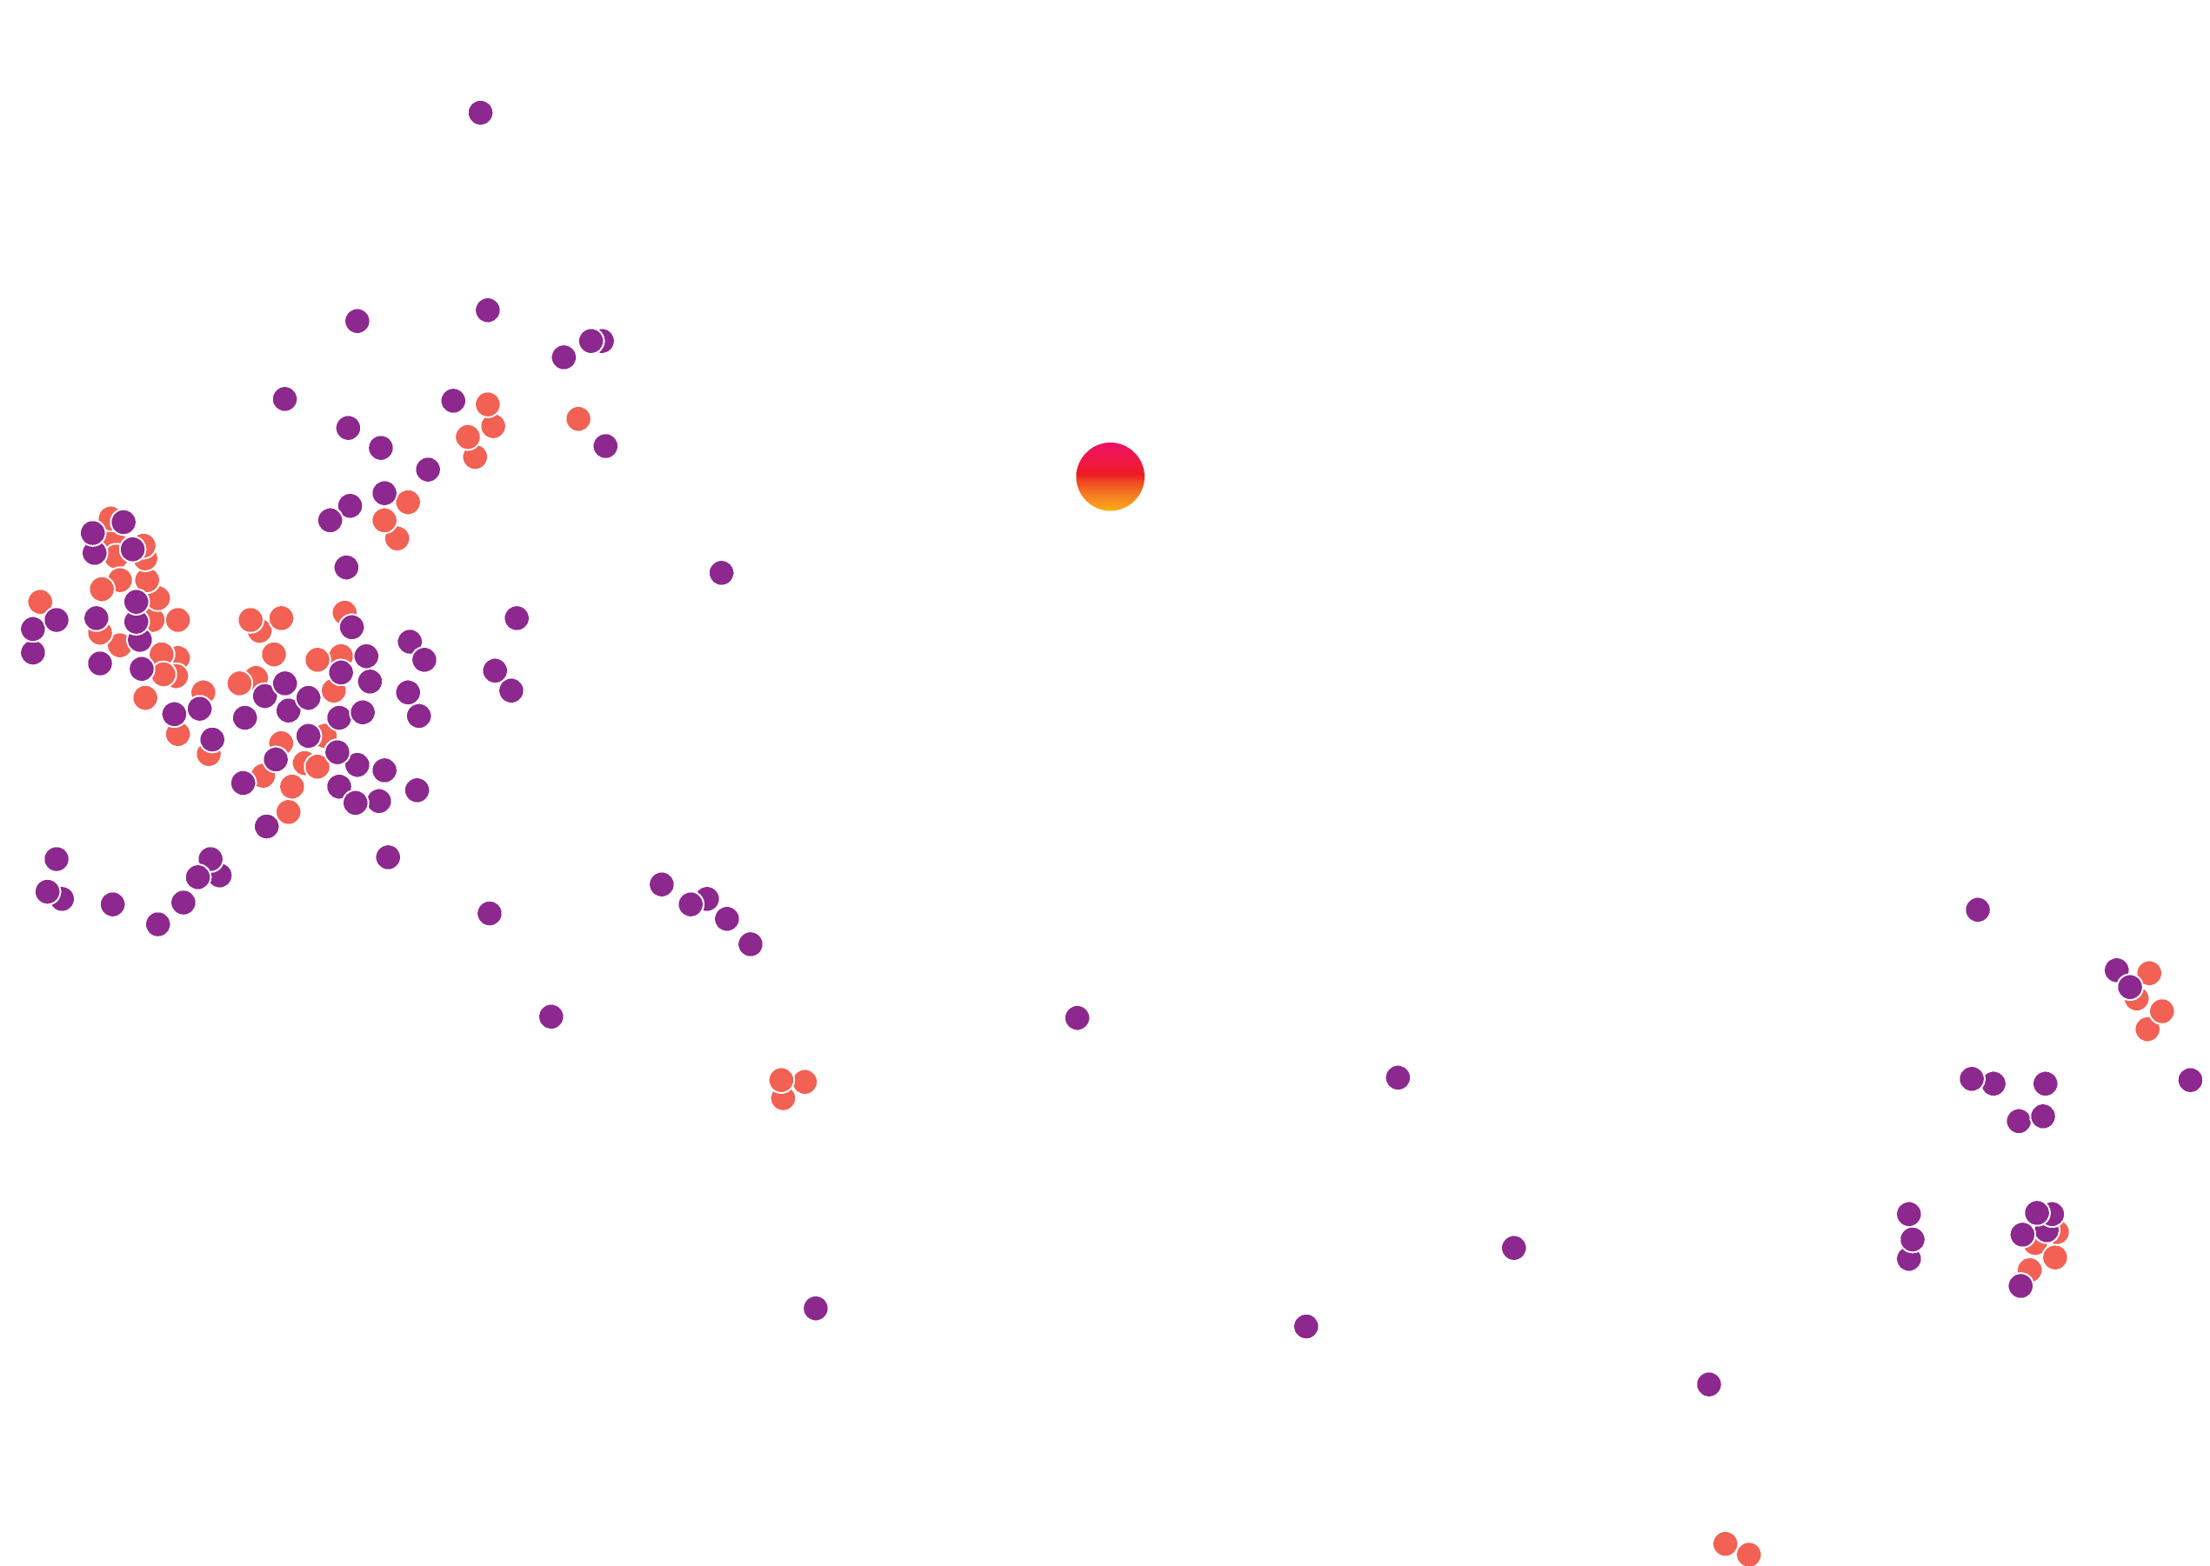

www.urfu.ru
Our dream is to establish a world-class university in the heart of Eurasia
Ural Federal University
Top-10 in Russia according to national rankings
Top-100 in QS World University Ranking: BRICS
Top-600 QS World Universities
Top-60 QS Ranking: Emerging Europe and Central Asia
Top-6 among Russian universities in Webometrics
Red point are the universities in THE top 200
Purple dots are the universities from THE top 200-400
Source: Times Higher Education World University Rankings 2012-13

Slide 4


International communications for students
www.urfu.ru
The most important features of education at UrFU are:
World-class academic staff involved in practical research.
Vast research infrastructure providing the framework for the successful implementation of innovative research projects.
Close connections with the local community providing a strong base for practical-oriented education through internships and workshops.
The University offers a wide variety of Bachelor, Master and PhD programs in Russian and English languages in Engineering, Natural Sciences, Technical Sciences, Economics, Social Sciences and Humanities.

Slide 5
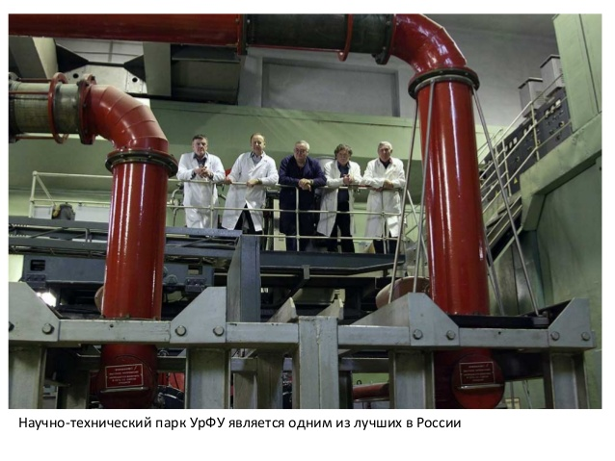
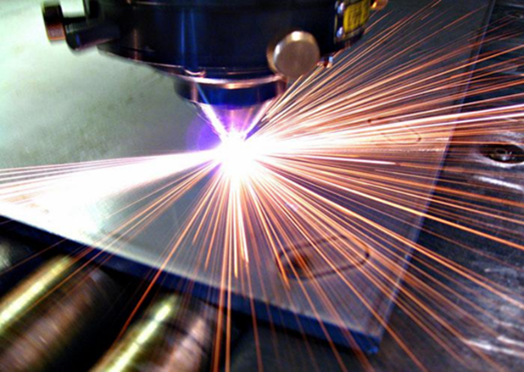
5
Research Activities
www.urfu.ru
  Research priorities
Biotechnology and Biochemistry
Civil Engineering
Economics and Management
Power Engineering
Information Technologies
Humanities and Arts
Mathematics
Mechanical Engineering and Machine-Building
Metallurgy
Natural Sciences
New Materials and Material Science
Nuclear Technologies
Social Sciences

Slide 6
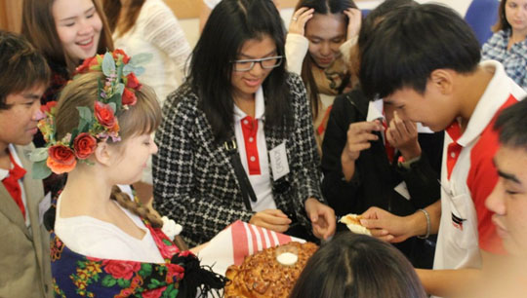
6
6
Internationalization
www.urfu.ru
  Internationalization of education
More than 2 000 international students from 80 countries of the world are currently enrolled in the university
The Institute of International Education was established as an instrument for coordinating the efforts of UrFU Institutes in development of cross-disciplinary programs taught in English. 21 Master programs in English have already been developed.
UrFU serves as an important center for teaching Russian as a foreign language
UrFU is a member of the SCO Network University, the CIS Network University and the Network University of the Arctic
UrFU established a system of grants in support for the students and young researchers mobility :
20 grants a year for foreign post-docs
50 grants a year for foreign degree-seeking students
55 grants a year for foreign exchange students coming to UrFU for one semester
150 grants a year for UrFU students coming to foreign partner universities in the framework of the exchange programs
Share of international students, %
4,2
From “far-abroad” countries
From CIS countries
3,4
2,8

Slide 7
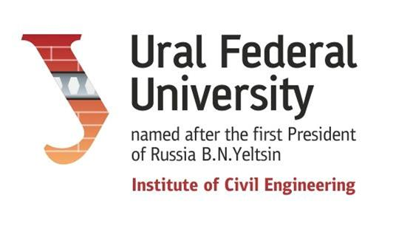
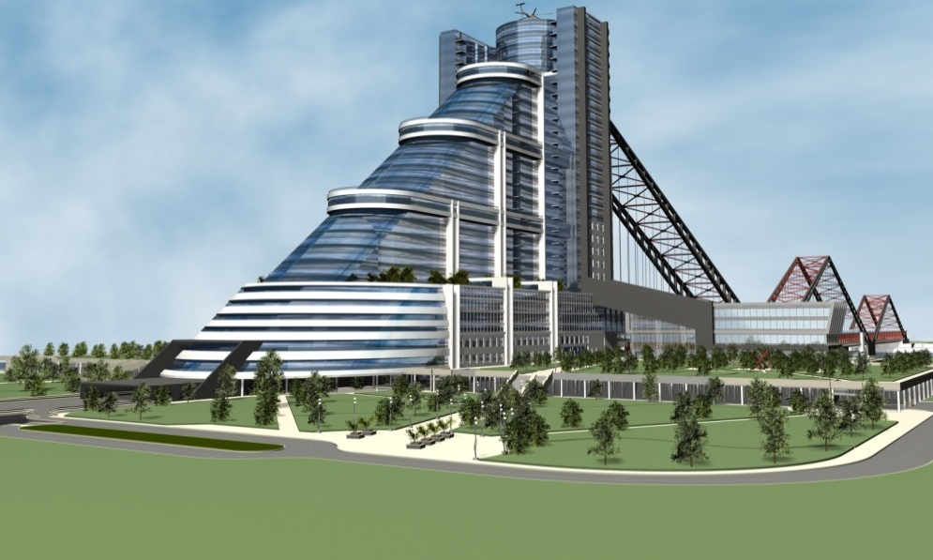
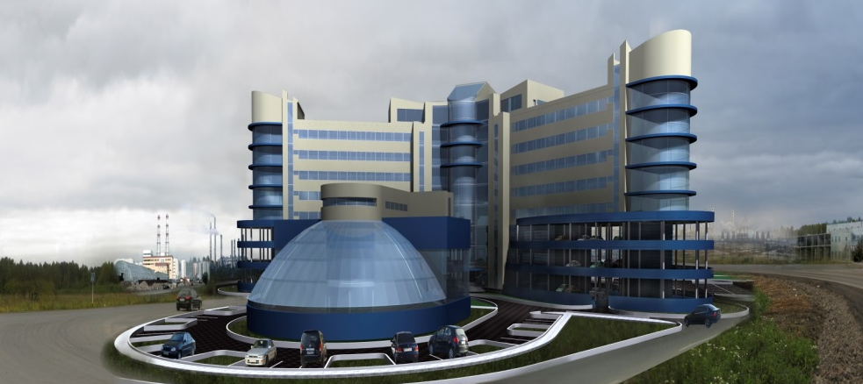
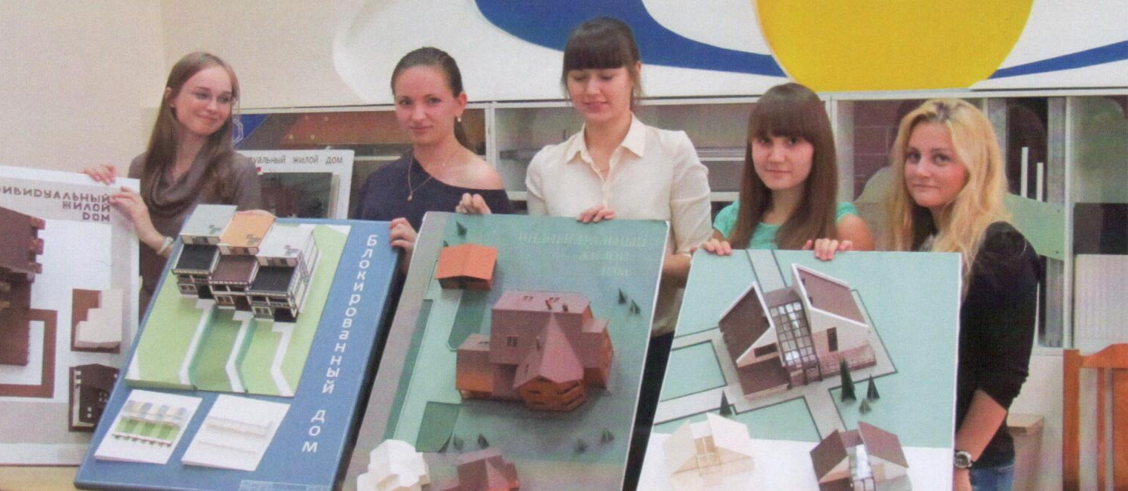
Institute of Civil Engineering
Institute of Civil Engineering
was founded 1929.
It is well known as a highly respected school preparing of civil engineers for Russia and the foreign countries

Slide 8
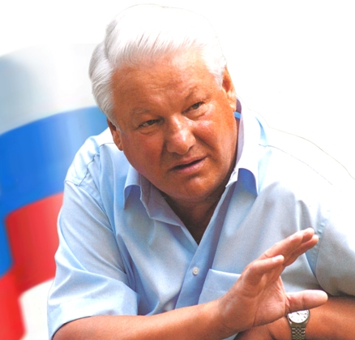
Institute of Civil Engineering
The Institute is proud of its more than 23,000 graduates.
The most famous of them is the first President of Russia B. N. Yeltsin.

Slide 9
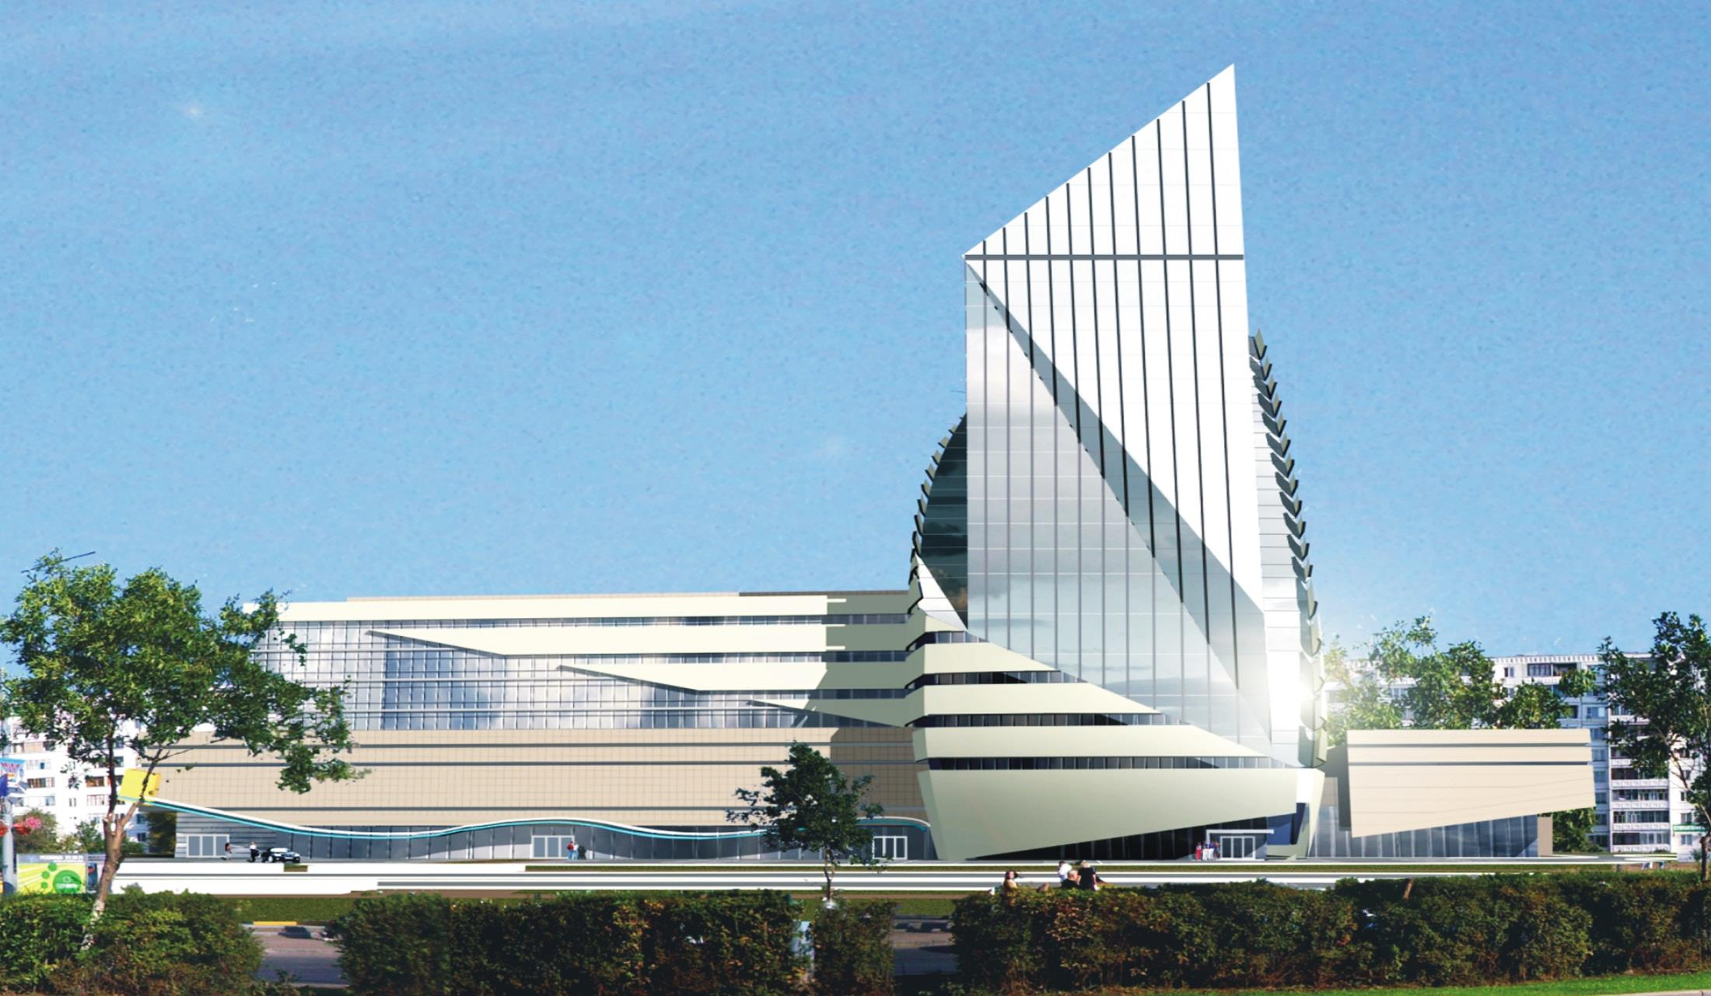
Institute of Civil Engineering
10 Departments include:
2 Members of the Russian State Academy of Architecture and Construction Sciences;
5 Associate Members of PUBLIC Academies,
15 Doctors of science;
89 Candidates of science;
2 Honored Civil Engineers of Russian Federation;
3 Laureates of State Prize

Slide 10
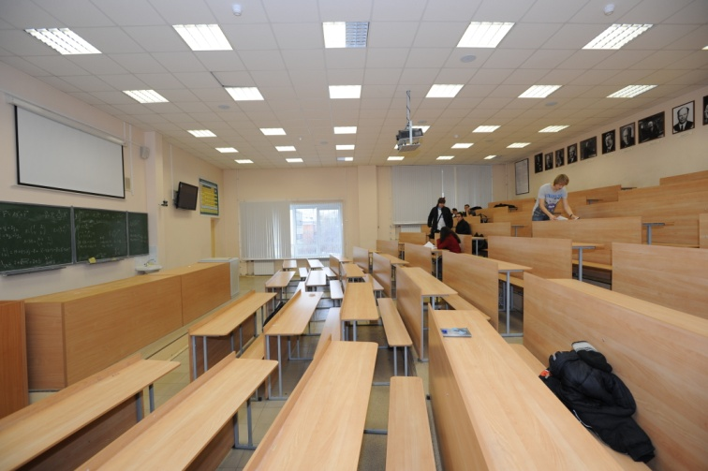
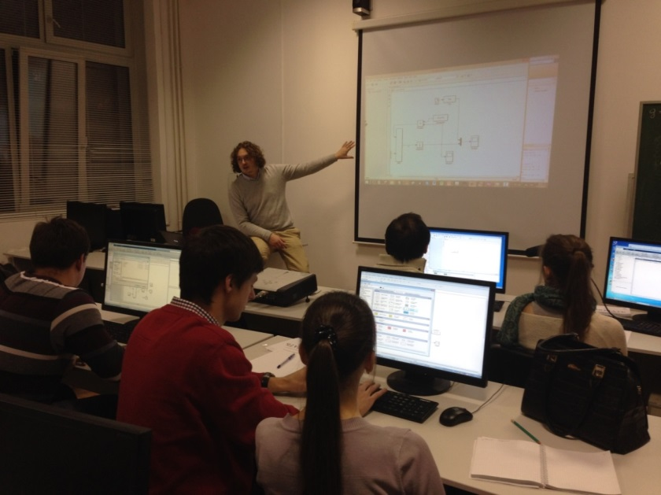
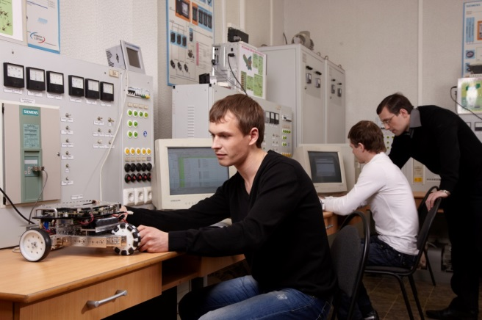
Institute of Civil Engineering
Institute of Civil Engineering
5 – Post-graduate Programs (4 years)
8 – Masters Degree Programs(2 years)
11 – Bachelors Degree Programs (4 years)
1 – Specialist Degree(6 years)
9 multimedia auditoriums
4 computer rooms
6 laboratories

Slide 11
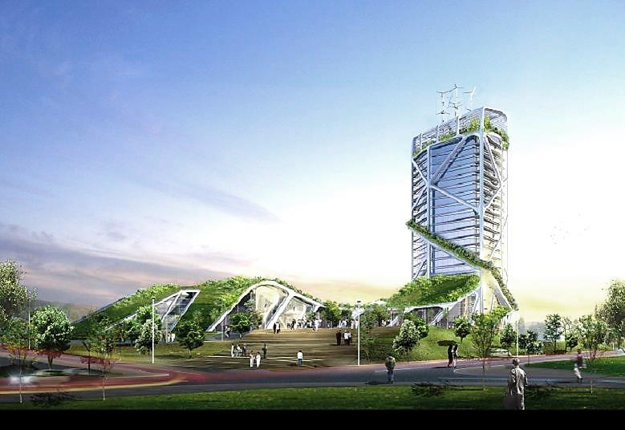
Master’s Degree Programs Full-time Duration of study: 2 years
Building Design for Sustainable Development
The program is interdisciplinary and practice-oriented. It is targeted on development of applied research and creative design based on current demands of multi-comfort environment using innovative materials and «green» technologies for sustainable development. The program includes designing energy-efficient buildings for resource saving owing to wide utilization of renewable energy sources typical for cities (sun, wind, geothermal energy, biogas etc.).

Slide 12
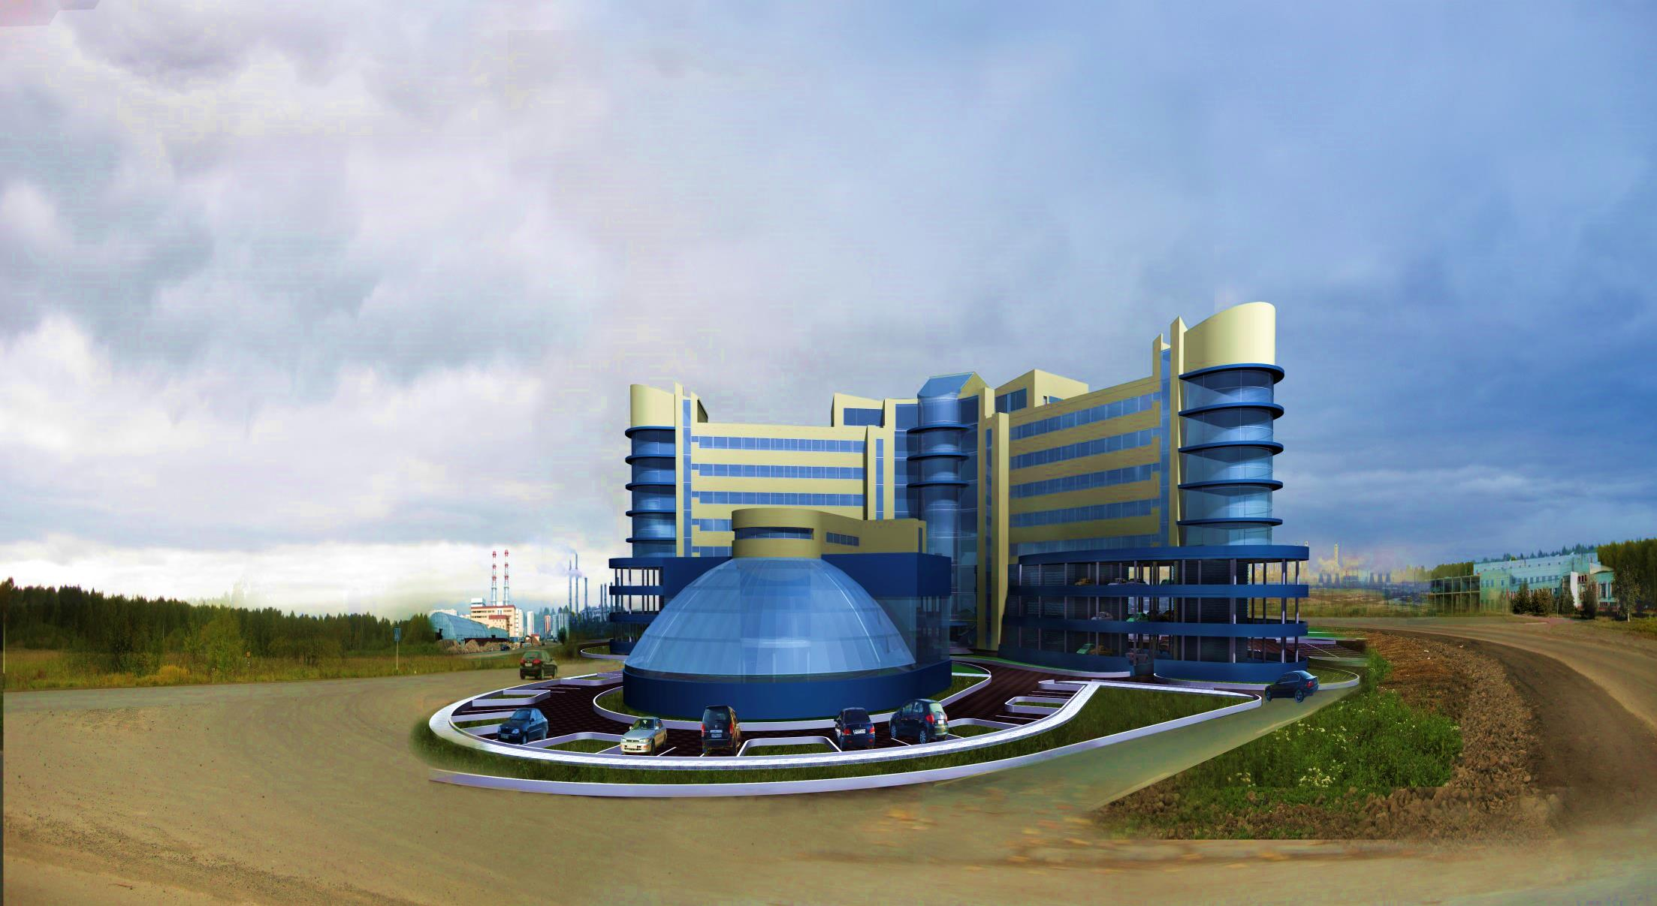
Master’s Degree Programs Full-time Duration of study: 2 years
Water Disposal and Waste Water Treatment
Water Supply of Cities and Industrial Facilities

Slide 13
Master’s Degree Programs Full-time Duration of study: 2 years
Water Disposal and Waste Water Treatment
The Рrogram was developed and professionally accredited as a part of the international project TEMPUS NETWATER and meets the requirements of the European Commission to Master's Degree Programs in the sphere of sustainable water use. Modules cover the essential aspects of waste water disposal (sewerage, treatment) providing an understanding of how these systems work. Special focus is made on innovative membrane technologies of separating water solutions - ultrafiltration, reverse osmosis, and on key skills of applying unique membrane equipment. Our students obtain professional knowledge in the sphere of water ecology and water resources conservation.

Slide 14
Master’s Degree Programs Full-time Duration of study: 2 years
Water Disposal and Waste Water Treatment
This Program is ideal if you are an engineering graduate wishing to enhance your capabilities in urban water design, operation and management, or an engineer working in the water industry looking to acquire knowledge, skills and a formal qualification in this area. The Program will open up a wide range of employment opportunities and can act as a foundation for further research in the areas of urban water management and water systems.

Slide 15
Master’s Degree Programs Full-time Duration of study: 2 years
Water Supply of Cities and Industrial Facilities
The Program provides in-depth study of modern technologies for drinking water treatment and for treatment of surface and underground water meant for industrial use. Special focus is made on innovative membrane technologies of separating water solutions - ultrafiltration, reverse osmosis, water disinfection. Training and research is done under the guidance of the Department's senior faculty. We also engage for teaching top specialists from large companies of housing and utilities sector, industry, engineering and research organizations who conduct tutorials both in class and on site. Our graduates have experience of applying unique membrane equipment and key skills of engineering and implementing both municipal and industrial water supply systems.

Slide 16
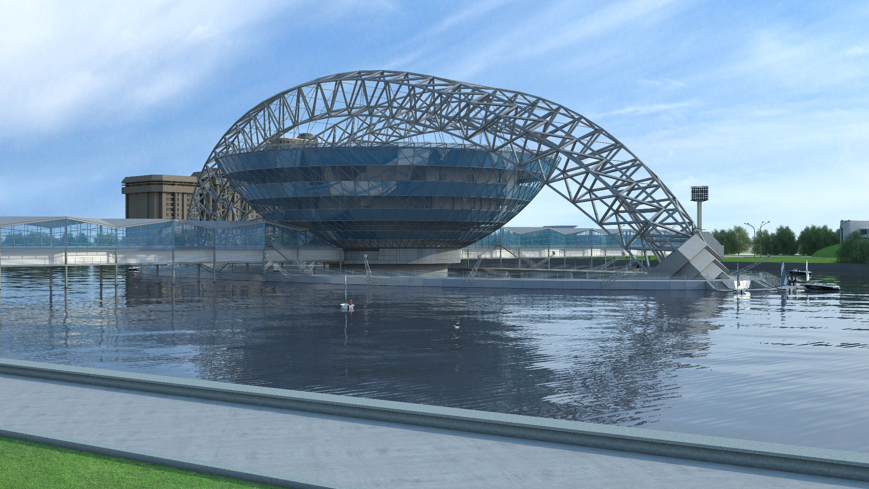
Master’s Degree Programs Full-time Duration of study: 2 years
Engineering and Maintenance of Systems of Heat and Gas Supply, Ventilation and Conditioning
Energy-saving Technologies of Microclimate. Energy Audit.

Slide 17

Master’s Degree Programs Full-time Duration of study: 2 years
The Programs provide in-depth knowledge of energy-saving technologies for creating micro-climate in buildings. Our graduates work in research and development, implement innovative processes and technologies in the
sphere of engineering, construction, and reconstruction of heat and gas supply, ventilation and conditioning systems in municipal and industrial buildings.

Slide 18
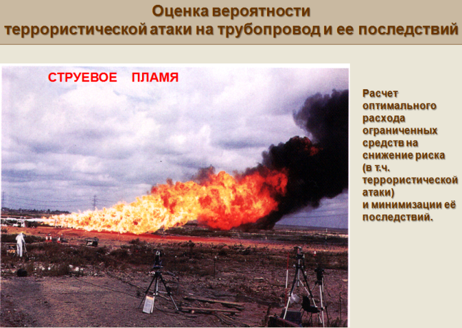
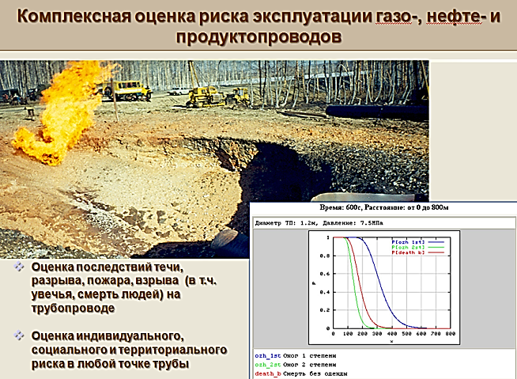
Master’s Degree Programs Full-time Duration of study: 2 years
Safety and Reliability of Civil Engineering Critical Infrastructures and Territories
Program purpose: Training of high-skilled specialists able to perform a broad scope of professional activities (innovation, survey, design, production-technological, scientific-research, pedagogical, expert, supervision, inspection-auditing and normative-methodical) in the fields of complex safety assurance and stable development of civil engineering critical infrastructures and territories, urban metropolitan complexes at stages of engineering surveys, design, construction, reconstruction and operation of civil engineering objects, using modern design, engineering and intellectual systems.

Slide 19
Master’s Degree Programs Full-time Duration of study: 2 years
Safety and Reliability of Civil Engineering Critical Infrastructures and Territories
The main specifics of the program is its systemic approach, based on the latest leading edge scientific and practical achievements in the field of construction safety, stability against loads and fractures, reduction vulnerability of modern housing and multi-functional high-rise complexes, objects of high social significance and mass accumulation of people (stadiums, hotels, railway stations, airports), strategically important infrastructures of power engineering systems (electrical transmission lines, pipelines), modern systems of safety control of certain objects.
The program is flexible allowing entering alterations and addenda into subjects by taking into account their actual character and demands of various industries.

Slide 20
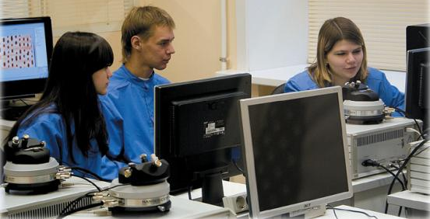
Master’s Degree Programs Full-time Duration of study: 2 years
Some courses concerning Green Technologies and Energy Saving:
1. Development of architectural typology of low-rise energy efficient buildings;
2. Innovative сonstruction materials;
3. Development of architectural typology of multistory energy efficient residential and public buildings;
4. Design of long-span and high-rise buildings (skyscrapers);
5. Ecology and transformation of urban realm;
6. Conceptual architectural design
7. Regional resilience and strategic preparedness of critical infrastructures

Slide 21
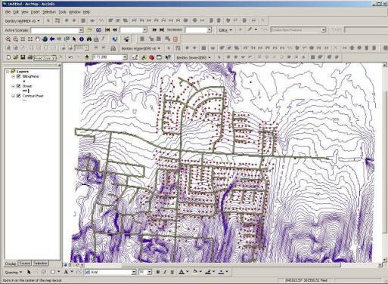
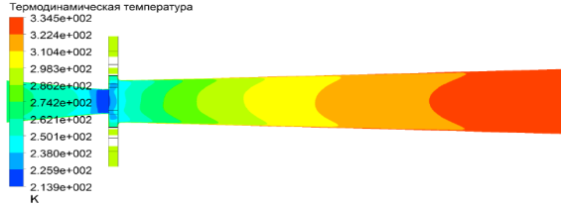
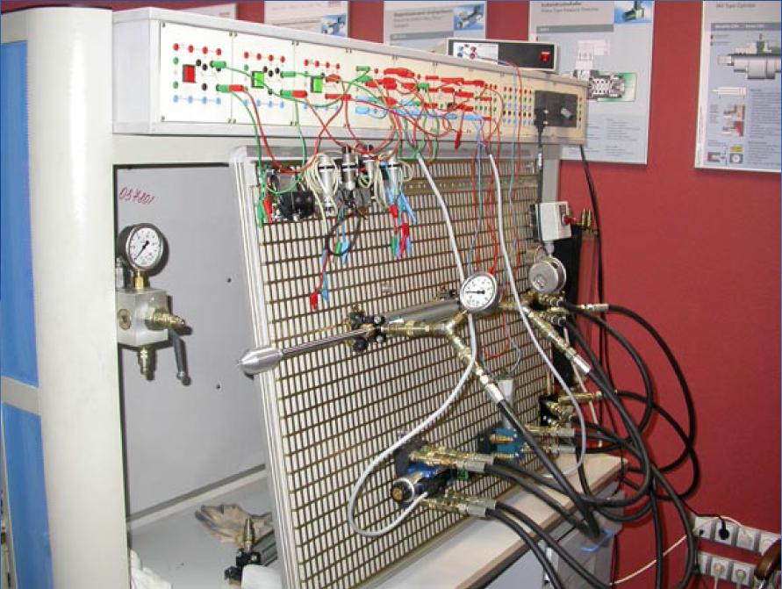
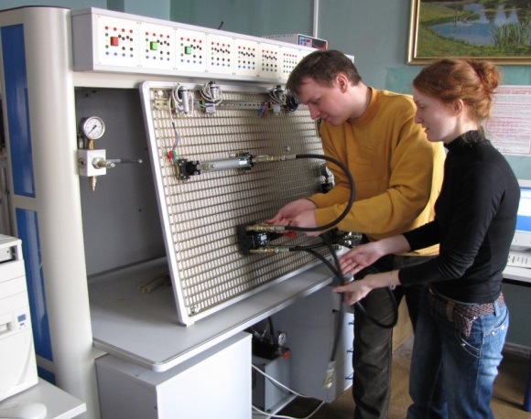
Laboratories
Laboratory of hydro-pneumodrive
and automation systems
The laboratory is equipped with special-purpose test benches by Festo with Siemens controllers for studying basic designs of automation devices. They allow studying conventional contact-relay and analog automation devices as well as systems with microbased control.
Equipment not only used for maintaining desired room climate but allows to save considerable amount of energy (electric and thermal energy).

Slide 22
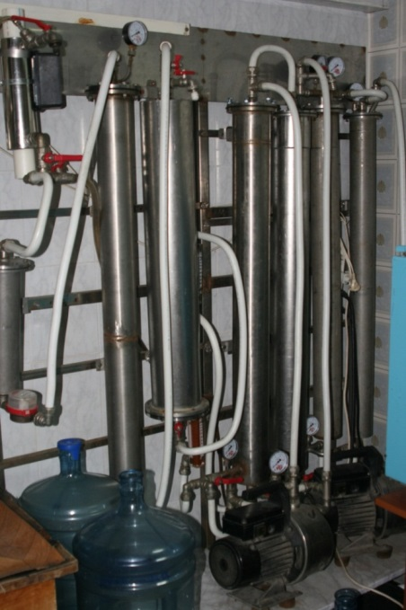
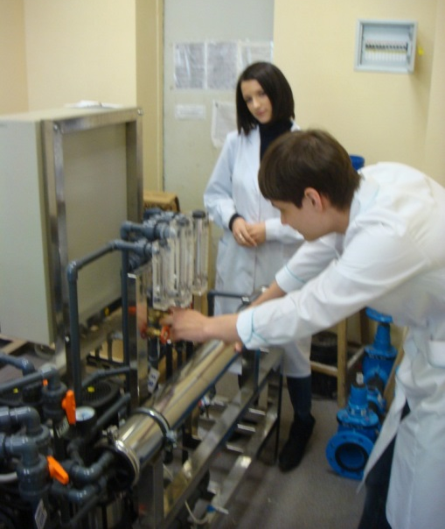
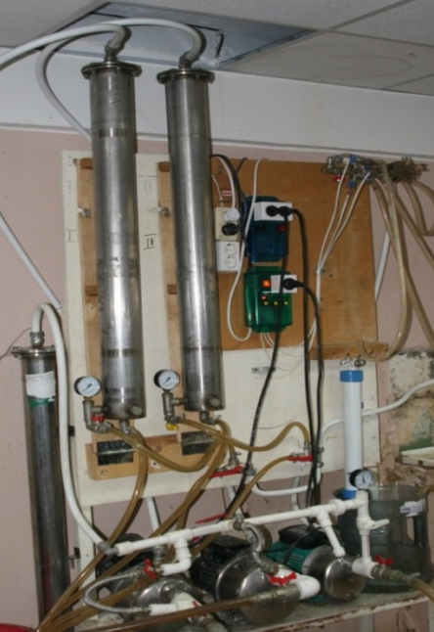
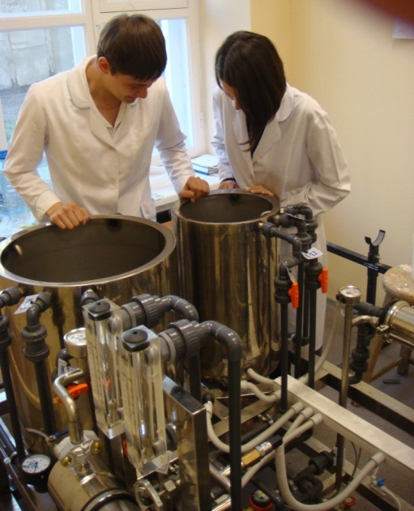
Laboratories
Water treatment Laboratory
Membrane water processing and waste-water treatment research laboratory is equipped with:
semiindustrial low-pressure reverse osmosis plant;
semiindustrial high-pressure reverse osmosis plant;
laboratory benches for studying nano- and ultrafiltration processes using roll diaphragm elements;
test bench for studying coagulation and clarification processes of water solutions;
test bench for studying sludge dewatering processes;
laboratory-scale plants – columns for studying ion exchange and sorption processes;
analytic equipment - calorimeter, pH indicator, conductometers, magnetic stirrers, electronic scales.

Slide 23
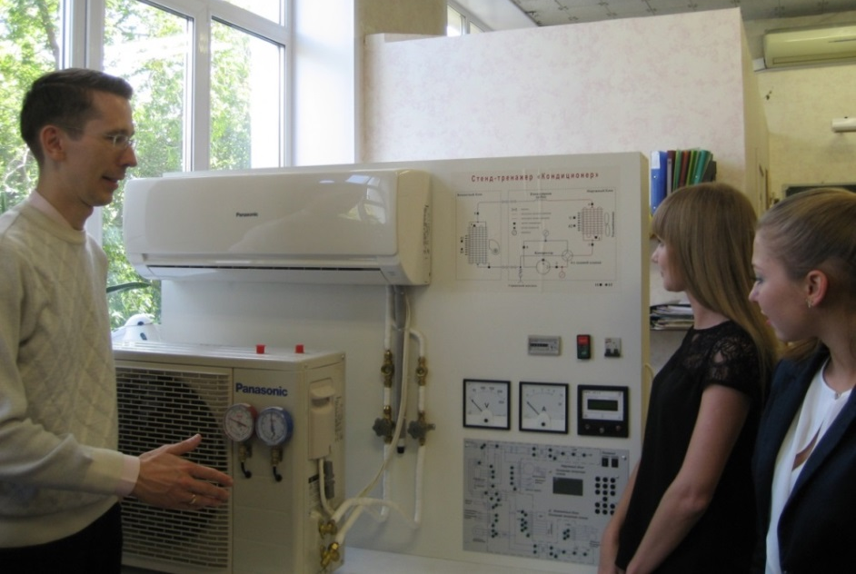
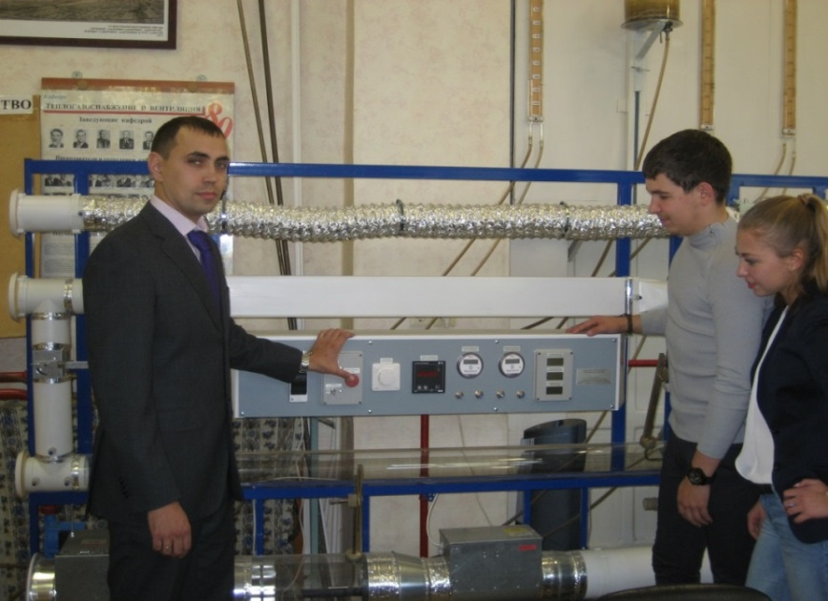
Laboratories
Laboratory of Systems of Heat and Gas Supply and Ventilation
1. Educational and research complex “Energy stability of heat supply systems".
Complex allows studying hydraulic control for various options of interconnections of consumers to heating systems and investigating hydraulic stability and reliability of heating systems as well as drawing piezometric diagrams.
2. Suite of equipment «Vent systems» enables to determine heat rating of heating units, drag of ducts with round and rectangular section, flexible ducts, investigate characteristics of control valve, along with air (chest) diffuser.

Slide 24
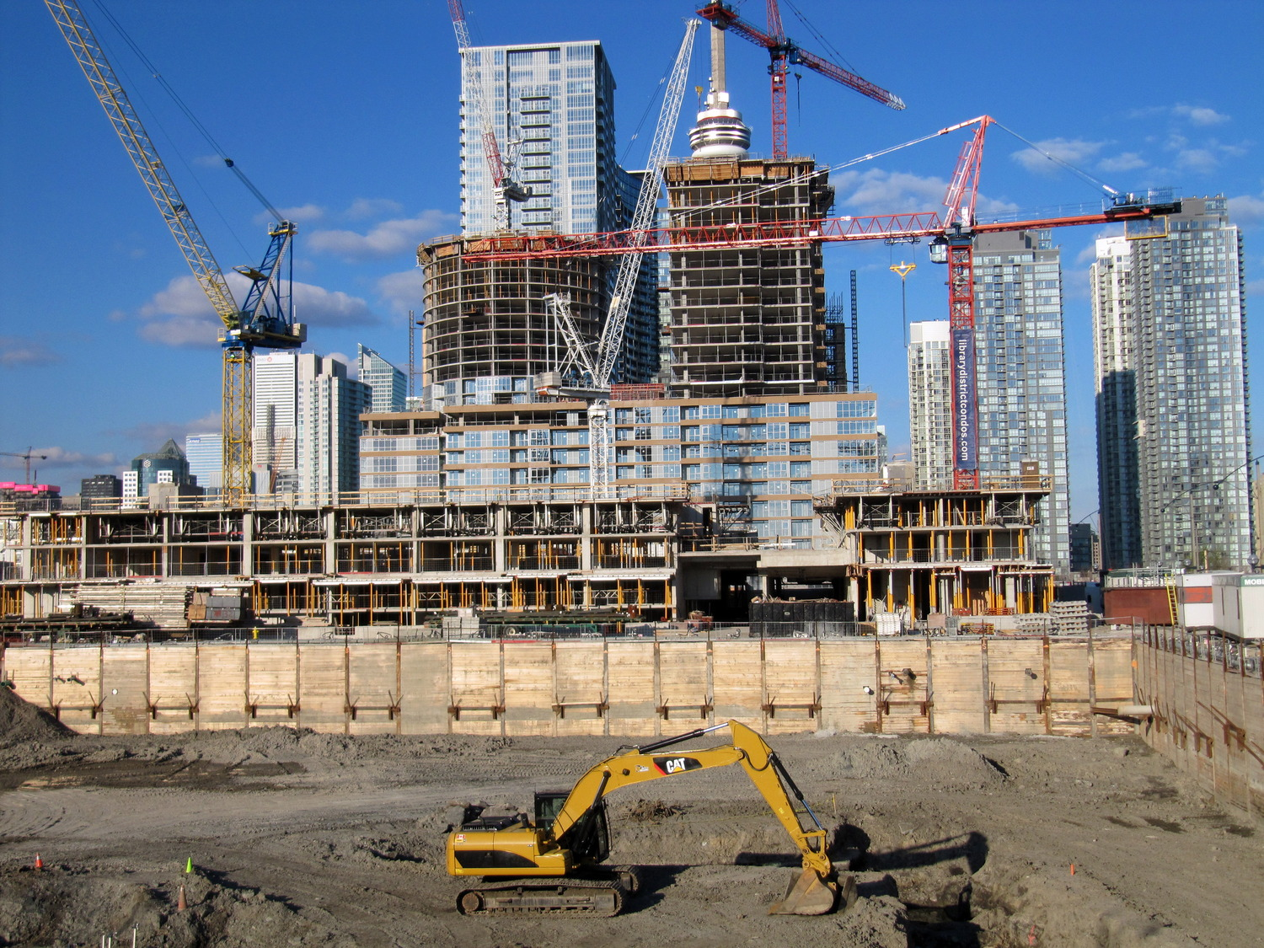
Laboratories
Research and Educational Centre of Competences
«Safety Technology of Strategic Infrastructures and Тerritories»
In the laboratory students are given the unique possibility to assimilate the methodology of risk analysis and practical application of methods of evaluation and prediction of consequences of possible accidents at actual high-risk industrial objects of the Sverdlosk / Ekaterinburg Region, to gain experience and industrial expertise of design documentation, hazardous production objects, to develop measures aimed at assurance of safety level of civil engineering critical infrastructures and territories, to protect the production personnel and population.

Slide 25


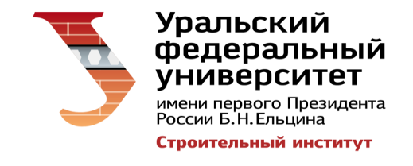
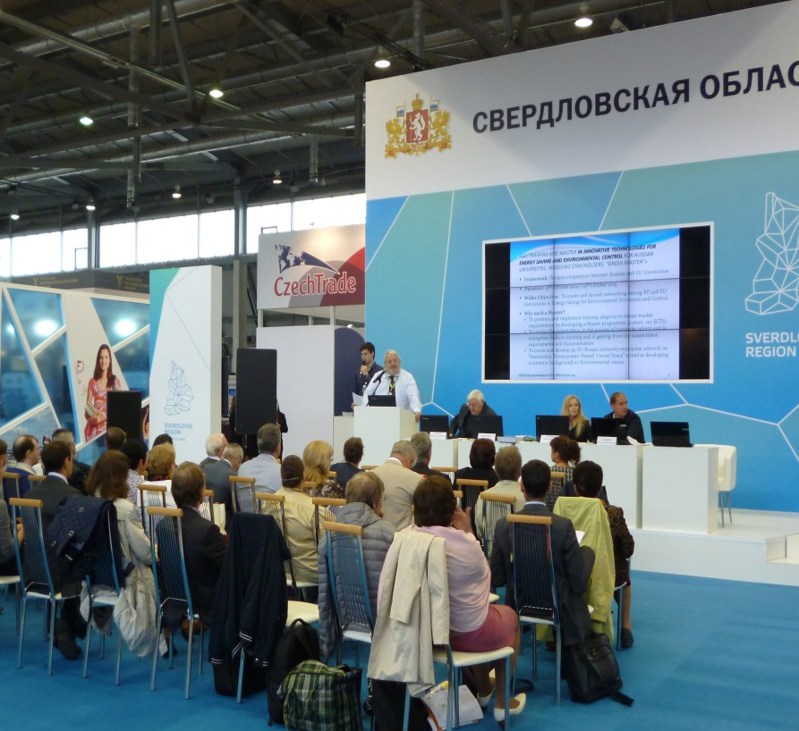
TEMPUS GREENMA 530620- TEMPUS -1-1T-TEMPUS-YPCR
“Innovative Technologies for Energy Saving and Environmental Control”
2012 – 2016
(V. Alekhin is Project Coordinator for the Ural and Siberian regions)
9 Russian Universities and 5 European Universities were involved in the project.
Two Master's Programs have been opened :
«Engineering and Maintenance of Systems of Heat and Gas Supply, Ventilation and Conditioning»;
«Energy-saving Technologies of Microclimate. Energy Audit».
Project results were posted at the international exhibition INNOPROM 2015.

Slide 26
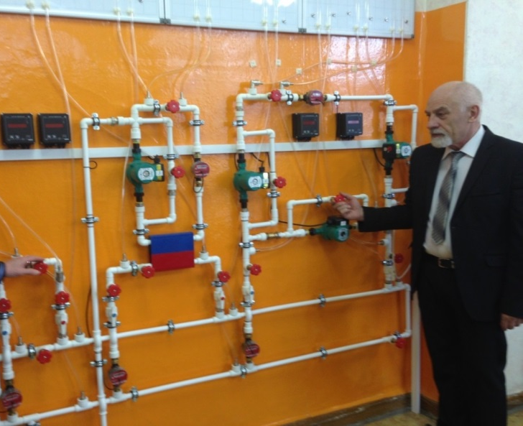
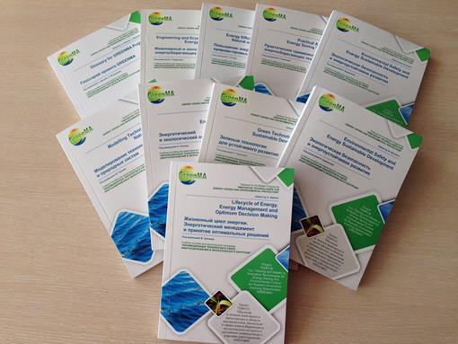
The International Project
TEMPUS GREENMA 530620- TEMPUS -1-1T-TEMPUS-YPCR
“Innovative Technologies for Energy Saving and Environmental Control”
2012 – 2016
Within :
10 volumes of the textbook for Master's Degree Programs have been published;
The electronic educational resources in English, with the participation of professor of the University of Genoa V. Bianko have been developed;
15 professors from European Universities were giving lectures to undergraduates of Institute of Civil Engineering
13 teachers and researchers STI were trained at universities in Europe;
The laboratory equipment, textbooks, manuals, scientific publications in Russian and English languages purchased

Slide 27
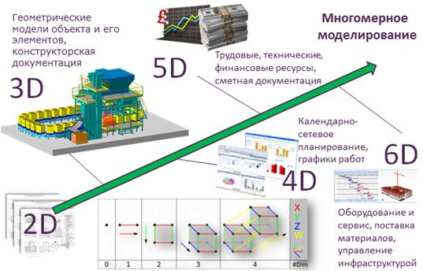
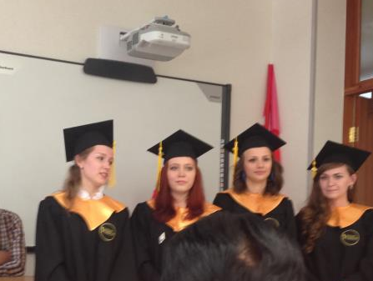
Institute of Civil Engineering
PhD Research Topics
"Building envelope analysis in terms of multi-comfort environment of civic buildings"
The study is aimed at modelling various building constructions behavior based on experimental data and developing effective energy-saving measures. Main focus is on creating comfortable environment, energy-efficiency and interaction between heating appliances and building envelope.
"Energy efficiency as a factor of sustainable territory development”
The subject is an analysis of the economic effect of using energy efficient technologies in building industry. The aim is to attract developers to the problem of energy saving.
"Research and design of new constructional concepts for mobile facades of sustainable buildings”
The study of this thesis concerns an actual research related to the reduction of energy consumption in buildings and maintenance of comfort space air conditions that are applicable for Ural region. Some of constructional concepts intended to increase energy efficiency of buildings are also focused on automation of labour-intensive processes connected with thermal covering and facade facing.

Slide 28
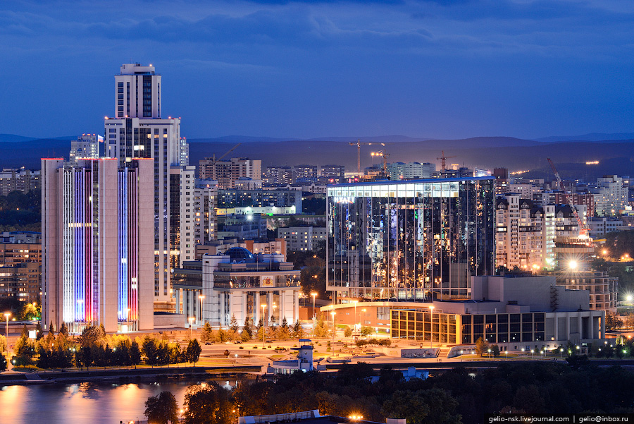
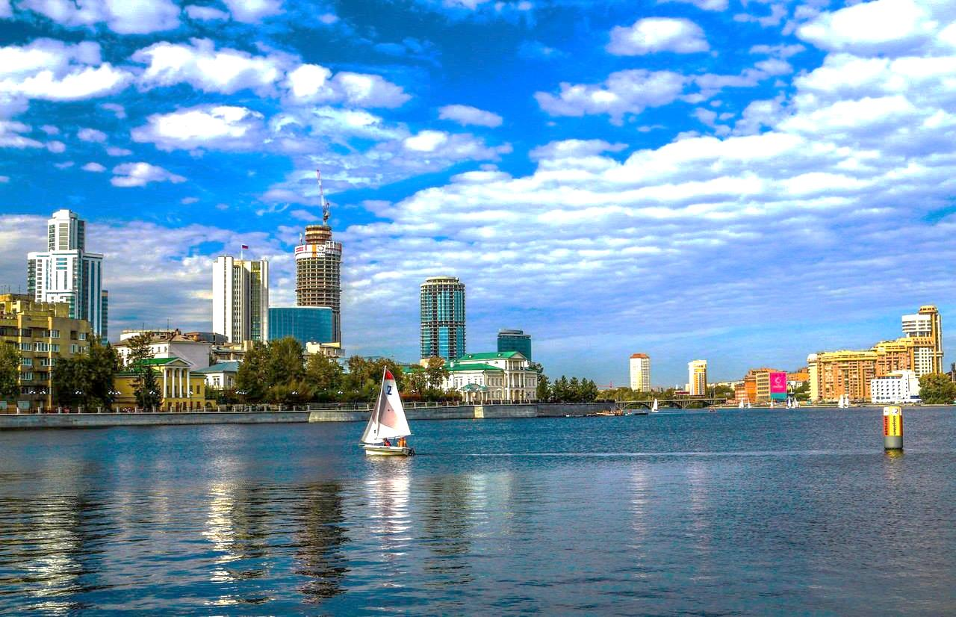
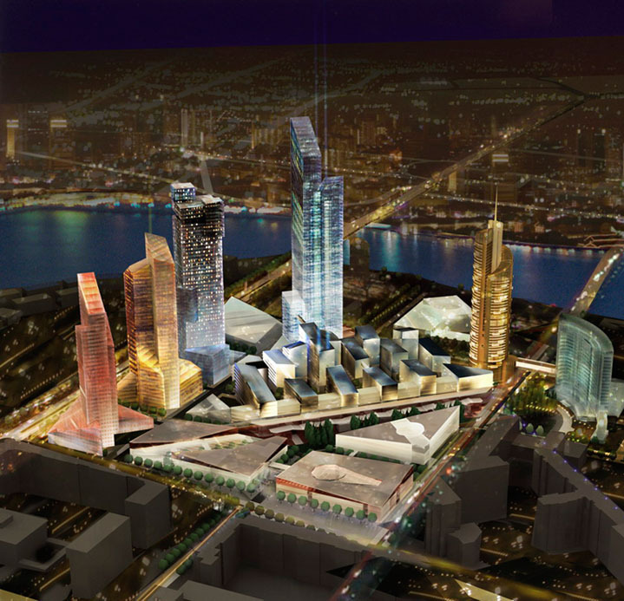
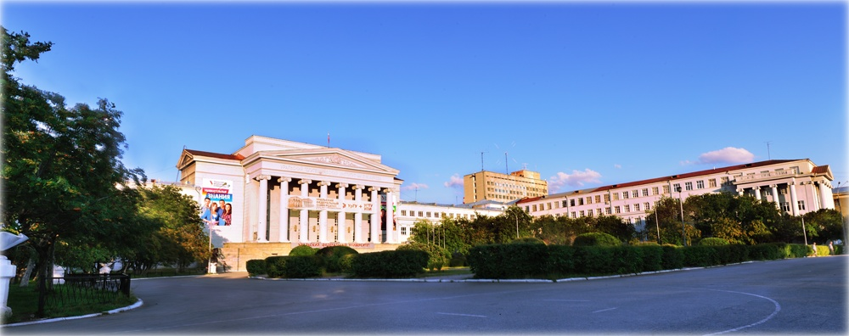
Institute of Civil Engineering
THANK YOU FOR YOUR ATTENTION!

Slide 29
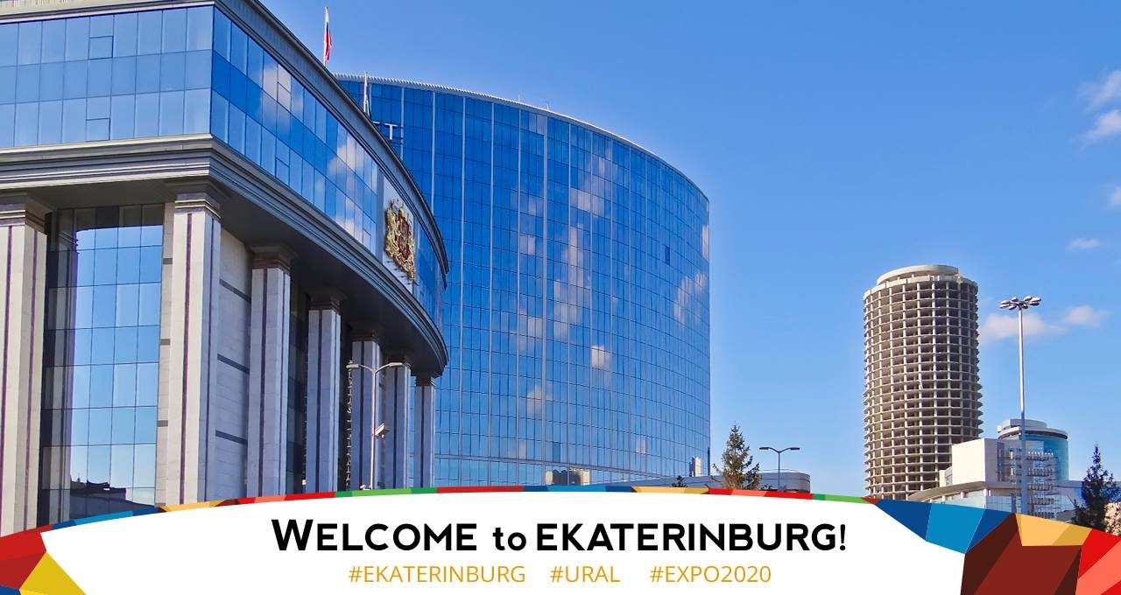
Institute of Civil Engineering
Vladimir Alekhin
referetsf@yandex. ru
Irina Maltseva
3724316@mail.ru

