Slide 1
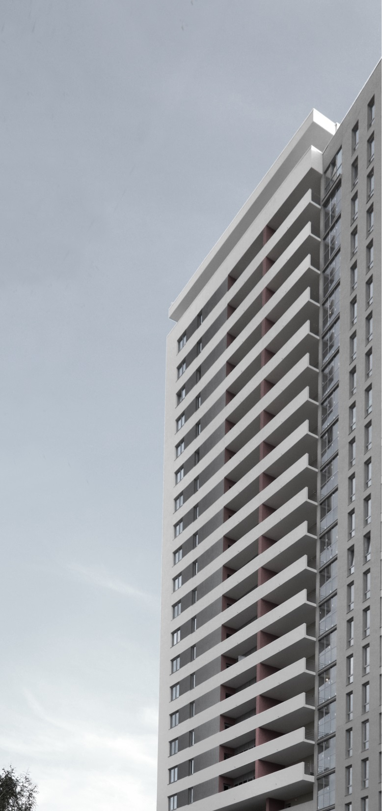
Uralprojectdubrava
company profile

Slide 2
Our services
Uralprojectdubrava
комплексное проектирование многоквартирных жилых домов;
комплексное проектирование общественных зданий;
разработка градостроительной документации в части планировки и схем инженерного оснащения территорий;
дизайн интерьеров;
авторское сопровождение строительства объекта от котлована до сдачи объекта «под ключ».
Architectural Design:
Residential
Commercial
Office
Urban Design / Master Plan
Interior design
Construction Administration

Slide 3
About us
Uralprojectdubrava
ООО "УРАЛПРОЕКТДУБРАВА" предлагает полный комплекс услуг в сфере проектирования зданий. Проектная организация специализируется на проектировании жилых и общественных зданий, в т.ч. торговых центров, банков, офисных зданий, а так же индивидуальных жилых домов. Существуя с 1990 года ООО "УРАЛПРОЕКТДУБРАВА" выполнила более 40 крупных проектов, среди которых торговые центры, офисные здания, банки, детский театр балета, детская поликлиника, Еврейский общинный центр, каждый из этих объектов уникален. На все услуги ООО "УРАЛПРОЕКТДУБРАВА" имеет лицензию.
Опыт и высокий творческий потенциал фирмы подтвержден строительной практикой. Как правило, мы обеспечиваем проектной документацией объекты от их зарождения до рабочих чертежей и их реализации в строительстве. Фирма оснащена современной компьютерной техникой, оборудованием, и сопровождает архитектурное проектирование 3D-моделированием.

Slide 4
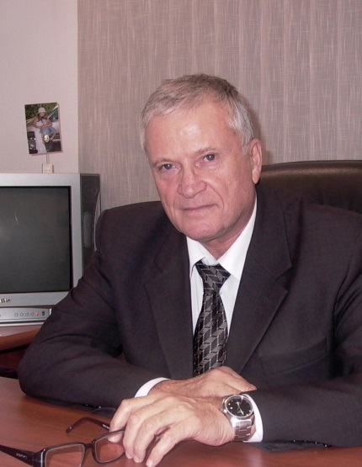
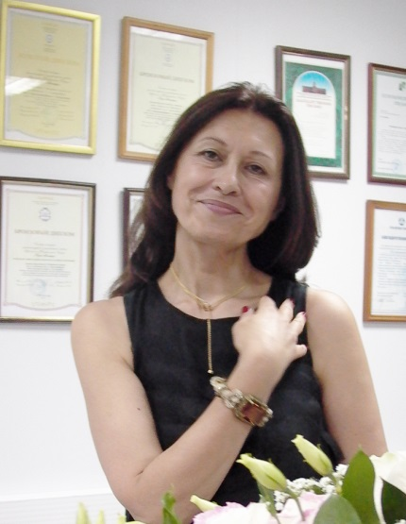
Team
Uralprojectdubrava
Mark Alexandrovich Pakin
PhD in Engineering Sciences
Director
Builder emeritus of Russian Federation
Honorable Power Engineer of Russian Federation
Marina Baisheva
Senior architect
Honorable Architect of Russian Federation
The member of the Union of Architects of Russia

Slide 5
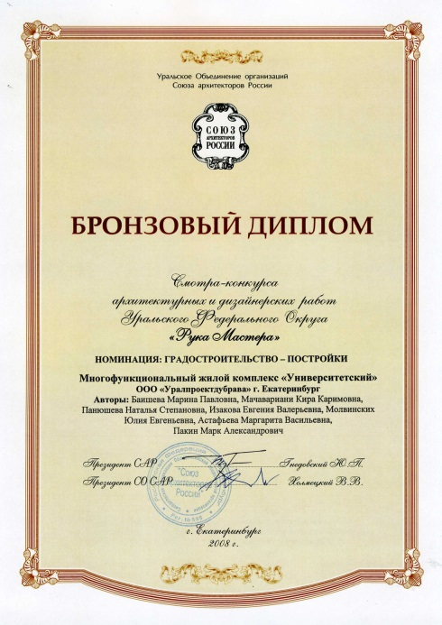
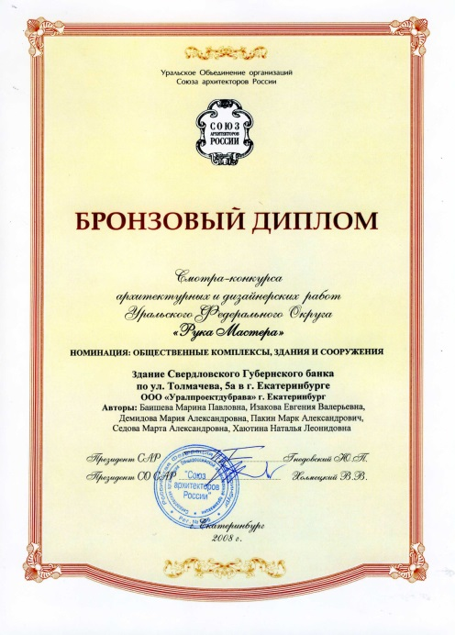
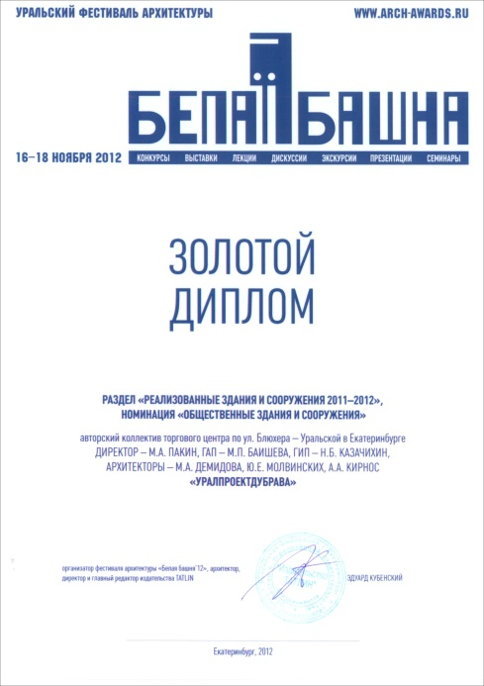
Awards
Uralprojectdubrava
Bronze AWARD of Russian Festival of Architecture “Master’s Hand” –’08
The “Completed buildings and facilities”,
Nomination “Residential Buildings and Complexes” with a project “Residential Complex “Universitetskiy”
Bronze AWARD of Russian Festival of Architecture “Master’s Hand” –’08
The “Completed buildings and facilities”,
Nomination “Public Buildings and facilities” with a project “Bank Gubernsky”
Gold AWARD of the Ural Festival of Architecture “White tower” –’11
The “Projects of buildings and facilities 2010/2011”,
Nomination “Residential Buildings and Complexes” with a project “Residential building on Kuibyshev St.”
Gold AWARD of the Ural Festival of Architecture “White tower” –’12
The “Completed buildings and facilities 2011/2012”,
Nomination “Public Buildings and Facilities” with a project “Shopping Center on Uralskaya St.”

Slide 6
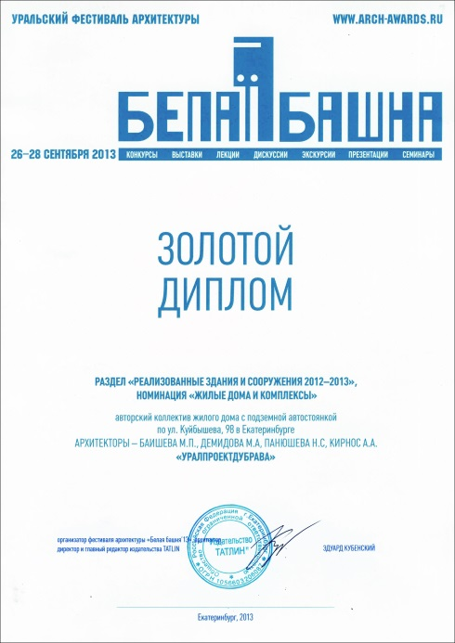
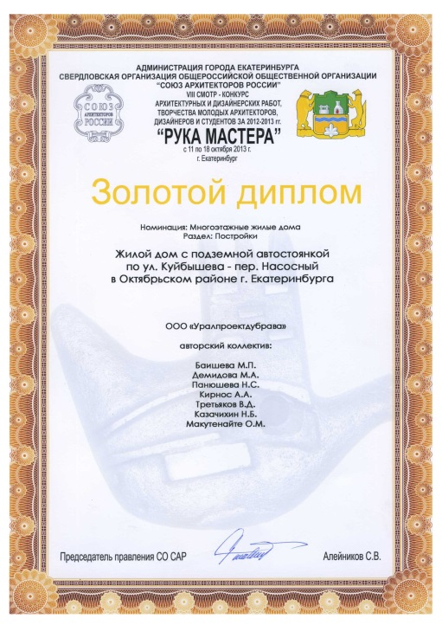
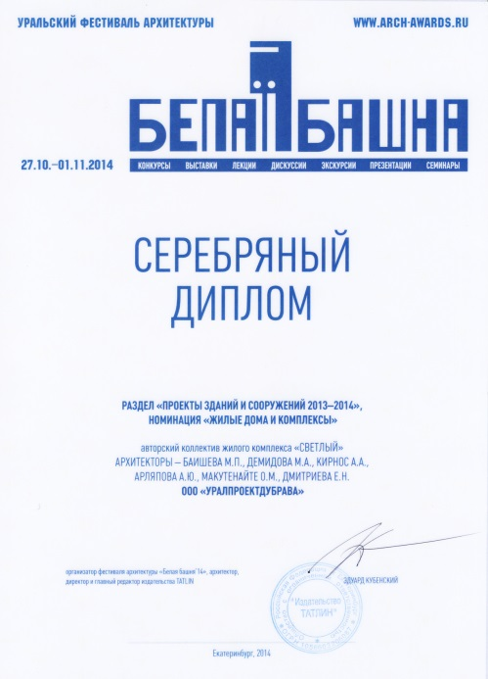
Awards
Uralprojectdubrava
Gold AWARD of the Ural Festival of Architecture “White tower” –’13
The “Completed buildings and facilities 2012/2013”,
Nomination “Residential Buildings and Complexes” with a project “Residential building on Kuibyshev St.”
Gold AWARD of Russian Festival of Architecture “Master’s Hand” –’13
The “Completed buildings and facilities 2012/2013”,
Nomination “Residential Buildings and Complexes” with a project “Residential building on Kuibyshev St.”
Silver AWARD of the Ural Festival of Architecture “White tower” –’14
The “Projects of buildings and facilities 2013/2014”,
Nomination “Residential Buildings and Complexes” with a project “Residential Complex “Svetlyi”
First prize among engineering and design companies of Sverdlovsk Region

Slide 7
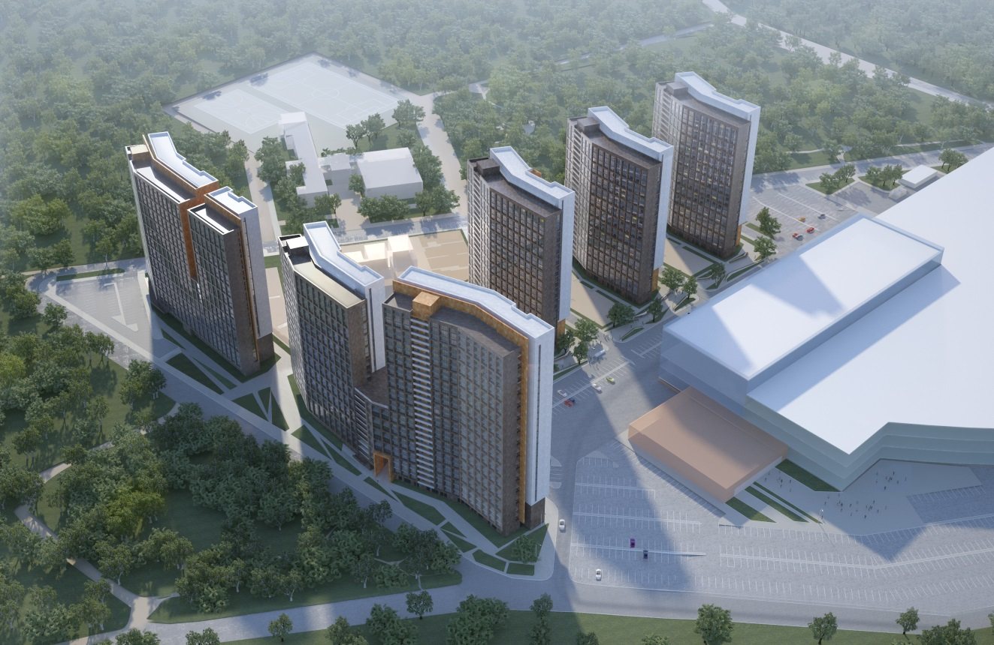
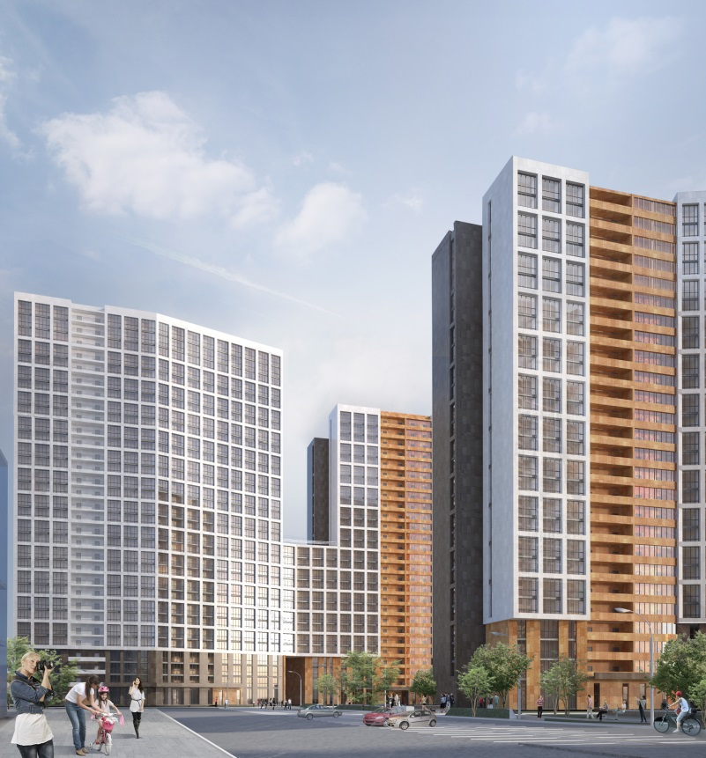
Project. Residential Complex “Svetlyi”
Uralprojectdubrava
Location: Yekaterinburg, Russia
Area: 135,000 sqm
Year: 2013

Slide 8
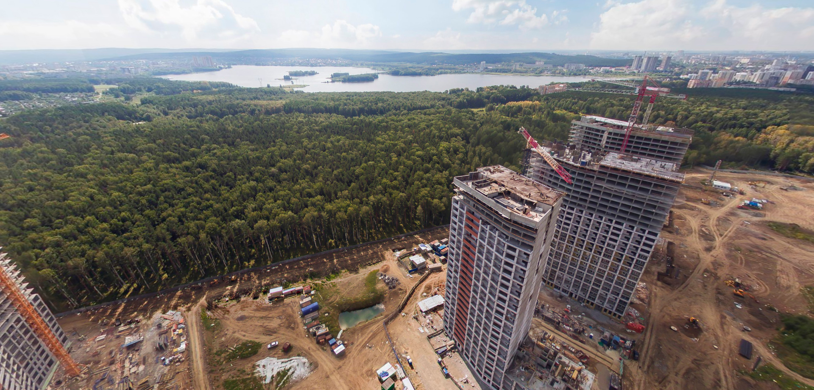
Project. Residential Complex “Svetlyi”
Uralprojectdubrava
Image source: www.svetliy-ekb.ru
Under construction

Slide 9
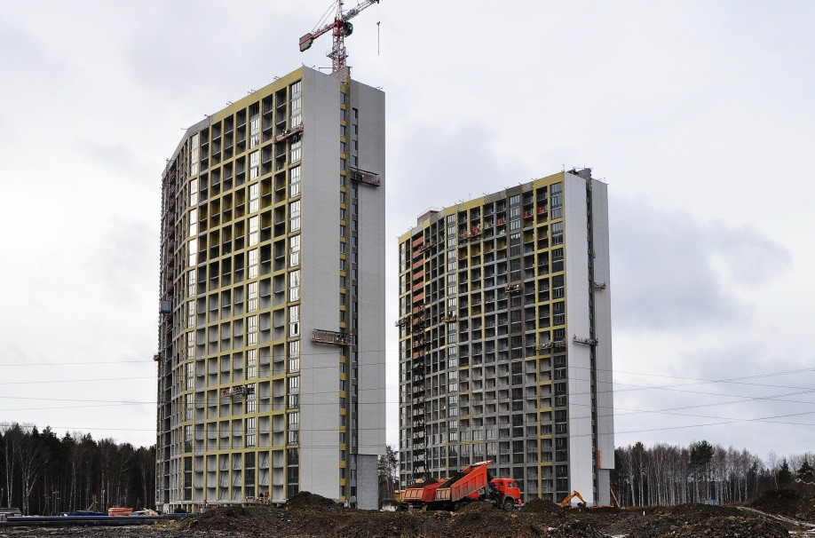
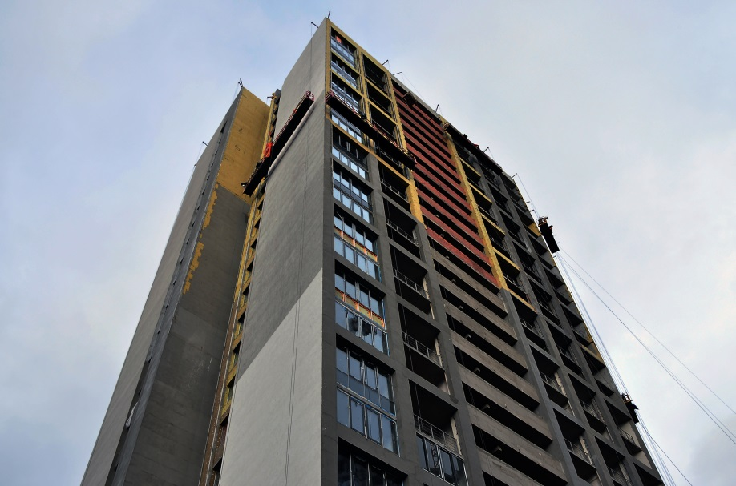
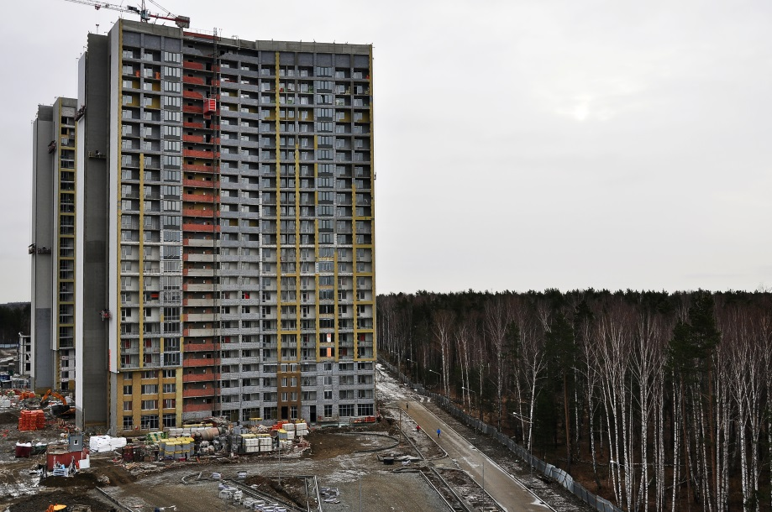
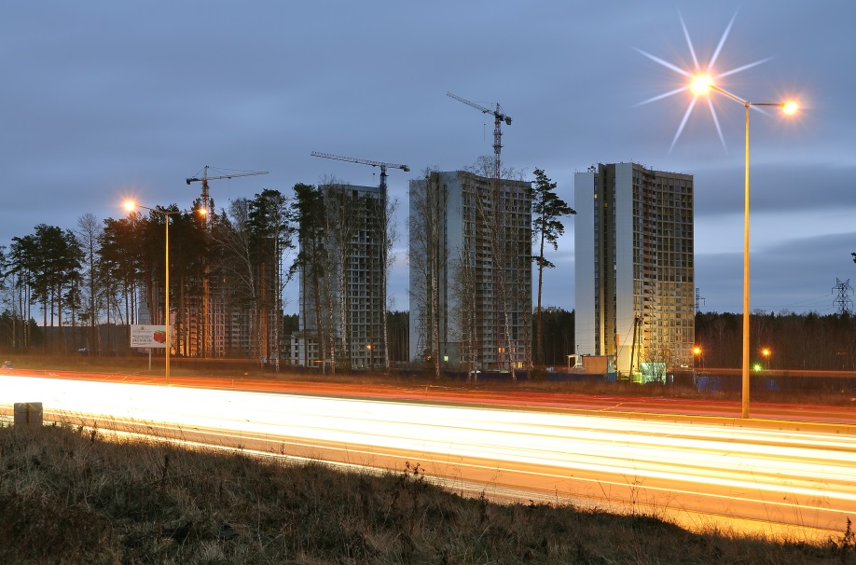
Project. Residential Complex “Svetlyi”
Uralprojectdubrava
Image source: www.svetliy-ekb.ru
Under construction

Slide 10
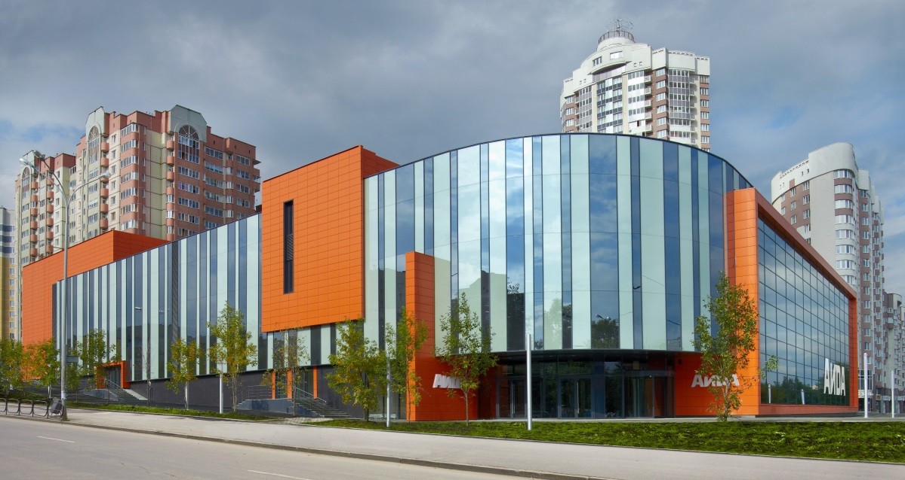
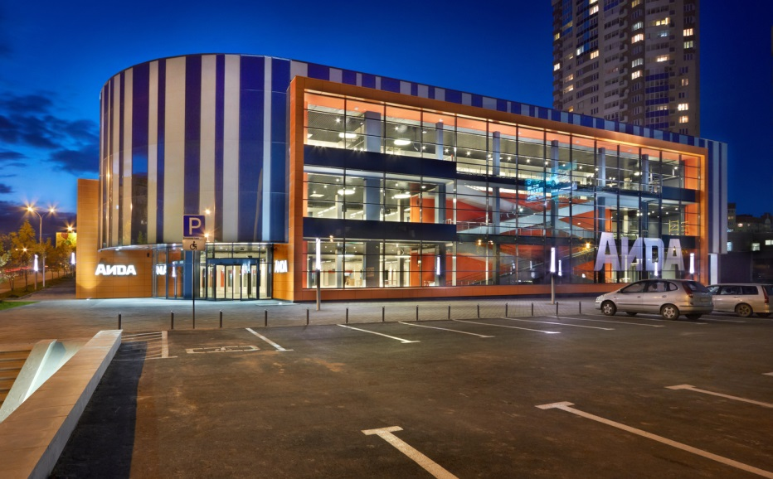
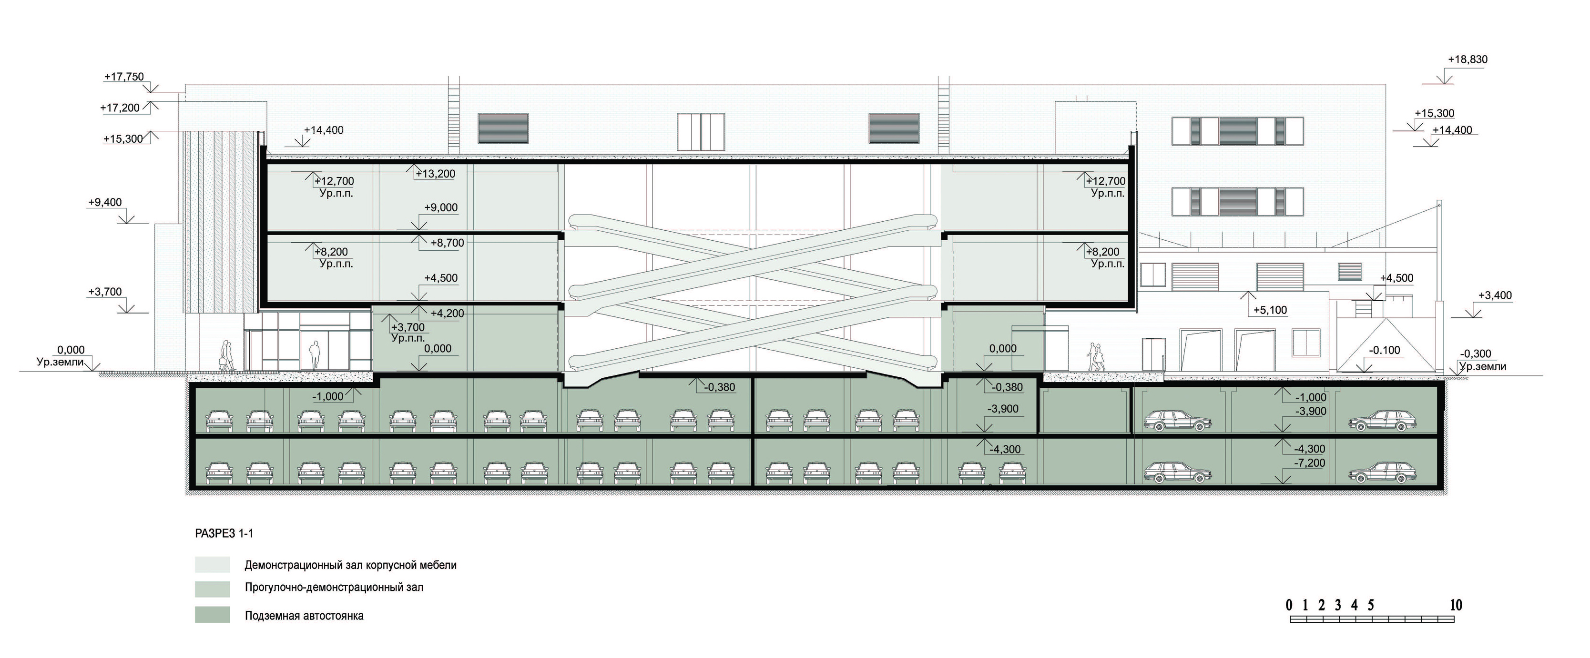
Project. Shopping center “AIDA”
Uralprojectdubrava
Location: Yekaterinburg, Russia
Area: 30,700 sqm
Year: 2011/2012

Slide 11
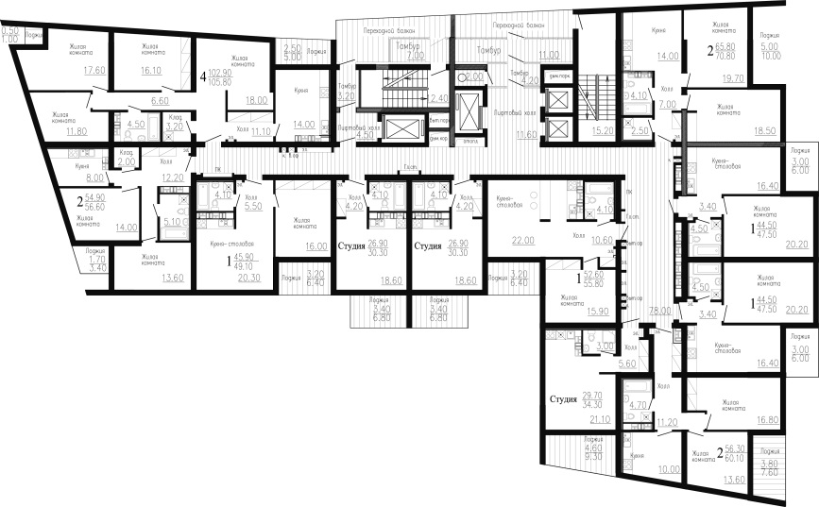
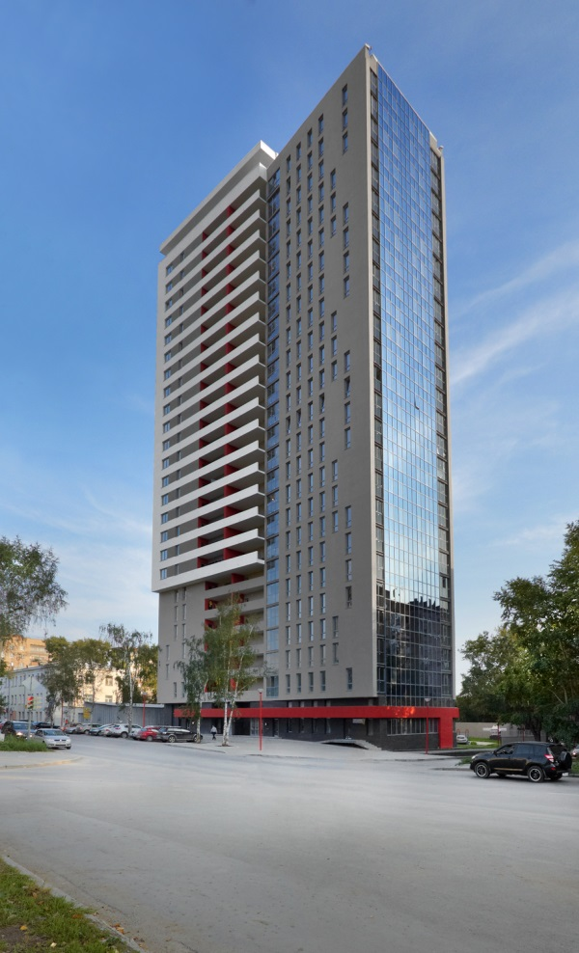
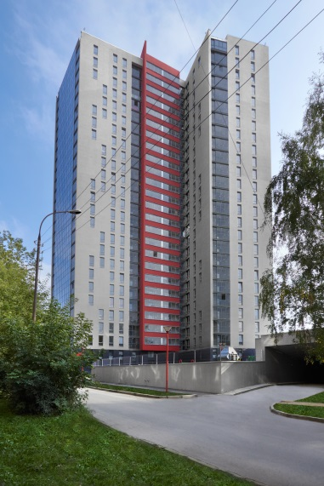
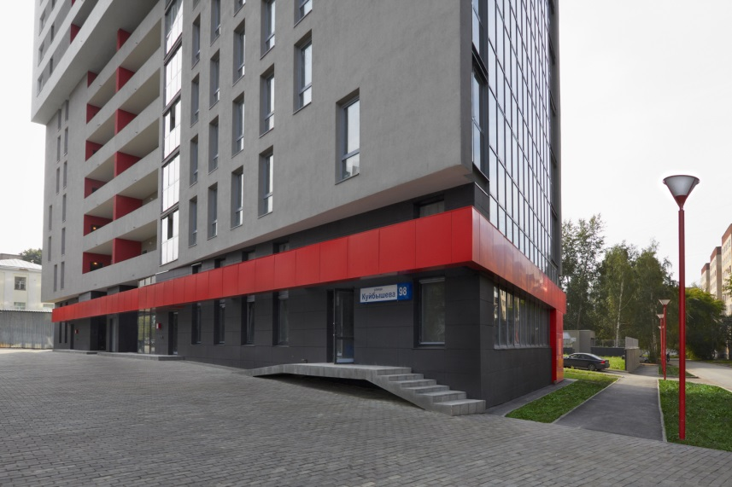
Project. Residential building “Kuibysheva, 98”
Uralprojectdubrava
Location: Yekaterinburg, Russia
Area: 21,790 sqm
Year: 2012/2013

Slide 12
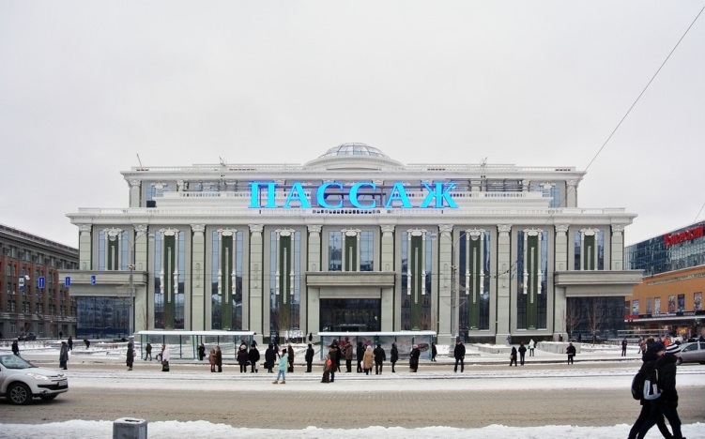
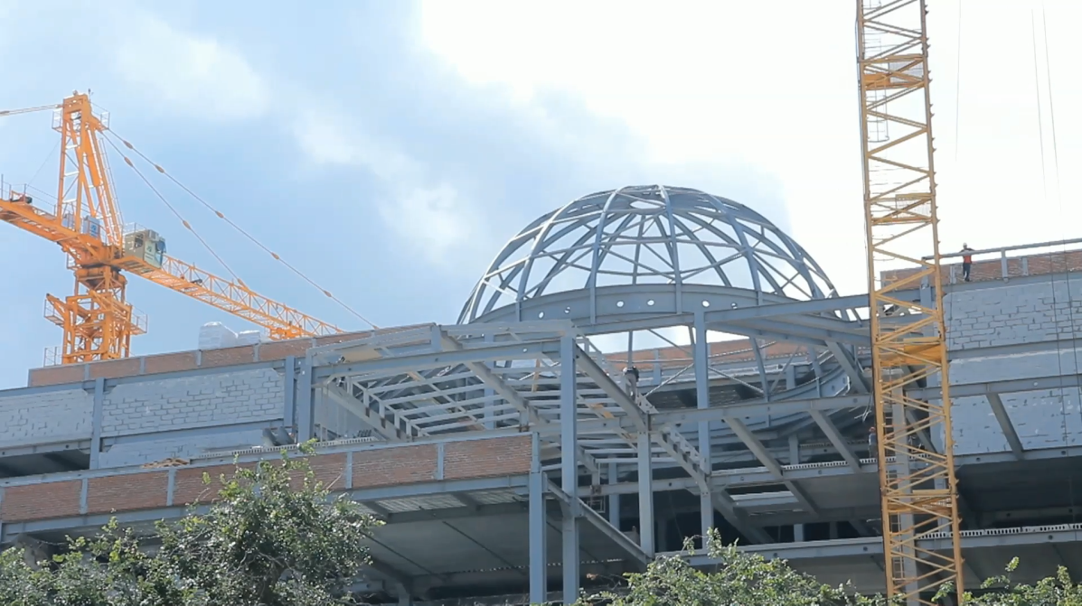
Project. Shopping center “Passage”
Uralprojectdubrava
Location: Yekaterinburg, Russia
Area: 65,000 sqm
Year: 2015
Under construction

Slide 13
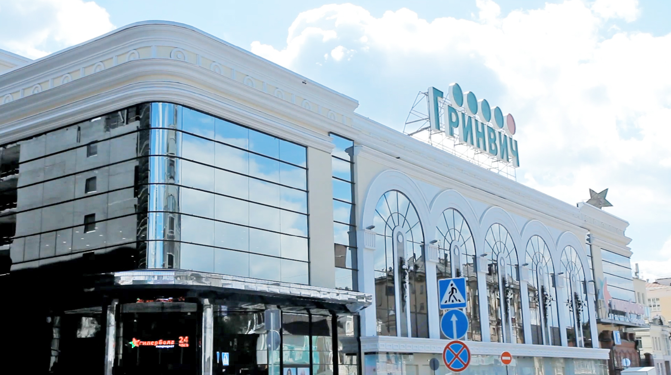
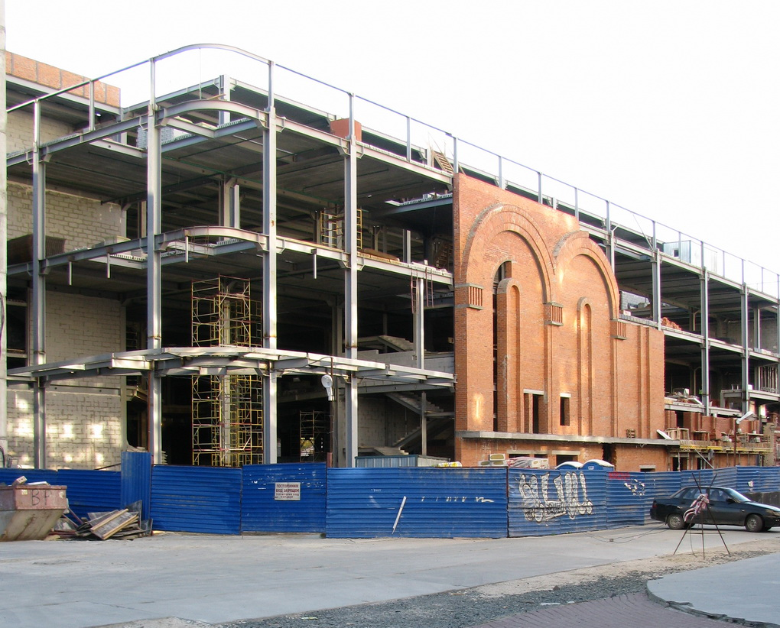
Project. Shopping center “Greenwich”
Uralprojectdubrava
Location: Yekaterinburg, Russia
Area: 136,000 sqm
Year: 2015
Under construction

Slide 14
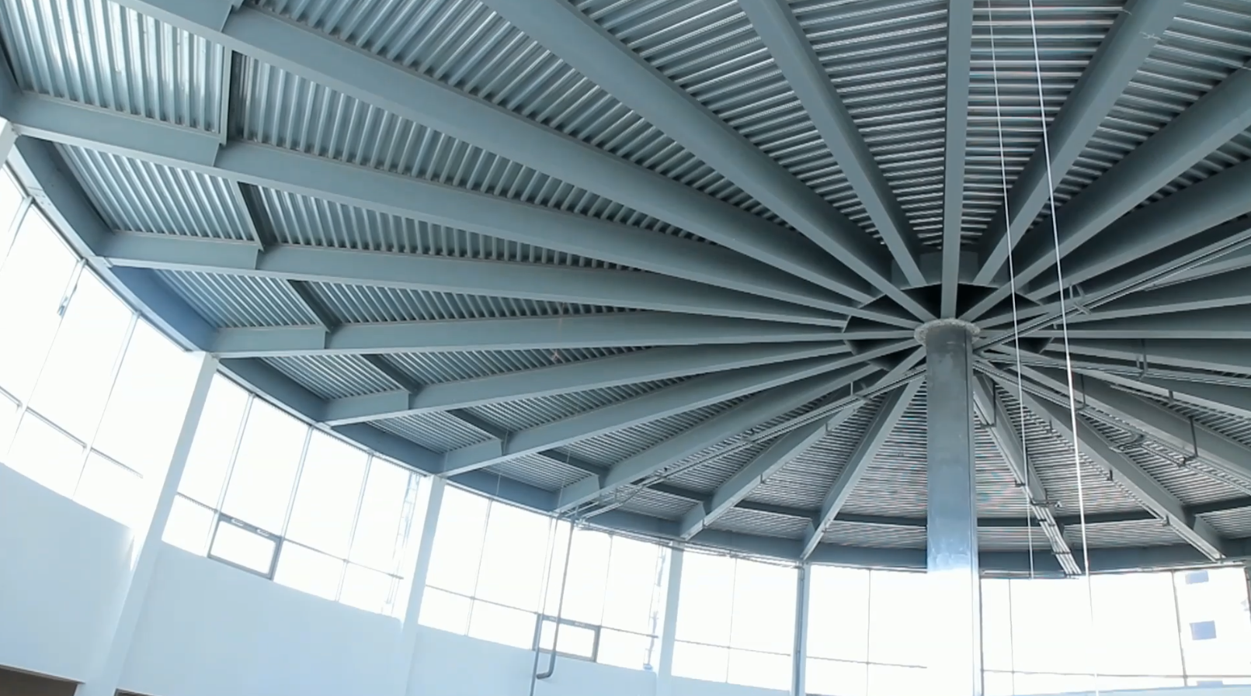
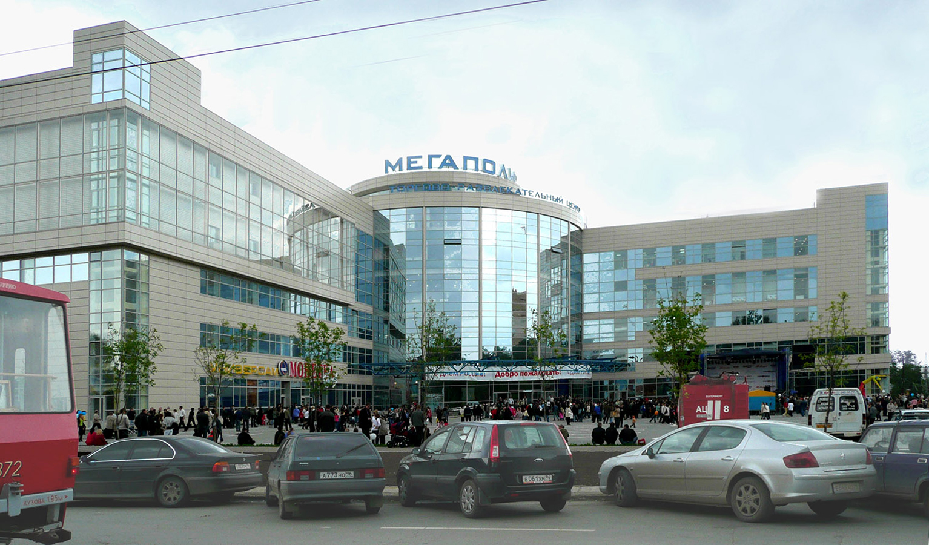
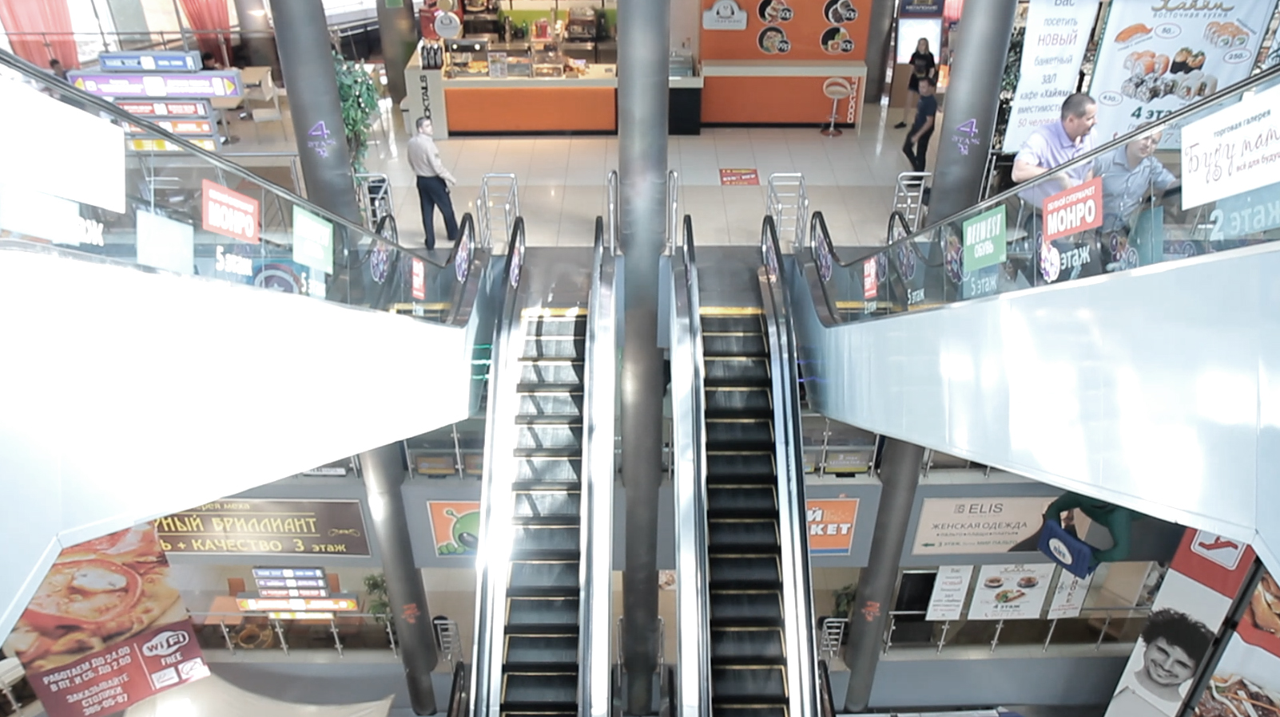
Project. Shopping center “Megapolis”
Uralprojectdubrava
Location: Yekaterinburg, Russia
Area: 41,500 sqm
Year: 2008

Slide 15
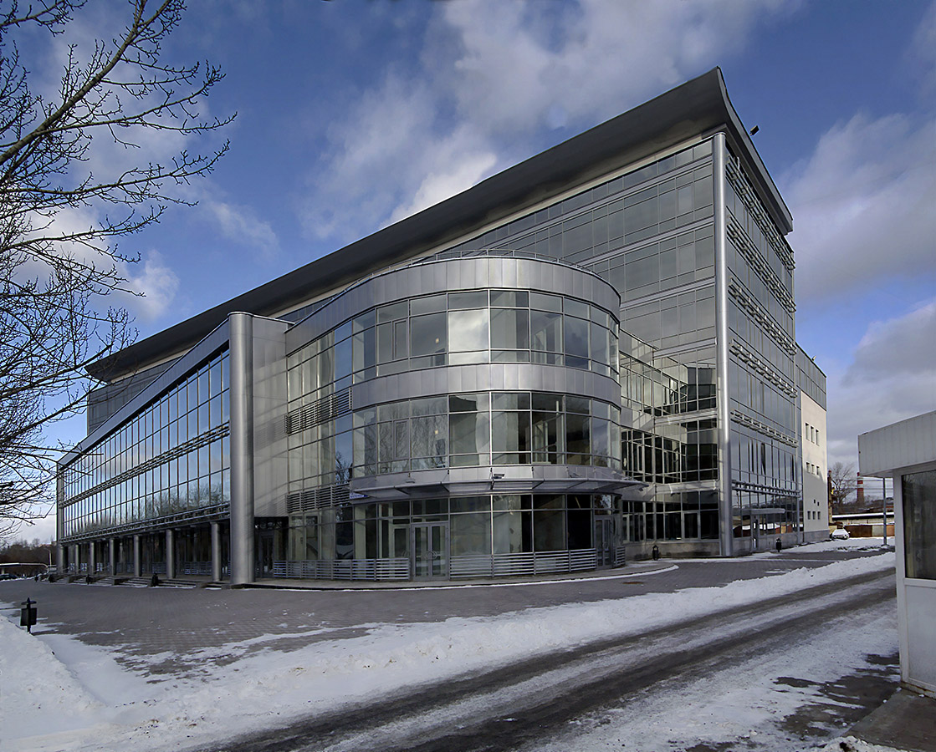
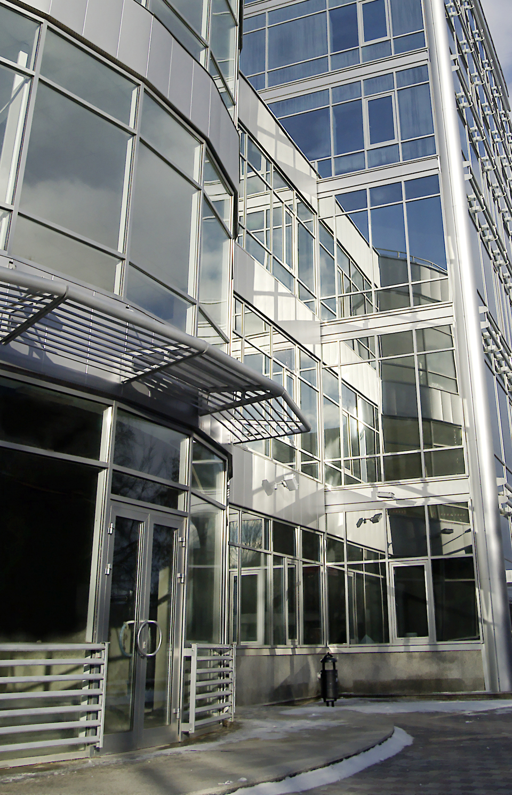
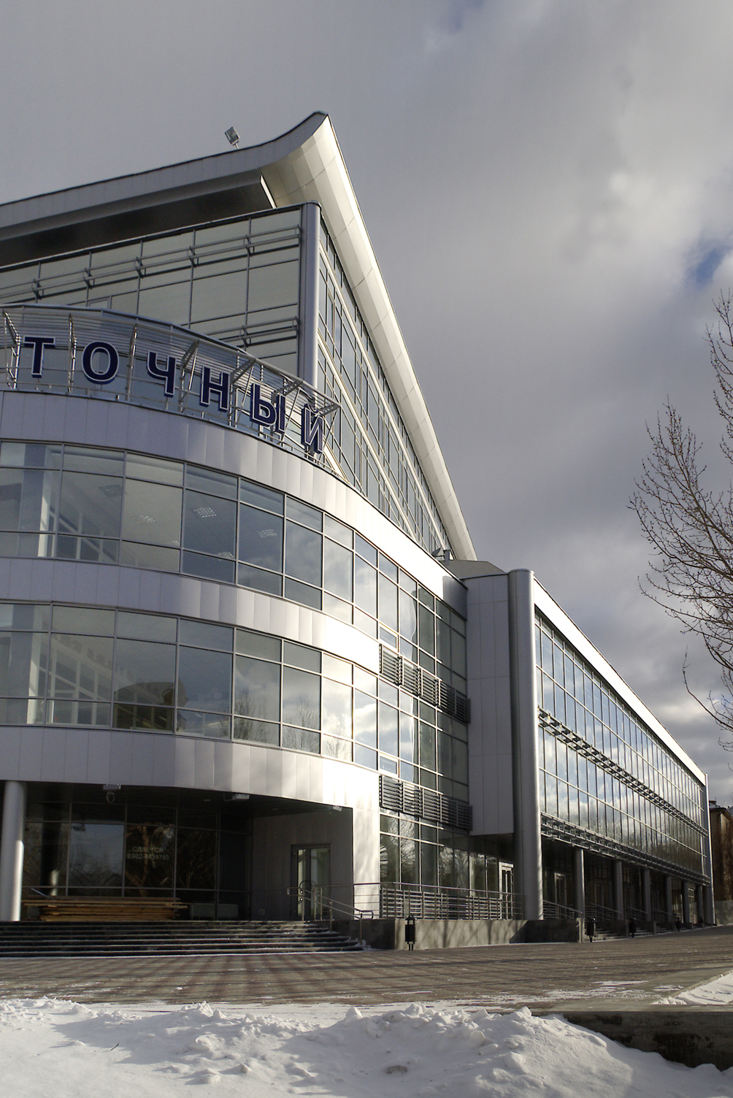
Project. Office center “Vostochnyi”
Uralprojectdubrava
Location: Yekaterinburg, Russia
Area: 13,200 sqm
Year: 2000

Slide 16
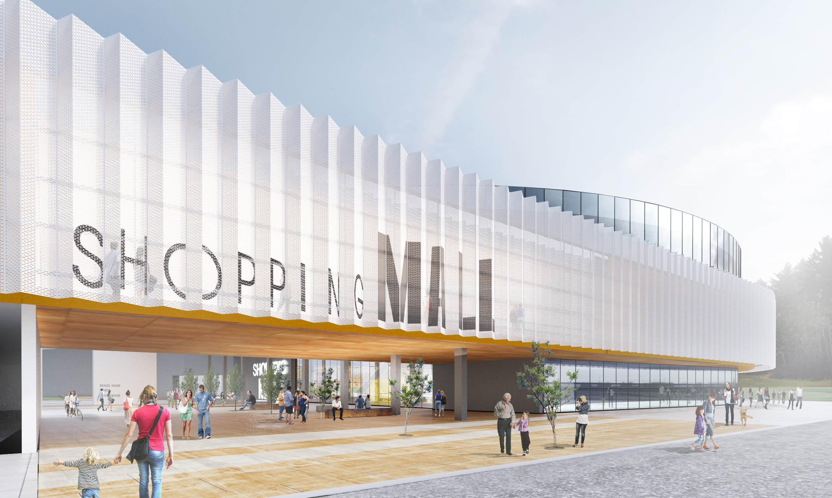
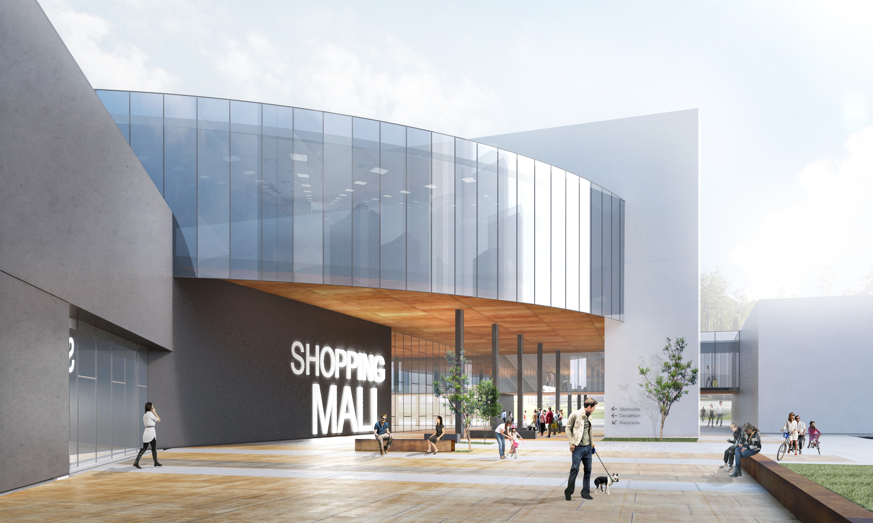
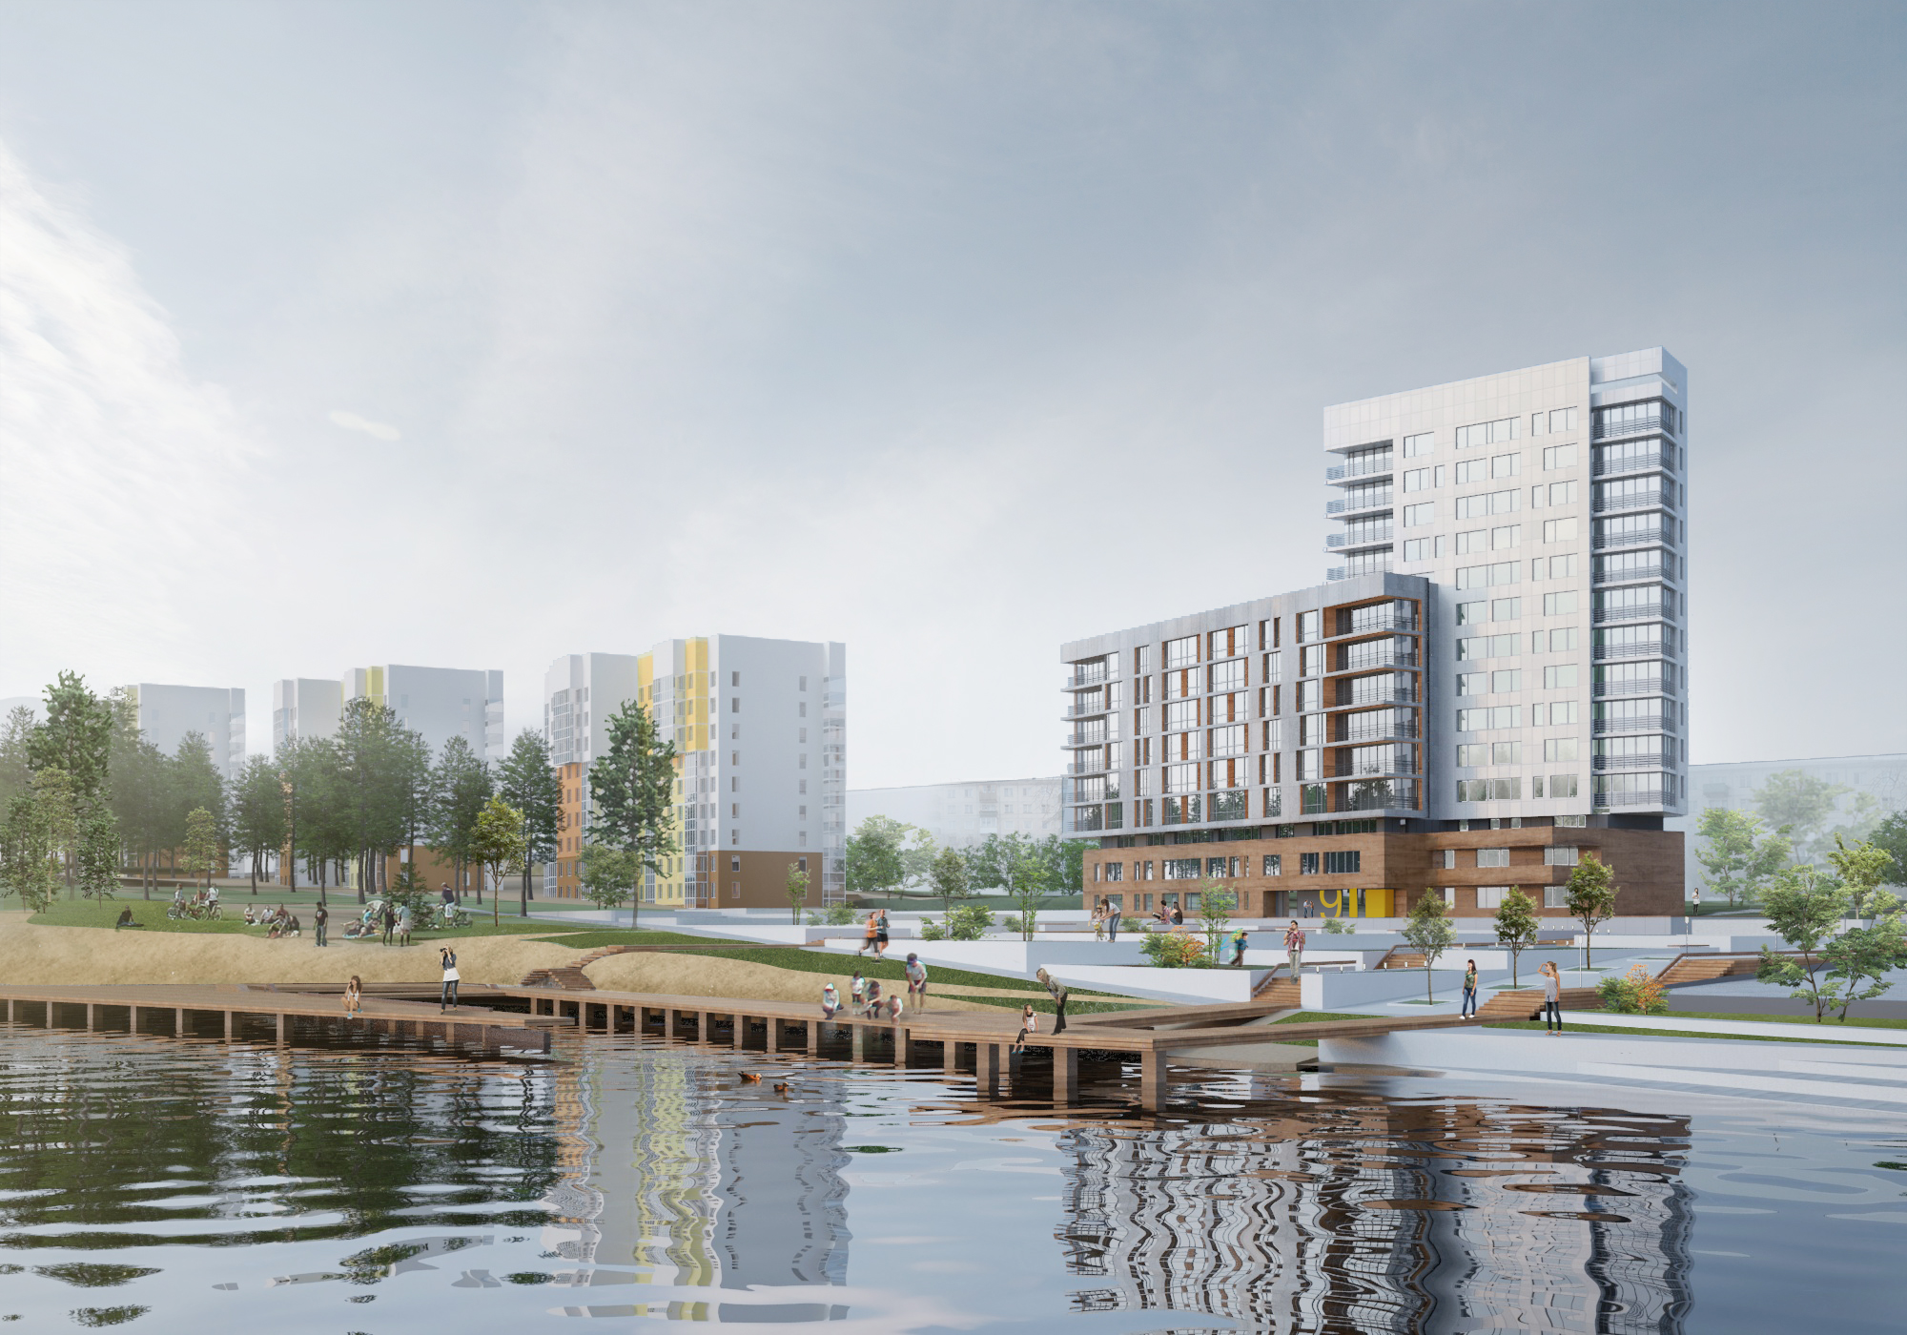
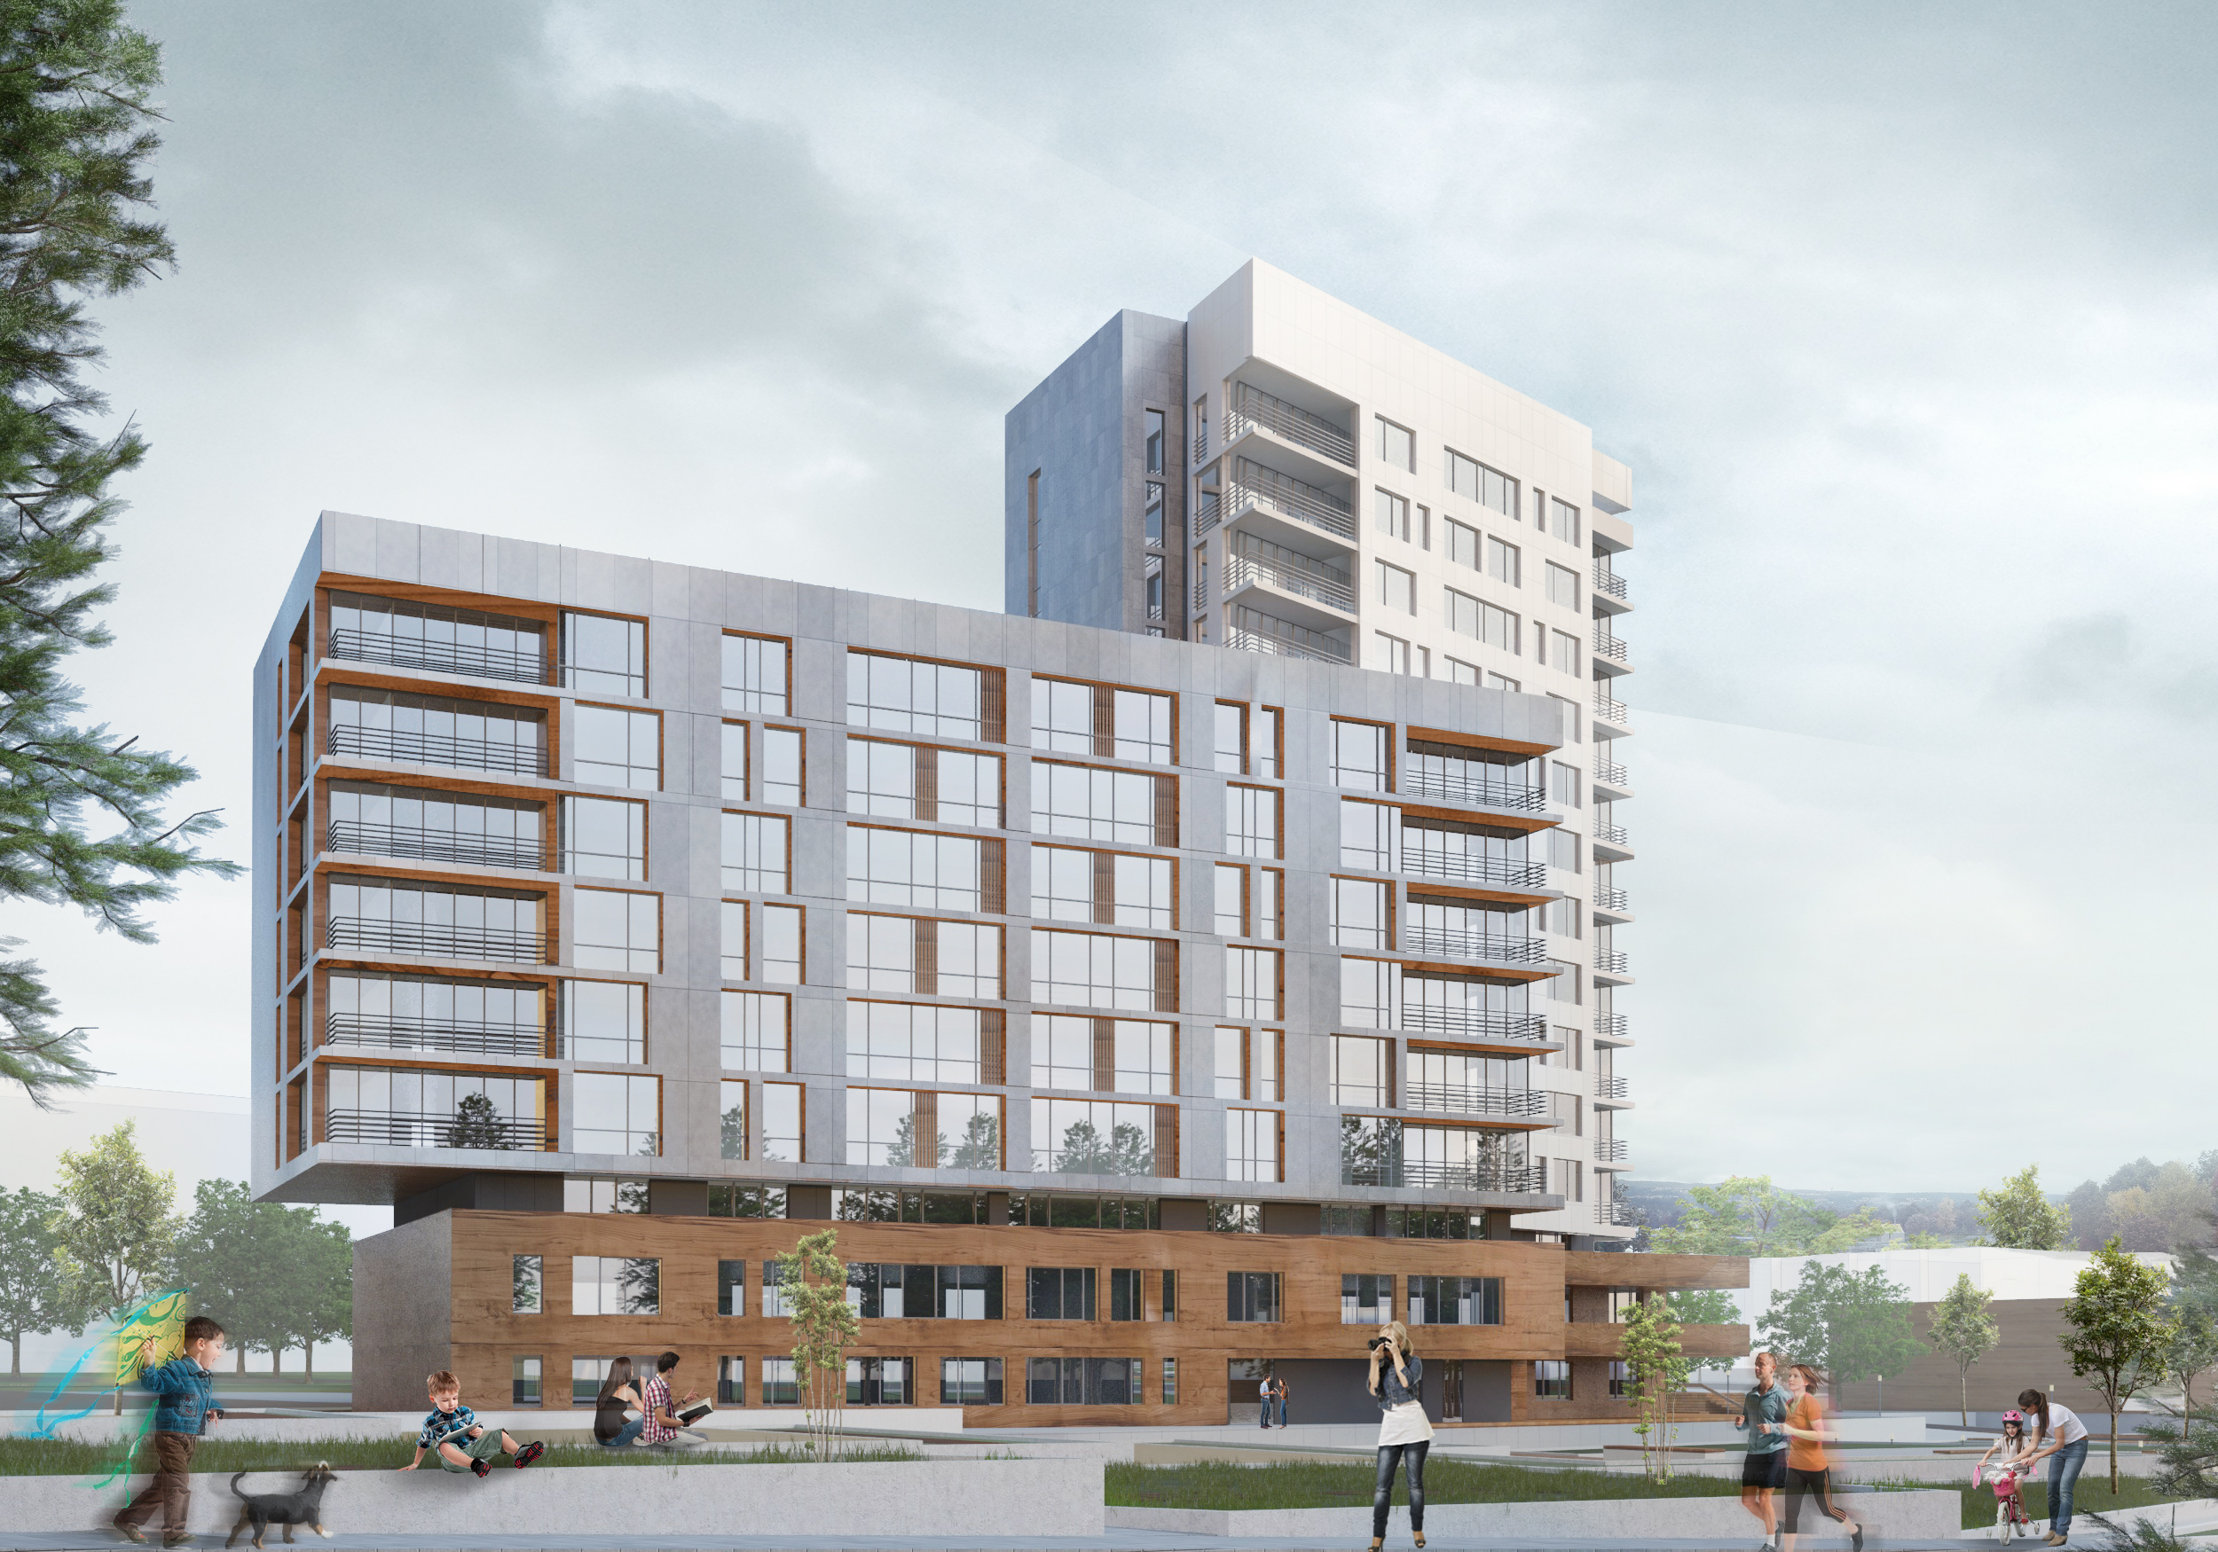
Current projects
Uralprojectdubrava
Shopping Center
Yekaterinburg, Russia
Residential building
Yekaterinburg, Russia

Slide 17
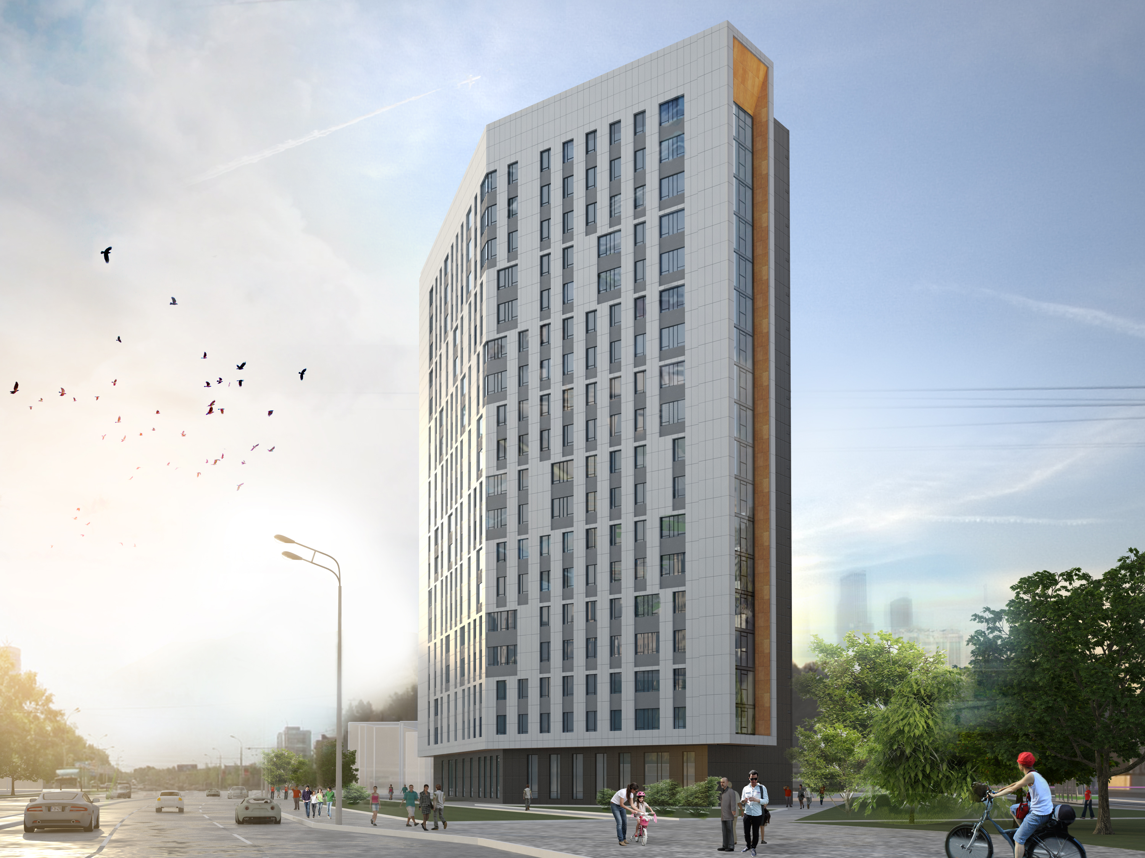
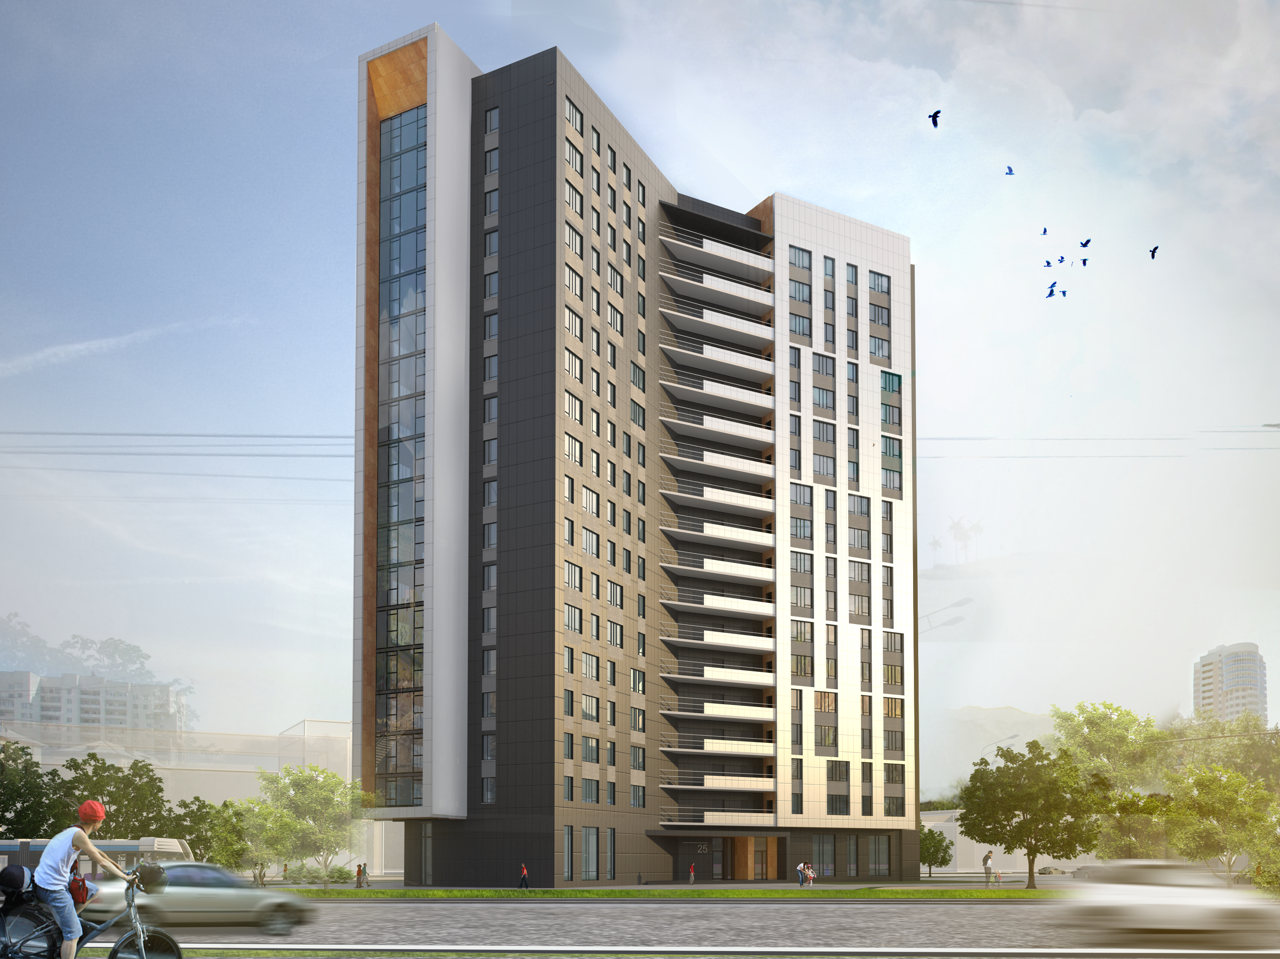
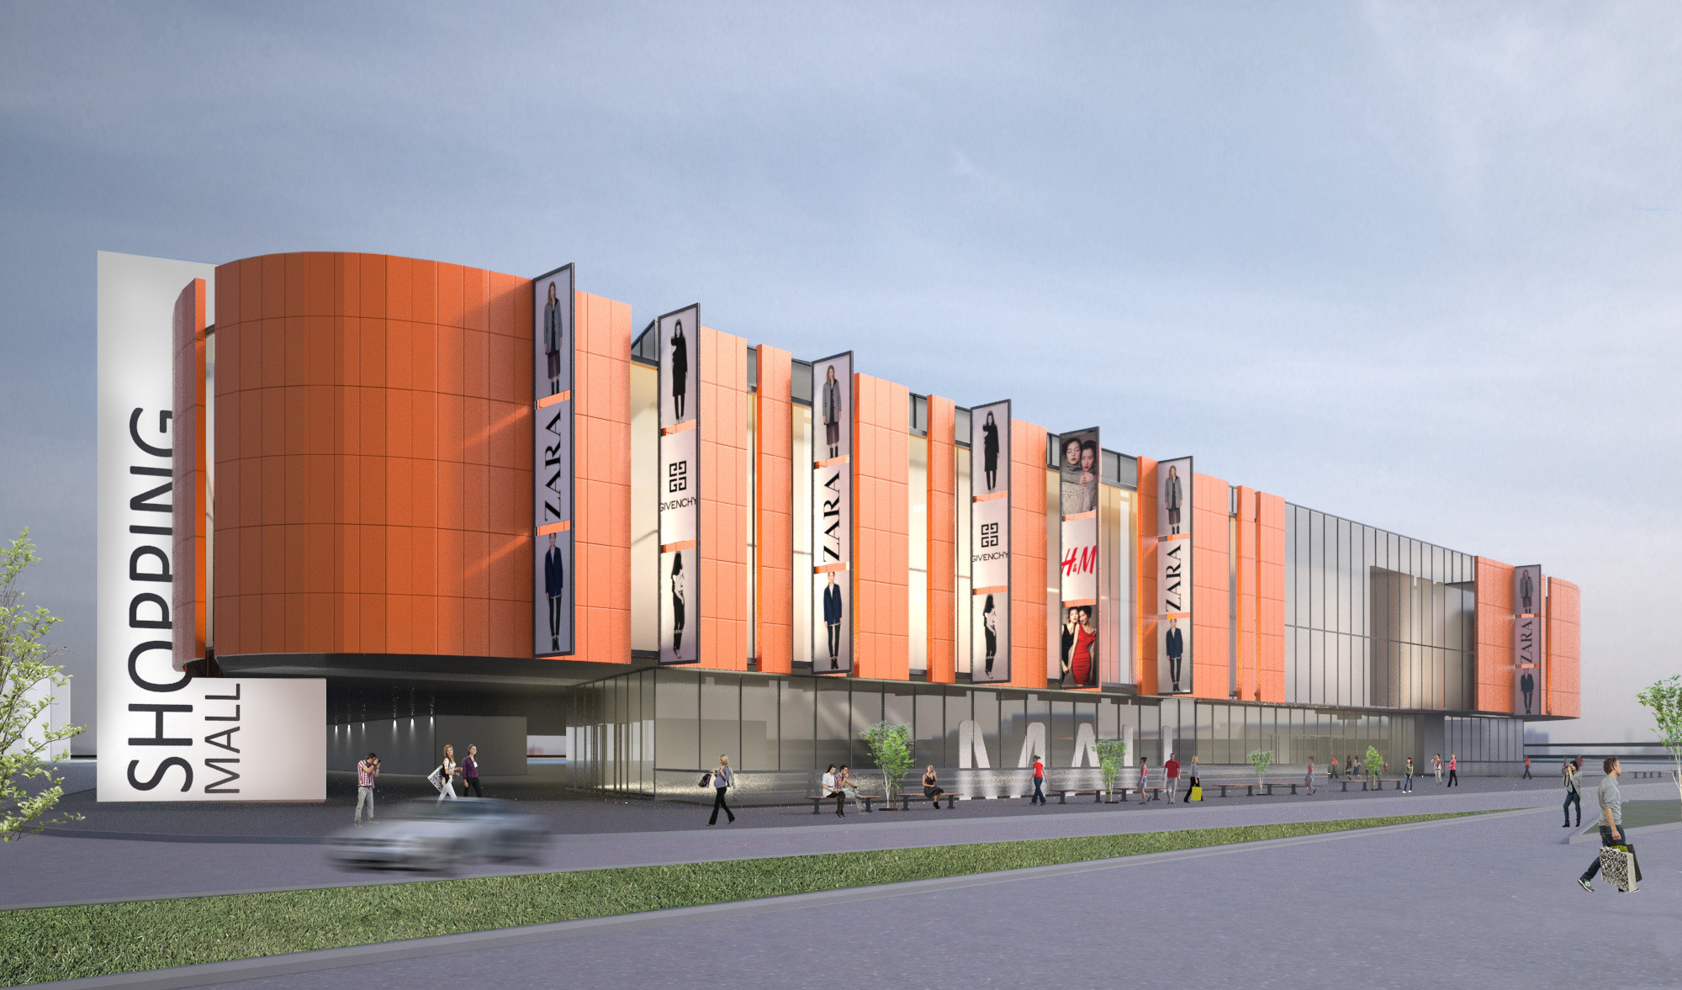
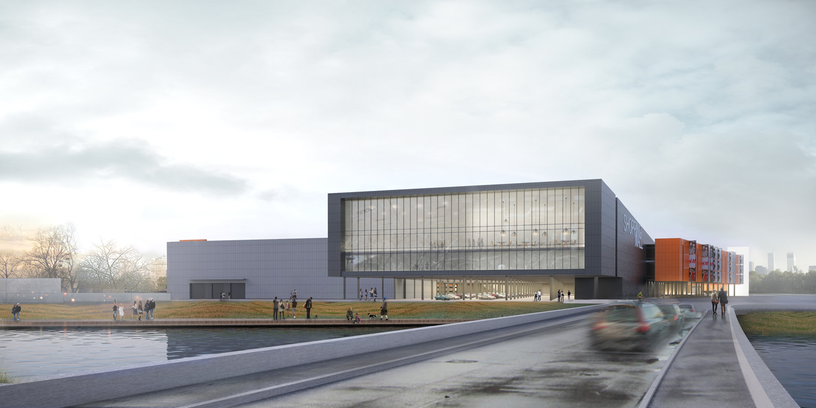
Current projects
Uralprojectdubrava
Residential complex
Yekaterinburg, Russia
Shopping center
Yekaterinburg, Russia

Slide 18
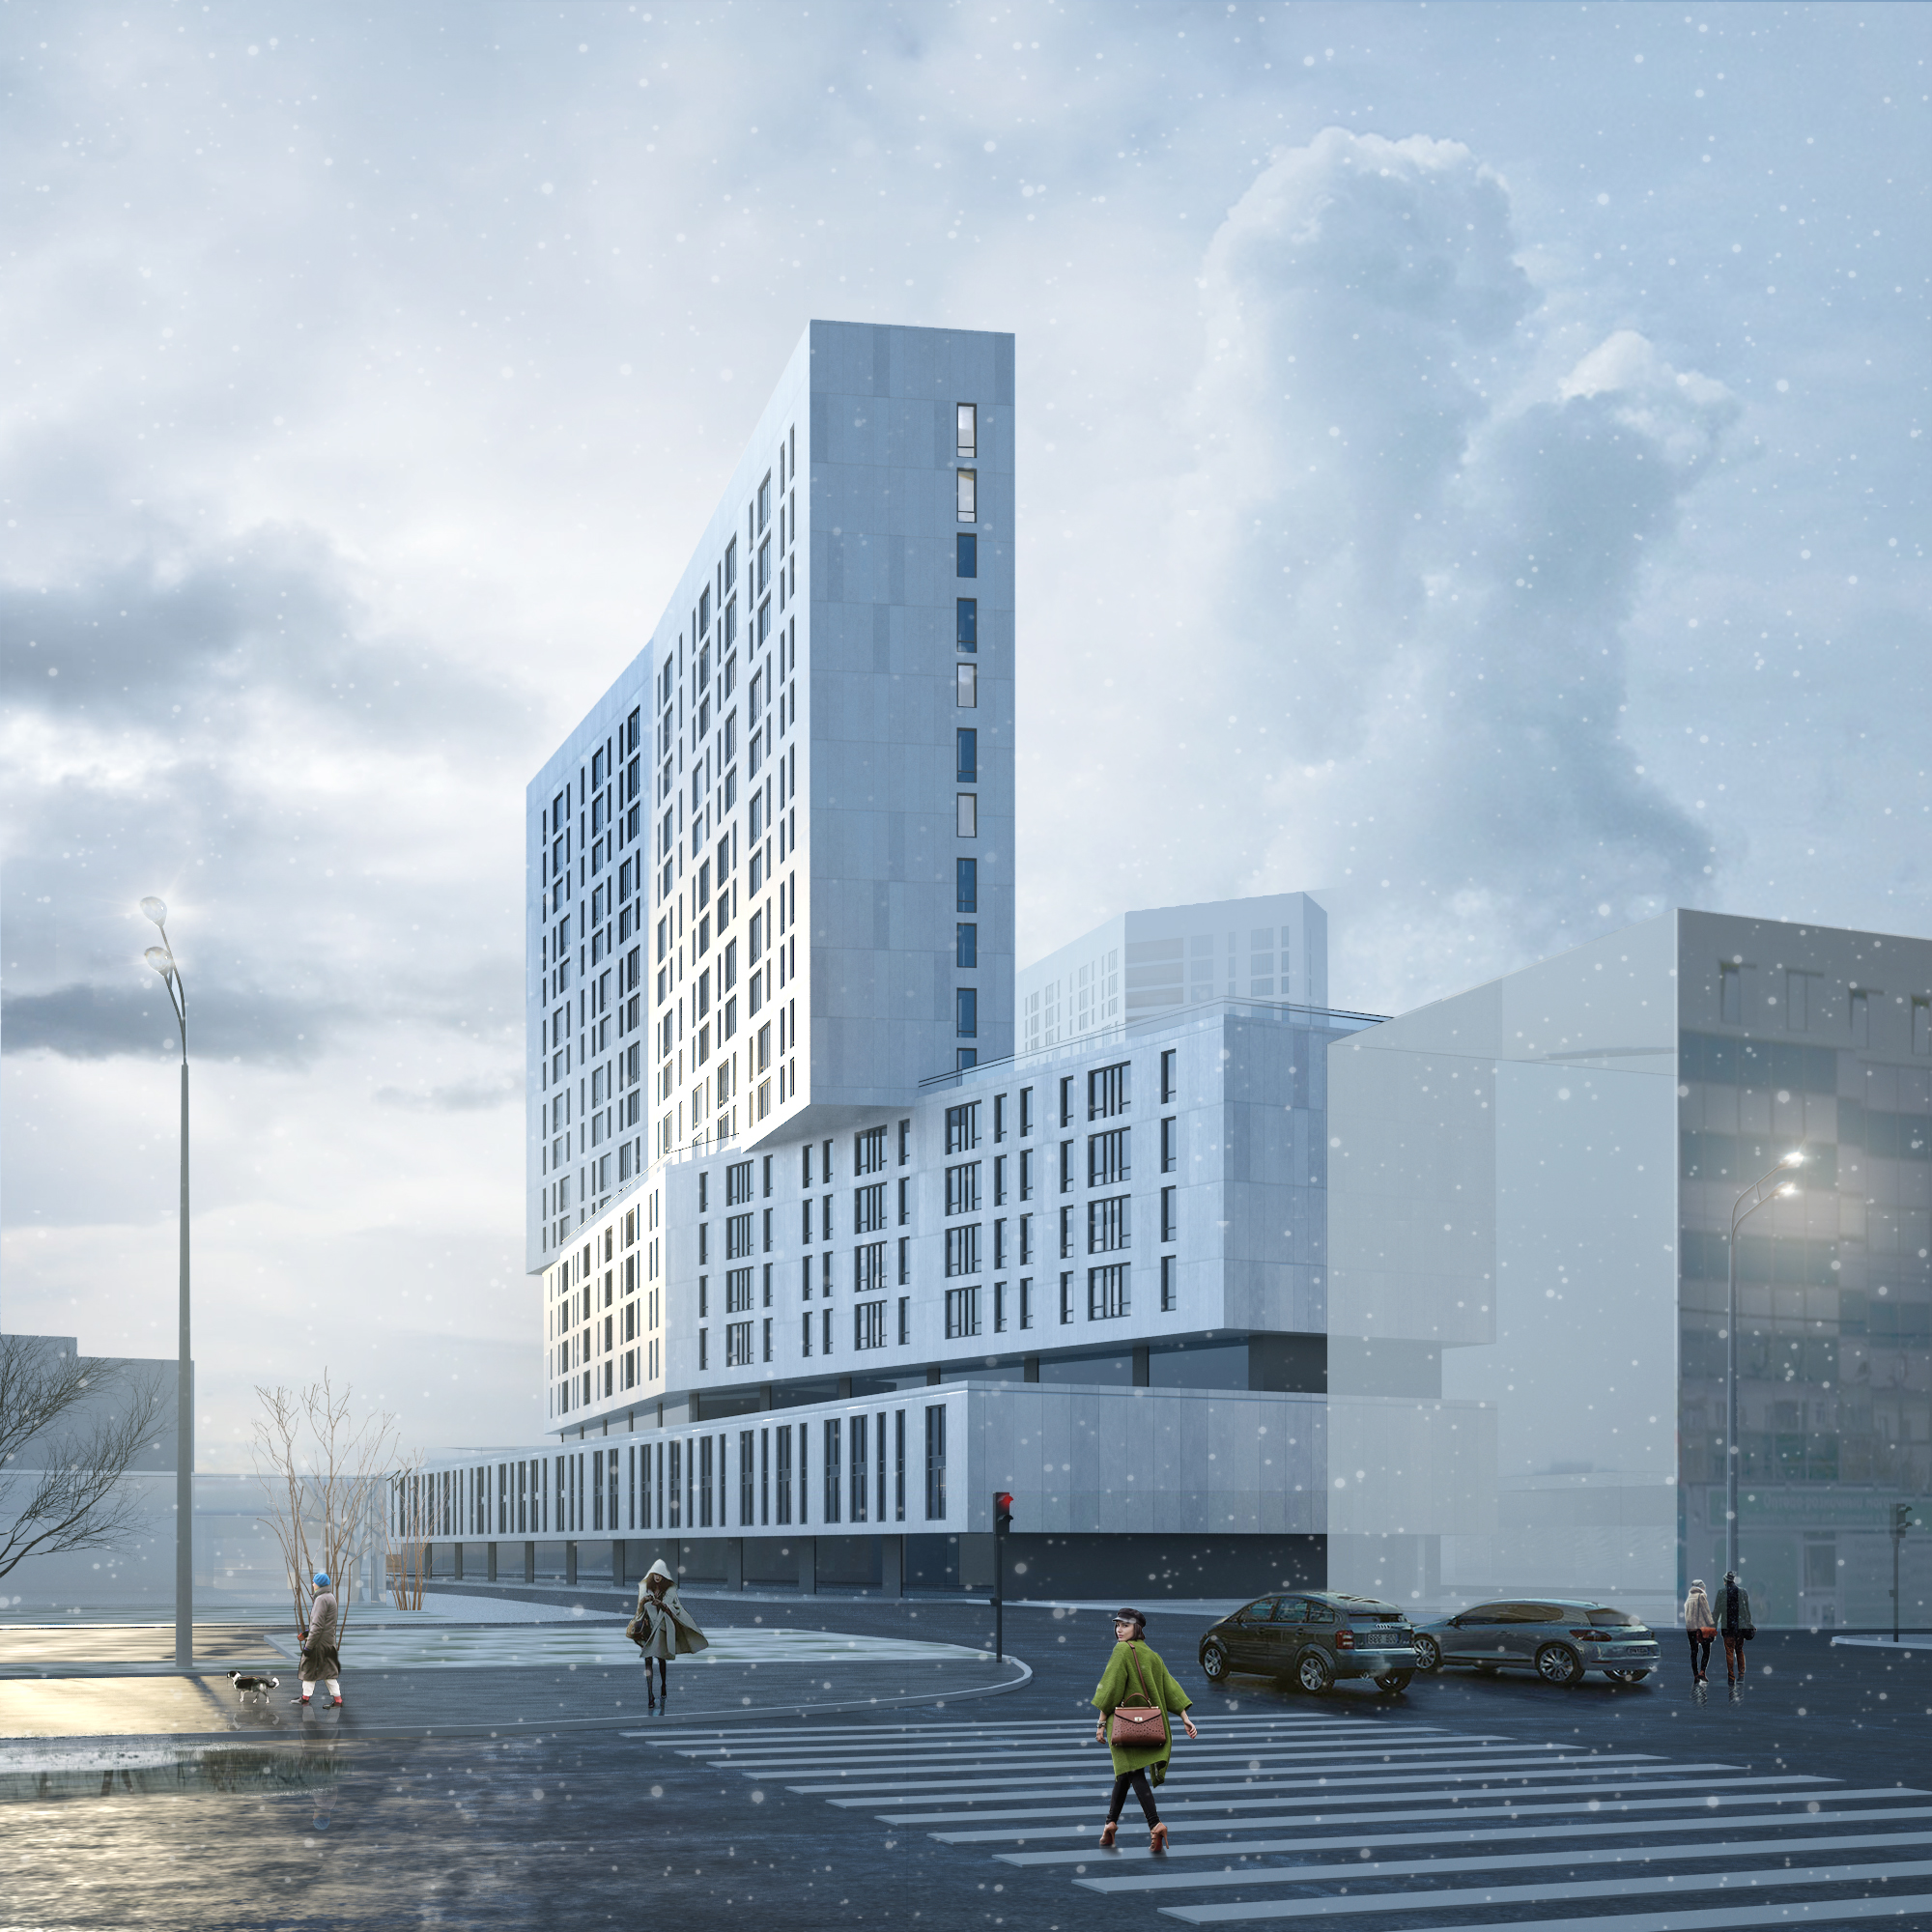
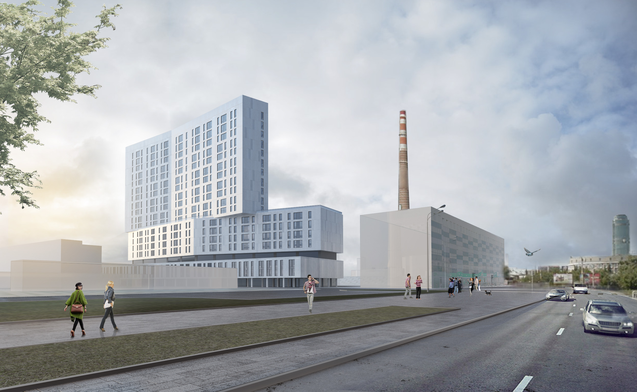
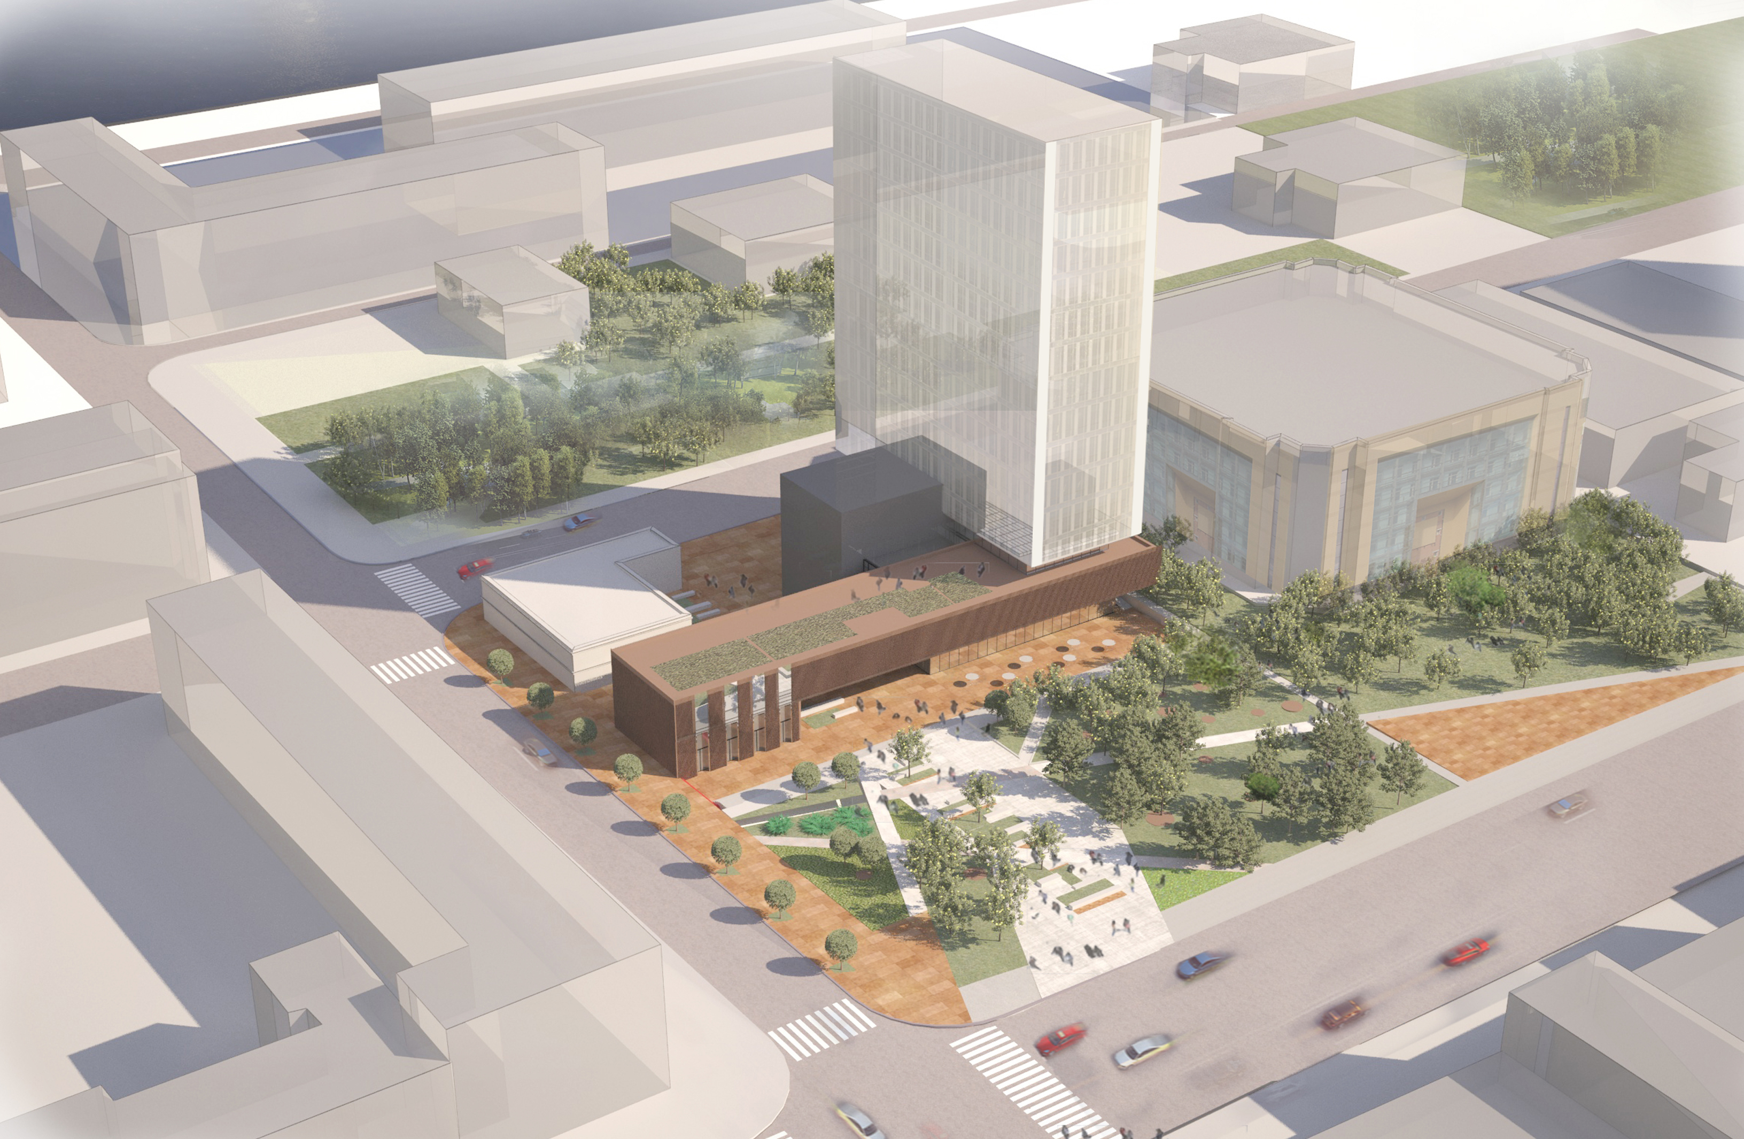
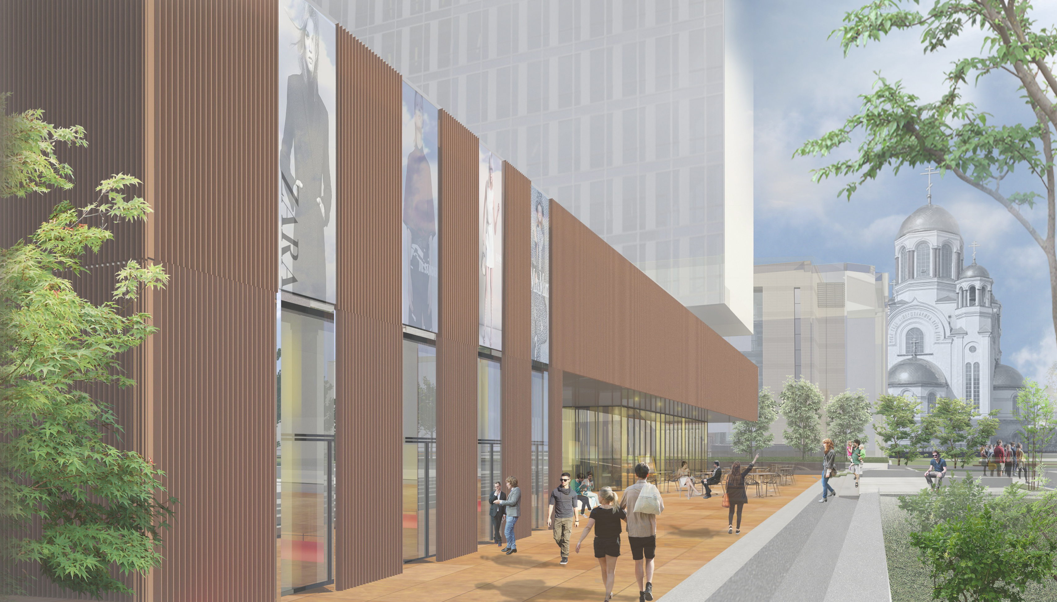
Current projects
Uralprojectdubrava
Residential complex
Yekaterinburg, Russia
Residential complex
Yekaterinburg, Russia

Slide 19
Contacts
Uralprojectdubrava
www.updubrava.ru
dubrava@updubrava.ru
Tel.: +7(343)79-90-38

