Slide 1
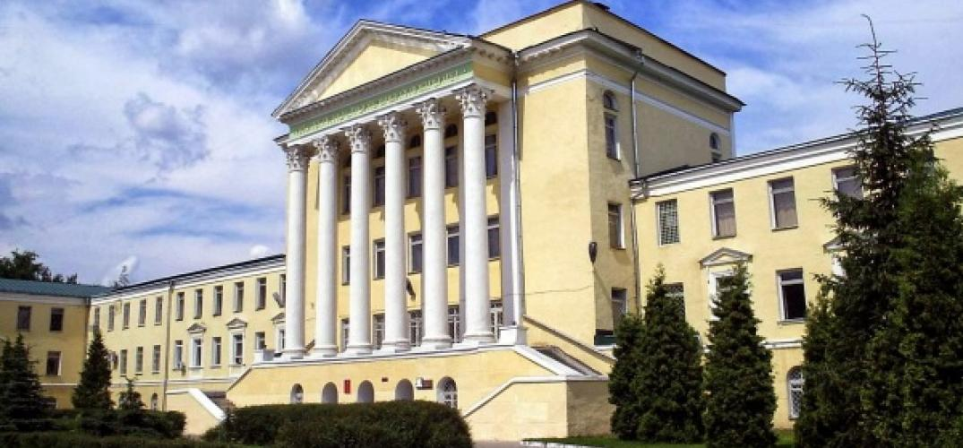
Voronezh State University of Architecture and Civil Engineering

Slide 2
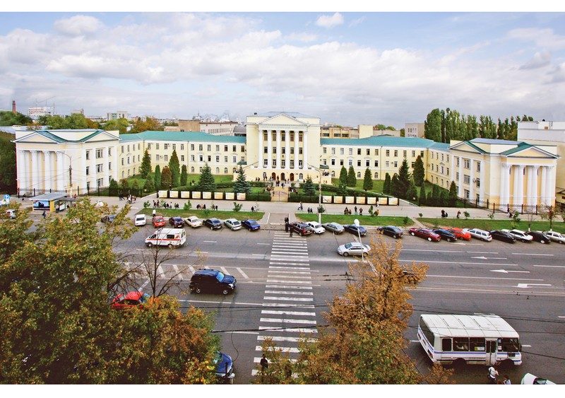
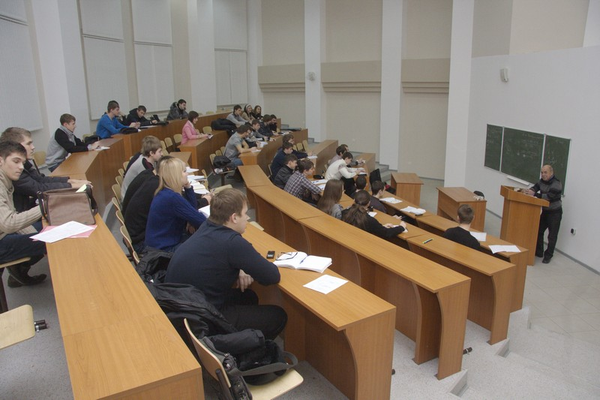
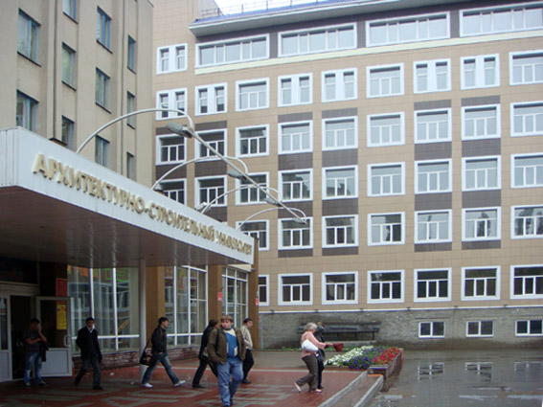
Voronezh State University of Architecture and Civil Engineering was founded in 1930.
It’s campus includes 7 study buildings and laboratories, a scientific library with 500,000 books, 6 hostels, a health center, a recreation sanatorium, and a refectory.

Slide 3
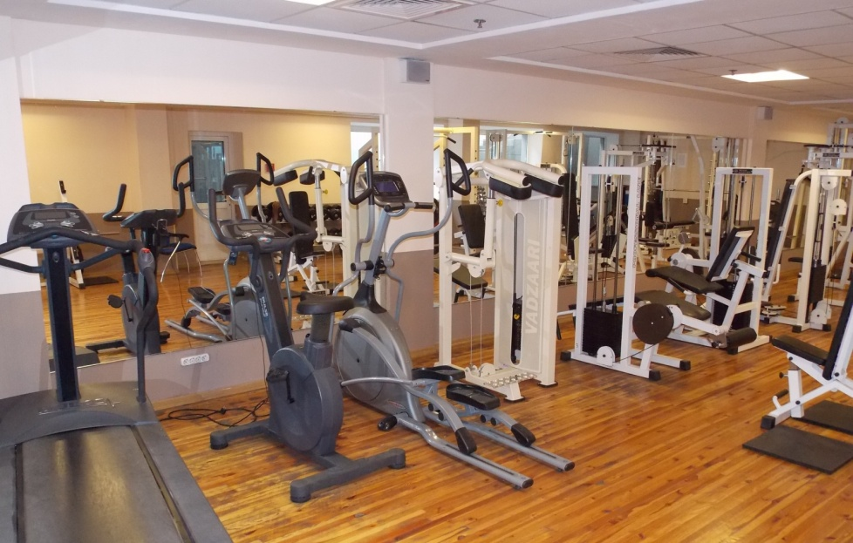
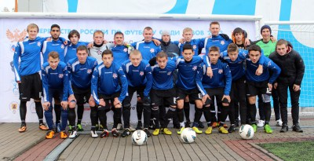
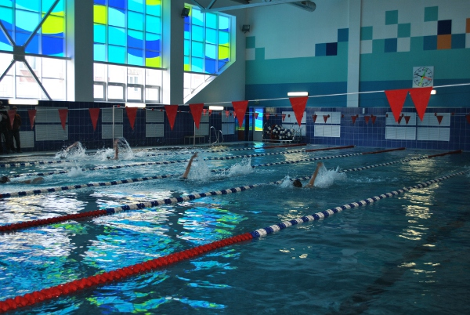
Sports center includes 7 halls, 2 shooting galleries, swimming pool, a set of sports grounds, and a summer recreation camp set in attractive countryside, which makes it possible for students to go in for 26 kinds of sport activities.

Slide 4

About 10,000 students are enrolled with VSUACE, including about 500 international students from Europe, Asia, Africa and Latin America.
Academic staff involves 750 persons, among them about 100 Doctors of Science and 400 PhD degree holders.
University offers education programs at the following institutes and faculties:
Institute of Civil Engineering
Institute of Engineering Systems in Construction
Architectural and City Planning Institute
Road and Transport Institute
Institute of Economy, Management and Information Technologies
Civil Engineering and Technological Institute
Institute of Master Degree Programs
Faculty of Secondary Professional Education
Faculty of Pre-University Training

Slide 5
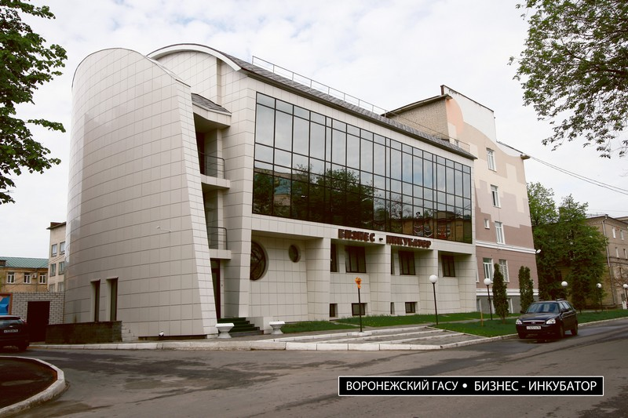
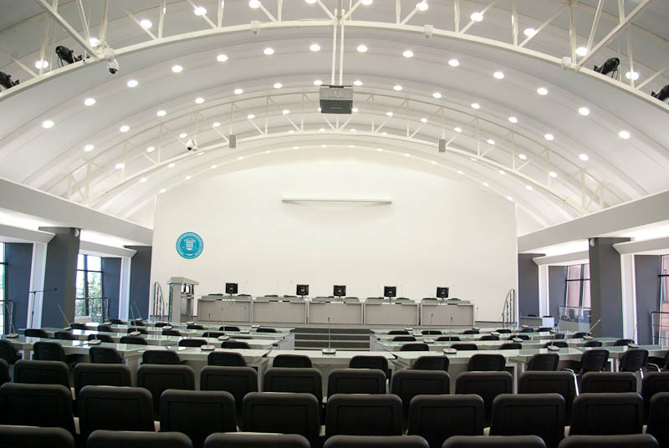
Innovative business incubator for students, post-graduate students and researchers named after Professor Y.M. Borisov
The main purpose of the business incubator is to support small companies in the early stages of development. It was established by the initiative of students, graduate students and researchers of the Voronezh SUACE.

Slide 6
I. Bachelor Programs
1. Civil Engineering 08.03.01 (4-year programs)
Speciality | Course Titles
1.1 City building and economy | Energy efficient resources in housing and communal services, Energy efficiency in municipal services, Thermal insulation materials
1.2 Heat and gas supply and ventilation | Energy efficiency of heat and gas supply systems and ventilation, Modern systems of air-conditioning of buildings, Ecological safety of heat and gas supply systems, Urban ecology
1.3 Industrial and civil construction | Effective composites and constructions on their basis
1.4 Water supply and water disposal systems | Drainage systems and wastewater treatment, Economy of water supply and water disposal

Slide 7
2. Architecture 07.00.00 (5-year programs)
Speciality | Course Titles
2.1. Architecture | Resource saving technologies in architecture
2.2. City planning | Сity green building
2.3. City planning, infrastructure and communications | Сity green building
3. Electro- and thermal energy engineering 13.03.01 (4-year programs)
Speciality | Course Titles
3.1 Design and construction of energy networks | Energy efficiency in thermal energy engineering and thermotechnics, Alternative and renewable energy sources, Technology and organization of construction of energy networks, Design of energy networks in earthquake terrotories, Electro energy engineering, Power electronics, Methods of similarity theory in power engineering, Justification of energy networks projects
4. Chemistry 04.00.00 (4-yea programs)
Speciality | Course Titles
4.1 Chemistry, physics and mechanics of materials | Special structural and functional building materials, Physical chemistry of disperse systems and nanomaterials

Slide 8
II. Master level programs
1. Civil Engineering 08.04.01 (2-year programs)
Speciality | Course Titles
1.1 Energy supply of populated areas and enterprises | Electro energy generation, Solar heating systems, Modern devices and equipment for heat and gas supply systems, Protection of the environment from harmful emissions
1.2 Energy saving and energy security of engineering systems and heat and gas supply structures | Energy security and the basics of legal and regulatory framework of the state energy saving policy, Energy inspection and energy audit, Technology and organization of works on energy efficiency, Renewable and secondary energy resources, Organization of metering and control of heat energy and material resources, Economics of energy saving, Thermal efficiency of boiler installations, Ecology of electro energy engineering and environmental protection activities
1.3 Design of civil buildings via modern constructive and energy-efficient solutions | Modern problems of energy saving in architecture, Energy-saving technology

Slide 9
1.4 Design, construction and operation of energy-efficient and environmentally friendly buildings (GREENMA Program) | The modern world experience in solving energy- saving problems, The life cycle of energy resources and real estate objects, Energy balance and energy audits, Main directions of energy efficiency in the designing and construction of buildings, Features of operation of energy efficient buildings, Methodology for evaluation of the effectiveness of energy saving measures, Program-targeted methods of increasing energy efficiency, The use of secondary energy resources, Legal and regulatory base of energy saving, "Green building" for the sustainable development of territories, Modern problems of energy saving in architecture, Ecological safety and energy sustainable development, Renewable energy sources
1.5 Buildings and constructions under microclimate systems maintenance, | Energy saving in ensuring the microclimate in the building premises, Systems of comfort and process air conditioning, The use of alternative energy sources in ensuring the microclimate of buildings and structures
1.6 Technical operation and reconstruction of buildings and constructions | Methodical bases of the organization of energy saving in the building complex and housing and communal services, Energy balance and energy audit of buildings

Slide 10
1.7 Engineering systems of water supply and water disposal | New technology of erection of networks and structures of water supply and drainage, Renovation of water supply and drainage systems
1.8 Effective composites and constructions on their basis | Effective composite structures
2. Architecture 07.00.00 (2-year programs)
Speciality | Course Titles
2.1 Architecture | Modern life support technology in buildings
2.2 Modern concepts and practice of city planning | Ecology and energy efficiency in city planning
2.3 City planning, infrastructure and communications | Green building
3. Electro- and thermal energy engineering 13.04.01 (2-years programs)
Speciality | Course Titles
3.1 Thermal energy engineering and thermotechnics | Modern problems in thermal energy engineering, thermotechnics and heat technologies, Problems of energy- and resource saving in thermal energy engineering, thermotechnics and heat technologies, Principles on the effective control of technological processes in thermal energy engineering, thermotechnics and heat technologies, Electro energy engineering, Electric power generation, Building construction of energy networks

Slide 11
III. PhD Programs
1. Civil Engineering 08.06.01 (4-year programs)
Speciality | Course Titles
05.23.03 Heat supply, ventilation, air conditioning, gas supply and illumination | Modern devices and equipment in heat and gas supply and ventilation systems, Ecological safety of heat and gas supply and ventilation systems
05.23.04 Water supply, water disposal, building systems of protection of water resources | Modern devices and equipment in water supply and drainage systems
05.23.01 Building structures, buildings and constructions | Modern metal constructions, Modern devices and equipment for control of building structures work, Automated system of modeling and calculation of building structures
05.23.08 Technology and organization of construction | Engineering and construction technology, Construction industry, Formwork systems for the construction of monolithic rotation surfaces
2. Electro- and thermal energy engineering 13.06.01 (4-year programs)
Speciality | Course Titles
05.09.03 Electrotechnical complexes and systems | Electrotechnical complexes and systems

Slide 12
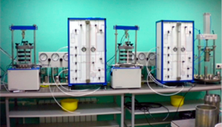
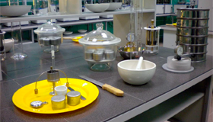
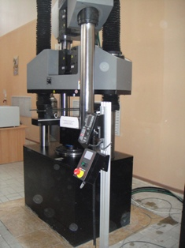
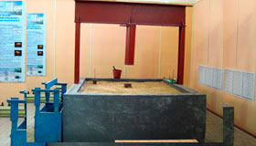
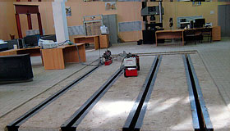

The centre of collective usage named after Professor Y.M. Borisov
Laboratory of physical-and-chemical research
Laboratory of Soils and Soil Mechanics
Laboratory of building materials and technology
Road laboratory
Laboratory of building structures testing
Laboratory of acoustics

Slide 13
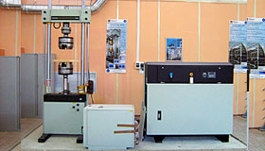
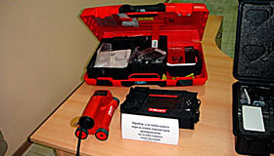
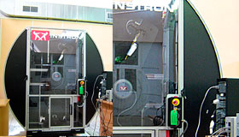
Laboratory of building structures testing
Servo-hydraulic floor test system INSTRON 8802
Compression testing in static and dynamic mode.
Test on the relaxation / creep under compression and tension.
The dynamic range of up to ± 250 kN.
Ferroscan PS 200 HILTI
Detection and determining the depth and diameter of
reinforcing bars.
Scanning depth of up to 180mm
Pendulum electromechanical testing machine with an impact energy of 450 J
The impact velocity of 0.6 to 5.3 m / s
Temperature measuring range from -70 to 200 0C
The deflection angle of the pendulum 12-152 ⁰

Slide 14
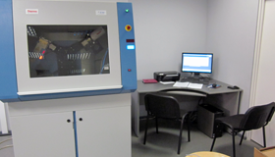
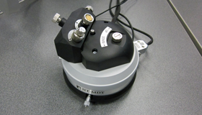
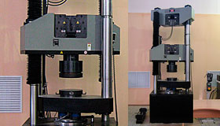
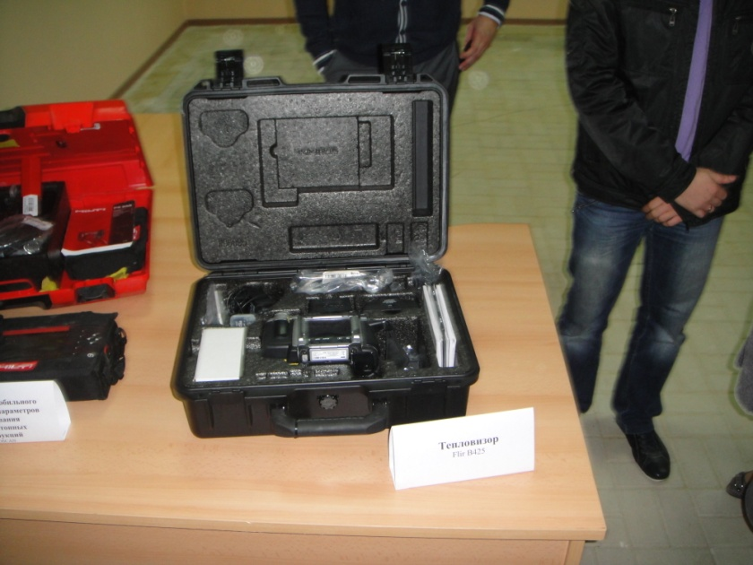
Laboratory of physical-and-chemical research
Powder X-ray diffractometer ARL X'TRA
Scanning Probe Microscope NanoEducator company NT MDT
Laboratory of building materials and technology
Universal floor 4-columned hydraulic test system INSTRON Satec 1500HDS
Thermal imager FLIR B425

Slide 15
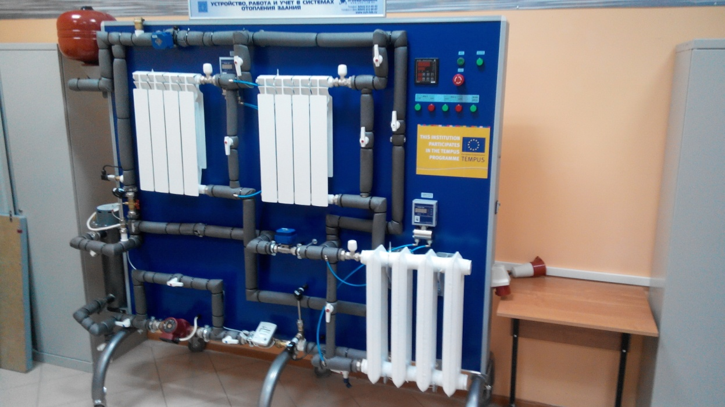
GREENMA DIDACTIC Laboratory
The laboratory complex acquaints students with the main instrumentations used in systems of water supply and heating, the principles of their work and possibility of application, definition of performance data of elements of systems of heating.
Educational laboratory equipment set "The device, maintenance and calculation in systems of building’s heating"

Slide 16
The laboratory stand "The Device, Maintenance and Calculation in Systems of Building’s Heating" carried out in floor execution represents the operating closed hydraulic system with the established samples of sensors which are applied in monitoring systems and the accounting of a consumption of water, pressure and water temperature control on objects of housing and communal services, and radiators of water heating.
The personal computer is intended for management of operation of the stand as a whole, namely: operation of the pump, the electric boiler, spherical cranes with the electric drive.
In the package of delivery the electrified training module with training indication has been included. The training module represents the interactive light-and-dynamic touch panel, allowing one to provide training and software testing to check the acquired material.

Slide 17
Thank you for attention!

